Slide 1

Deliverable 1
Data Analysis — Parkinson's Disease Gait Detection
Project: State Space Models (Mamba/SSM) for Medical Time Series
Dataset: PhysioNet gaitpdb | N=166 | 5-Fold CV
May 2026 | FAU Erlangen-Nürnberg | Technische Fakultät

Slide 2
01
Dataset Overview
Demographics · Cohort Structure · Label Distribution

Slide 3
Dataset Demographics — Full Dataset (N=166) + Fold 1 (N=80)
Source: demographics.xls + splits/Fold_1/ | 93 PD · 73 HC · 3 cohorts
01 · Dataset Overview
Full Dataset — demographics.xls
Per-Cohort — Fold 1
PD (n=93)
HC (n=73)
Cohort
PD
HC
Total
Condition
Male / Female
58 / 35
40 / 33
Ga (Yogev)
14
11
25
Normal walk
Age mean±SD
66.9±9.7 yrs
63.3±8.0 yrs
Si (Frenkel)
10
17
27
Treadmill
Height mean±SD
1.67±0.09 m
1.68±0.08 m
Ju (Hausdorff)
16
12
28
RAS walk
Weight mean±SD
68.1±10.8 kg
72.3±11.4 kg
H&Y 2.0
19
—
19
Mild
H&Y mean±SD
2.26±0.34
—
H&Y 2.5
14
—
14
Mild-Mod
UPDRS-M mean±SD
18.0±9.6
—
H&Y 3.0
7
—
7
Moderate
⚠ Cohort confound: Ga=normal walk · Si=treadmill · Ju=rhythmic auditory stimulation (RAS). Panel B in each PCA/t-SNE checks if walking condition separates more than PD diagnosis.
Severity imbalance: H&Y 2.0=19, H&Y 2.5=14, H&Y 3.0=7 (Fold 1). SMOTE applied on training folds ONLY in Deliverable 2+.
Deliverable 1 — PD Gait Analysis | FAU Erlangen-Nürnberg
4 / 22

Slide 4
02
Signal Visualization
Raw VGRF Traces · Force Variability · CV Comparison

Slide 5
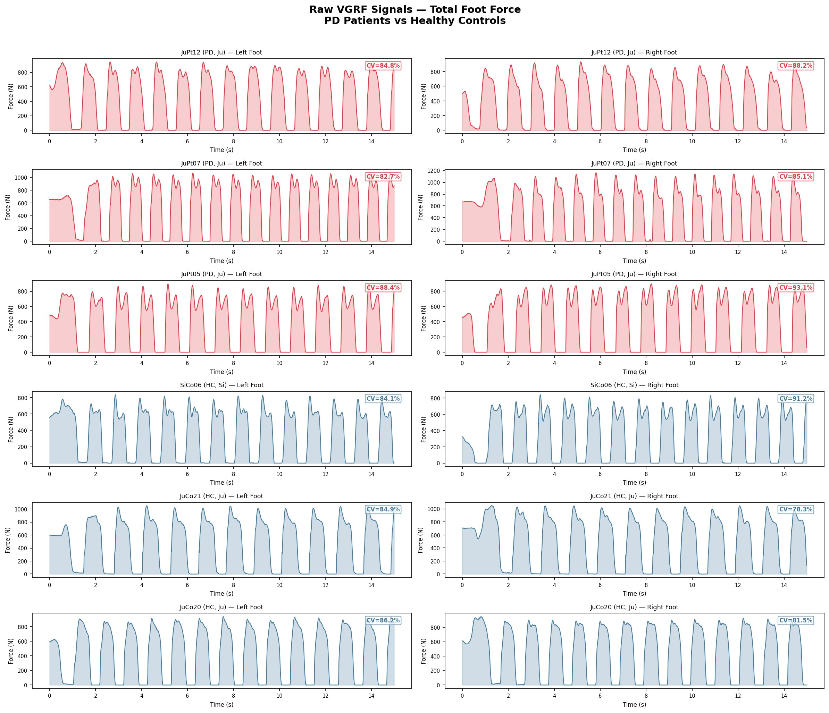
Raw VGRF Signals — PD vs Healthy Controls
15 s · total force · left & right foot · 3 PD + 3 HC subjects · CV annotated per trace
02 · Signal Visualization
PD: irregular peak spacing & variable amplitude (bradykinesia). HC: regular rhythmic force pattern. CV (std/mean×100%) shown top-right each subplot.
Deliverable 1 — PD Gait Analysis | FAU Erlangen-Nürnberg
6 / 22

Slide 6
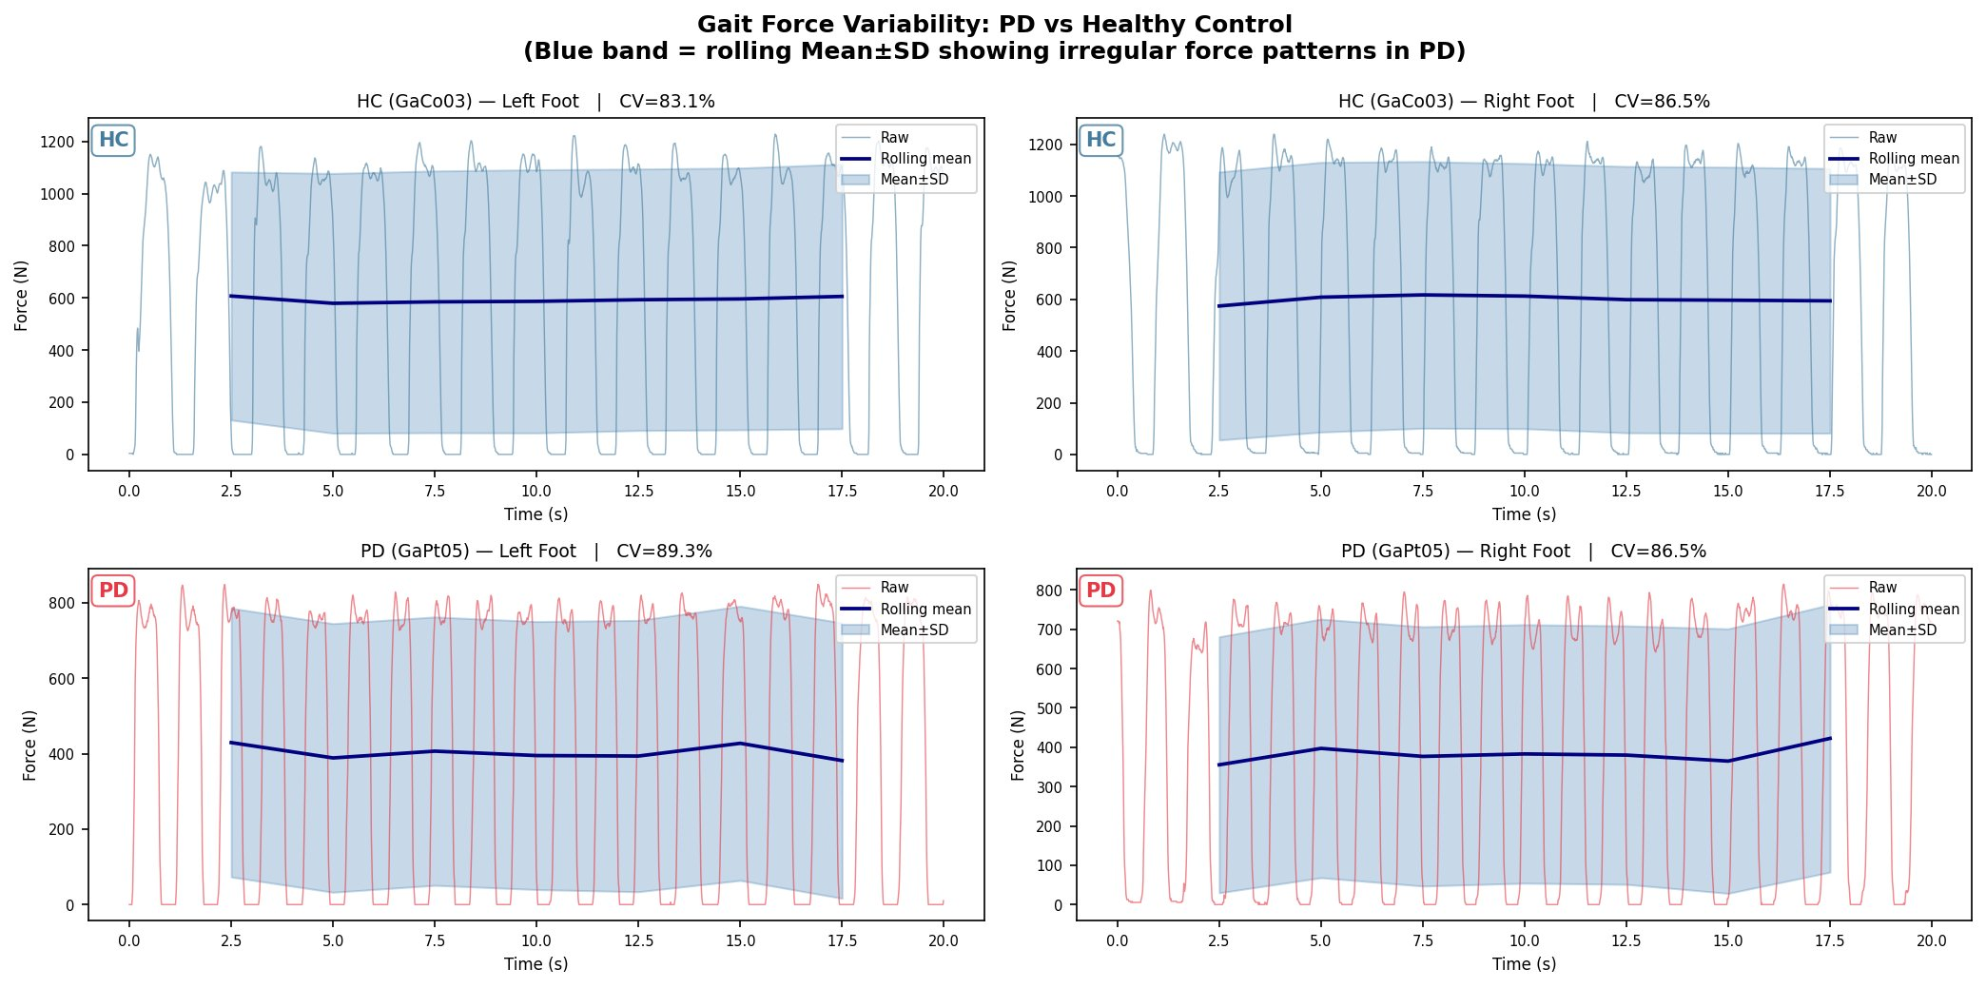
Gait Force Variability — PD vs Healthy Control
Rolling mean±SD | 5s window, 2.5s step | blue band = variability envelope
02 · Signal Visualization
Yogev et al. (2005): In healthy adults gait rhythmicity is automatic. In PD it becomes attention-demanding — stride variability increases under dual-task, reflecting loss of basal ganglia automaticity.
Deliverable 1 — PD Gait Analysis | FAU Erlangen-Nürnberg
7 / 22

Slide 7
03
Feature Extraction
TSFresh · 5s Windows · Z-Score Normalisation · Per-Subject Stats

Slide 8
Feature Extraction Pipeline
Windowed extraction → per-subject aggregation → z-score normalisation before PCA/t-SNE
03 · Feature Extraction
TSFresh (EfficientFCParameters)
Three Foot Conditions
• Library: tsfresh (EfficientFCParameters)
• ~750+ features per channel per window
• Window: 5 s (500 samples) · Step: 2.5 s (50%)
• Channels: L1–L8 + TotalLeft / R1–R8 + TotalRight
Per-subject aggregation (across windows):
→ Mean → Std → Skewness → Kurtosis
Final feature matrices (z-score normalised):
Left foot: 80 subjects × ~3,000 features
Right foot: 80 subjects × ~3,000 features
Combined: 80 subjects × ~6,000 features
✓ StandardScaler applied BEFORE PCA / t-SNE
1 · Left Foot Only
L1–L8 + TotalLeft (9 channels)
2 · Right Foot Only
R1–R8 + TotalRight (9 channels)
3 · Combined (L+R)
All 18 channels — concatenated
Why TSFresh?
• Captures temporal statistics: variability,
autocorrelation, entropy, peak structure
• All highly relevant to PD gait rhythmicity
• Combined feet: bilateral asymmetry is a PD hallmark
• z-score normalisation ensures fair comparison
Combination: concatenation. Alternative also tested: 15 manual features per channel (mean, std, skew, kurt, CV, energy, dominant freq) — faster but fewer features. TSFresh results shown in subsequent slides.
Deliverable 1 — PD Gait Analysis | FAU Erlangen-Nürnberg
9 / 22

Slide 9
04
Dimensionality Reduction
PCA · t-SNE · Left / Right / Combined · z-score normalised

Slide 10
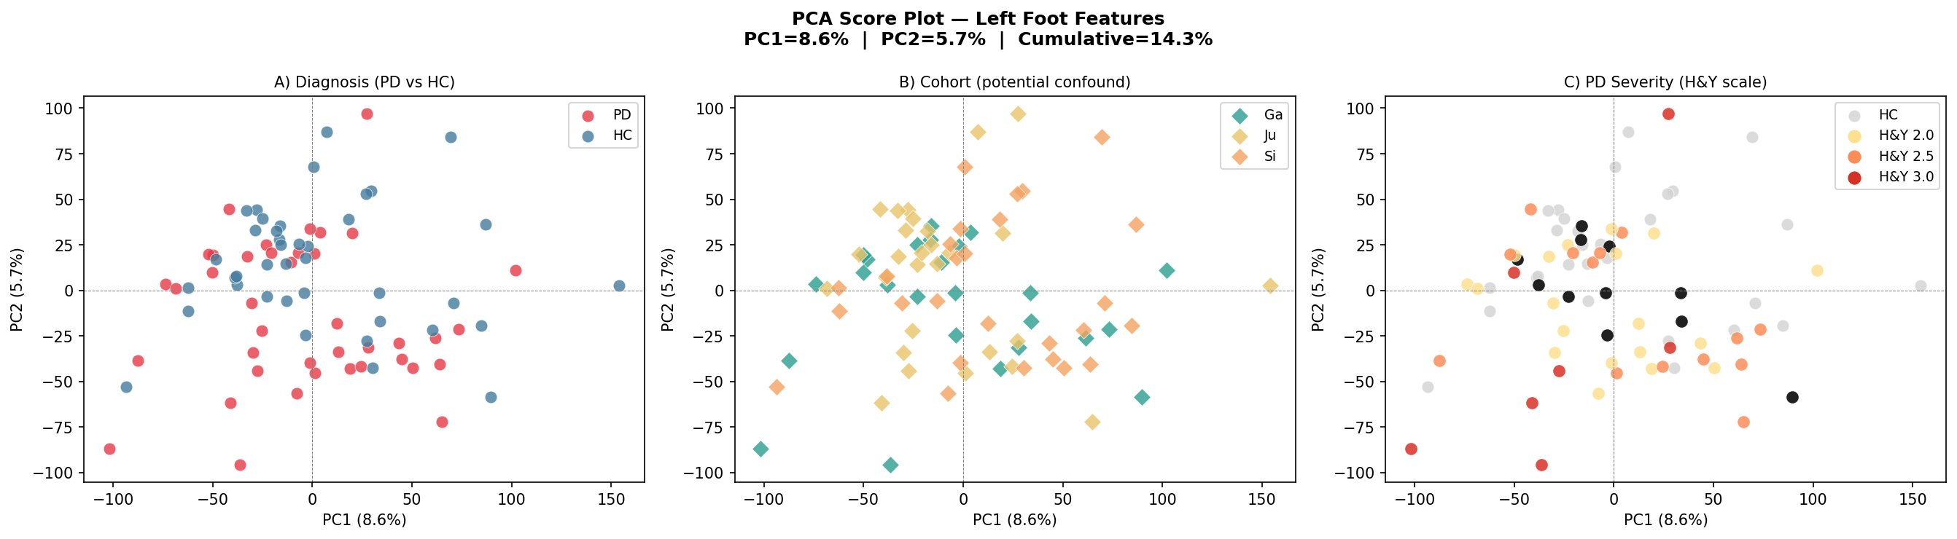
PCA — Left Foot Features (PC1=8.6%, PC2=5.7%)
z-score normalised | (A) PD/HC diagnosis (B) cohort confound (C) H&Y severity
04 · PCA — Left Foot
Deliverable 1 — PD Gait Analysis | FAU Erlangen-Nürnberg
11 / 22

Slide 11
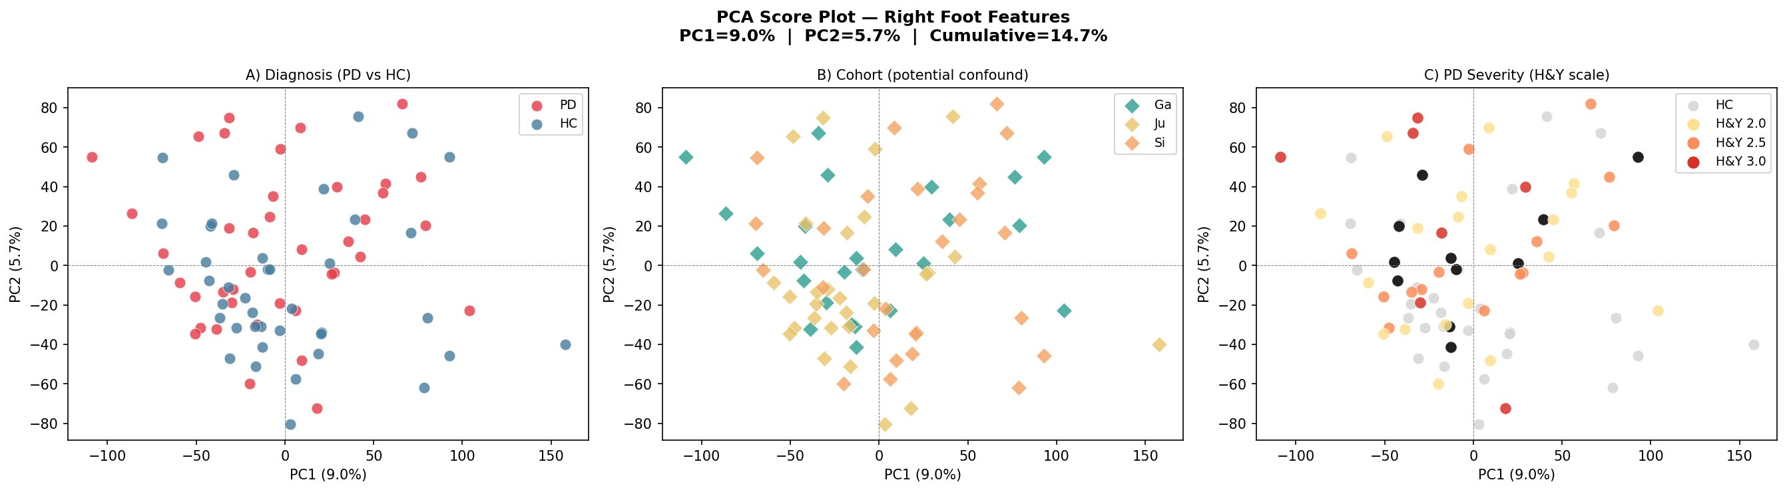
PCA — Right Foot Features (PC1=9.0%, PC2=5.7%)
z-score normalised | (A) PD/HC diagnosis (B) cohort confound (C) H&Y severity
04 · PCA — Right Foot
Deliverable 1 — PD Gait Analysis | FAU Erlangen-Nürnberg
12 / 22

Slide 12
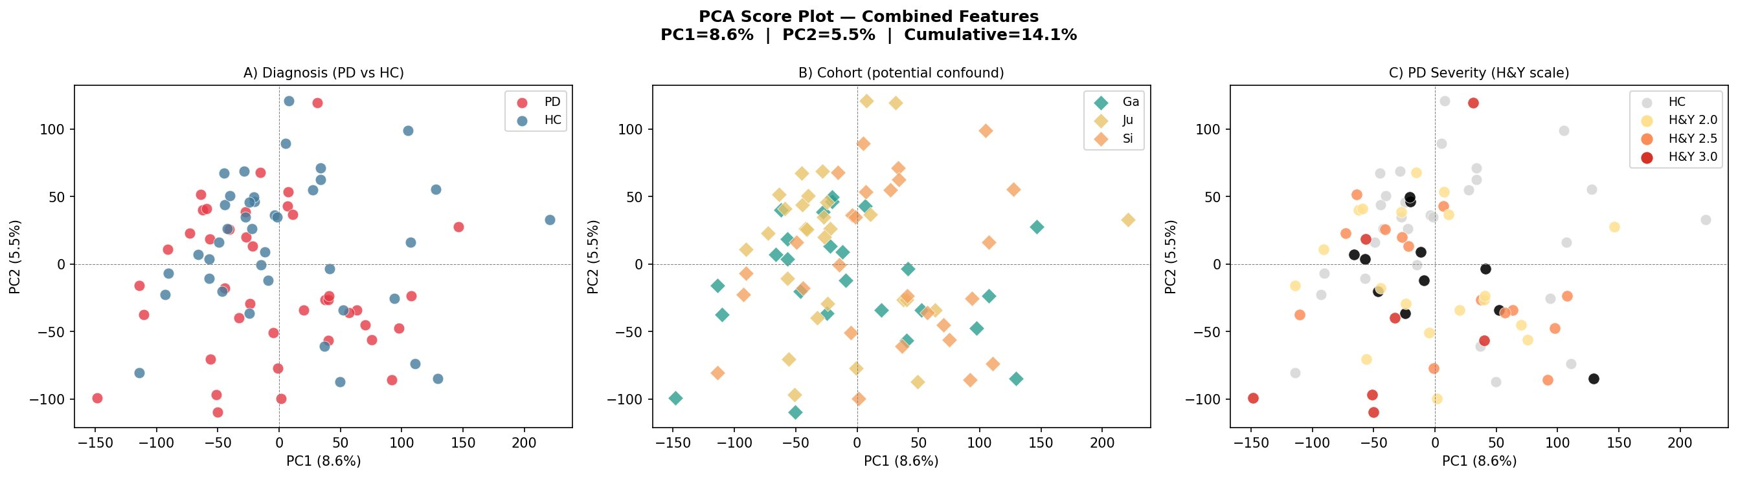
PCA — Combined Features (PC1=8.6%, PC2=5.5%)
z-score normalised | (A) PD/HC diagnosis (B) cohort confound (C) H&Y severity
04 · PCA — Combined
Deliverable 1 — PD Gait Analysis | FAU Erlangen-Nürnberg
13 / 22

Slide 13
PCA — Key Observations
04 · PCA Findings
What the PCA plots reveal
Variance explained & top features
Panel A — Diagnosis (PD vs HC):
• Substantial overlap — not linearly separable
• PD points spread wider → higher variance
• Consistent with literature findings
Panel B — Cohort:
• Ju cohort (teal) partially separates from Ga/Si
• Walking condition drives some structure in the data
• Cohort confound confirmed — must be controlled for
Panel C — H&Y Severity:
• No clear gradient 2.0 → 2.5 → 3.0
• Severity not linearly captured by PCA
• Motivates non-linear sequence models (Mamba)
Cumulative variance (PC1+PC2):
Left foot
14.3%
Right foot
14.7%
Combined
14.1%
⚠ ~14% variance in PC1+PC2 is expected for high-dimensional TSFresh features. Informative signal spans many PCs — motivating Mamba full-sequence modelling.
Most discriminative features (all feet):
• end_attr__stderr__chunk_len_10__f_agg__var
• L1_maximum / L1_absolute_maximum
• L1_n_absolute_max_number_of_maxima_7
• end_attr__stderr__chunk_len_50__f_agg__max
→ All relate to force amplitude regularity in PD
Deliverable 1 — PD Gait Analysis | FAU Erlangen-Nürnberg
14 / 22

Slide 14
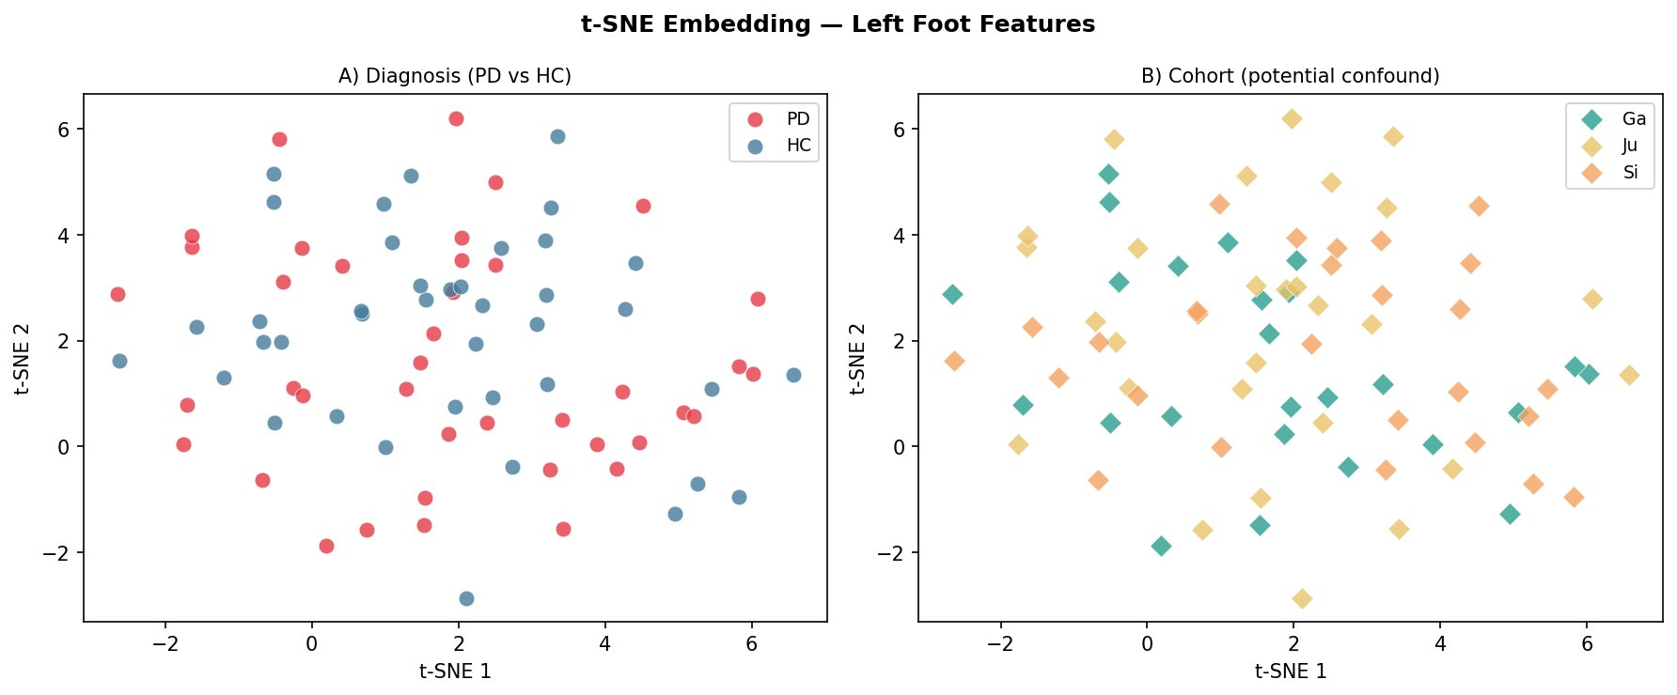
t-SNE — Left Foot Features
z-score → PCA(20) → t-SNE | perplexity=20, 1000 iterations | (A) diagnosis (B) cohort
04 · t-SNE — Left Foot
Panel A: PD and HC overlap with no clear separation — features not linearly separable. Panel B: Ju cohort (teal) clusters distinctly, confirming the cohort walking-condition confound.
Deliverable 1 — PD Gait Analysis | FAU Erlangen-Nürnberg
15 / 22

Slide 15
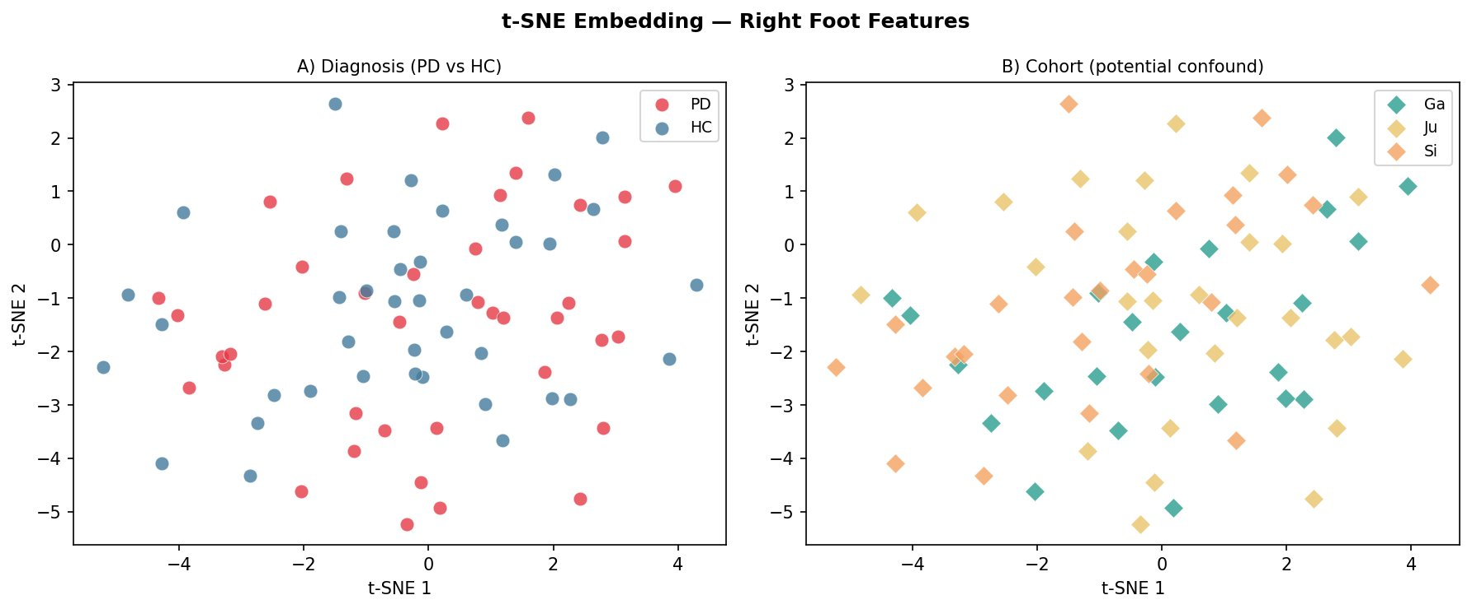
t-SNE — Right Foot Features
z-score → PCA(20) → t-SNE | perplexity=20, 1000 iterations | (A) diagnosis (B) cohort
04 · t-SNE — Right Foot
Panel A: PD and HC overlap with no clear separation — features not linearly separable. Panel B: Ju cohort (teal) clusters distinctly, confirming the cohort walking-condition confound.
Deliverable 1 — PD Gait Analysis | FAU Erlangen-Nürnberg
16 / 22

Slide 16
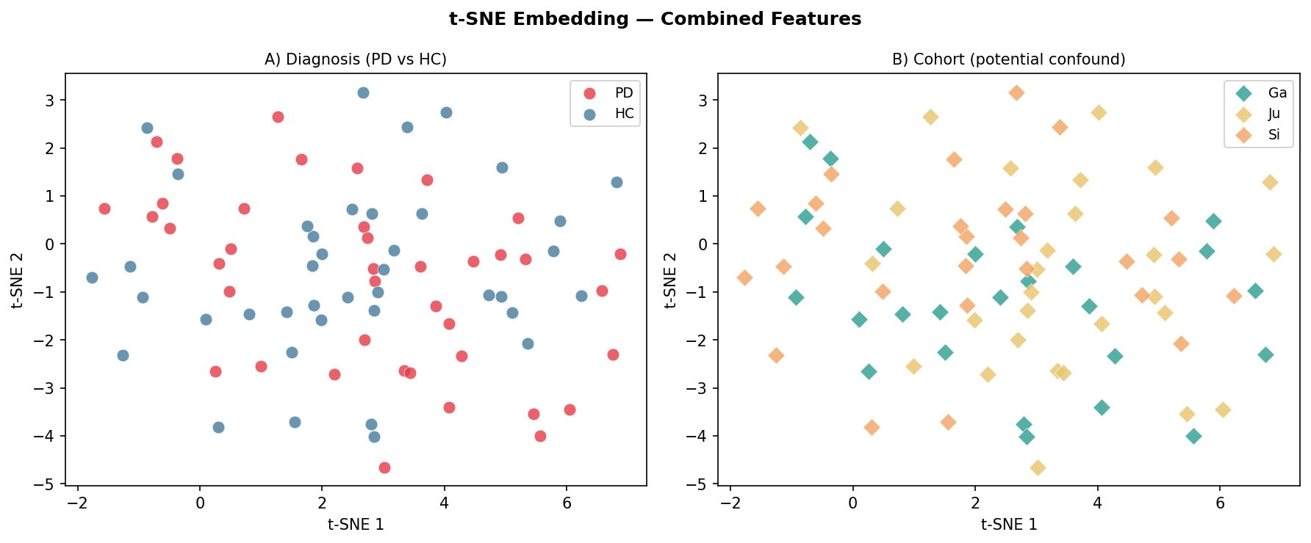
t-SNE — Combined Features (Left + Right)
z-score → PCA(20) → t-SNE | perplexity=20, 1000 iterations | (A) diagnosis (B) cohort
04 · t-SNE — Combined
Panel A: PD and HC overlap with no clear separation — features not linearly separable. Panel B: Ju cohort (teal) clusters distinctly, confirming the cohort walking-condition confound.
Deliverable 1 — PD Gait Analysis | FAU Erlangen-Nürnberg
17 / 22

Slide 17
05
Alternative Approaches
Feature Heatmap · KDE Distributions · Key Observations

Slide 18
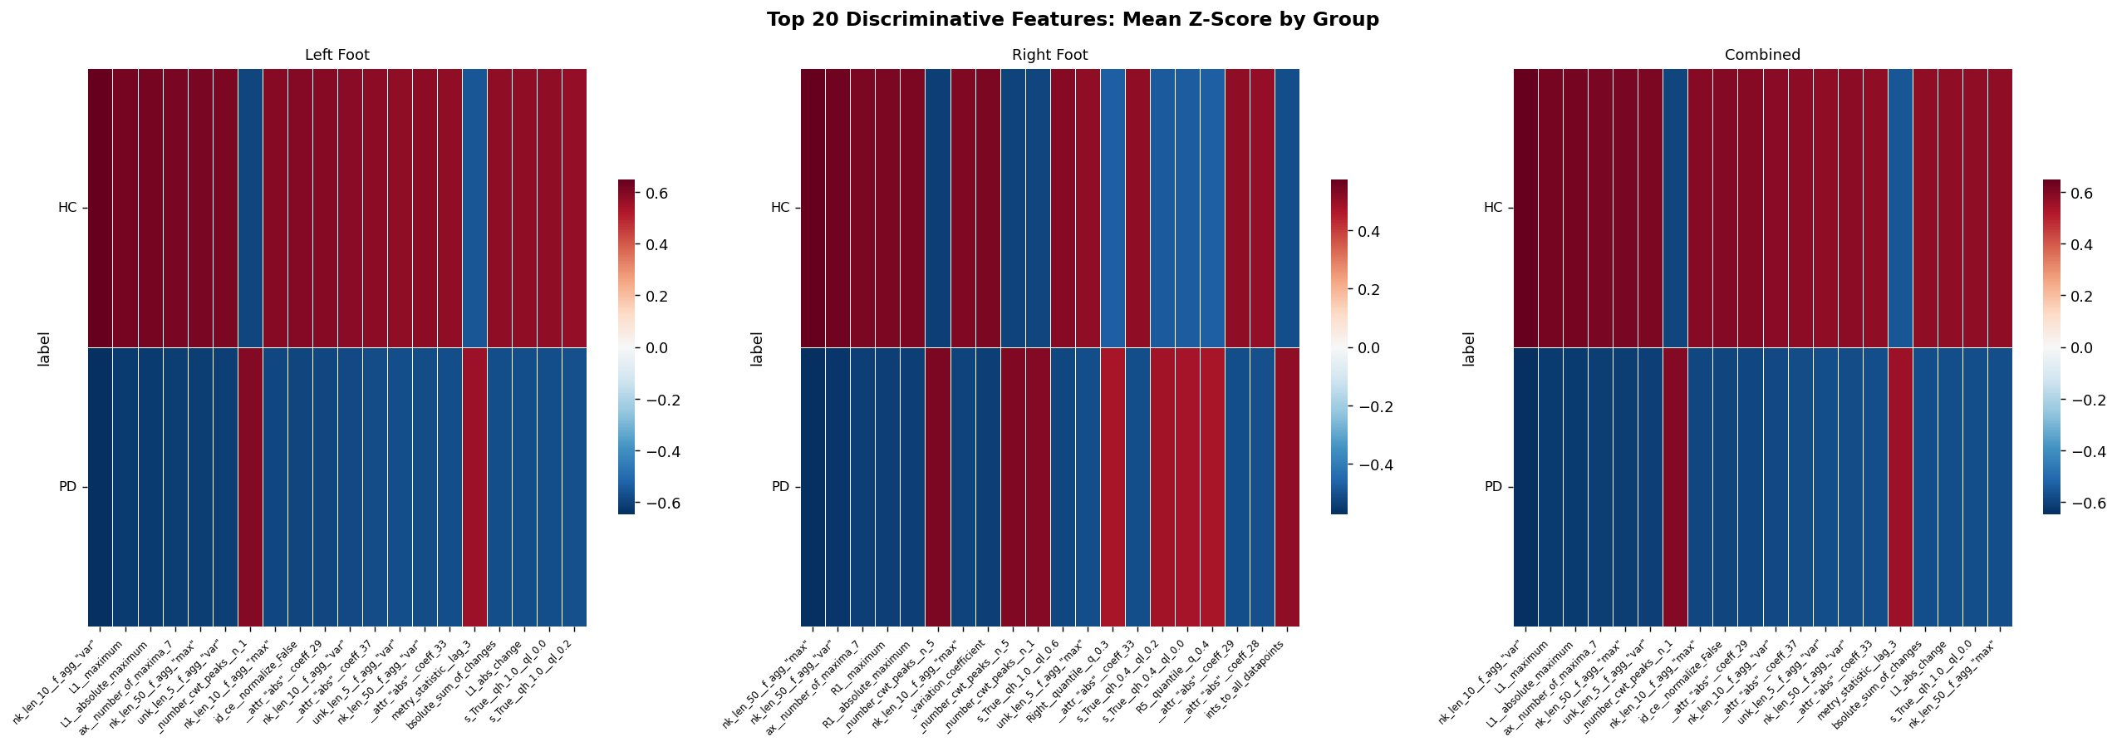
Feature Heatmap — Top 20 Discriminative Features
Mean Z-Score by group | ranked by |PD−HC| / pooled SD | red=PD elevated, blue=HC elevated
05 · Feature Heatmap
Consistent across all 3 foot conditions: force amplitude features (maximum, abs. max, peak counts) are lower in PD (blue). Variability features (chunk variance stderr) are higher in PD (red). Pattern is robust and foot-independent.
Deliverable 1 — PD Gait Analysis | FAU Erlangen-Nürnberg
19 / 22

Slide 19
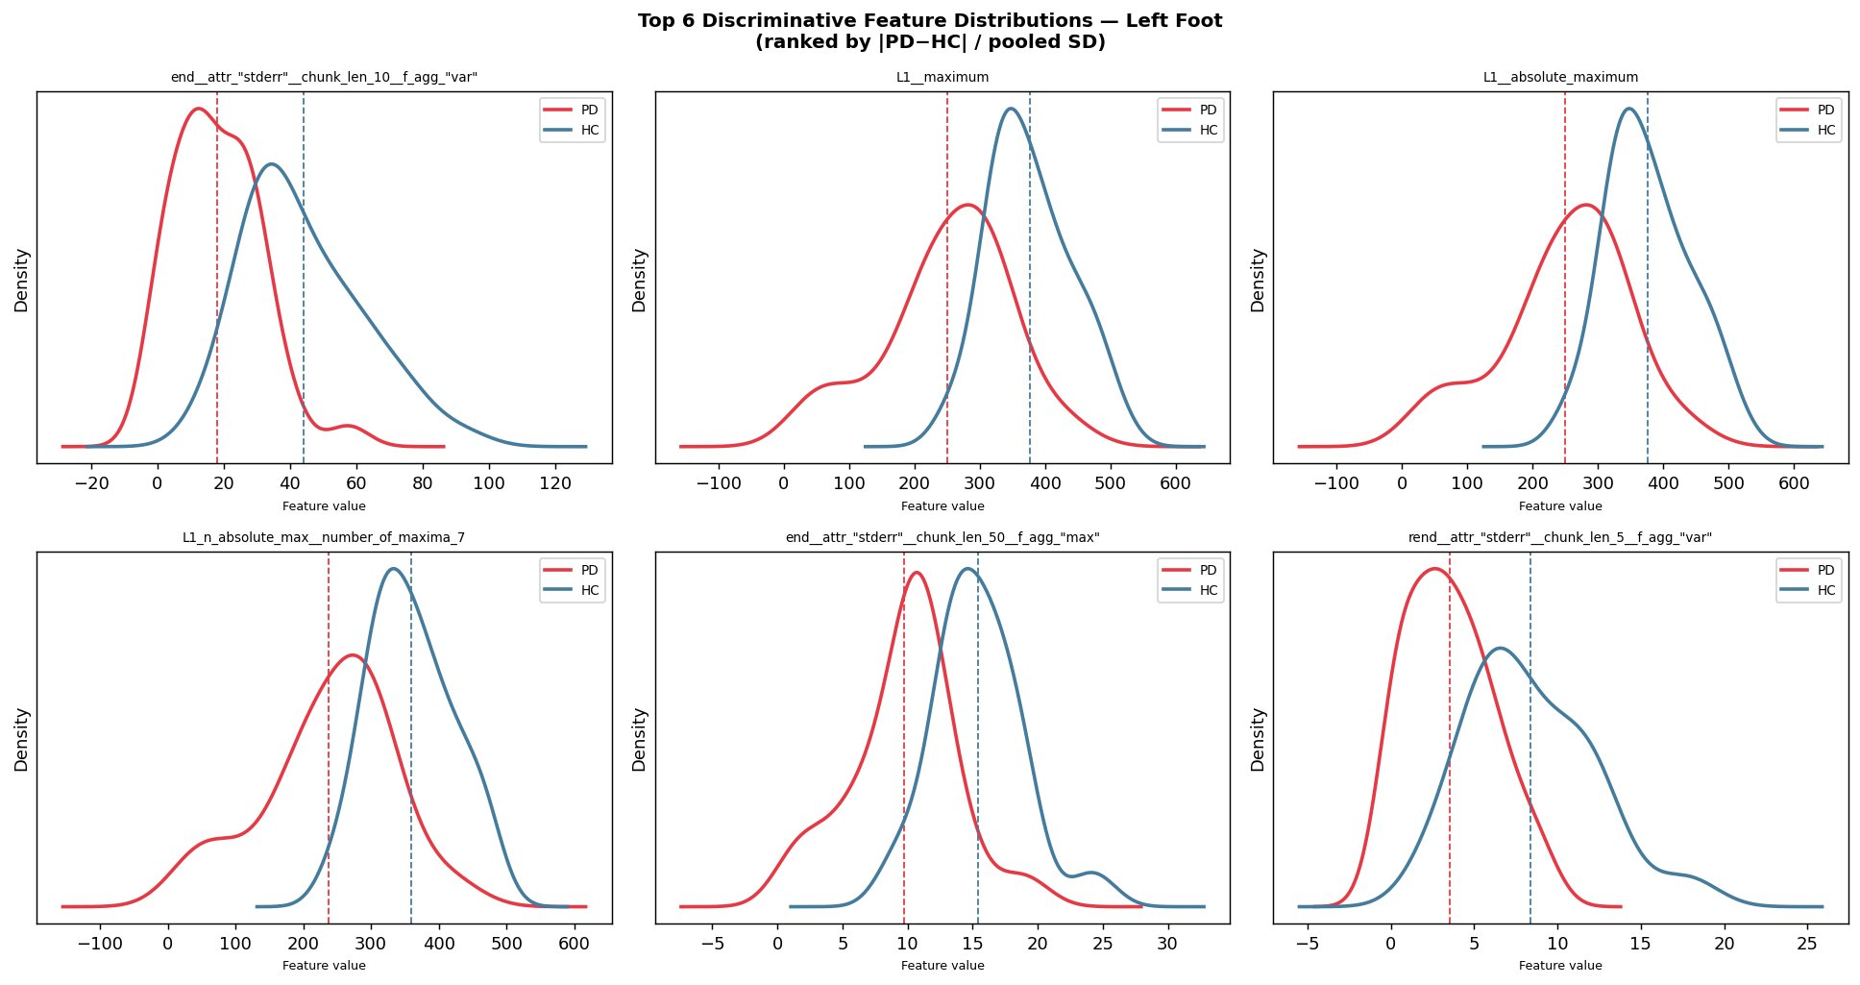
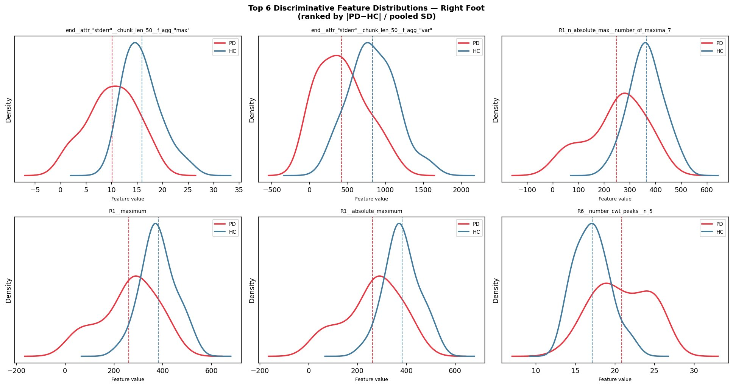
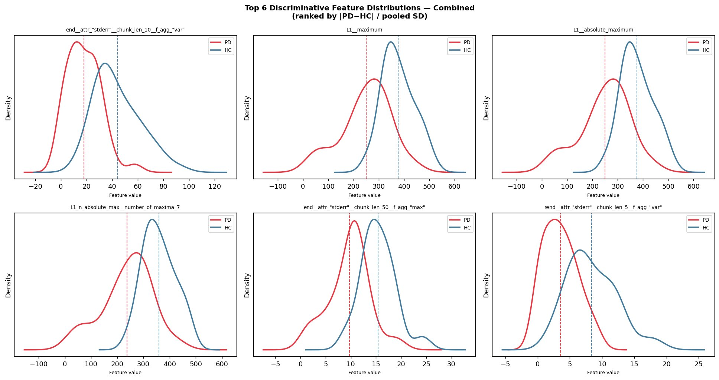
Feature KDE Distributions — Top 6 Features per Foot Condition
Ranked by |PD−HC| / pooled SD | dashed line = group mean | red=PD blue=HC
05 · KDE Distributions
Left Foot
Right Foot
Combined
Deliverable 1 — PD Gait Analysis | FAU Erlangen-Nürnberg
20 / 22

Slide 20
06
Key Findings & Next Steps
Summary · Observations · Mamba Modelling Outlook

Slide 21
Key Findings — Deliverable 1 Summary
06 · Summary & Next Steps
Observations
Next Steps (Deliverable 2+)
Signal analysis:
• PD: irregular peak spacing, variable amplitude
• HC: regular rhythmic force pattern
• Consistent with Yogev et al. (2005) findings
TSFresh feature extraction:
• Top discriminative features: chunk variance,
force maximum, absolute maximum, peak counts
• Same features rank top across left, right, combined
→ Robust, foot-independent signal
PCA / t-SNE (z-score normalised):
• No linear separation (expected for PD)
• ~14% variance in PC1+PC2
• Cohort confound (Ga/Si/Ju) confirmed
• Combined feet marginally better than single foot
→ High-dimensional, non-linear problem
→ motivates Mamba sequence modelling
→ RF + SVM Baselines
TSFresh + RF, SVM-linear, SVM-RBF · 5-fold CV · SMOTE on training folds only
→ Mamba / SSM Model
Raw VGRF time series · bidirectional Mamba encoder · binary + severity head
→ Cross-Cohort Validation
Train Ga+Si → test Ju · true generalisation beyond random split
→ Target Benchmark
Beat Naimi et al. (2023/24): 88% severity accuracy on PhysioNet gaitpdb
Deliverable 1 — PD Gait Analysis | FAU Erlangen-Nürnberg
22 / 22

Slide 22
Thank You
Questions & Discussion
Deliverable 1 — Data Analysis | PD Gait Detection via Mamba/SSM
Dataset: PhysioNet gaitpdb | FAU Erlangen-Nürnberg | May 2026

