Slide 1

Deliverable 1
Data Analysis — Parkinson's Disease Gait Signal Detection
Project: State Space Models (Mamba) for Medical Time Series
Dataset: PhysioNet — Gait in Parkinson's Disease | N=166 | 5-Fold CV
May 2026 | FAU Erlangen-Nürnberg | Technische Fakultät

Slide 2
Agenda - Deliverable 1: Data Analysis
01
Dataset Overview
04
Dimensionality Reduction
Full demographics and fold split structure
PCA and t-SNE (left / right / combined)
02
Signal Visualization
05
Feature Diagnostics
Raw VGRF traces & variability comparison
Heatmap and combined-feature distributions
03
Windowed TSFresh/manual features, z-score normalization
06
Key Findings
TSFresh + manual features, z-score normalisation
Task 1 observations and presentation takeaways

Slide 3
01
Dataset Overview
Demographics · Cohort Structure · Label Distribution

Slide 4
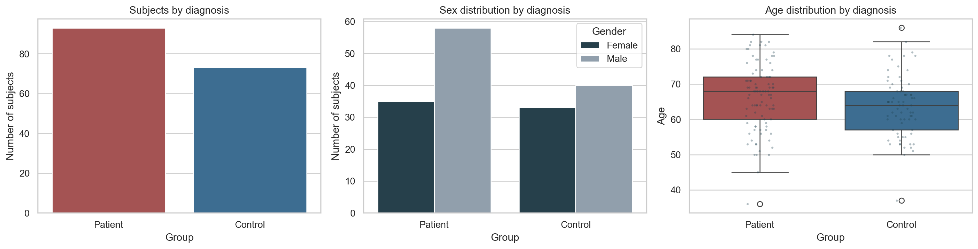
Dataset Demographics — Full Dataset (N=166)
01 · Dataset Overview
Full Dataset (from demographics.xls)
Per-Cohort Breakdown
PD (n=93)
HC (n=73)
Cohort
PD
HC
Total
Condition
Age PD
Male / Female
58 / 35
40 / 33
Ga (Yogev)
29
18
47
Normal walk
61.6±8.8
Age mean±SD
66.9 ± 9.7 yrs
63.3 ± 8.0 yrs
Si (Frenkel-Toledo)
35
29
64
Treadmill
67.2±9.1
Height mean±SD
1.68 ± 0.10 m
1.68 ± 0.08 m
Ju (Hausdorff)
29
26
55
RAS walk
66.8±10.8
Weight mean±SD
72.3 ± 11.8 kg
72.3 ± 11.4 kg
H&Y mean±SD
2.26 ± 0.34
—
UPDRS-M mean±SD
18.0 ± 9.6
—
Deliverable 1 — PD Gait Analysis | FAU Erlangen-Nürnberg
4/21

Slide 5
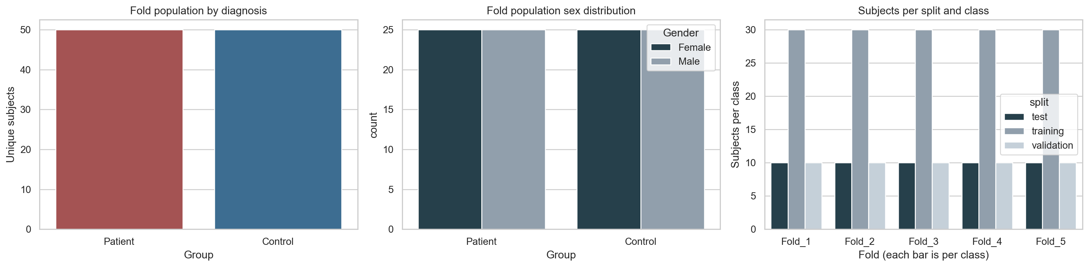
Dataset Demographics - 5-Fold Split Files
01 · Dataset Overview
Per-fold composition (validation included)
Split Integrity Note
PD
HC
Total
- Every fold is class-balanced: 30/30 train, 10/10 validation, 10/10 test.
- The same 100-subject balanced subset appears across the five split files.
- Validation should be used for model selection; test remains held out.
- Prepared feature figures in deliverable1_outputs are from the existing Fold 1 train+test output subset (N=80).
Training files / fold
30
30
60
Validation files / fold
10
10
20
Test files / fold
10
10
20
Per-fold total
50
50
100
Unique subject set
50
50
100
Cohorts Ga / Si / Ju
18 / 16 / 16
13 / 21 / 16
31 / 37 / 32
PD H&Y 2.0 / 2.5 / 3.0
26 / 16 / 8
-
50 PD
Deliverable 1 — PD Gait Analysis | FAU Erlangen-Nürnberg
5/21

Slide 6
02
Signal Visualization
Raw VGRF Traces · Force Variability · PD vs HC Comparison

Slide 7
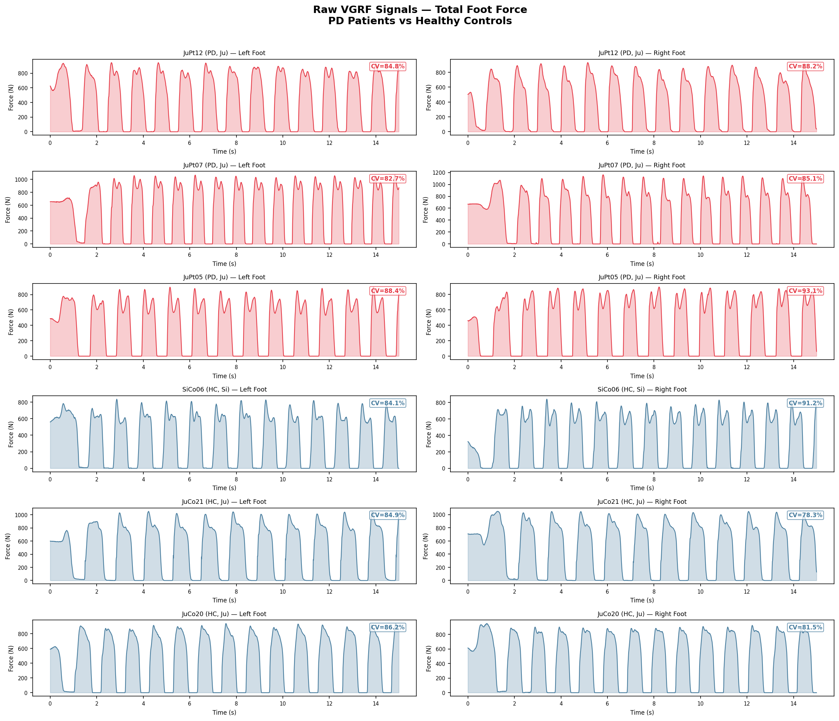
Raw VGRF Signals — PD vs Healthy Controls
15 seconds of total force, left and right foot
02 · Signal Visualization
Vertical Ground Reaction Force (VGRF) captures the force each foot exerts on the ground. 16 sensors per foot at 100 Hz. Coefficient of Variation (CV) shown per trace.
Deliverable 1 — PD Gait Analysis | FAU Erlangen-Nürnberg
7/21

Slide 8
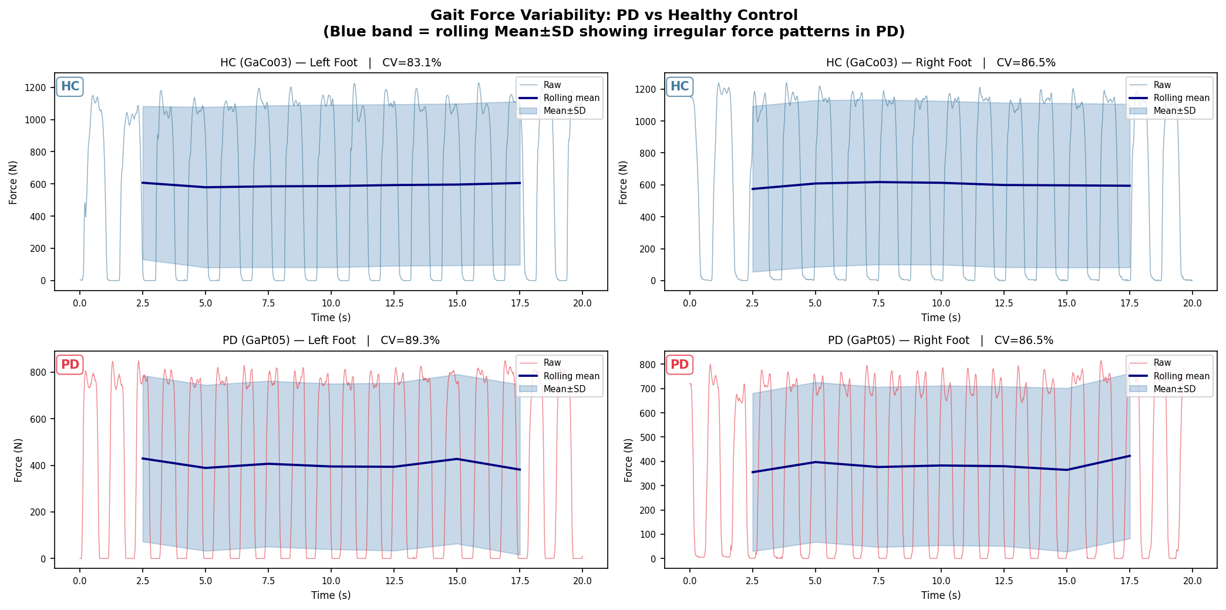
Gait Force Variability — PD vs Healthy Control
Rolling mean ± SD (5s window, 2.5s step)
02 · Signal Visualization
Key finding (Yogev et al., 2005): In healthy adults, gait rhythmicity is automatic — stride variability is unaffected by cognitive load. In PD, variability increases markedly under dual-task conditions, indicating a loss of automaticity.
Deliverable 1 — PD Gait Analysis | FAU Erlangen-Nürnberg
8/21

Slide 9
03
Feature Extraction
TSFresh · Manual Features · Z-Score Normalisation · Per-Subject Statistics

Slide 10
Feature Extraction Pipeline
Windowed extraction → per-subject statistics → z-score normalisation
03 · Feature Extraction
TSFresh (Primary Approach)
Manual Features (Alternative Approach)
• Library: tsfresh (EfficientFCParameters)
• ~750+ features per channel per window
• Window: 5 seconds (500 samples)
• Step: 2.5 seconds (50% overlap)
• Channels: 9 (L1–L8 + TotalLeft) per foot
Per-subject aggregation:
→ Mean across windows
→ Std across windows
→ Skewness across windows
→ Kurtosis across windows
Final matrix: 80 subjects × ~3,000 features
Applied: z-score normalisation (StandardScaler)
15 features per channel per window:
· Mean, Std, Min, Max
· Skewness, Kurtosis
· Q25, Q75 (interquartile range)
· Mean |Δ|, Std Δ (first diff)
· Range, CV (coefficient of variation)
· Signal energy (mean x²)
· Dominant frequency (FFT)
· Low-frequency energy
Advantages over TSFresh:
→ Faster (seconds vs. hours)
→ Interpretable (domain knowledge)
→ Less prone to overfitting
Final matrix: 80 subjects × 60–120 features
Applied: z-score normalisation (StandardScaler)
Three feature sets computed independently: (1) Left foot only · (2) Right foot only · (3) Combined (concatenation)
Deliverable 1 — PD Gait Analysis | FAU Erlangen-Nürnberg
10/21

Slide 11
04
Dimensionality Reduction
PCA · t-SNE · Left / Right / Combined Feet · z-score normalised

Slide 12
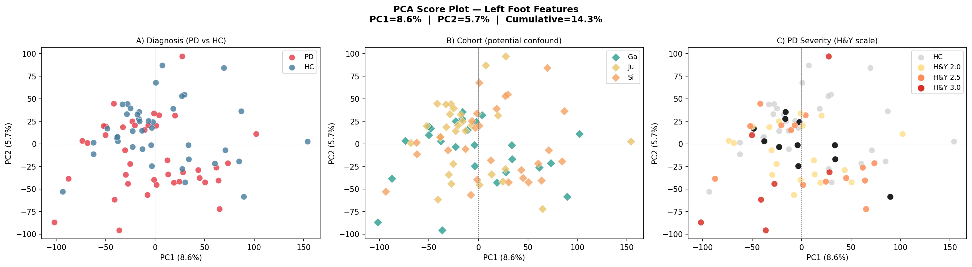
PCA — Left Foot Features
Features z-score normalised before PCA
04 · PCA (Left Foot)
Three panels: (A) PD/HC diagnosis · (B) Cohort — possible confound · (C) H&Y severity stage
Deliverable 1 — PD Gait Analysis | FAU Erlangen-Nürnberg
12/21

Slide 13
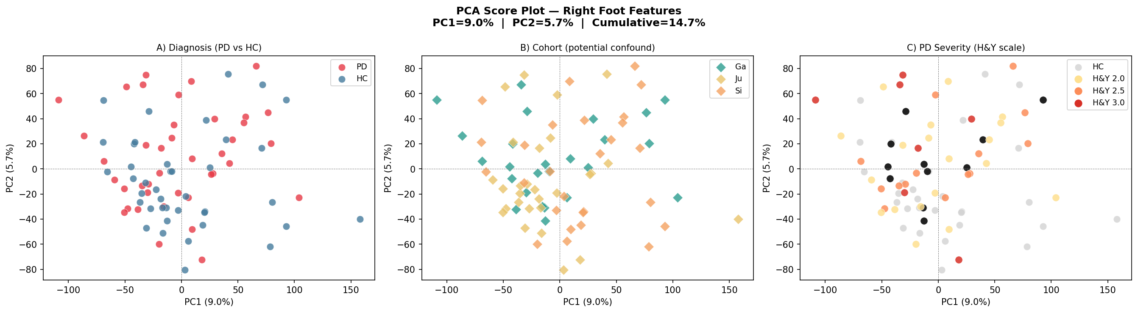
PCA — Right Foot Features
Features z-score normalised before PCA
04 · PCA (Right Foot)
Three panels: (A) PD/HC diagnosis · (B) Cohort — possible confound · (C) H&Y severity stage
Deliverable 1 — PD Gait Analysis | FAU Erlangen-Nürnberg
13/21

Slide 14
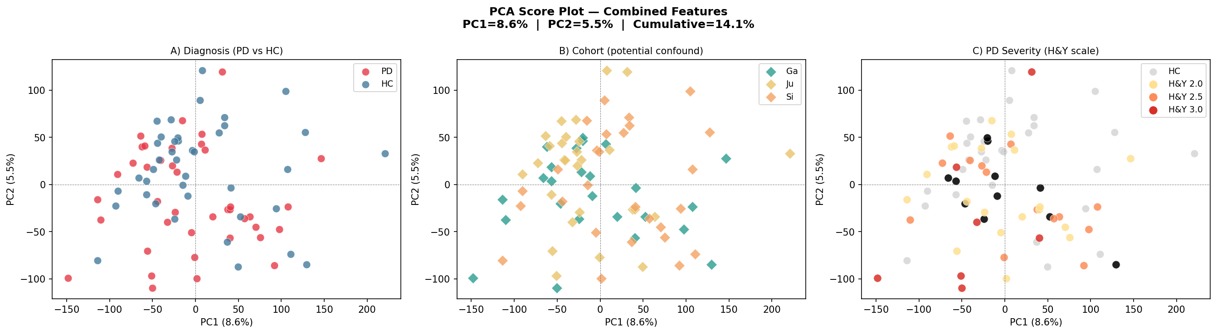
PCA — Combined Feet Features (Left + Right)
Features z-score normalised before PCA
04 · PCA (Combined)
Three panels: (A) PD/HC diagnosis · (B) Cohort — possible confound · (C) H&Y severity stage
Deliverable 1 — PD Gait Analysis | FAU Erlangen-Nürnberg
14/21

Slide 15
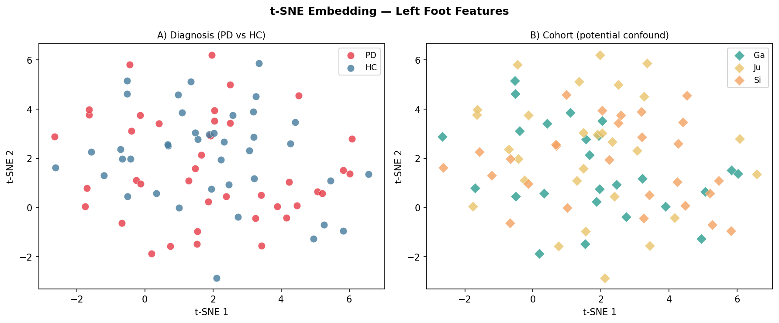
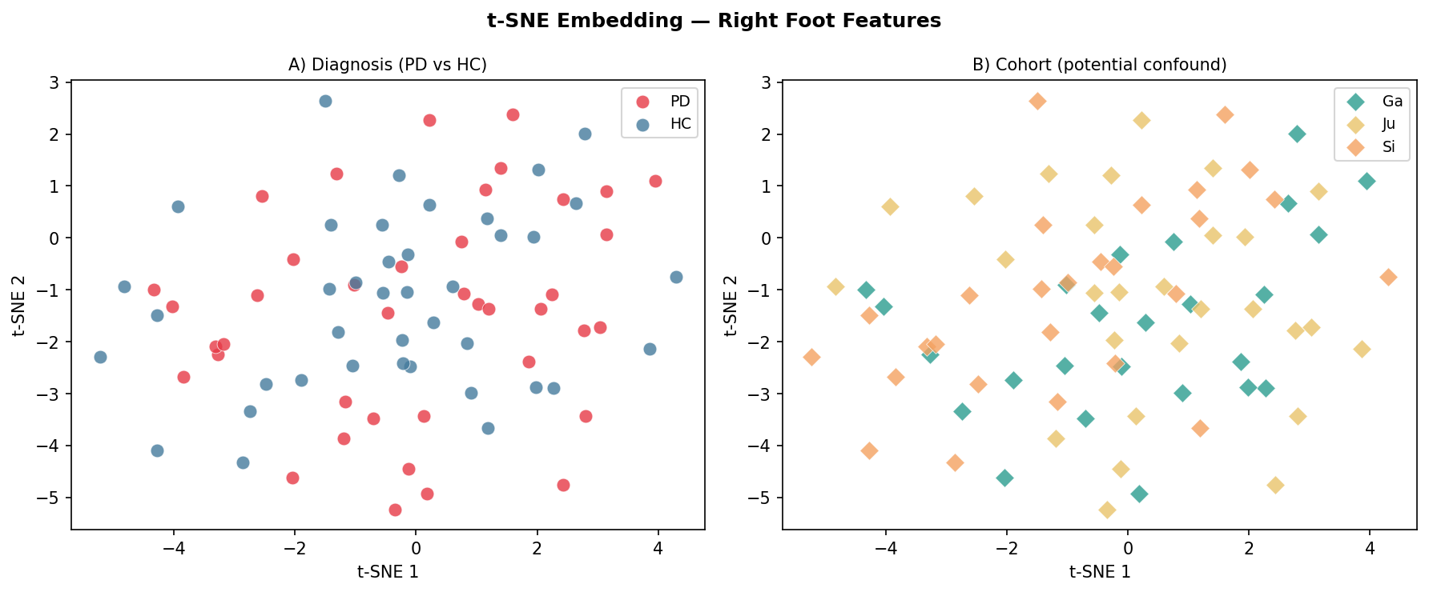
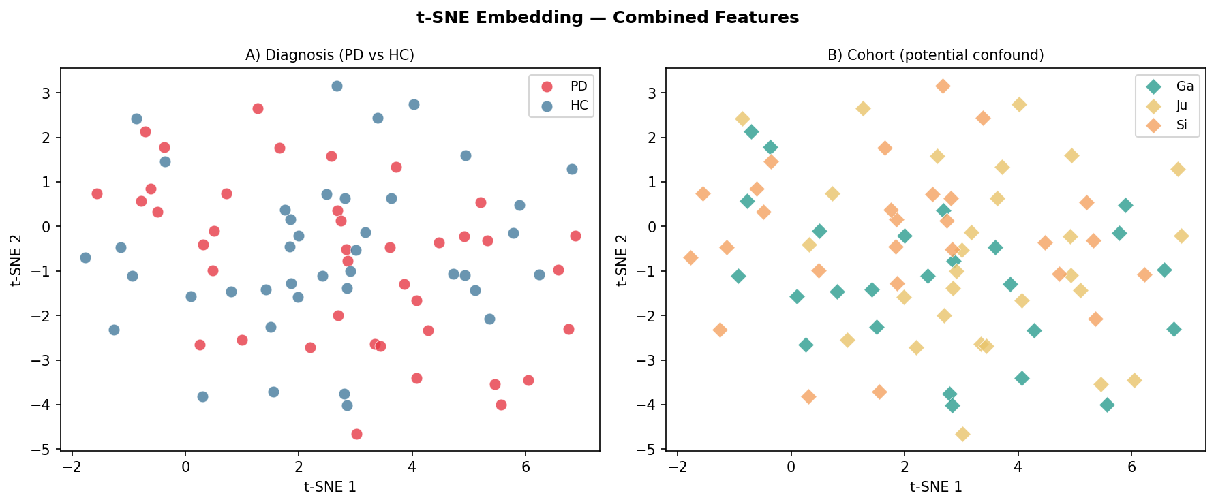
t-SNE Embedding — Left / Right / Combined Feet
Features z-score normalised; PCA pre-compression → t-SNE
04 · t-SNE
Each plot: (A) PD/HC coloured · (B) Cohort coloured | Perplexity=20, 1000 iterations
Left Foot
Right Foot
Combined Feet
Interpretation guide: • Good cluster separation in panel A → features distinguish PD from HC • Cluster alignment with cohort in panel B → cohort confound present (condition, not disease) • Compare left vs right vs combined to see if bilateral features help separation • Combined feet expected to show best separation (more information)
Deliverable 1 — PD Gait Analysis | FAU Erlangen-Nürnberg
15/21

Slide 16
05
Feature Diagnostics
Heatmaps - Feature Distributions - PCA/t-SNE Interpretation

Slide 17
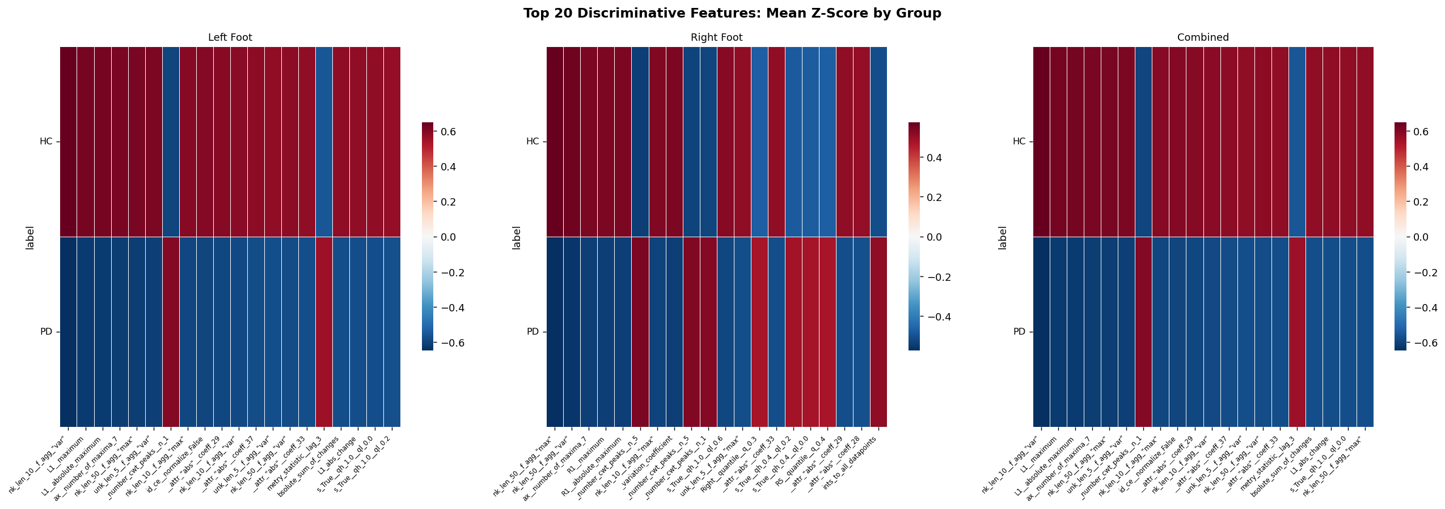
Feature Analysis - Heatmap
05 - Feature Diagnostics
Top discriminative features by foot condition
Group-wise z-score means highlight which extracted features differ between PD and healthy controls.
Deliverable 1 — PD Gait Analysis | FAU Erlangen-Nürnberg
17/21

Slide 18
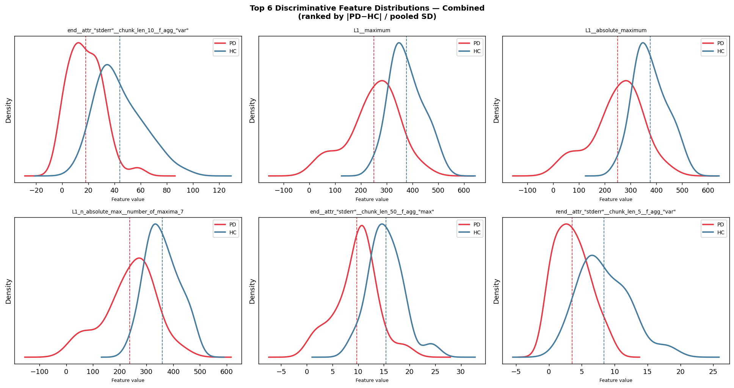
Feature Distributions - Combined Feet
05 - Feature Diagnostics
KDE distributions for selected combined-foot features
Deliverable 1 — PD Gait Analysis | FAU Erlangen-Nürnberg
18/21

Slide 19
06
Key Findings
Summary of Deliverable 1 - Task 1 Presentation Takeaways

Slide 20
Key Findings
06 · Discussion
What the data shows
Presentation takeaway
Demographics:
- Full Excel cohort: 166 subjects (93 PD, 73 HC).
- Fold files use a balanced 100-subject subset.
- Each fold has 60 train, 20 validation, 20 test files.
Signal analysis:
- Raw VGRF traces show clear gait-cycle structure.
- Several PD examples show higher force variability.
- Variability plots are consistent with PD gait-rhythm disruption reported in the literature.
Feature space:
- Features are z-score normalized before PCA/t-SNE.
- Left, right, and combined-foot views are analyzed separately.
Main message for Task 1:
- The dataset is usable and the official split structure is balanced.
- PCA/t-SNE show partial visual structure, not perfect PD/HC separation.
- Cohort effects remain visible and should be controlled in later modeling.
Recommended next analysis checks:
- Regenerate final feature figures with validation included if the presentation must reflect all fold files.
- Keep train/validation/test boundaries fixed for future model evaluation.
- Report model results by fold and inspect cohort-specific behavior.
Deliverable 1 — PD Gait Analysis | FAU Erlangen-Nürnberg
20/21

Slide 21
Thank you
for your attention!

