Slide 1
Deliverable #1
Gait Time-Series Data Analysis
Parkinson's disease patients vs. controls using walk-01 vertical ground reaction force signals.
50
50
100 Hz
5s / 2.5s
patients
controls
sampling rate
window / step
Outputs generated in /results: fold manifests, TSFresh features, PCA scores, baseline metrics, figures, and this draft deck.
May 2026 | Time Series Project | 1

Slide 2
Dataset Snapshot
The five provided folds reuse the same 100 walk-01 subjects with balanced 60/20/20 train/validation/test splits.
63.0 +/- 8.37
66.5 +/- 9.77
25/25
25/25
control age, mean +/- SD
patient age, mean +/- SD
control M/F
patient M/F
Each time step has 19 columns: time, 8 left-foot sensors, 8 right-foot sensors, and total force per foot.
All files in this first pass are normal walk-01 recordings sampled at 100 Hz.
Every fold has 30 patients / 30 controls for training, 10 / 10 for validation, and 10 / 10 for test.
Feature extraction uses overlapping 5-second windows with a 2.5-second step, matching the deliverable guidance.
Subject-level vectors summarize each window feature by mean, standard deviation, skewness, and kurtosis.
May 2026 | Time Series Project | 2

Slide 3
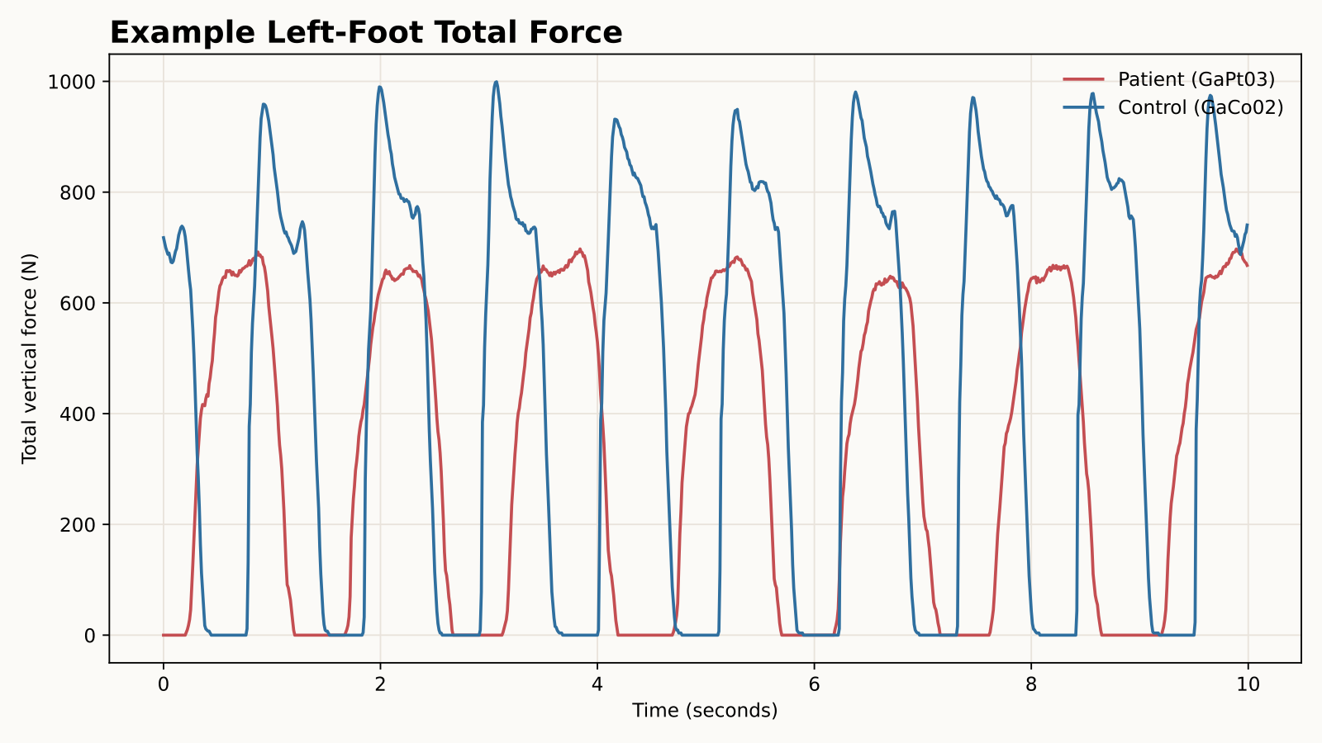
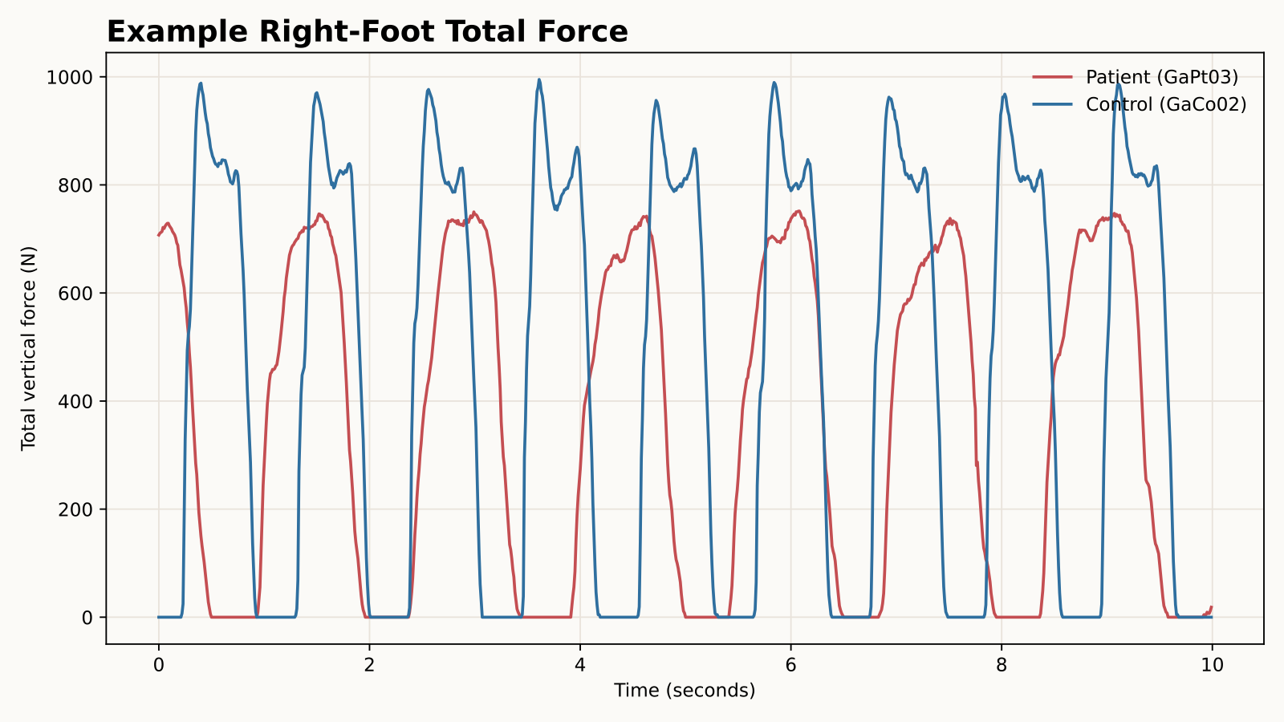
Example Patient-Control Signals
Total vertical ground reaction force over the first 10 seconds of representative subjects.
Patient and control traces differ in amplitude rhythm and stance timing in this example; the later PCA slides test whether windowed features produce broader subject-level separation.
May 2026 | Time Series Project | 3

Slide 4
Feature Pipeline
The analysis produces fold-safe TSFresh, gait, asymmetry, and wavelet subject features.
Raw signal
Windowing
Feature set
Subject vector
Projection
19 columns at 100 Hz
5s window, 2.5s step
Curated TSFresh + engineered gait features
mean/std/skew/kurt across windows for every feature
z-score normalization followed by PCA
The feature matrix is written to results/tables/subject_feature_matrix.csv for reproducibility.
Enhanced features add contact timing, COP, force symmetry, paired left-right differences, and Morlet wavelet power.
PCA is run three ways as requested: right foot only, left foot only, and concatenated left+right features.
Baselines use each fold's training split for fitting, validation split for model selection, and test split for final reporting.
May 2026 | Time Series Project | 4

Slide 5
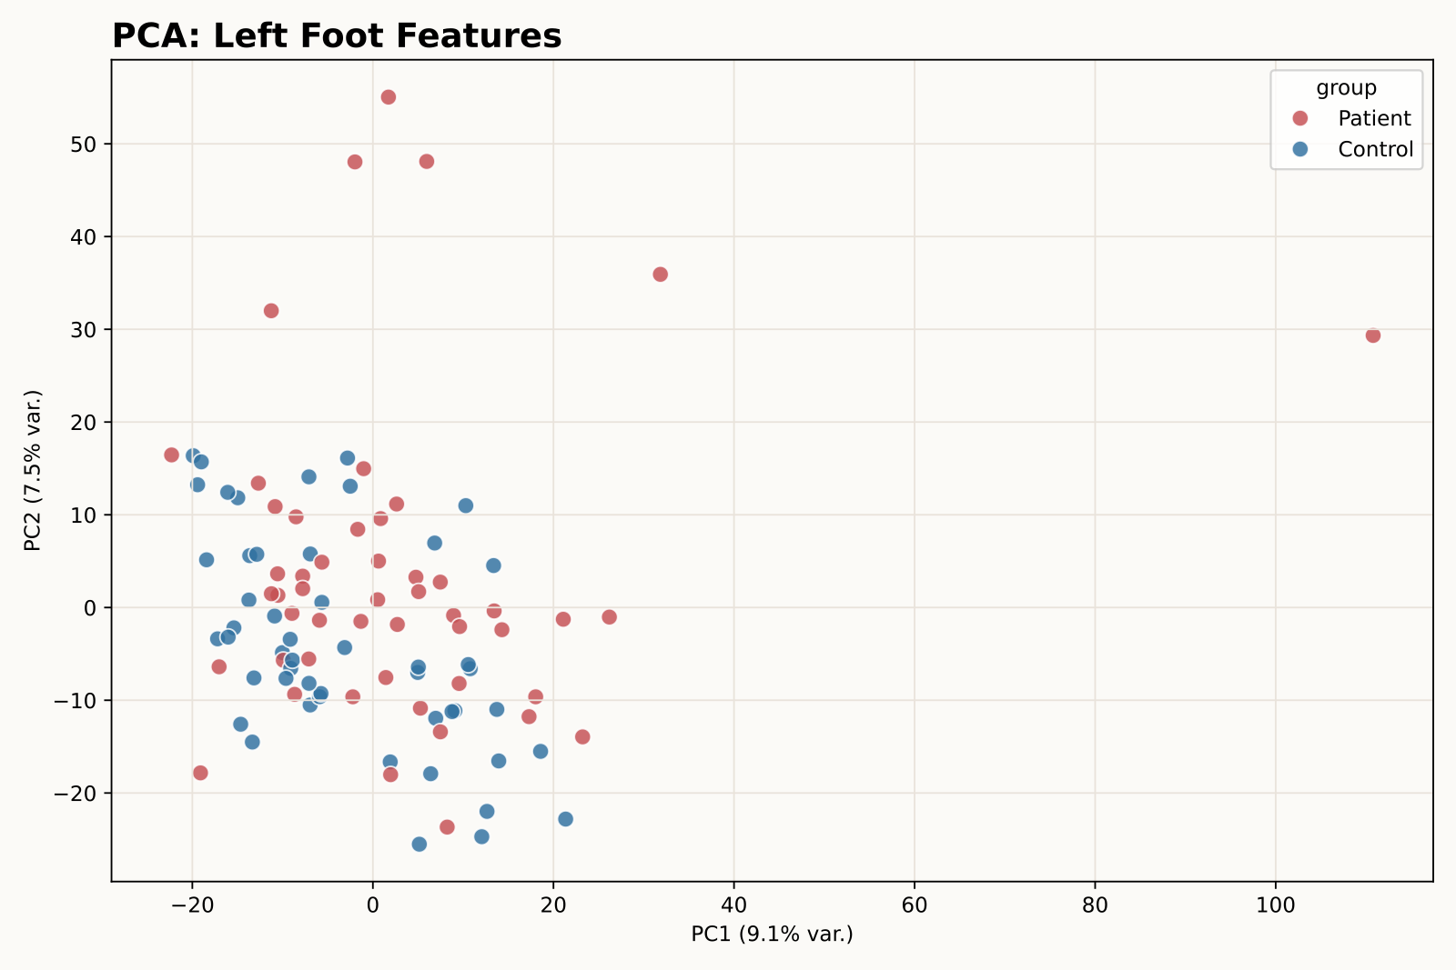
PCA: Left Foot Features
PC1 9.1%, PC2 7.5% explained variance.
May 2026 | Time Series Project | 5

Slide 6
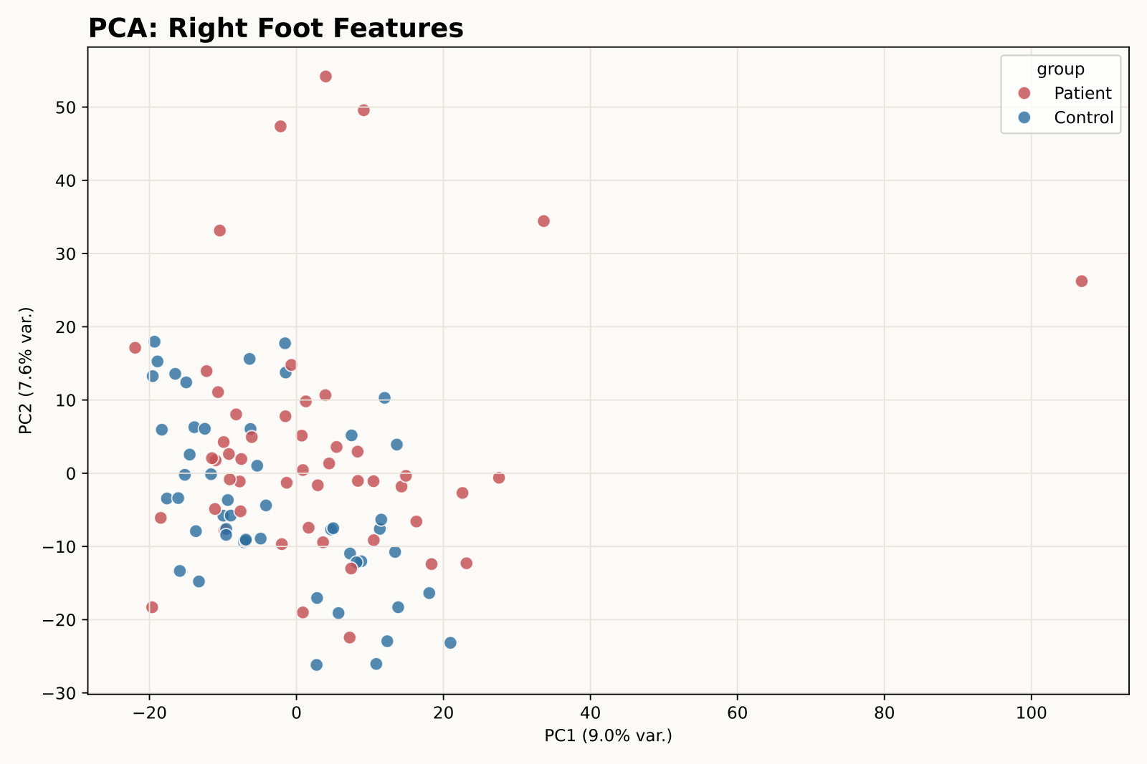
PCA: Right Foot Features
PC1 9.0%, PC2 7.6% explained variance.
May 2026 | Time Series Project | 6

Slide 7
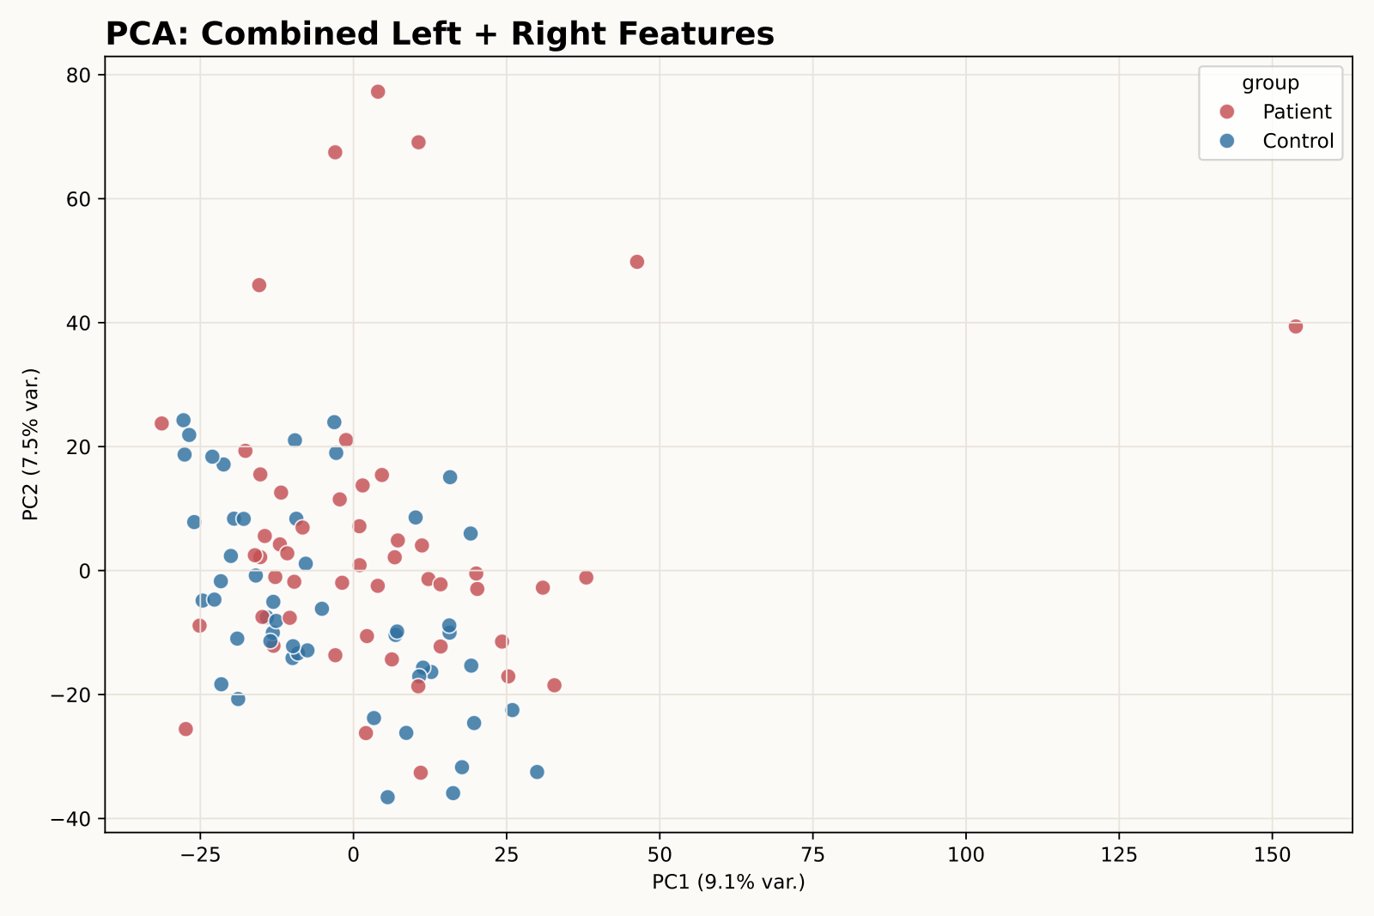
PCA: Combined Left + Right Features
PC1 9.1%, PC2 7.5% explained variance.
First-pass readout
The groups are not cleanly separable in the first two PCA axes.
Study/source effects and gait-speed differences may explain part of the structure.
The supervised baseline slide quantifies what PCA alone cannot show visually.
May 2026 | Time Series Project | 7

Slide 8
Baseline Models Before Mamba
Enhanced features add gait timing, COP, asymmetry, and wavelet descriptors to the TSFresh subject vectors.
Scope | Model | Val F1 | Test Acc. | Test F1
enhanced | l1 logistic | 90.8% | 81.0% | 80.1%
enhanced | linear svm | 85.5% | 79.0% | 79.5%
combined | l1 logistic | 86.2% | 79.0% | 77.3%
enhanced | extra trees | 87.6% | 78.0% | 74.9%
enhanced | random forest | 83.9% | 77.0% | 74.4%
right | l1 logistic | 86.1% | 76.0% | 74.1%
combined | random forest | 85.2% | 74.0% | 73.9%
left | random forest | 82.1% | 74.0% | 73.1%
right | extra trees | 87.6% | 72.0% | 71.7%
enhanced | rbf svm | 89.1% | 73.0% | 71.3%
Best mean test F1 is 80.1% from enhanced l1 logistic. The strongest linear SVM reaches 79.0% mean test accuracy on enhanced features, matching the meeting-slide baseline range.
No Mamba/SSM model is implemented in this step.
Validation is separate from the held-out test split in each fold.
Metrics are stored in baseline_fold_metrics.csv and baseline_summary.csv.
May 2026 | Time Series Project | 8

