Slide 1


Time Series Project SS26 | Deliverable 1
Gait-Based Parkinson's Disease Detection
Data analysis, feature engineering, and non-Mamba baseline results using the provided 5-fold protocol.
100
81.0%
80.1%
walk-01 subjects
best test accuracy
best test F1
May 2026

Slide 2
Deliverable 1
Executive Summary
Non-Mamba baselines now exceed the reference linear-SVM range while preserving the official split protocol.
Main result
50 / 50
5
60 / 20 / 20
Enhanced features with sparse L1 logistic regression reach 81.0% mean test accuracy and 80.1% mean test F1 across the five folds.
controls / patients
predefined folds
train / validation / test per fold
The data is balanced by class in every training, validation, and test split.
Model selection uses validation data only; final metrics are averaged over held-out fold test sets.
The strongest linear SVM reaches 79.0% mean test accuracy, above the 73% reference mentioned in the meeting slides.
The best overall non-Mamba model is sparse logistic regression on enhanced features.
enhanced l1 logistic
80.1%
enhanced linear svm
79.5%
combined l1 logistic
77.3%
enhanced extra trees
74.9%
enhanced random forest
74.4%
right l1 logistic
74.1%
combined random forest
73.9%
May 2026 | Time Series Project | Deliverable 1
Technische Fakultat
1

Slide 3
Deliverable 1
Dataset and Fold Protocol
The analysis uses only the provided walk-01 files and keeps testing isolated by fold.
50
50
63.0 / 66.5
25 / 25
103.3s
control subjects
PD subjects
mean age: control / PD
male / female in each class
mean analyzed duration
Fold structure
Split | Controls | PD patients | Total
Training | 30 | 30 | 60
Validation | 10 | 10 | 20
Test | 10 | 10 | 20
Each fold repeats the same class balance, which removes the need for SMOTE in this first pass.
The validation split controls model and feature-count selection.
The test split remains untouched until final scoring.
May 2026 | Time Series Project | Deliverable 1
Technische Fakultat
2

Slide 4
Deliverable 1
Feature Engineering Pipeline
Literature and repository review motivated variability, asymmetry, and time-frequency descriptors.
Trim
Window
TSFresh
Engineer
Select
Model
Remove 5s from start and end
5s windows, 2.5s step
Curated force-signal features
Timing, COP, asymmetry, wavelets
Fold-safe SelectKBest
RF, ExtraTrees, SVM, sparse logistic
Gait literature emphasizes rhythmicity, variability, asymmetry, stance timing, and double support.
The GitHub CNN/scalogram work suggested capturing time-frequency information; here it is added as classical wavelet features.
All scaling, imputation, feature selection, and model selection are performed inside the fold pipeline.
Enhanced representation
Left and right TSFresh vectors are combined with paired absolute differences, gait contact statistics, force symmetry, center-of-pressure descriptors, and Morlet wavelet power summaries.
May 2026 | Time Series Project | Deliverable 1
Technische Fakultat
3

Slide 5
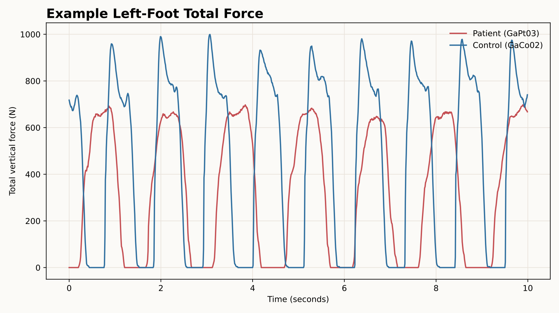
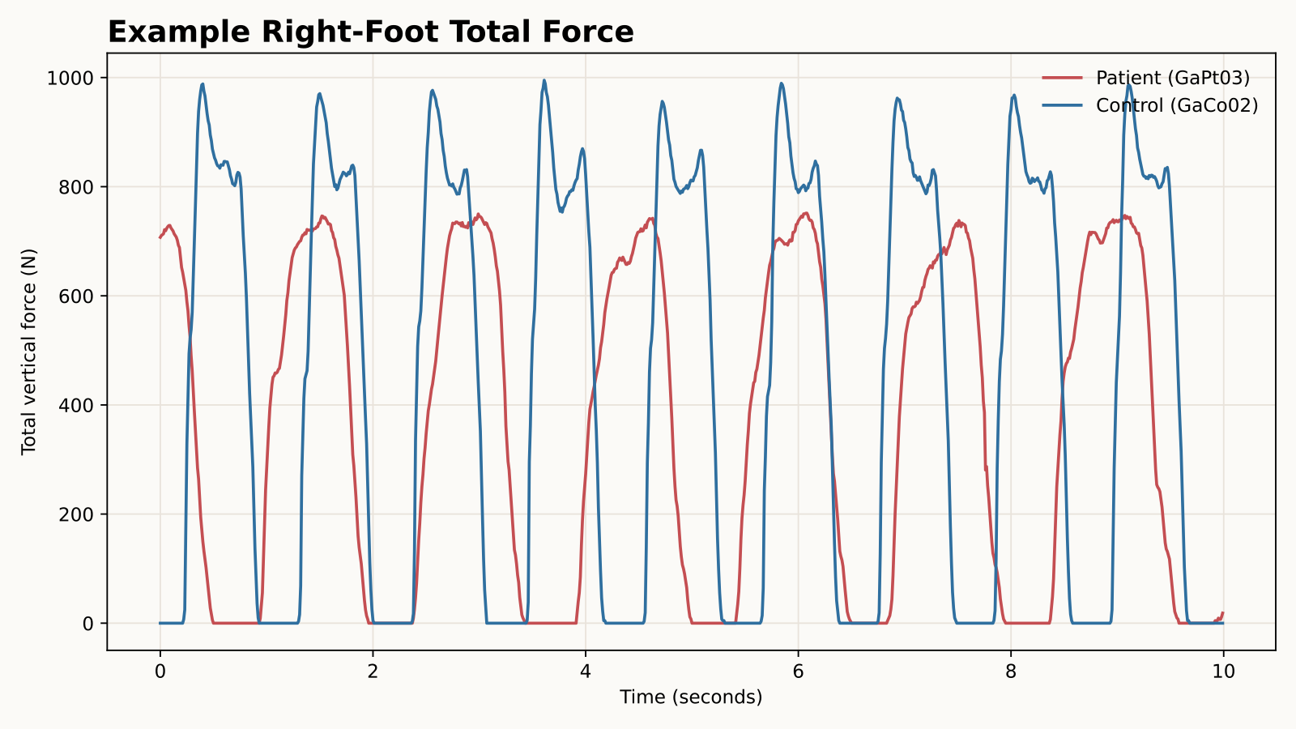
Deliverable 1
Representative Force Signals
Total vertical ground-reaction force over the first 10 seconds after trimming.
The patient/control examples show differences in rhythm and force timing.
Single traces are illustrative only; classification uses subject-level summaries across the full recording.
May 2026 | Time Series Project | Deliverable 1
Technische Fakultat
4

Slide 6
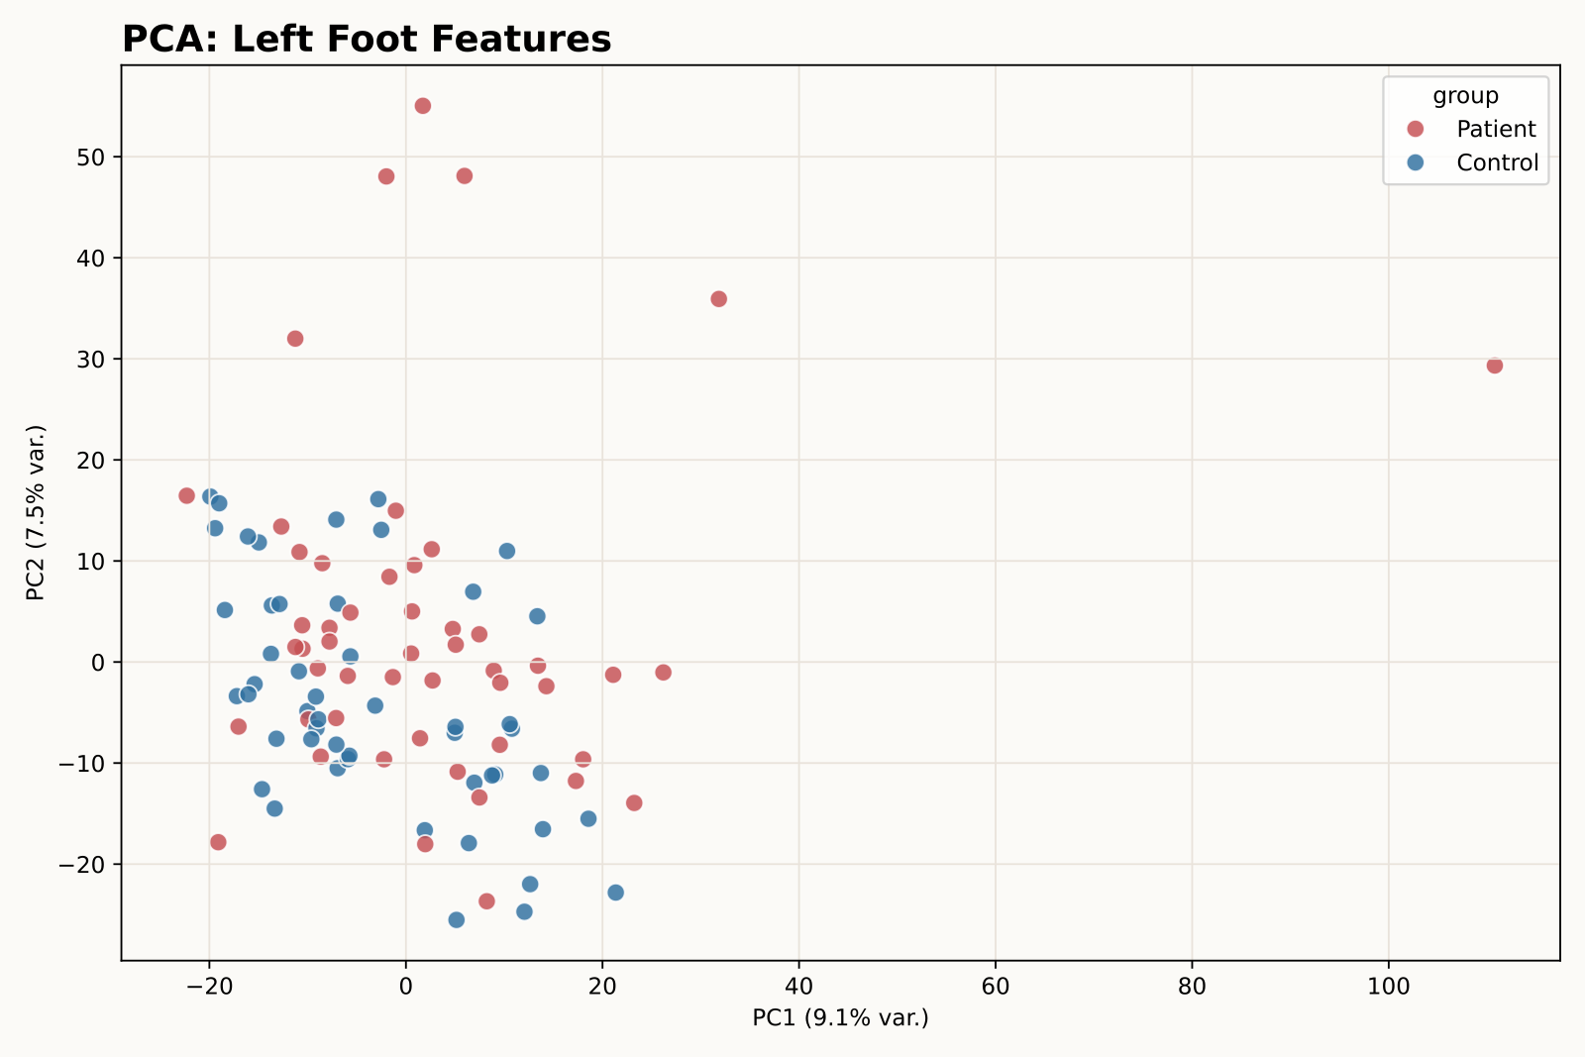
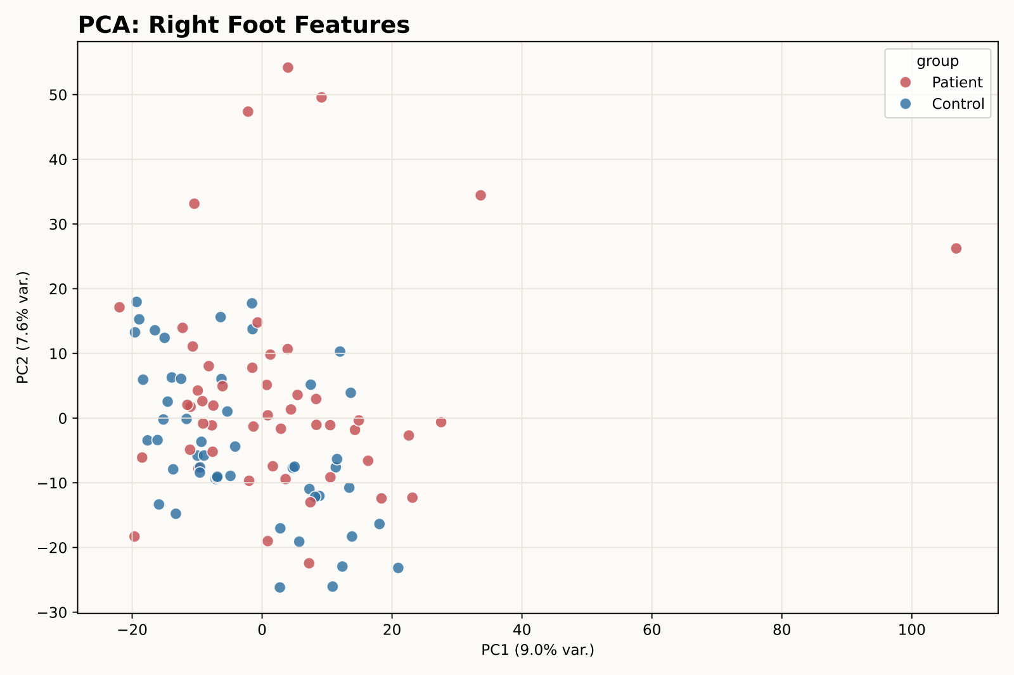
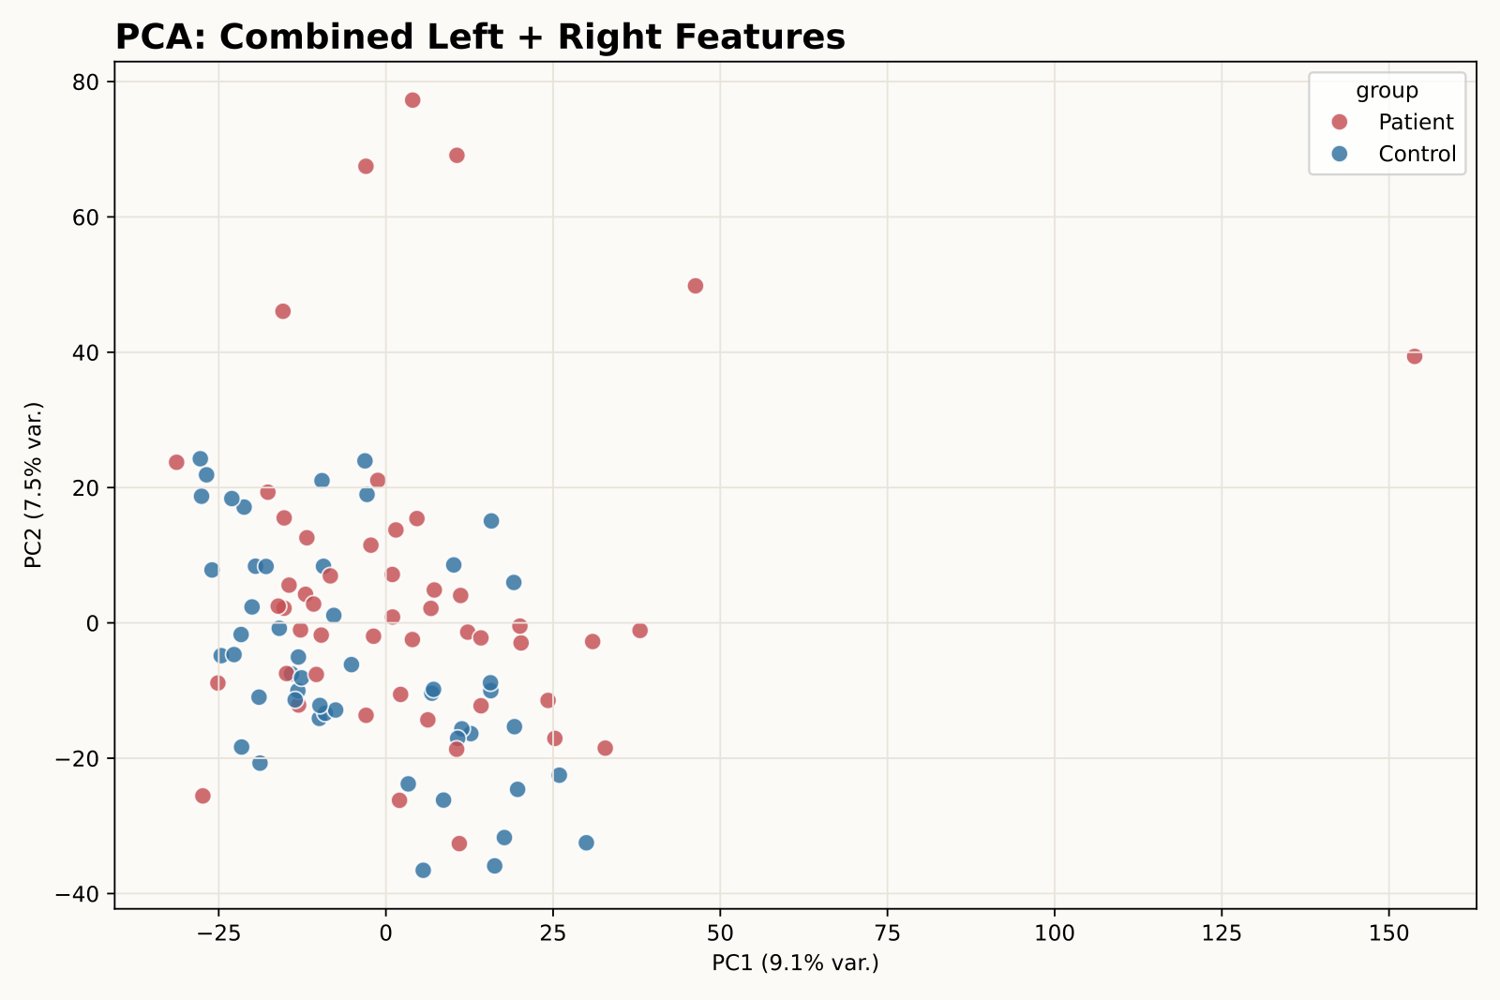
Deliverable 1
PCA Diagnostics
The first two principal components help visualize structure but do not cleanly separate the classes.
Left PC1+PC2: 16.6% variance
Right PC1+PC2: 16.6% variance
Combined PC1+PC2: 16.6% variance
PCA is useful as a sanity check, not as the final separation mechanism.
Supervised feature selection and nonlinear/regularized baselines capture more discriminative structure.
May 2026 | Time Series Project | Deliverable 1
Technische Fakultat
5

Slide 7
Deliverable 1
Baseline Results
The enhanced feature set gives the best fold-averaged test performance before Mamba/SSM models.
Scope | Model | Val F1 | Test acc. | Test F1
enhanced | l1 logistic | 90.8% | 81.0% | 80.1%
enhanced | linear svm | 85.5% | 79.0% | 79.5%
combined | l1 logistic | 86.2% | 79.0% | 77.3%
enhanced | extra trees | 87.6% | 78.0% | 74.9%
enhanced | random forest | 83.9% | 77.0% | 74.4%
right | l1 logistic | 86.1% | 76.0% | 74.1%
combined | random forest | 85.2% | 74.0% | 73.9%
left | random forest | 82.1% | 74.0% | 73.1%
right | extra trees | 87.6% | 72.0% | 71.7%
Best model
enhanced l1 logistic: 81.0% mean test accuracy and 80.1% mean test F1.
Linear SVM reference
Enhanced linear SVM reaches 79.0% mean test accuracy, exceeding the 73% meeting-slide reference.
All rows use the same five train/validation/test folds.
The enhanced scope includes TSFresh, asymmetry, gait, COP, and wavelet features.
L1 logistic is attractive because it is sparse and easier to explain than deeper models.
May 2026 | Time Series Project | Deliverable 1
Technische Fakultat
6

Slide 8
Deliverable 1
What Improved the Model
The gain came from adding domain-informed descriptors while keeping the validation protocol strict.
Gait timing
Left-right asymmetry
Contact duration, swing intervals, cadence, double support, and step interval variability.
Paired absolute differences between left and right TSFresh features plus force symmetry descriptors.
Time-frequency power
Sparse selection
Morlet wavelet power captures rhythmic energy patterns without training a CNN yet.
L1 logistic and SelectKBest reduce high-dimensional noise on only 100 subjects.
Important caveat
Published papers often report higher scores under different protocols, full datasets, balancing strategies, or cross-validation choices. These results use the provided folds directly.
May 2026 | Time Series Project | Deliverable 1
Technische Fakultat
7

Slide 9

Deliverable 1
Conclusion and Next Steps
Deliverable 1 is complete as a reproducible non-Mamba baseline package.
Current best
Suggested next experiments
81.0% accuracy / 80.1% F1 with enhanced sparse logistic regression.
Inspect selected L1 features per fold to identify stable gait markers.
Add fold-safe probability calibration and confusion matrices.
Then implement Mamba/SSM and compare against this enhanced baseline.
The project now has fold manifests, demographics summaries, signal diagnostics, PCA plots, feature matrices, and baseline metrics.
The strongest baseline is interpretable and improves meaningfully over the first TSFresh-only result.
Mamba/SSM modeling can now start from a stronger and better documented classical baseline.
May 2026 | Time Series Project | Deliverable 1
Technische Fakultat
8

