Slide 1
StellarSnap
Visual discovery engine for finding ideas, people, trends, home, style inspiration, and more
PixelTriads/Team number: 3
Pearl (Team Leader) 2210990648
Prachi Anand 2210990660
Prachi Malik 2210990661

Slide 2
Index
Objective
Introduction
Methodology, Approach & Techniques
Algorithm
Flow Chart
Result
Source Code (Screenshots)
Conclusion
Reference

Slide 3
Objective
The objective of StellarSnap, website created using HTML, CSS, and JavaScript, could be multi-faceted, aiming to accomplish several goals:
1. Provide Visual Bookmarking Service: StellarSnap should allow users to visually bookmark content from around the web. The primary objective is to create a platform where users can discover, save, and organize images and ideas that interest them.
2. User Engagement: Encourage users to engage actively with the platform by saving, sharing, and commenting on pins. Increasing user interaction contributes to the growth and sustainability of the platform.

Slide 4
Objective
3. Personalization and Curation: Enable users to personalize their experience by curating boards and following other users with similar interests. This fosters a sense of community and helps users discover content relevant to their tastes.
4. Monetization: Depending on the business model, the objective could include generating revenue through advertising, sponsored content, or premium features. Monetization strategies should be implemented without compromising user experience.
By aligning its objectives with these principles, StellarSnap can strive to become a successful Pinterest clone while offering its unique value proposition to users.

Slide 5
Introduction
StellarSnap is a visual discovery engine for finding ideas like recipes, home and style inspiration, and more. With billions of Pins on StellarSnap, you'll always find ideas to spark inspiration. When you discover Pins you love, save them to boards to keep your ideas organized and easy to find. You can also create Pins to share your ideas with other people on StellarSnap.[1]
Your home feed is where you'll find Pins, people and businesses we think you'll love, based on your recent activity. We'll also show you Pins from the people and boards you choose to follow.
You can also search for Pins by typing in keywords into the search bar. Try typing "birthday party" in the search bar to see ideas for birthday party decor, party food recipes, and birthday gift ideas.[2]

Slide 6
Introduction
Use the search bar to discover ideas, people and trends. Explore suggested topics or search for topics of your own. Tap Profiles on the search page to discover creators, people and brands based on your search. Use your camera to find ideas relevant to your photos and narrow beauty results by skin tone range or hair pattern.[3]

Slide 7
Methodology, Approach and Techniques
Methodology and Approach:
1. Requirement Analysis: Understand the objectives and target audience of StellarSnap. [4]
2. Design and Planning: Create wireframes and plan the architecture and features of the platform.[5]
3. Technology Selection: Choose appropriate technologies for frontend and backend development.[6]
4. Agile Development: Use an iterative approach to build and refine the platform.[7]

Slide 8
5. Testing and Quality Assurance: Ensure functionality, usability, and performance through rigorous testing.[8]
6. Deployment and Launch: Deploy the platform to production and execute a marketing strategy.[9]
7. User Feedback and Iteration: Gather user feedback and iterate based on usage metrics and behavior.[10]
8. Maintenance and Support: Provide ongoing maintenance and updates to keep the platform stable and secure.[11]

Slide 9
Techniques:
Various techniques used to build StellarSnap are:
1. HTML, or Hypertext Markup Language, is the standard markup language used to create and structure content on web pages. It serves as the foundation of the World Wide Web and is essential for building websites and web applications.
HTML consists of a series of elements or tags that define the structure and semantics of a web page. These elements include headings, paragraphs, lists, links, images, forms, tables, and more. Each element is enclosed within opening and closing tags, and may contain attributes that provide additional information or modify the element's behavior. [12]

Slide 10
2. CSS, or Cascading Style Sheets, is a style sheet language used to describe the presentation and visual formatting of HTML and XML documents. It enables web developers to control the appearance of web pages, including layout, colors, fonts, spacing, and more.
CSS works by associating style rules with HTML elements, specifying how those elements should be displayed in the browser.[13]
3. JavaScript is a high-level, interpreted programming language primarily used for building dynamic and interactive web applications. It is one of the core technologies of web development, alongside HTML (Hypertext Markup Language) and CSS (Cascading Style Sheets).
JavaScript allows developers to add interactivity, manipulate the content of web pages, respond to user actions, and dynamically update the page without requiring a full page reload. [14]

Slide 11
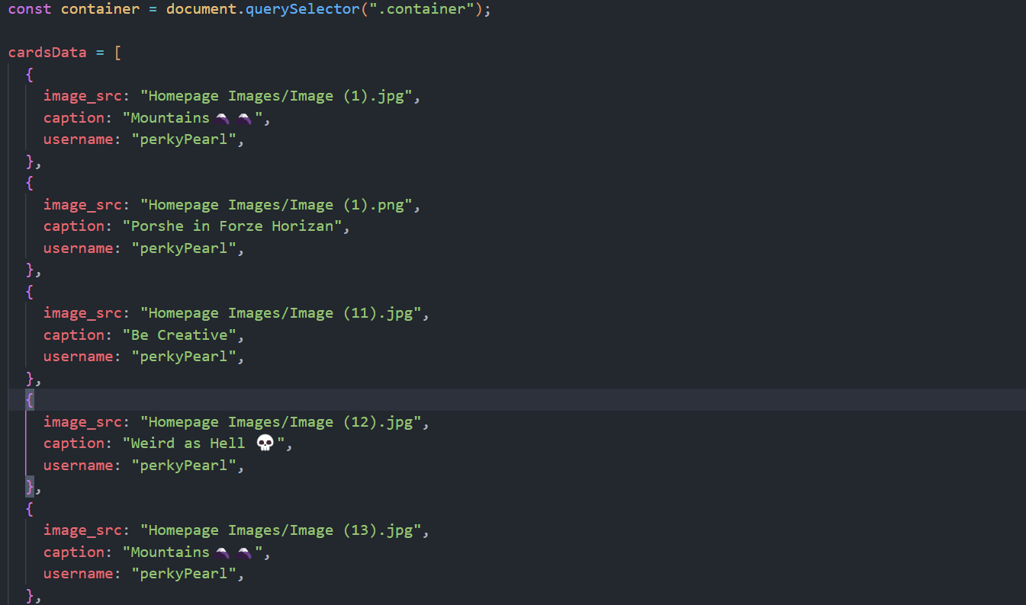
Algorithm
Data Compilation: Gather the Information and Store that into the form of arrays of JSON(JavaScript Object Notation) with the Source of the Images, Caption and Username of the Person who posted it.
Fig (1). Snapshot Of Data Compilation

Slide 12
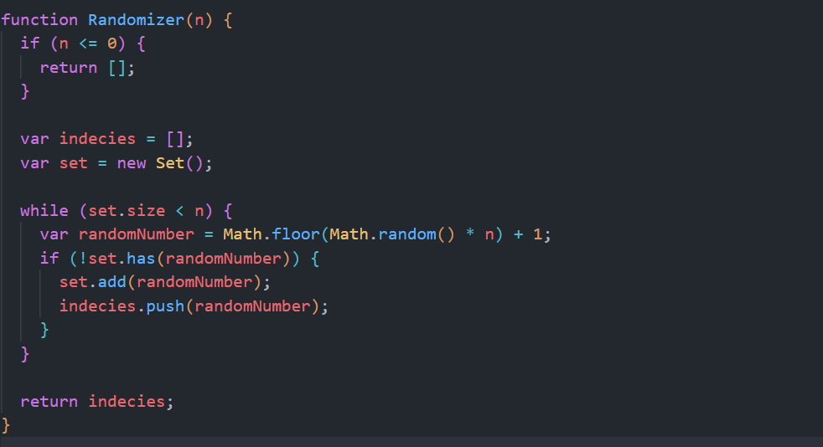
Algorithm
Randomizer: It Creates an array of the size of the data to be displayed on the Feed. It creates a random unique elements array and stores that into an array
Fig (2). Snapshot Of Randomizer

Slide 13

Algorithm
Generating Cards: This creates the Cards on the Webpage using DOM (Document Object Model) Manipulation. It access the Data from the Database in this case, Array of JSON and access their Images Sources, Caption and User who sent that. And Renders it.
Fig (3). Snapshot Of Generating Cards

Slide 14
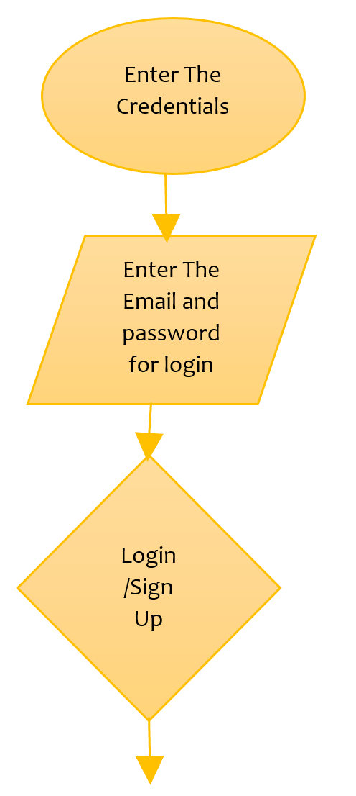
Flowchart

Slide 15
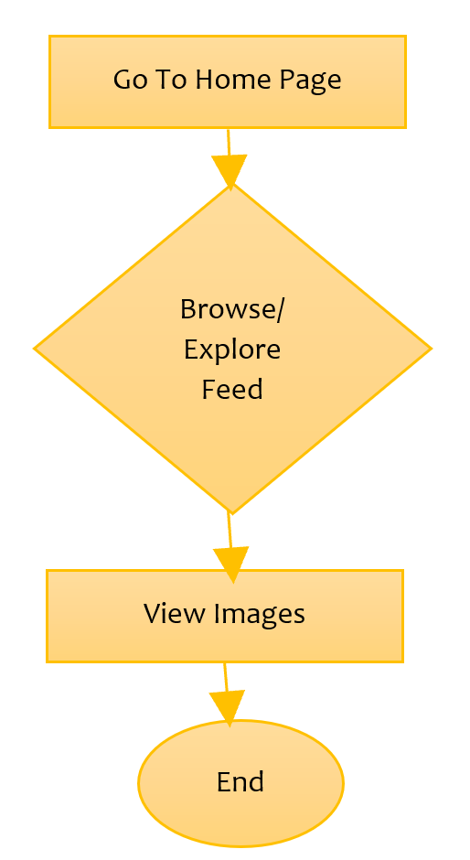

Slide 16
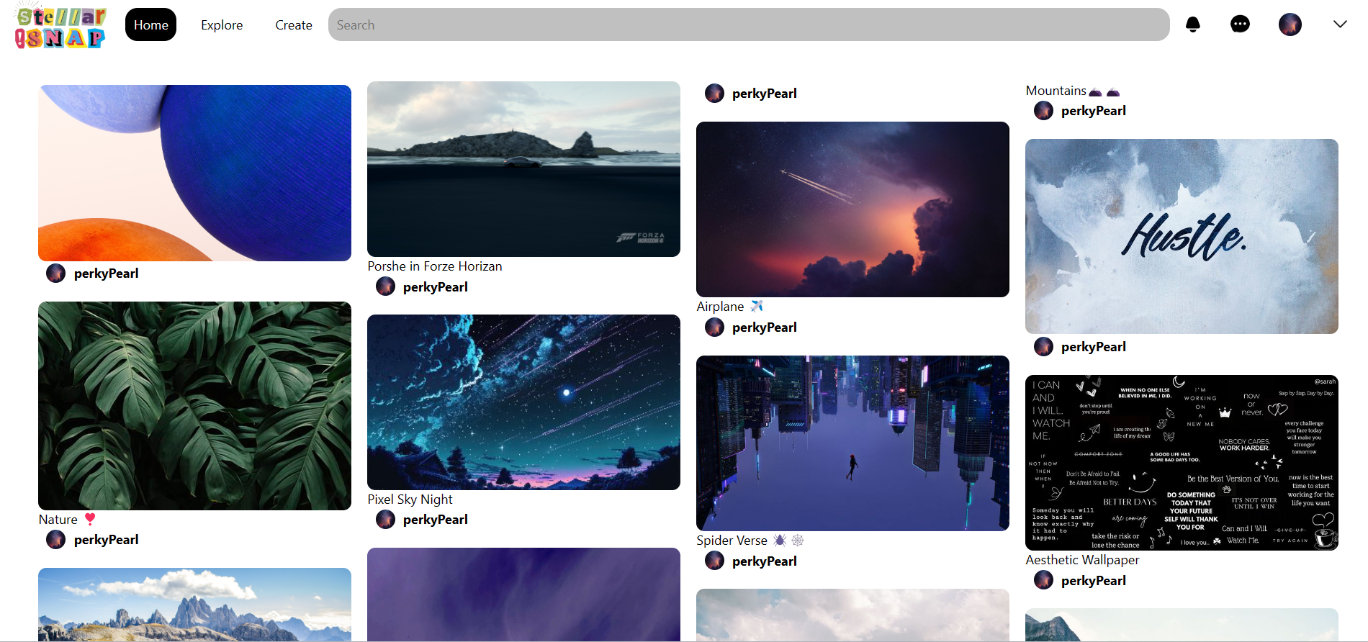
Result
Feed of the Website:
Fig (4). Result Feed Of Website

Slide 17
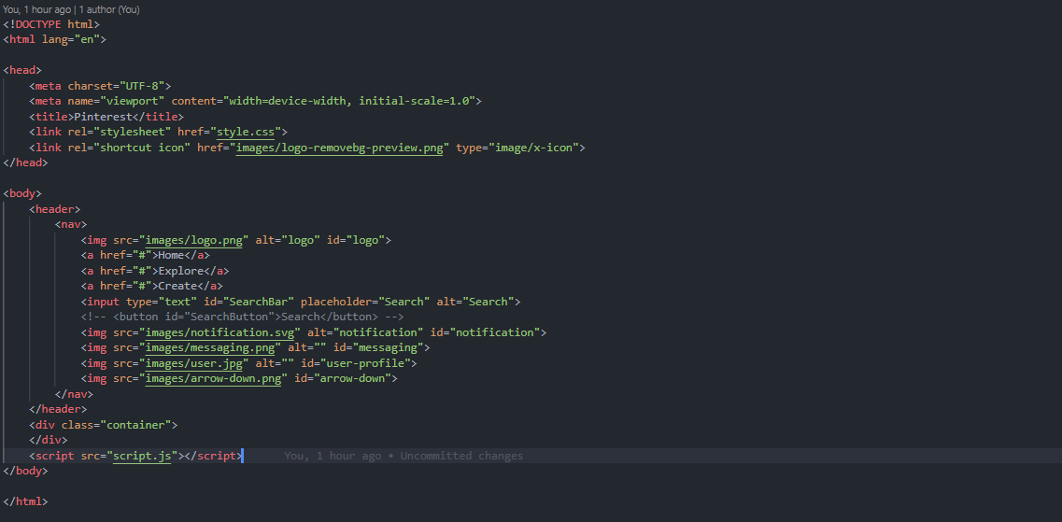
Source Code(Screenshots)
Feed’s HTML:
Fig (5). HTML Of Result Field

Slide 18
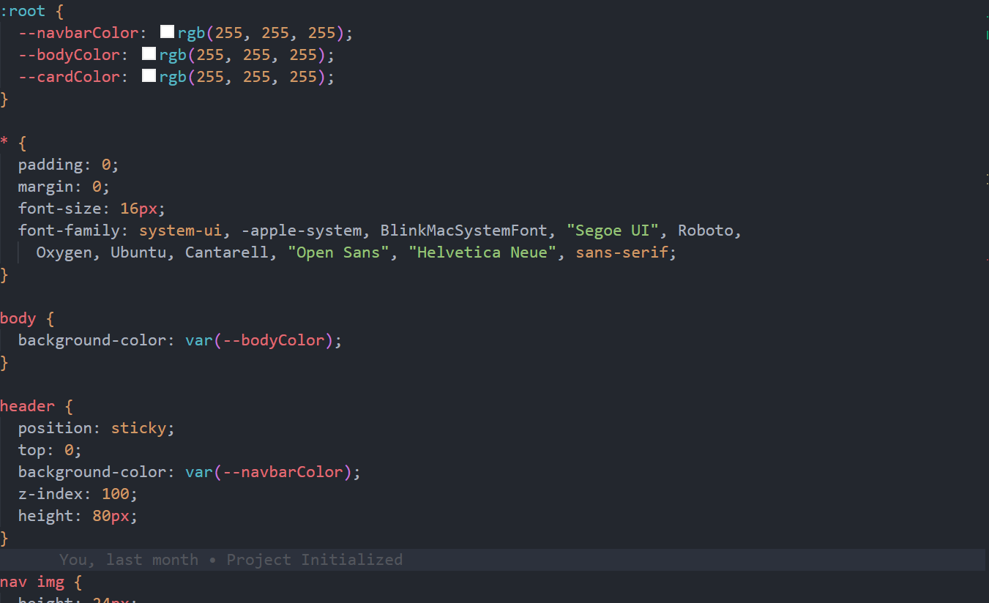
Source Code(Screenshots)
Feed’s CSS:
Fig (6). CSS of Result Feed

Slide 19
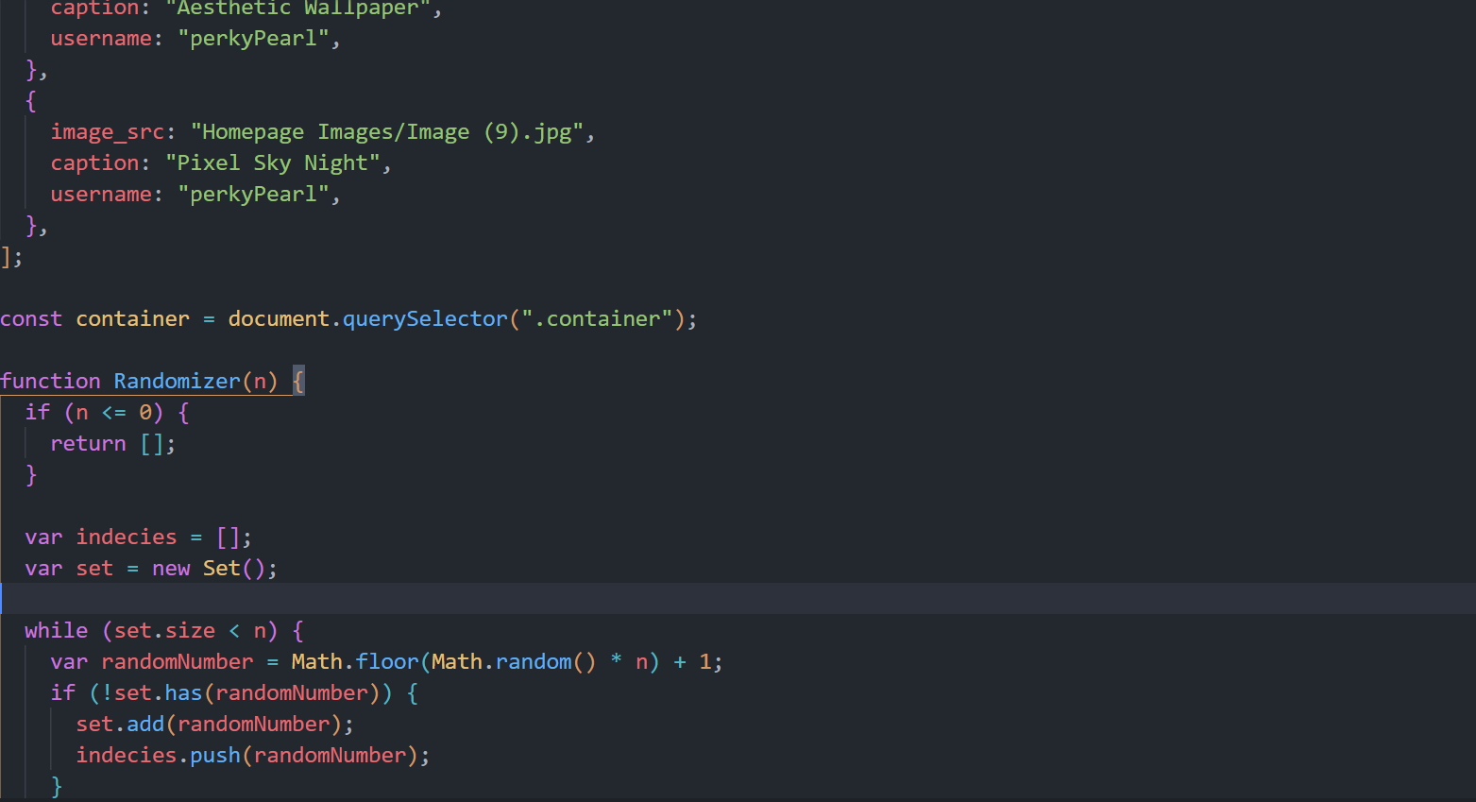
Source Code(Screenshots)
Feed’s JS:
Fig (7). JavaScript Of Result Feed

Slide 20
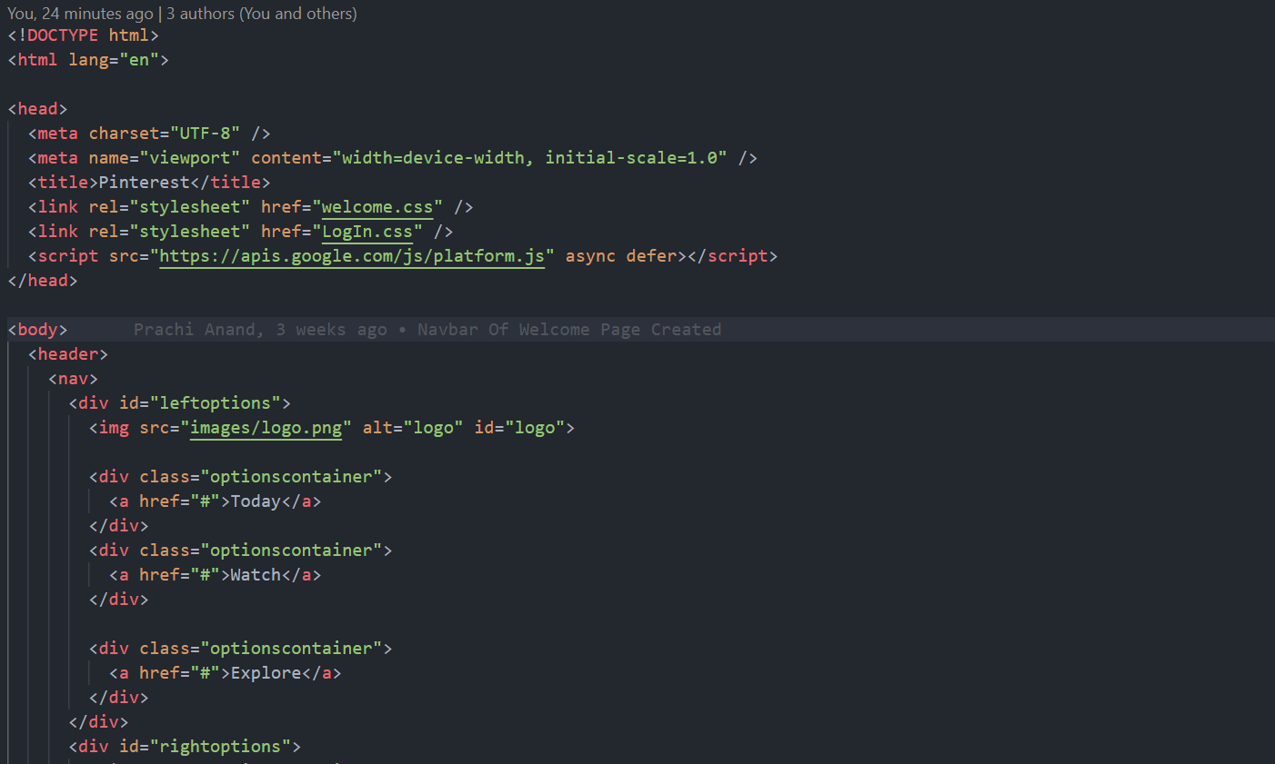
Source Code(Screenshots)
Home Page's HTML:
Fig (8). HTML OF Home Page

Slide 21
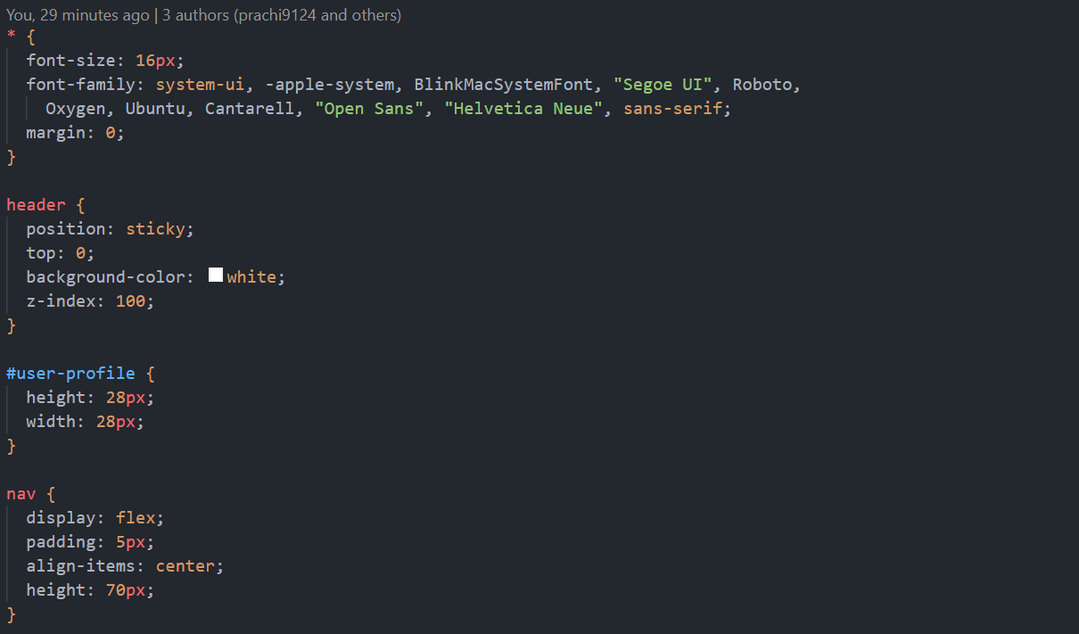
Source Code(Screenshots)
Homepage's CSS:
Fig (9). CSS Of Home Page

Slide 22
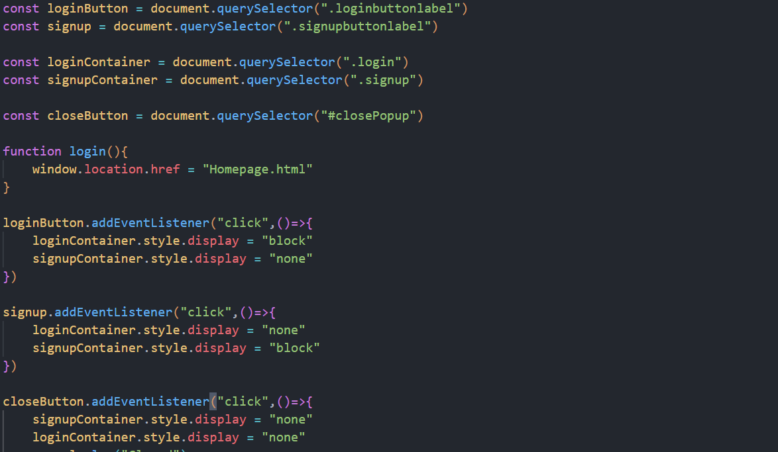
Source Code(Screenshots)
Homepage's JS
Fig (10). JavaScript Of Home Page

Slide 23
Conclusion
In conclusion, StellarSnap presents itself as a promising contender in the realm of social media platforms, offering users a visually appealing and intuitive interface akin to Pinterest. Through its innovative features, seamless user experience, and robust community engagement tools, StellarSnap has the potential to carve out its own niche in the market. As we've explored throughout this analysis, its emphasis on creativity, inspiration, and seamless content discovery sets it apart, catering to a diverse range of interests and passions. Moving forward, continued focus on user feedback, technological advancements, and strategic partnerships will be pivotal in sustaining StellarSnap's growth trajectory and solidifying its position as a leading destination for visual discovery and inspiration on the web.

Slide 24
Reference
[1-3]Pinterest, https://in.pinterest.com/,Accessed on March 3, 2024
[4-11] ChatGPT, chat.openai.com, Accesed on March 1,2024
[12-14] Google, https://www.google.com, Accesed on February 25,2024

Slide 25
The End

