Slide 1
public
private
⬄ Tilstand
 Opførsel
 Hukommelse
 Konstruktion

Slide 2
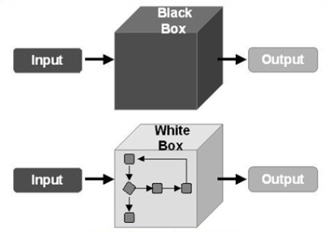

Slide 3

object (Circle)
c =
Circle c = new Circle(…);

Slide 4

object (Circle)
c1 =
object (Circle)
c2 =
Circle c1 = new Circle(…);
Circle c2 = new Circle(…);

Slide 5

object (Circle)
c1 =
= c2
Circle c1 = new Circle(…);
Circle c2 = c1;

Slide 6
⬄
double x = c.X; // get
c.X = 12.5; // set

Slide 7

c.Move(2.5, 4.7);
c.Enlarge(12);

