Slide 1
Object-Oriented Programming Design Patterns and Best Practices Per Storgård Laursen

Slide 2
Where to go from here…

Slide 3
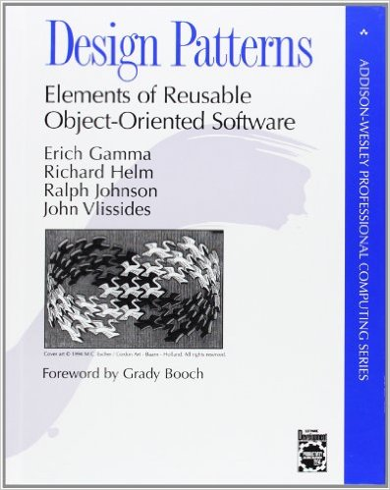
The classic…
Describes the ”classic” 23 design patterns
Grouped by Creational, Structural and Behavioral
Perhaps more a references than a textbook…
ISBN: 978-0201633610

Slide 4
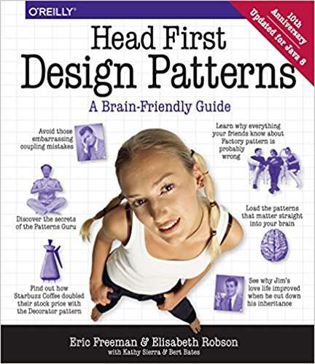
The entertaining…
Only (?) describes about ten patterns
More accessible to beginners
ISBN: 978-0596007126

Slide 5
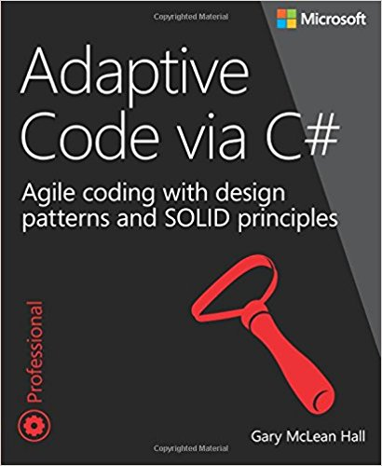
The challenging…
Goes into detail with SOLID design principles
Links SOLID with agile software development
Assumes pretty solid (heh…) OOP skills
ISBN: 978-0735683204

Slide 6

The webz…
Of course lots of material online…
Many excellent video tutorials, even for free ☺

Slide 7

The essentials
Code towards interfaces instead of specific implementations
Isolate parts that vary
Keep it simple

Slide 8

https://github.com/perl-easj/Laurea-materials

Slide 9

https://github.com/perl-easj

Slide 10
?

Slide 11
☺ Thank you for listening!

