Slide 1
Object-Oriented Programming Brush-up and C# syntax (focus on inheritance) Per Storgård Laursen

Slide 2
Class Fundamentals

Slide 3
Class
Data
Logic

Slide 4
Class
State
Behavior

Slide 5
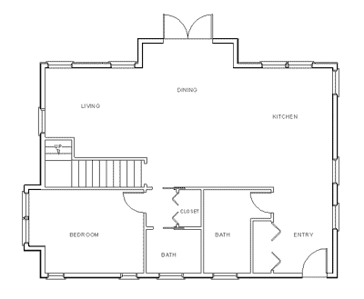
Class Definition
Instance fields
Properties
Methods
Constructor(s)

Slide 6
public class Car
{
}

Slide 7
Instance fields
Variables used for representing the state of an object
Each object has its own set of these variables
The ”memory” of an object
Are usually defined as private
Naming convention: start with _ (underscore), followed by camelCase (e.g. _price)

Slide 8
public class Car
{
private string _licensePlate;
private string _brand;
private string _model;
private int _price;
}

Slide 9
Properties
Used for getting/setting a value relating to the state on an object
Is often – but not always – closely associated with an instance field
Naming convention: start with CAPITAL LETTER (e.g. Price)

Slide 10
public int Price
{
get { return _price; }
set { _price = value; }
}

Slide 11
public int Price
{
get { return _price; }
…
}
Car c = new Car(…);
int price = c.Price;

Slide 12
public int Price
{
…
set { _price = value ; }
}
Car c = new Car(…);
c.Price = 85000;

Slide 13
public class Car
{
private string _licensePlate;
private string _brand;
private string _model;
private int _price;
public int Price
{
get { return _price; }
set { _price = value; }
}
public string LicensePlate
{
get { return _ licensePlate; }
}
…
}

Slide 14
Methods
Used for invoking a behavior for an object
Definition always contains
Access specifier (public / private)
Return type
Method name
Parameter list
Method body
Naming convention: start with CAPITAL LETTER

Slide 15
public void PrintSummary(string header)
{
Console.WriteLine(header);
Console.WriteLine(_licensePlate);
Console.WriteLine(_brand);
Console.WriteLine(_model);
Console.WriteLine(_price);
}

Slide 16
public void PrintSummary(string header)
{
Console.WriteLine(header);
Console.WriteLine(_licensePlate);
Console.WriteLine(_brand);
Console.WriteLine(_model);
Console.WriteLine(_price);
}
Access specifier

Slide 17
public void PrintSummary(string header)
{
Console.WriteLine(header);
Console.WriteLine(_licensePlate);
Console.WriteLine(_brand);
Console.WriteLine(_model);
Console.WriteLine(_price);
}
Return type (void: no return value)

Slide 18
public void PrintSummary(string header)
{
Console.WriteLine(header);
Console.WriteLine(_licensePlate);
Console.WriteLine(_brand);
Console.WriteLine(_model);
Console.WriteLine(_price);
}
Method name

Slide 19
public void PrintSummary(string header)
{
Console.WriteLine(header);
Console.WriteLine(_licensePlate);
Console.WriteLine(_brand);
Console.WriteLine(_model);
Console.WriteLine(_price);
}
Parameter list

Slide 20
public void PrintSummary(string header)
{
Console.WriteLine(header);
Console.WriteLine(_licensePlate);
Console.WriteLine(_brand);
Console.WriteLine(_model);
Console.WriteLine(_price);
}
Method body

Slide 21
Constructor
Ensures that object is in a meaningful state from creation
Looks like a method, except:
No return type
Same name as class
May take parameters
You can define define several constructors

Slide 22
public Car(string licensePlate, string brand,
string model, int price)
{
_licensePlate = licensePlate;
_brand = brand;
_model = model;
_price = price;
}

Slide 23
public class Car
{
private string _licensePlate;
private Engine _engine;
private InfoSystem _infoSystem;
private AutoDrive _autoDrive;
}

Slide 24
public Car(string licensePlate, …)
{
_licensePlate = licensePlate;
_engine = new Engine(…);
_infoSystem = new InfoSystem(…);
_autoDrive = new AutoDrive(…);
}

Slide 25
Car c = new Car(…);

Slide 26
c.TurnOnEngine();

Slide 27
Inheritance Fundamentals

Slide 28
Car
Wheel
has-a

Slide 29
Animal
Dog
is-a

Slide 30
Animal
base class
(superclass)
Inheritance
Dog
derived class
(subclass)

Slide 31
Dog
Cat

Slide 32

Common
Common
Dog
(specific)
Cat
(specific)

Slide 33

Animal
(common)
Dog
(specific)
Cat
(specific)

Slide 34
public class Dog : Animal
{
// Dog-specific parts…
}

Slide 35
public class Animal
{
private int _age;
public int Age {…}
}

Slide 36
public class Dog : Animal
{
private bool _canHunt;
public bool CanHunt {…}
}

Slide 37
Dog myDog = new Dog(…);
Console.WriteLine(myDog.Age);
Console.WriteLine(myDog.CanHunt);

Slide 38
private P;
Client
Subclass

Slide 39

public P;
Client
Subclass

Slide 40
protected P;
Client
Subclass

Slide 41
public class Animal
{
public Animal(int age)
{
//…
}
//…
}

Slide 42
public class Dog : Animal
{
public Dog(bool canHunt)
{
//…
}
//…
}

Slide 43
public class Dog : Animal
{
public Dog(int age, bool canHunt)
: base(age)
{
//…
}
//…
}

Slide 44
int _age;
public Dog(int age, bool canHunt)
: base(age)
{
//…
}
bool _canHunt;

Slide 45
Inheritance Polymorphic behavior (virtual/override)

Slide 46
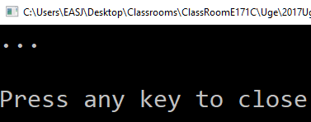
Animal
public void Sound()
{
Console.WriteLine("…");
}
Animal a = new Animal(…);
a.Sound();

Slide 47
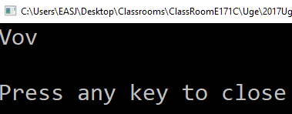
Dog
public void Sound()
{
Console.WriteLine("Vov");
}
Dog d = new Dog(…);
d.Sound();

Slide 48

Animal
Animal a = new Dog(…);
a.Sound();
30
25
20
15
10
5
Dog

Slide 49
Animal
public void Sound()
{
Console.WriteLine("…");
}
public void Sound()
{
Console.WriteLine("Vov");
}
Dog

Slide 50
Animal
public virtual void Sound()
{
Console.WriteLine("…");
}
public override void Sound()
{
Console.WriteLine("Vov");
}
Dog

Slide 51
Virtual/override
public virtual void Sound()
{
Console.WriteLine("…");
}
public override void Sound()
{
Console.WriteLine("Vov");
}
Base class: I have an imple-mentation of Sound, which a derived class may choose to override
Derived class: I do choose to override the base class imple-mentation of Sound with my own implementation

Slide 52
Animal
Animal a = new Dog(…);
a.Sound();
Dog
Polymorphic behavior

Slide 53

Animal a = new Dog(…);
a.Sound();
Animal
Dog
Vov
a
Sound(); // Dog version

Slide 54


Slide 55

List<Animal> zoo = new List<Animal>();
zoo.Add(new Cat(…));
zoo.Add(new Dog(…));
zoo.Add(new Cat(…));
foreach (Animal a in zoo)
{
a.Sound();
}
List<Animal>
Cat
Miav
Dog
Vov
Cat
Miav

Slide 56



List<Animal> zoo = new List<Animal>();
zoo.Add(new Cat(…));
zoo.Add(new Dog(…));
zoo.Add(new Cat(…));
zoo.Add(new Duck(…));
foreach (Animal a in zoo)
{
a.Sound();
}
List<Animal>
Cat
Miav
Dog
Vov
Cat
Miav
Duck
Quack

Slide 57
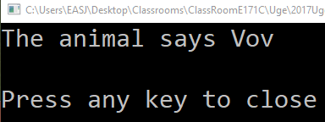
Animal
public virtual void Sound()
{
Console.Write("The animal says ");
}
public override void Sound()
{
base.Sound();
Console.WriteLine("Vov");
}
Dog

Slide 58
Inheritance Going abstract…

Slide 59
Animal
public void Sound()
{
Console.WriteLine("…");
}

Slide 60
Animal
public abstract void Sound();

Slide 61
Animal
public abstract void Sound();
Base class: I do not have an implementation of Sound, but anyone who inherits from me must implement their own version of Sound.

Slide 62
Animal
public abstract void Sound();
public abstract class Animal
{
//…
}
protected Animal(…)
{
//…
}

Slide 63
Animal
public abstract void Sound();
Animal a = new Dog(…);
Animal a = new Animal(…);

Slide 64
 | Base class implementation? | Override in derived class? | Create variables of base class type? | Create objects of base class type?
virtual | Yes | May | Yes | Yes
abstract | No | Must | Yes | No

Slide 65
public abstract class Animal
{
protected Animal(…)
{
//…
}
public abstract void Sound();
public abstract void Eat(…);
public abstract bool Sleeping { get; }
}

Slide 66
public interface IAnimal
{
void Sound();
void Eat(…);
bool Sleeping { get; }
}

Slide 67
public class Dog : IAnimal
{
public Dog(bool canHunt)
{
//…
}
public void Sound()
{
//…
}
//…
}

Slide 68
List<IAnimal> zoo = new List<IAnimal>();
zoo.Add(new Cat(…));
zoo.Add(new Dog(…));
zoo.Add(new Cat(…));
foreach (IAnimal a in zoo)
{
a.Sound();
}
List<IAnimal>
Cat
Miav
Dog
Vov
Cat
Miav

Slide 69
IAnimal
ISaveable
Dog

Slide 70
Interfaces
Think of interfaces as a minimal contract between a client and a service provider
Client: needs ”services” (methods/properties plus specifi-cation), does not care about specific implementations
Service provider: Implements interface, but has freedom with regards to how specifications are met
…but who chooses specific implementations to use?

Slide 71
public class Client
{
public void DoSomething(IAnimal a)
{
// Does not know specific animals
}
// …
}

Slide 72
Where does this happen…?
Client c = new Client(…);
IAnimal a = new Dog(…);
c.DoSomething(a);

Slide 73


