Slide 1


CAFÉ CLOUD
TEAM MEMBERS:
SAI SMRUTHI SIDDEMSETTY (CRN:13898, 700754105)
JYOTHIRLATHA PERLA (CRN:13898, 700759284)
SRIRAMA SPHOORTHY (CRN:12463, 700756577)

Slide 2
PROJECT OVERVIEW
Our project aims to streamline and automate various processes involved in planning and managing orders in a cafe. This platform will provide a user-friendly interface for customers to place online orders and improve their overall café experience.
This project involves setting up the website on AWS, configuring two environments (development and production) in different AWS Regions, and ensuring the website's functionality and accessibility. The café seeks to enhance customer experience by offering online ordering capabilities.
Enhanced café website with online ordering tends to meet customer demand. This is the more robust web application which increases customer satisfaction through improved online ordering and enables controlled testing of new features, with multi-region deployment for robust disaster recovery.

Slide 3
TECHNOLOGIES INVOLVED
Languages Used: PHP, HTML & CSS
Database: MySQL
Deployment: Using AWS Cloud

Slide 4
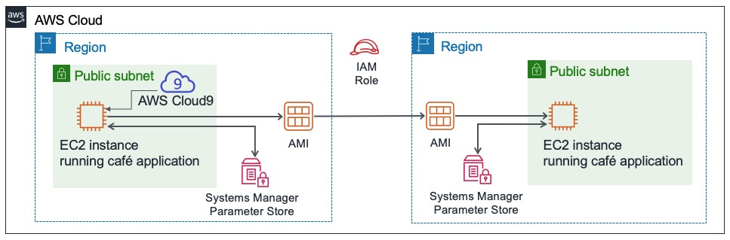
ARCHITECTURE

Slide 5

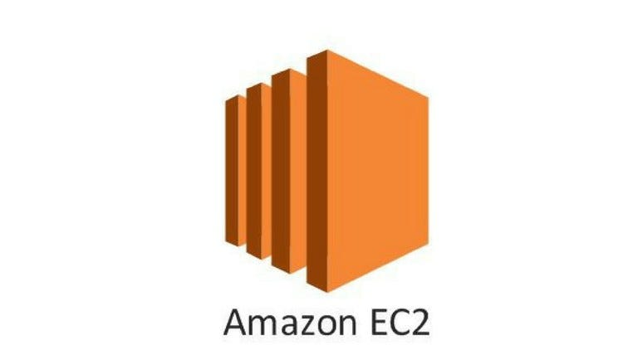
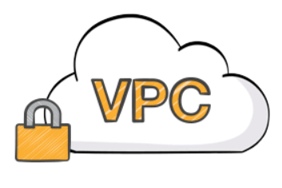



CLOUD SERVICES
IAM: To safely restrict access to the resources and services that AWS has to offer
EC2: Hosting the café's website on virtual machines in two AWS regions, one for development and one for production.
Amazon VPC: Creating isolated network environments for EC2 instances, enhancing security.
AWS Cloud9: Providing an integrated development environment for code editing and testing
Amazon S3: Storing web application and database files for data backup and recovery.
AWS Systems Manager Parameter Store: Securely managing application parameters,
enabling easy configuration changes.

Slide 6
AMAZON S3
Amazon S3, a scalable storage service by AWS, securely stores and retrieves data from anywhere on the web.
Widely employed for data backup, archival, and static website hosting, serving as a cost-effective solution.
It has fine-grained access controls and robust security, AWS S3 ensures data integrity and confidentiality.
As a versatile and scalable storage service, S3 is fundamental for diverse cloud applications, meeting modern storage needs effectively.

Slide 7
AWS CLOUD9
AWS Cloud9 is a cloud-based integrated development environment, eliminating the need for extensive local setups.
It supports collaborative coding, allowing multiple developers to work on the same project simultaneously.
Cloud9 provides a flexible coding environment with pre-installed tools for popular languages, ensuring a smooth development experience.
Beneficial for distributed teams, Cloud9 promotes collaborative coding practices, enhancing development efficiency and consistency.
Overall, AWS Cloud9 enhances development agility by eliminating the complexities associated with local environment management and promoting collaborative coding practices in a cloud-based ecosystem.

Slide 8
AWS SYSTEMS MANAGER
AWS Systems Manager provides a centralized interface for comprehensive management of AWS resources.
It enables the automation of operational tasks, improving efficiency and reducing manual efforts.
The service includes Parameter Store for secure storage of configuration data and secrets.
Systems Manager facilitates automated patching and secure instance control, enhancing operational control in AWS environments.

Slide 9
ELASTIC CLOUD COMPUTE(EC2)
Amazon EC2, a vital AWS component, offers scalable computing capacity in the cloud, allowing users to adjust resources based on their specific needs.
EC2 serves as a foundational service in various cloud computing scenarios, commonly employed for hosting applications, websites, and creating scalable environments for development and testing.
EC2 instances are versatile and well-suited for diverse workloads, including data processing, high-performance computing, and machine learning tasks, catering to a wide range of computing requirements.
EC2 seamlessly integrates with other AWS services such as Auto Scaling and Elastic Load Balancing, ensuring optimal performance and availability for applications. This integration enhances the overall efficiency of deploying and scaling virtual servers in the AWS cloud.

Slide 10
IDENTITY AND ACCESS MANAGEMENT
AWS Identity and Access Management (IAM) is a vital component in Amazon Web Services, ensuring secure management of access to diverse AWS resources.
IAM facilitates the creation and management of AWS user accounts, allowing customization of credentials and control over their access to AWS assets.
IAM provides precise control over AWS resource access, employing policies to specify allowable actions for users, groups, or roles concerning specific resources.
IAM enhances security by incorporating Role-Centric Access Control (RCAC), enabling the creation of roles with specific permissions. Additionally, IAM endorses Multi-Factor Authentication (MFA), adding an extra layer of verification for users beyond passwords.

Slide 11
AMAZON VPC
Amazon VPC allows the creation of a private, isolated network in the AWS Cloud with customizable IP addresses and network configurations.
VPC supports various connectivity options, including Internet Gateway for public access, Virtual Private Gateway for on-premises connections, and VPC Peering for interconnecting multiple VPCs.
Security groups and network ACLs enable fine-grained control over inbound and outbound traffic, enhancing network security within the VPC.
Amazon VPC seamlessly integrates with other AWS services, enabling resources within the VPC to interact with a wide range of cloud-based services.

Slide 12
ADVANTAGES
Improved Operational Efficiency: Automation streamlines processes, reducing manual efforts.
Scalability and Disaster Recovery: AWS services ensure scalability and multi-region deployment enhances disaster recovery.
Secure Data Storage: Amazon RDS prioritizes data security, protecting against breaches.
Cost-Effective Resource Management: Efficient use of AWS services and careful cost control ensures financial sustainability.
Agile Development Approach: Agile methodology allows flexibility, adaptability, and responsive system development.

Slide 13
DISADVANTAGES
User Adoption Challenges: One potential disadvantage is the challenge of encouraging user adoption. Introducing a new online ordering system may face resistance from users accustomed to traditional methods. Adequate training and user engagement strategies will be essential to overcome this hurdle.
Data Security Concerns: Managing user data securely is critical, and any lapses in data security could lead to privacy breaches. Ensuring robust security measures and compliance with data protection regulations is essential to mitigate this risk.
Technical Challenges: The project involves various AWS services and technologies, which could pose technical challenges during development and integration. Unforeseen technical issues may lead to delays or disruptions in the project timeline.
AWS Costs Management: AWS costs can escalate, especially with multiple services and a multi-region setup. Effective cost management practices are crucial to prevent exceeding the budget. Continuous monitoring and optimization of resource usage will be necessary to control expenses.

Slide 14
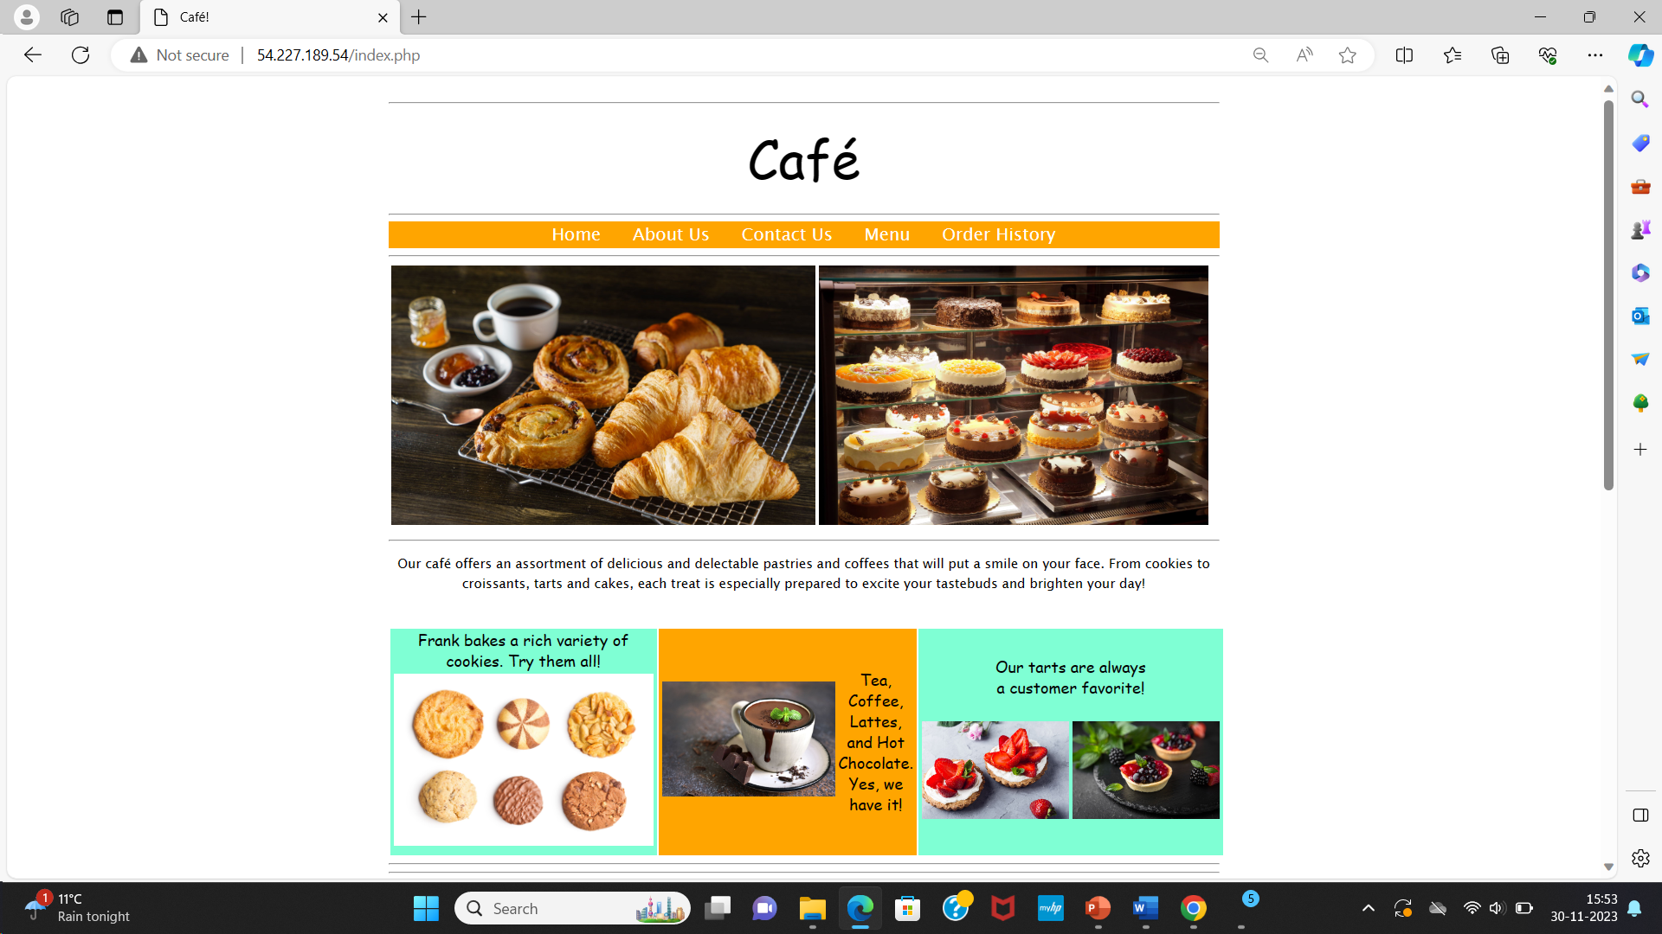
CAFÉ CLOUD APPLICATION

Slide 15
THANK YOU

