Slide 1

Structural Equation Modeling: R VS Python
Name: 李瑾
ID: g666501001
February 19, 2024

Slide 2
Introduction to SEM
Structural Equation Modeling (SEM) is a statistical technique that combines factor analysis and multiple regression analysis to analyze the relationships between observed variables and latent constructs. This approach is used to test theoretical models that include complex causal relationships among variables, allowing for both direct and indirect effects to be measured. SEM is particularly powerful for examining if a proposed theoretical model fits the data collected, making it a popular choice in social sciences, behavioral sciences, and business research.
Applications of Structural Equation Modeling (SEM): 1. Social Sciences: Widely used in psychology, sociology, education, etc., to study human behavior and societal phenomena, such as the relationship between family background, learning attitudes, and academic achievement. 2. Market Research: Businesses and market researchers use SEM to assess the relationships between brand image, customer satisfaction, and loyalty, and how these factors influence consumer purchase intentions. 3. Biostatistics and Medical Research: In biostatistics, SEM is utilized to analyze complex relationships between gene expression data, disease risk factors, and the likelihood of illness. 4. Environmental Science: Models the impact of environmental behavior on human health, e.g., assessing the potential impact of air pollution levels on public health. 5. Economics and Finance: SEM is applied to analyze issues related to economic policy, market structure, and financial risk management, exploring interactions between macroeconomic variables.

Slide 3
Overview
SEM in statistical analysis is reflected in several aspects:
1. Analysis of Multivariate Relationships: SEM allows for the complex analysis of relationships between multiple dependent variables, revealing direct and indirect effects and providing a comprehensive analytical perspective that traditional statistical methods, like linear regression, cannot achieve.
2. Modeling of Latent Variables: A key feature of SEM is its ability to include latent variables, which are not directly observable or measurable. The introduction of latent variables helps explain the relationships between observed variables, making the model closer to theoretical constructs.
3. Hypothesis-driven Research: SEM is a hypothesis-driven approach that requires researchers to build models based on theory or prior research. This methodology necessitates a clear statement of expected causal relationships, contributing to the rigor of scientific research and the development of theory.
4. Model Fit Assessment: SEM offers a range of statistical measures to assess how well a model fits the actual data, such as chi-square statistics, Comparative Fit Index (CFI), and Root Mean Square Error of Approximation (RMSEA), helping researchers evaluate the effectiveness of the model and determine if adjustments are necessary.
5. Analysis of Complex Data Structures: SEM supports the analysis of complex data structures, including longitudinal data over time and multilevel data. This makes SEM applicable across a broad range of disciplines, accommodating different types of data analysis needs.

Slide 4
Case Study
Young people's perceived service quality and environmental performance of hybrid electric bus service
年轻人对混合动力公交车（HEB）环境绩效的服务质量感知
H1:Tangible feature of HEBs is positively associated with young people’s customer satisfaction.
混合动力公交车的有形特征与年轻人的客户满意度呈正相关。
H2:HEB driver’s quality is positively associated with young people’s customer satisfaction.
混合动力公交车司机的服务质量与年轻人的客户满意度呈正相关。
H3:HEB service provider’s empathy is positively associated with young people’s customer satisfaction.
混合动力公交车司机的同理心与年轻人的客户满意度呈正相关。
H4:Young people’s perceived environmental performance with HEBs is positively associated with customer satisfaction.
混合动力公交车的环境绩效感知年轻人客户满意度呈正相关。
H5:Young people’s customer satisfaction with HEBs is positively associated with life satisfaction of young people.
混合动力公交车的客户满意度与年轻人的生活满意度呈正相关。

Slide 5
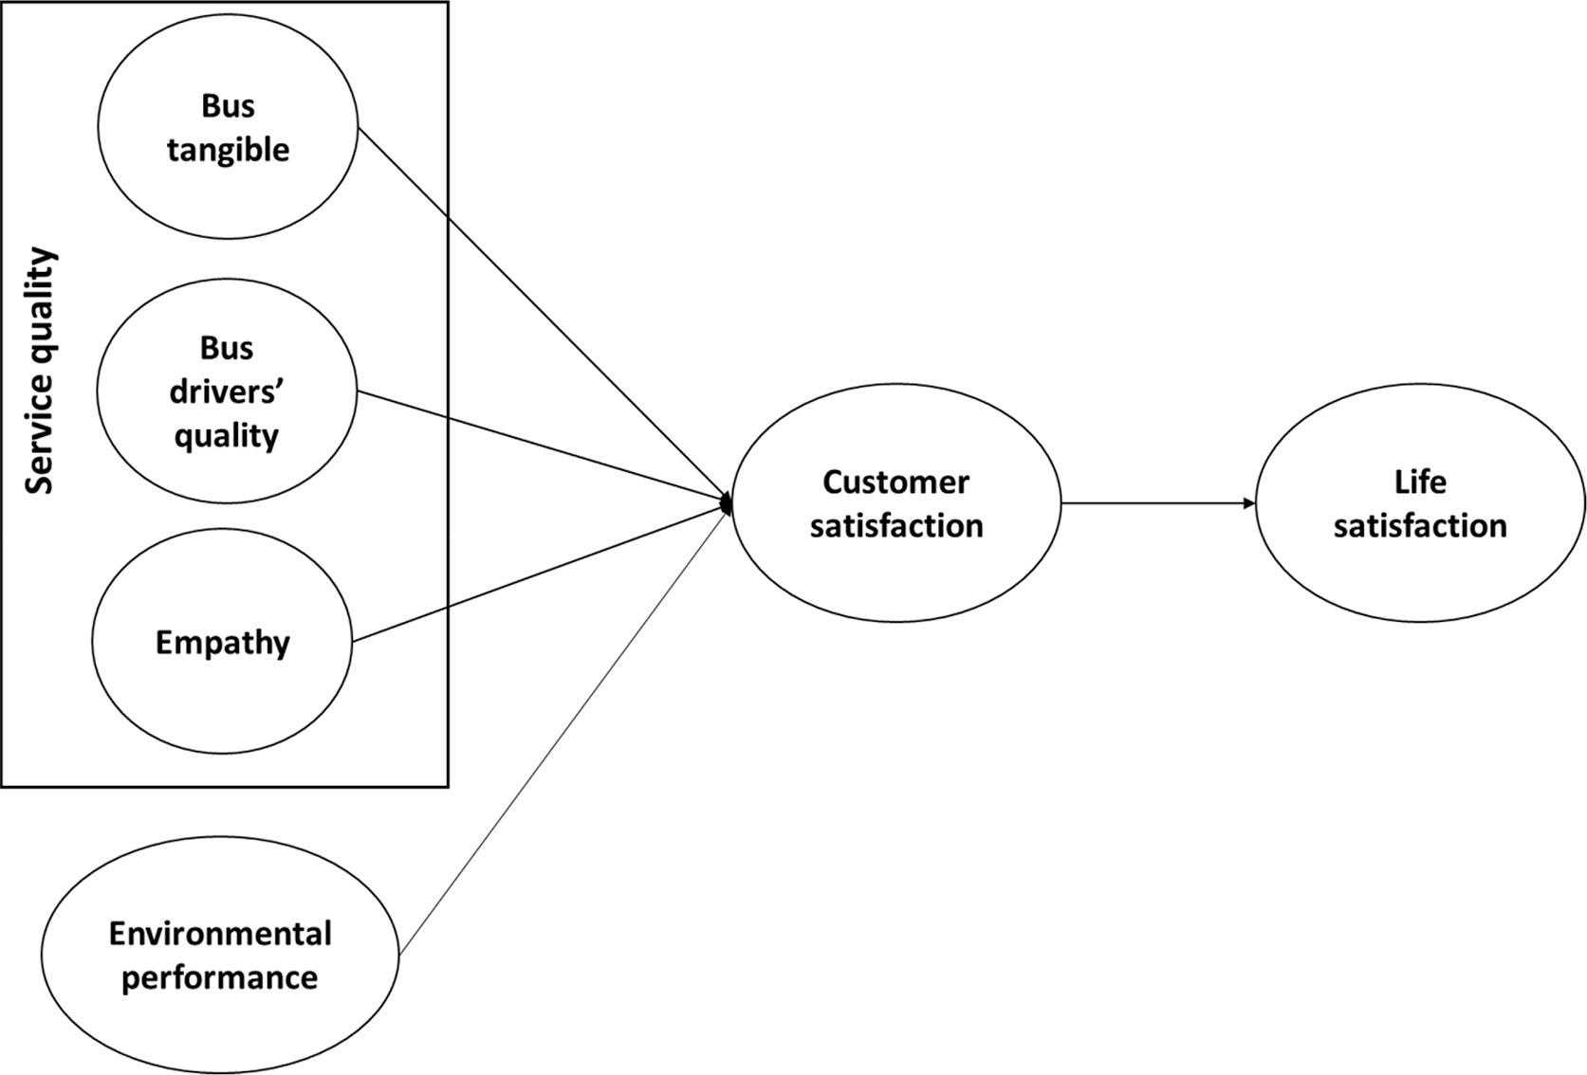
Case Study – Conceptual Framework Diagram

Slide 6
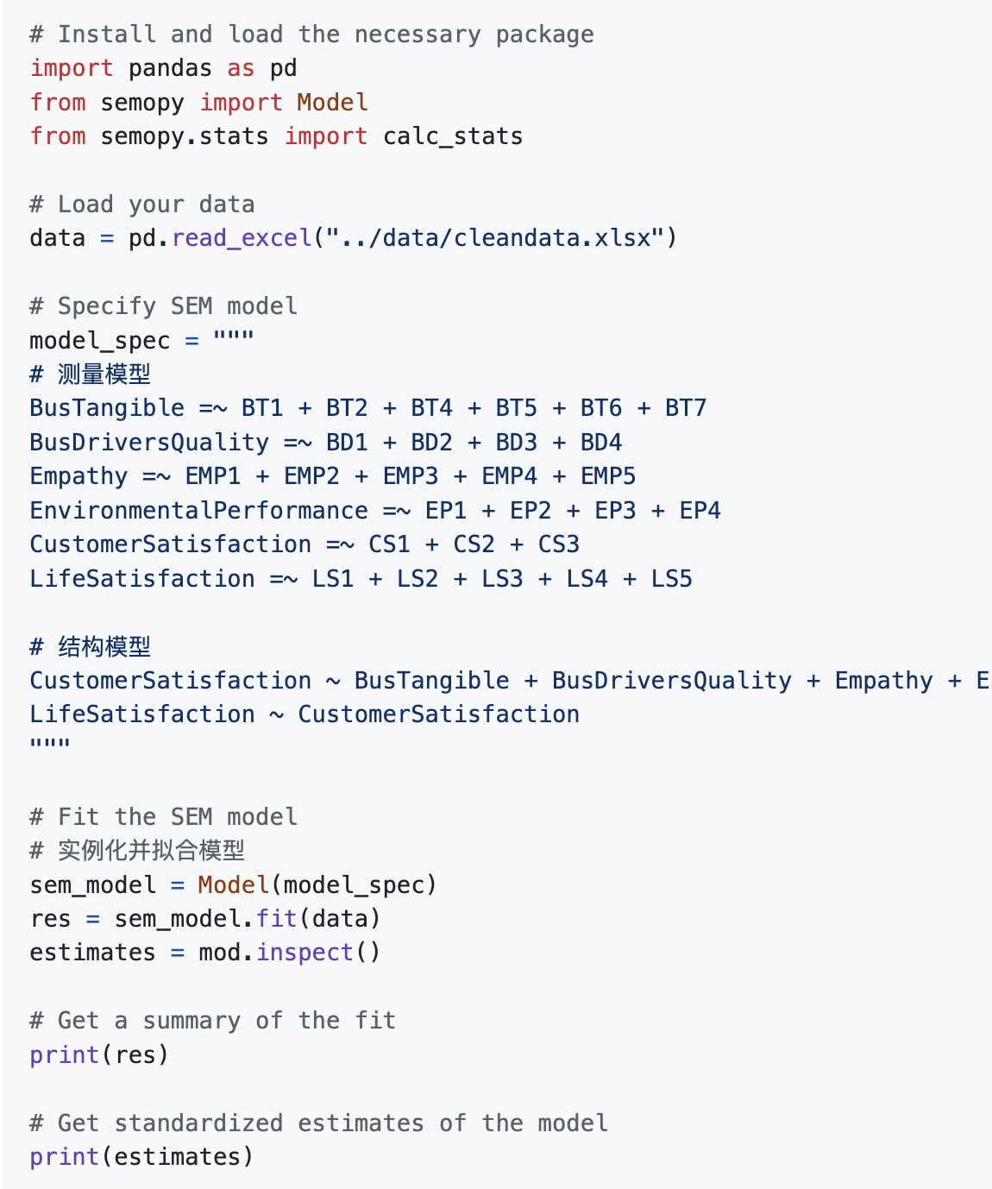
Python implementation of SEM
Basic Environment
Language: python3
IDE: Jupyter Notebook、Anaconda、pycharm
Library: semopy
代码：https://github.com/githubjli/R-vs-python/tree/main/src

Slide 7
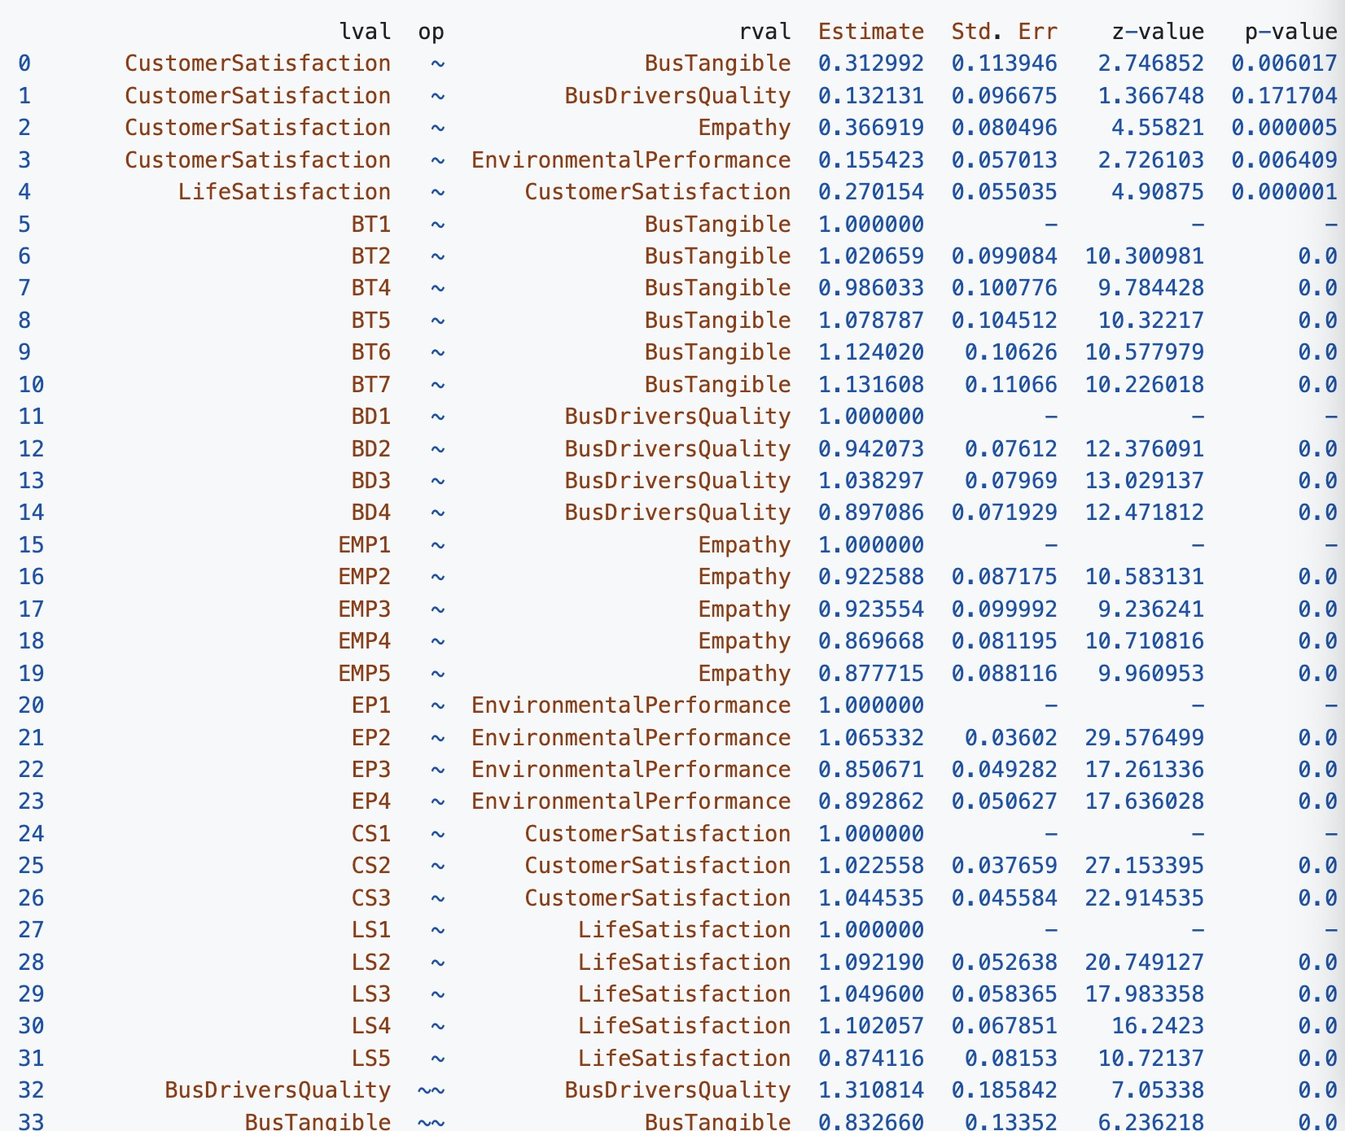
Python Output
The Python output shows the results of the structural equation model (SEM) analysis, including the independent variables (rval column), dependent variables (lval column), and the estimated coefficients (Estimate), standard errors (Std. Err), z-values (z-value), and p-values (p-value) for the relationships between them.
Both z-values and p-values are used to assess the statistical significance of the results, but they represent different aspects.
CustomerSatisfaction ~ BusTangible represents the relationship between customer satisfaction (dependent variable) and bus tangible features (independent variable). The estimated coefficient (Estimate) shows the size and direction of this relationship, while the p-value tells us whether this relationship is statistically significant.
代码：https://github.com/githubjli/R-vs-python/tree/main/src

Slide 8
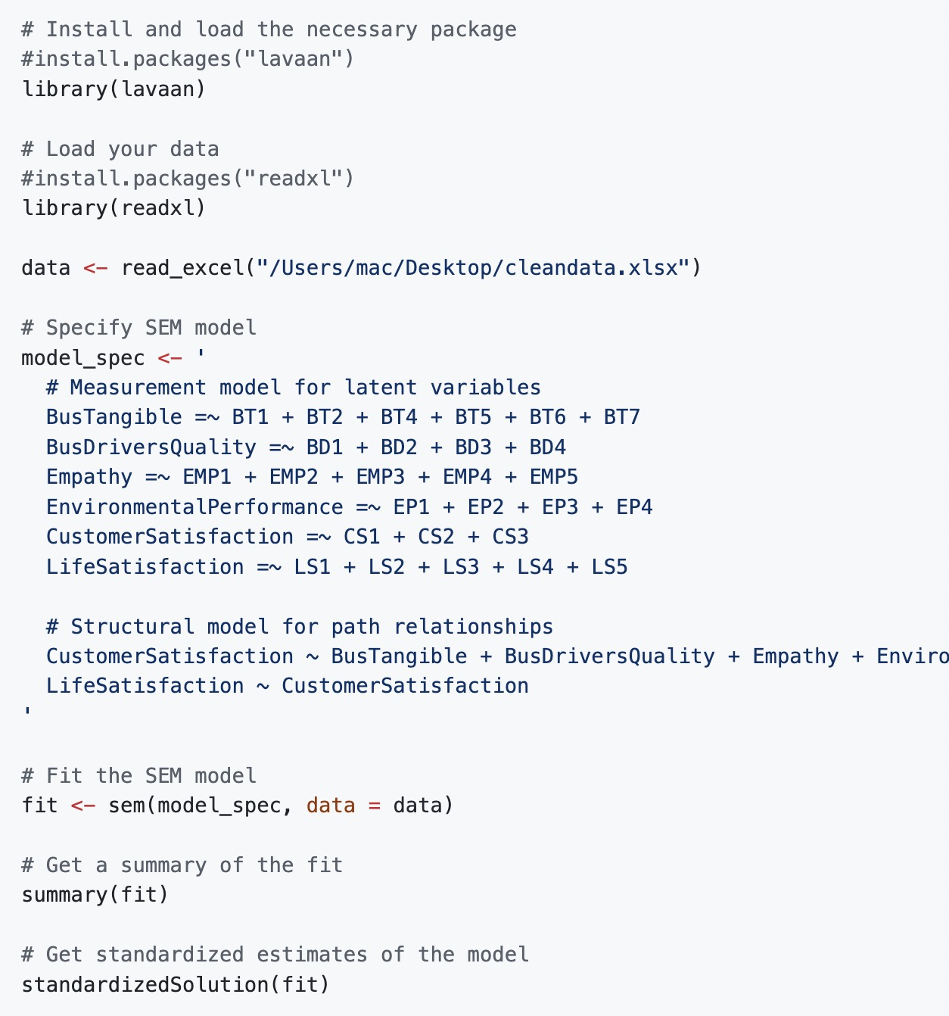
R Implementation of SEM
Basic Environment
Language : R
IDE: RStudio
Library : lavaan
代码：https://github.com/githubjli/R-vs-python/tree/main/src

Slide 9
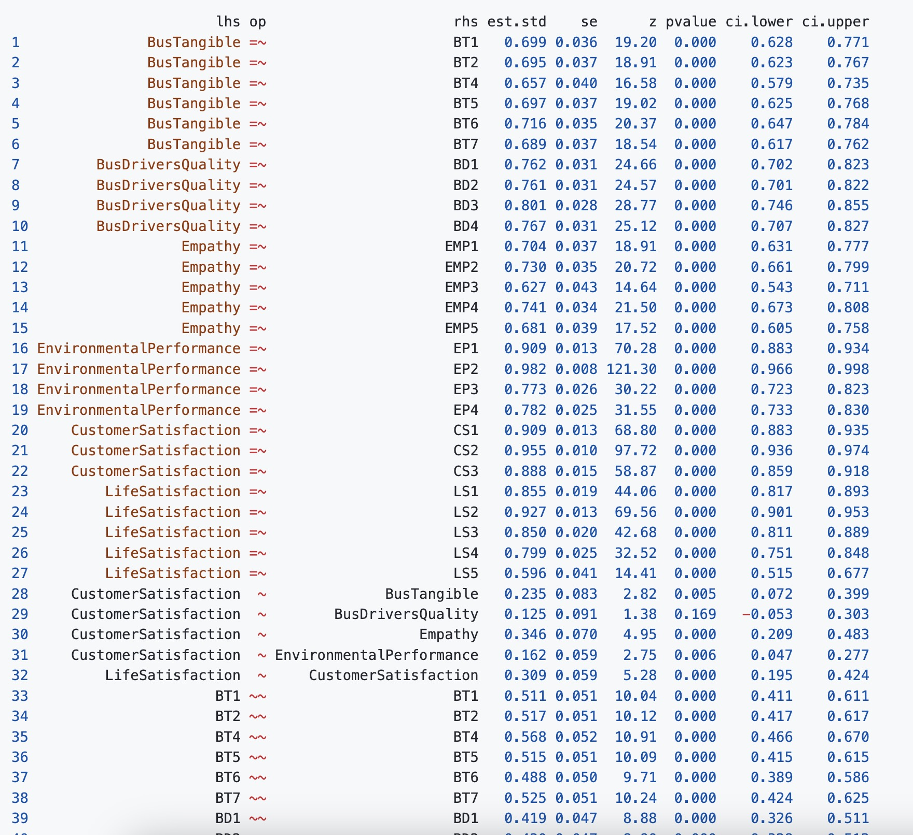
R Output
The output from R shows detailed results of the structural equation model (SEM) analysis, including the relationships between variables in the model. Here, lhs represents the left-hand side variable (dependent variable), op represents the operator (~= for measurement model indicator variables, ~ for structural model regression relationships, ~~ for variances or covariances), rhs represents the right-hand side variable (independent or latent variable), est.std is the standardized estimate, se is the standard error, z is the z-value, pvalue is the p-value, and ci.lower and ci.upper are the lower and upper bounds of the confidence interval.
Independent Variables: Typically located in the rhs column, indicating the variables in the model that serve as predictors.
Dependent Variables: Typically located in the lhs column, indicating the variables in the model that are predicted or explained.
代码：https://github.com/githubjli/R-vs-python/tree/main/src

Slide 10
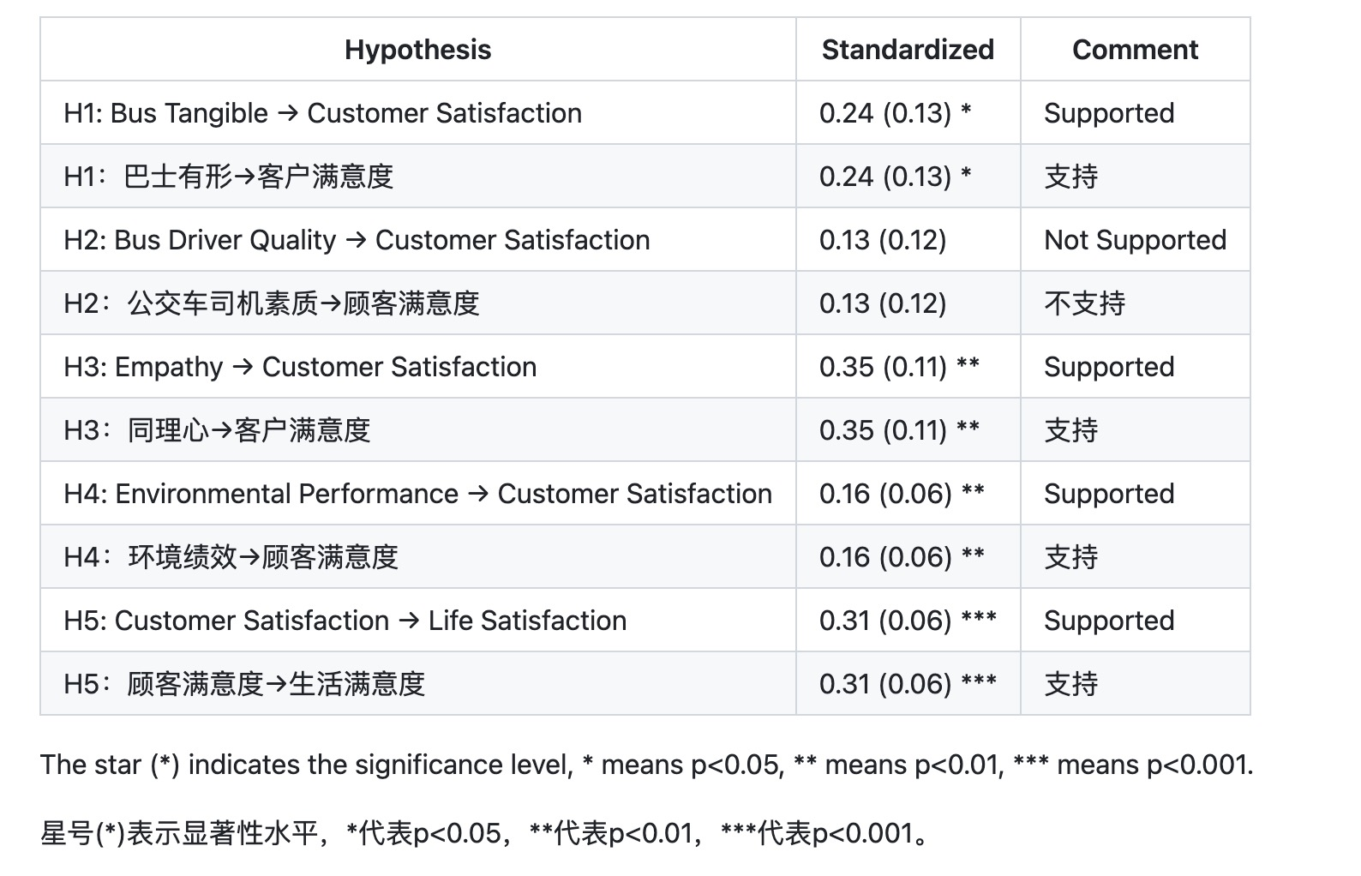
Case Study Conclusion

Slide 11
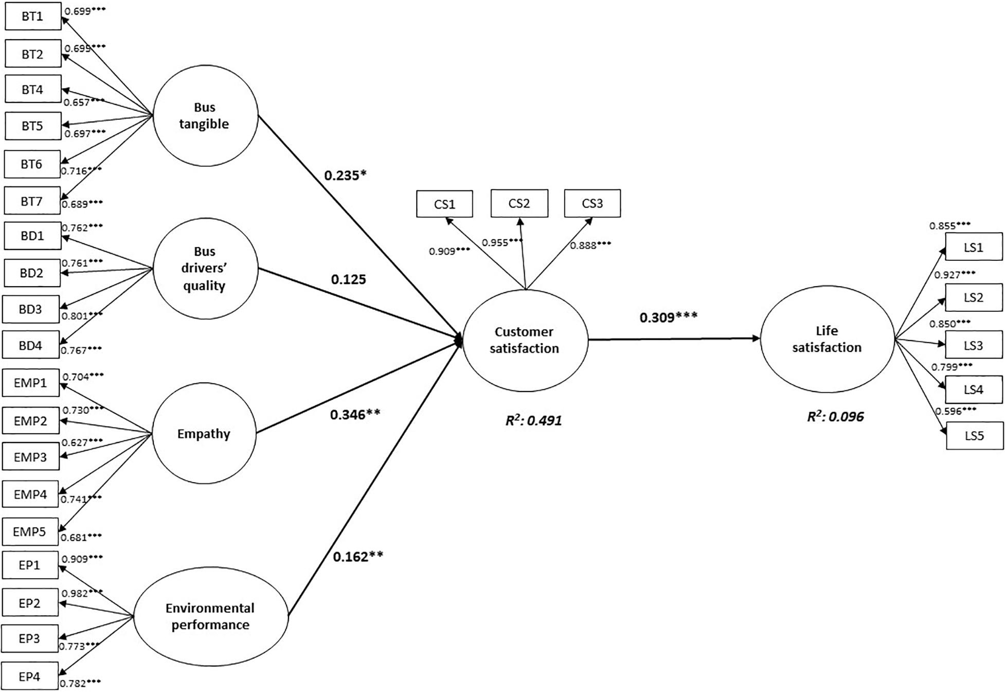
Case Study Conclusion

Slide 12
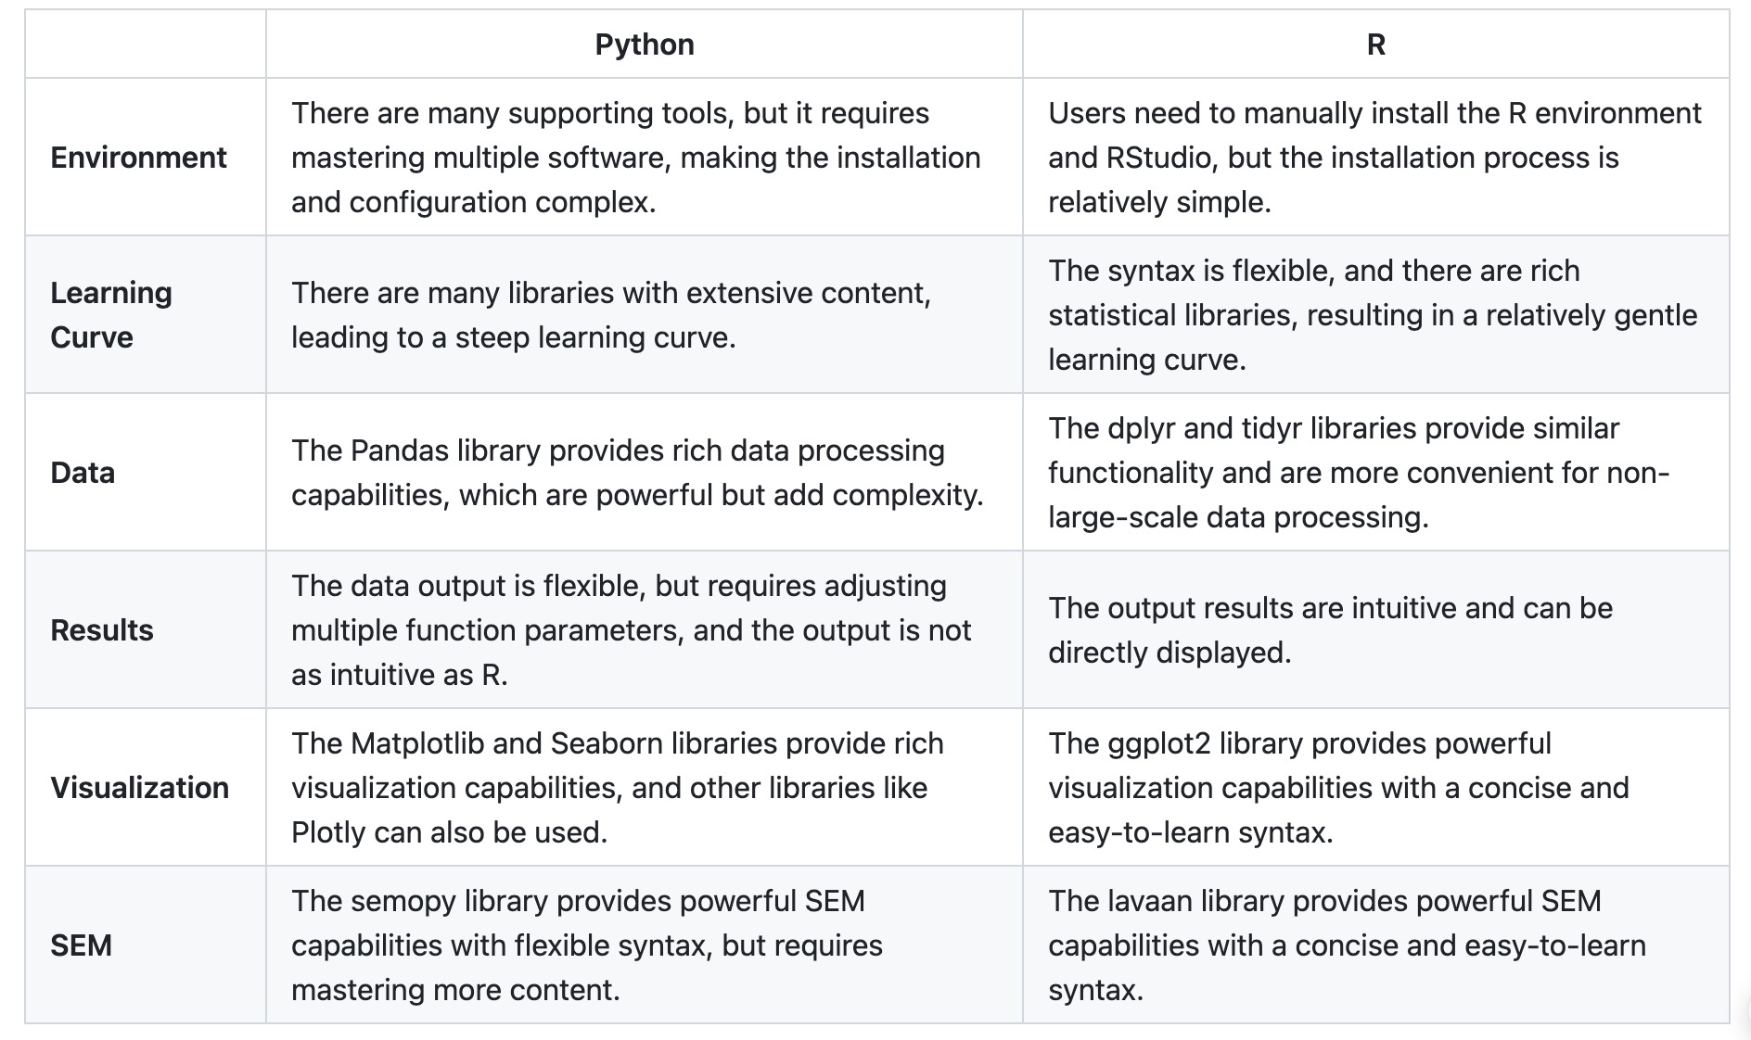
Python vs R - English

Slide 13
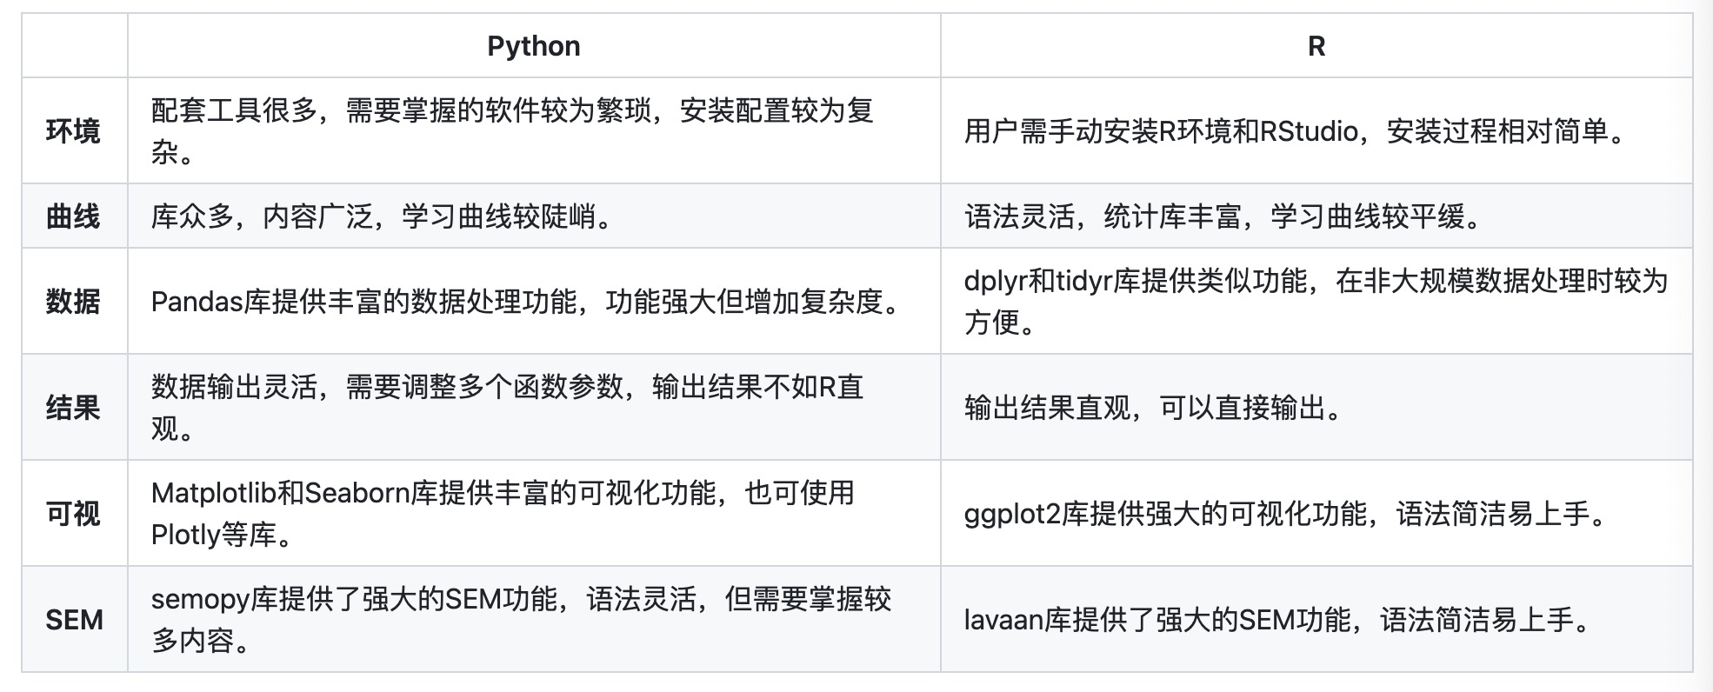
Python vs R - Chinese

Slide 14
Conclusion
Python and R are both mainstream programming languages in the field of data science, each with its unique advantages and characteristics.
In terms of implementing Structural Equation Modeling (SEM), Python's semopy and R's lavaan both provide powerful capabilities and flexible syntax to meet users' needs for SEM analysis.
However, for beginners, Python has a steeper learning curve and requires mastering more content, while R's syntax is more flexible, and it has a richer set of statistical libraries, resulting in a gentler learning curve.
For researchers in the social sciences, R may be the better choice.

Slide 15
END
https://github.com/githubjli/R-vs-python/tree/main/src

