Slide 1
Pilot Join Analysis
PerLa Language
Step 1
State of the Art -

Slide 2
What is the Pilot Join?
“A special operation that allows dynamic changes in the set of logical objects executing a specific Low Level Query, based on the results produced by another running query.”
...
“...it forces each involved logical object to start (or stop) the query execution if the joined stream contains (or not) a record that matches the current value of logical object attributes...” [1]
<Pilot Join Clause> PILOT JOIN <Correlated Table List>
<Correlated Table List> <Correlated Table> { ‘,’ <Correlated Table> }*
<Correlated Table> <Data Structure Name> ON <Condition>
E.g.:
PILOT JOIN BaseStationList ON
currentBaseStation = baseStationList.baseStationID

Slide 3
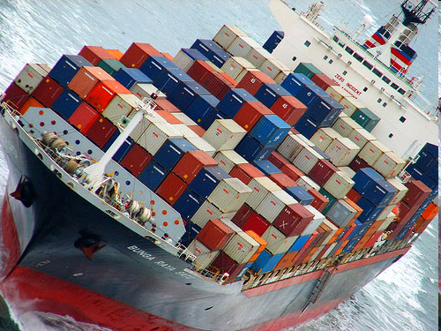
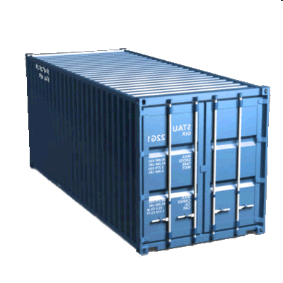
Pilot Join Example
Suppose we want to monitor the temperature of some containers inside a container ship [2]
BUT
We are more interested in those containers exposed at direct sunlight
(sampled every hour)
Photo by Patrick Boury (CC)
Every container has a light sensor on the outside, and a temperature sensor in the inside, not directly connected to each other.
Light sensor
Temperature sensor

Slide 4
Pilot Join Example
CREATE SNAPSHOT UnderTheSun (sensorID ID, light FLOAT, containerID ID)
WITH DURATION 1 h AS
LOW:
SELECT ID, light, containerID
SAMPLING EVERY 1 h
WHERE light > [threshold]
EXECUTE IF deviceType = “LightSensor”
CREATE OUTPUT STREAM Temperatures (sensorID ID, temp FLOAT, containerID ID) AS
LOW:
EVERY ONE
SELECT ID, temp, containerID
SAMPLING EVERY 1 m
PILOT JOIN UnderTheSun ON UnderTheSun.containerID = containerID
EXECUTE IF EXISTS (ALL)

Slide 5
Pilot Join definition
“PILOT JOIN is the key feature enabling the execution of context dependent queries: the content of the joined stream is a description of the current environmental situation, while the join condition defines the context-aware data tailoring the user is interested in.” [1]
This function adds context-awareness to the system, but some questions arise:
Is it the best way to model context-awareness?
Is it easy to be used in some complex cases?
Is there another (more powerful) way to implement a context-aware
WSN using a declarative language?
> Is someone else working on the same topic? <

Slide 6


Who is working on the topic?
An extended survey was made, analyzing about 15 related papers from 2004 to 2008 coming from different research laboratories around the world.
An analysis of similarities with PerLa was also performed.

Slide 7
Brief comparison w.r.t. Integration of context-awareness and Intelligence level (e.g. Context Discovery)
Intelligence level
4
3
6
10
12
5
7
9
2
1
PerLa
8
11
TinyDB
Context-awareness integration level

Slide 8

Key Ideas
Context Reification
  Explicit location for context information enables a reliable cross-context usage (e.g. Context node [2][3])
Context Nesting
  The capability of nesting different contexts allows to define subcontexts which validity depends on the upper context
Context Temporal Management
  A context may be valid only in a given time interval, keeping it explicit allows an easier management of time
Context Discovery
  By analyzing sensor data it is also possible to discover new contexts,
  not previously defined
Multiple Contexts per sensor
  A sensor may join different contexts at the same time (eg. low battery sensor and exposed to sunlight) [4]
Context Priority
  When orders to sensors interfere for active contexts, use priority information for each context

Slide 9
Key Ideas
The Pilot Join operation could be rethought in terms of explicit context, allowing PerLa to become a full context-aware system
But how to practically implement such a system?

Slide 10
Implementation
The context awareness in WSN is implemented in very different ways, but the key factor is to keep it work under a declarative language.
As an example, in [4][8][9][5] the concept of a declarative language is present, in other works is mentioned but no further detail is given (e.g. [10][7])

Slide 11
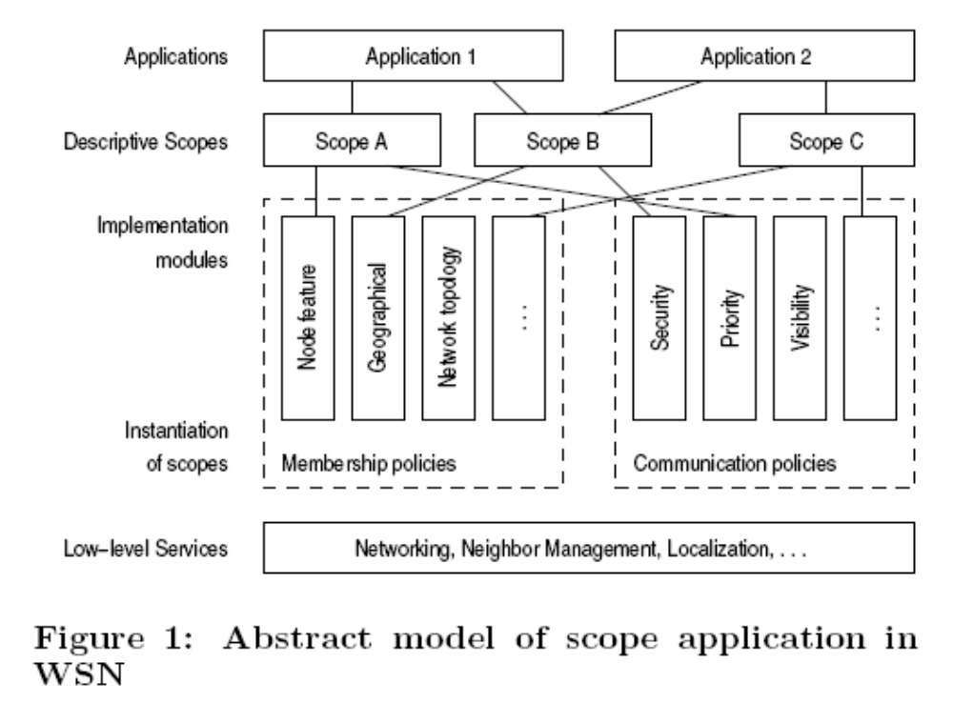
Some examples
Some conceptual schemata of various systems are presented here:
From [2]

Slide 12
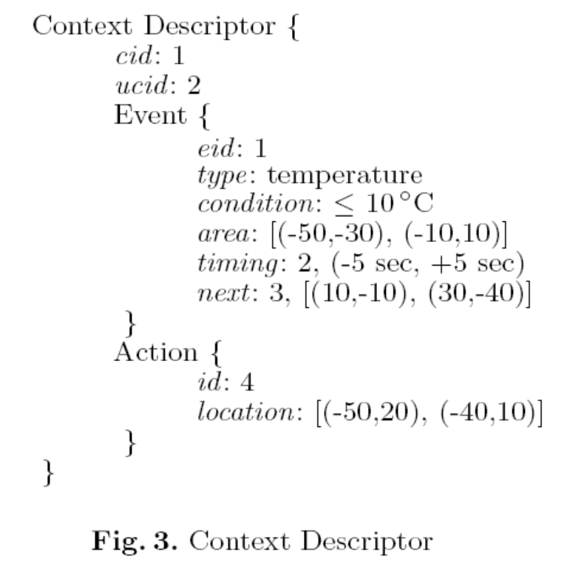
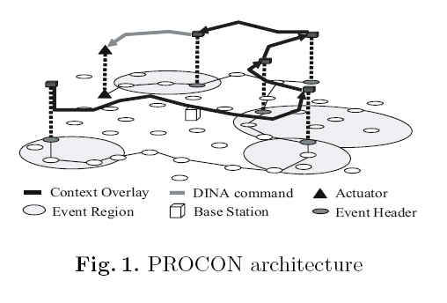
Some examples
Some conceptual schemata of various systems are presented here:
From [4]

Slide 13
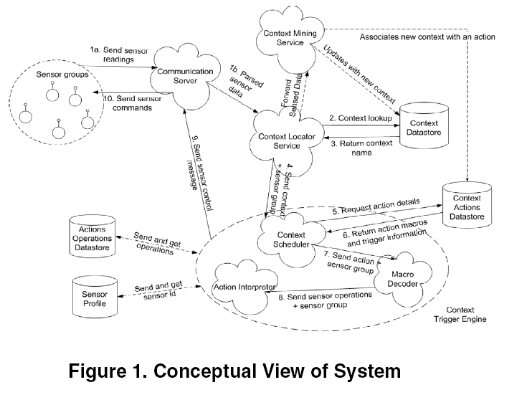
Some examples
Some conceptual schemata of various systems are presented here:
From [3]

Slide 14
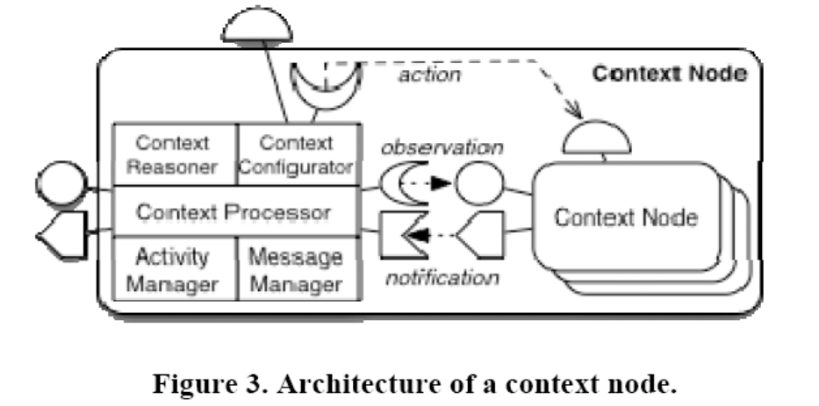
Some examples
Some conceptual schemata of various systems are presented here:
From [7]

Slide 15
Context-aware examples
Monitor the tampering sensor of the accessible containers when the ship is docked (GPS): if tampering is detected monitor nearby containers at higher frequency
(Four contexts may be involved, but the last one is created only after the other ones)
Photo by Patrick Boury (CC)
Tampering sensor

Slide 16
Context-aware examples
Every container with low sensor batteries must be monitored at a lower frequency, but if it is exposed to direct sunlight, it must be monitored at a higher frequency
(Two concurrent contexts are involved, but the last one has a higher priority and overrides the sampling frequency defined by the first one)
Photo by Patrick Boury (CC)
Every container with fresh food must be monitored after one hour since direct sunlight is detected, for a maximum time of three hours. Every 30 sec.
(Temporal dependent context is involved: the context is created after the sunlight detection, but it is activated after one hour)

Slide 17
Context-aware examples
Monitor the data correlation between temperatures, if an unexpected situation is detected (e.g. outliers detection) create a new context and raise an alarm
(e.g. a fire is spreading on the ship, but this event wasn’t defined!)
Photo by Patrick Boury (CC)

Slide 18
Implementation in PerLa
How would it be possible to extend the Pilot Join in PerLa to enhance context-awareness, given the results of the other research teams?
Some ideas:
Add data structures for explicit context (just like the SNAPSHOT)
Create a Context Manager which enables active management of contexts
Formally define the behavior of context tables
Think about intelligent Context Discovery (for the future)

Slide 19
Future work...
This presentation was just the first step
The next step will deal about the definition of suitable data structures to enable the context awareness in PerLa, in order to enhance the PILOT JOIN with a more powerful and general approach
BUT
...always keeping in mind the trade-off between a simple implementation and a powerful, yet usable, system

Slide 20
Bibliography
[1] A Middleware Architecture for Data Management and Integration in Pervasive Heterogeneous Systems
F.A. Schreiber, R. Camplani, M. Fortunato, M. Marelli
Politecnico di Milano, Dipartimento di Elettronica e Informazione, Milano, Italy
[2] Scoping in Wireless Sensor Networks
Jan Steffan Ludger Fiege Mariano Cilia Alejandro Buchmann
Department of Computer Science, Darmstadt University of Technology
[3] A Context-Aware Approach to Conserving Energy in Wireless Sensor Networks
Chong, Krishnaswamy, Loke
School of Computer Science and Software Engineering
Monash University,Melbourne, Australia
[4] Proactive Context-Aware Sensor Networks
Sungjin Ahn and Daeyoung Kim
Real-time and Embedded Systems Laboratory,
Information and Communications University (ICU)
[5] Energy Efficient Spatial Query Processing in Wireless Sensor Networks
Kyungseo Park, Byoungyong Lee, Ramez Elmasri
Computer Science and Engineering, University of Texas at Arlington
[6] Context-Aware Sensors
Eiman Elnahrawy and Badri Nath
Department of Computer Science, Rutgers University

Slide 21
Bibliography
[7] A Self-Adaptive Context Processing Framework for Wireless Sensor Networks
Amirhosein Taherkordi, Romain Rouvoy, Quan Le-Trung, and Frank Eliassen
University of Oslo, Department of Informatics
[8] A spatial extension of TinyDB for wireless sensor networks
Paolino Di Felice, Massimo Ianni, Luigi Pomante
DlEI DEWS - Universita dell'Aquila, Italy
[9] Efficient and Practical Query Scoping in Sensor Networks
Henri Dubois-Ferri`ere
School of Computer and Communication Sciences
EPFL Lausanne, Switzerland - Department of Computer Science UCLA, Los Angeles, CA
[10] Adaptive middleware for contextaware applications in smarthomes
Markus C. Huebscher DSE Group, Department of Computing Imperial College London
Julie A. McCann DSE Group, Department of Computing Imperial College London
[11] TinyDB: An Acquisitional Query Processing System for Sensor Networks
SAMUEL R. MADDEN Massachusetts Institute of Technology
MICHAEL J. FRANKLIN and JOSEPH M. HELLERSTEIN UC Berkeley
WEI HONG Intel Research, Berkeley
[12] Context Discovery in Sensor Networks
Chia-Hsing HOU, Hung-Chang Hsiao, Chung-Ta King, Chun-Nan Lu
Computer Science, National Tsing-Wua University, Hsinchu, Taiwan,

