Slide 1

Dispatches from Raku
The Perl and Raku Conference | 2022 – Houston, TX
Talk by: codesections <§> Daniel Sockwell
daniel@codesections.com

Slide 2
Dispatches from Raku
New Dispatch Mechanism
↪ 6guts.wordpress.com/2021/0 9/29/the-
new-moarvm-dispatch-mechanism-is-here/

Slide 3
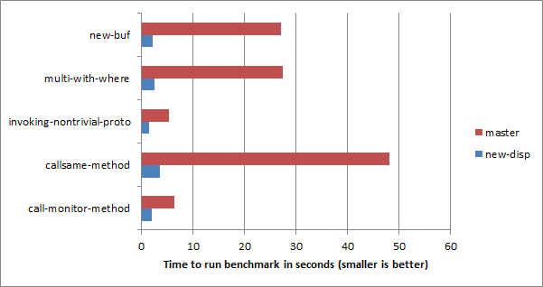
Dispatches from Raku

Slide 4
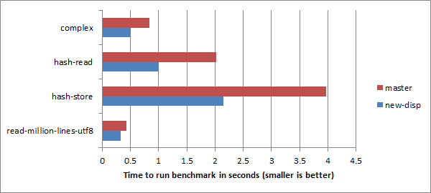
Dispatches from Raku

Slide 5
Dispatches from Raku
Many perf improvements
↪ github.com/rakudo/rakudo/pull/4536
Raku AST runs (in testing)
↪ conf.raku.org/talk/147
Fez ecosystem
↪ deathbyperl6.com/faq-zef-ecosystem
OSDEM Dev Room
↪ fosdem.org/2022/schedule/track/raku/

Slide 6
Dispatches from Raku
Improved immutability
↪ github.com/rakudo/rakudo/pull/4536
First CoC Application
↪ raku.github.io/Raku-Steering-Council/papers/CoC
The Raku Conf
↪ conf.raku.org
FOSDEM Dev Room
↪ fosdem.org/2022/schedule/track/raku/

Slide 7
Dispatches from Raku
The Perl and Raku Conference | 2022 – Houston, TX
Talk by: codesections <§> Daniel Sockwell
daniel@codesections.com

