Slide 1
Thinkful Data Science Capstone
A Treatise in Anomaly Detection Methods
In CyberSecurity

Slide 2
Problem Statement
Detecting Malicious Activity in corporations today is a real-world problem
Determining where this malicious activity occurs often requires anomaly detection, where abnormal behavior can be evaluated by Analysts.
In order to minimize the time Analysts have to spend on investigating anomalies, it is important to use the best-possible anomaly detection models

Slide 3
Background
Multi-modal Anomaly Detection
  Time Series Analysis
  Kalman Filters
  OneClass Support Vector Machine

Slide 4
Data
Insider Threat Test Dataset
Available from Carnegie Mellon University, Software Engineering Institute
https://resources.sei.cmu.edu/library/asset-view.cfm?assetid=508099
Multi-modal data sources include:
  Email Log data (similar to Exchange data)
  HTTP Log data (similar to proxy log data)
  Authentication Log data (similar to Windows Event Logs)

Slide 5
Kalman Filters

Slide 6
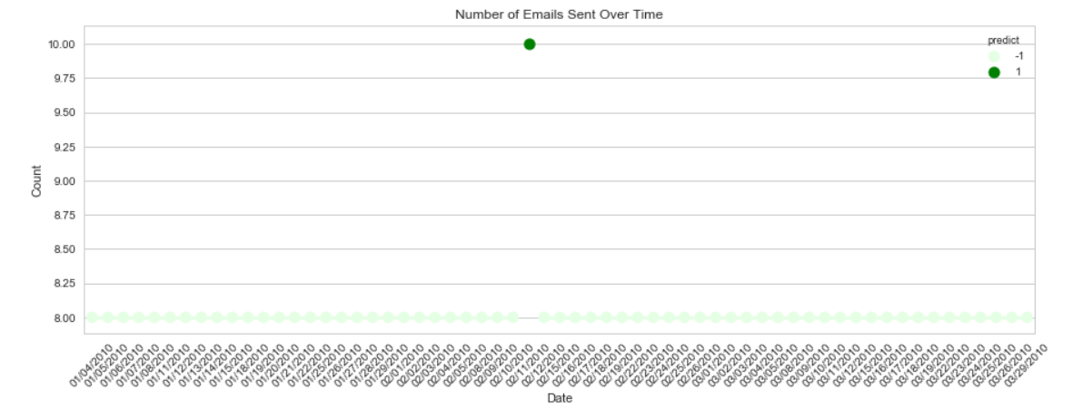
Detecting Anomalies in Email Usage
OneClass SVM

Slide 7
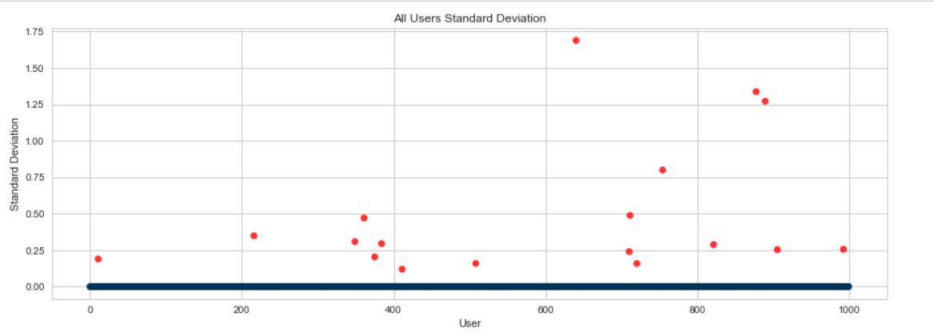
Impact Analysis OneClass SVM
Total Number of Users: 1000
Total Number of Anomalous Users: 18

Slide 8
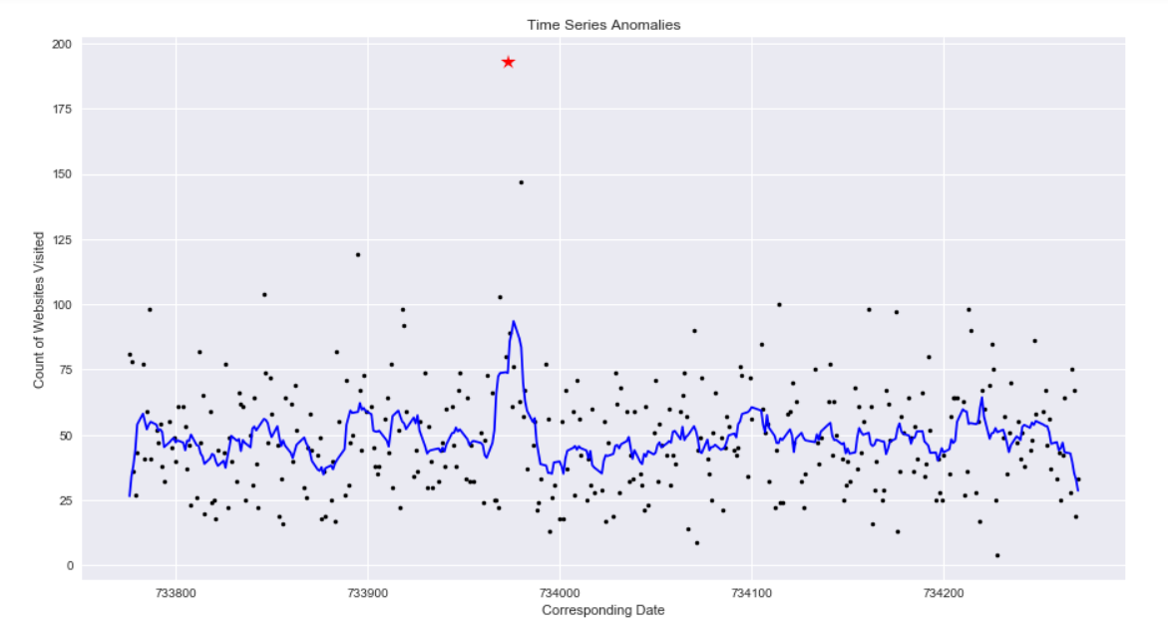
Time Series Anomalies Website Visits

Slide 9
Time Series Anomaly Impact Analysis
Total Number of Users: 1000
Total Number of Anomalous Users: 31

