Slide 2
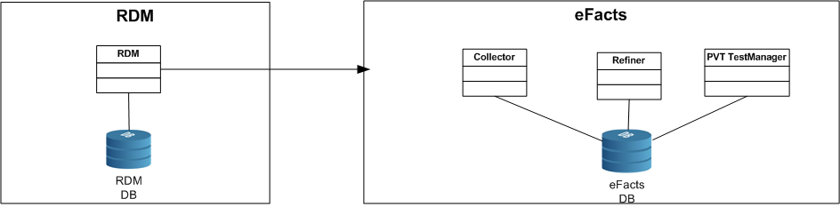
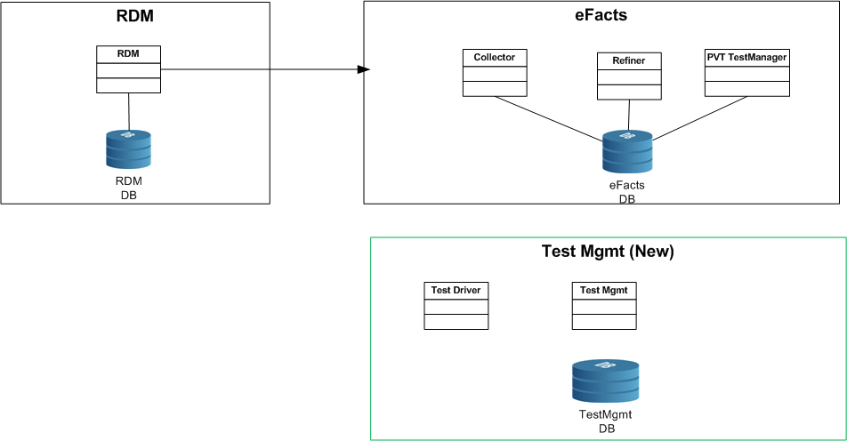
Before
After

Slide 3
Logical Order
Test Mgmt (New)
Test Driver (New)
RDM (Rebuild ?)
eFacts (New)

Slide 4
Alt 1
Rebuild & deploy complete Scope
Alt 2
1:
Build Test Mgmt (New)
Deprecate PVT Test Mgr
Stabilize RDM
2:Build Test Driver

