Slide 1
Test Management
Technologies

Slide 2
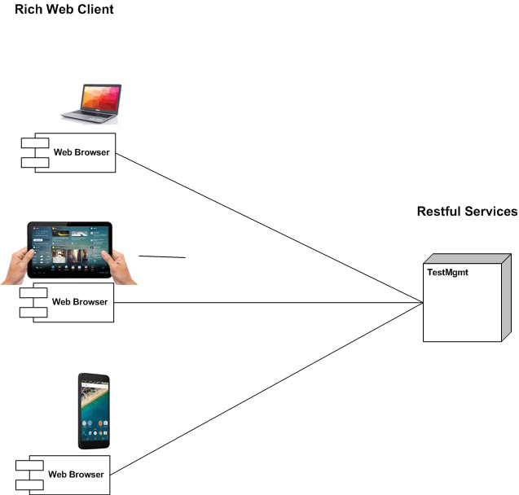
Rich Web Client – Restful Services

Slide 3
Rich Web Client – Restful Services
Portability
Client not tied to a desktop/laptop
Also mobile,tablet other devices
Same Client/Server technology used for all solutions

Slide 4
Technology

Slide 5
Reuse Gloria Technologies
Gloria as reference Architecture
Design examples
Code examples
Competence re-use

