Slide 2

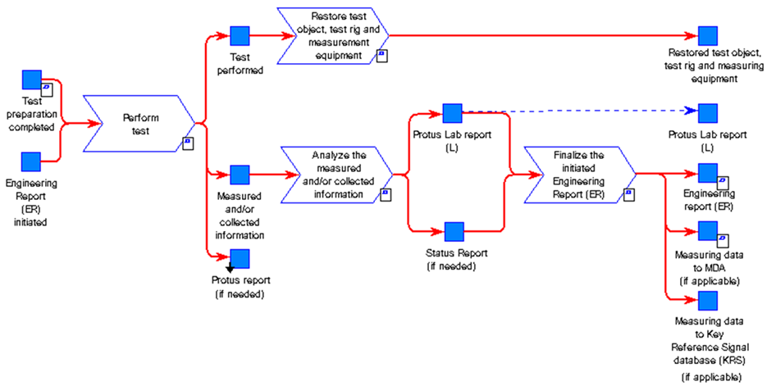
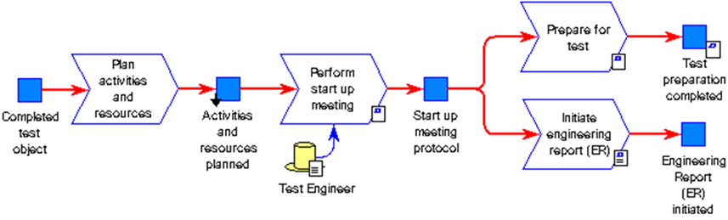


TO-BE
GTDM & TCP – Conceptual map
Test Collaboration Platform
GTDM Scope
Up- date
Re-plan
BOSS
GHOST
Test Manager
Incl Test Module?
HPG Planning tool
AXXOS
V&V plan
Defines acceptance criteria and methods. Selecting test objects and create time plan.
Test request
Based on V&V plan the test should be initiated e.g. n-8 weeks before the actual test should start.
In order to secure parts, material, resources and test object build. Quotation secured.
Plan activities and resources All needed resources and budget is secured.
Prepare for test The test object is
e.g. prepared with measurement equipment. The test procedure and method is prepared and secured.
Analyze/Reporting
Perform test Measurement systems and tools are efficient and control and give support during the test execution. E.g. test procedure, KPI, progress and status is available (results/running/faults found).
PROTUS
Vehicle Logging Tool
Data handling
Results and data are analyzed, documented and published. The data is also made available to upload for analysis or as input for future testing.
GHOST incl Test Module ?
Data information exchange
”Test Collaboration Platform”

Slide 3
Test Collaboration Platform
Up- date
Re-plan
V&V plan
Defines acceptance criteria and methods. Selecting test objects and create time plan.
Test request
Based on V&V plan the test should be initiated e.g. n-8 weeks before the actual test should start.
In order to secure parts, material, resources and test object build. Quotation secured.
Plan activities and resources All needed resources and budget is secured.
Prepare for test The test object is
e.g. prepared with measurement equipment. The test procedure and method is prepared and secured.
Perform test Measurement systems and tools are efficient and control and give support during the test execution. E.g. test procedure, KPI, progress and status is available (results/running/faults found).
Data handling
Results and data are analyzed, documented and published. The data is also made available to upload for analysis or as input for future testing.

