Slide 1
Current Symptom/Problem
Symptom
Difficult to understand context of JIRA-item
Product backlog items are on different levels
Difficult to analyse and Prioritize functionality
Hard to understand the activities on Kanban Board
Things are fallen between chairs
Who is working on tasks is not so visible

Slide 2
Gloria is the product
Business has requirement perspective
Requirements are expressed as
Acceptance criterias
UI-Prototypes
Product backlog shows the requirement perspective
IT has solution perspective
Defines a solution from high -> low level
Kanban board should show IT activities :
Design of Page x,Impl. of Service y ...

Slide 3
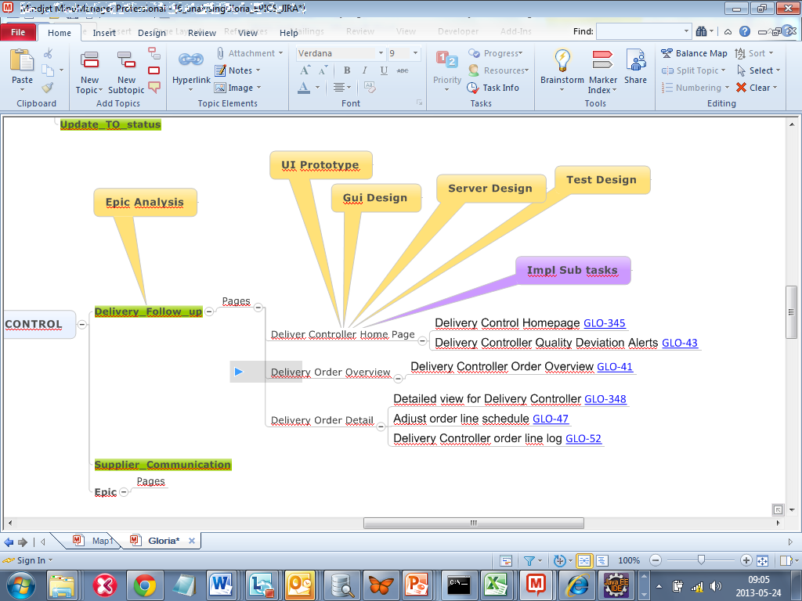

Slide 4
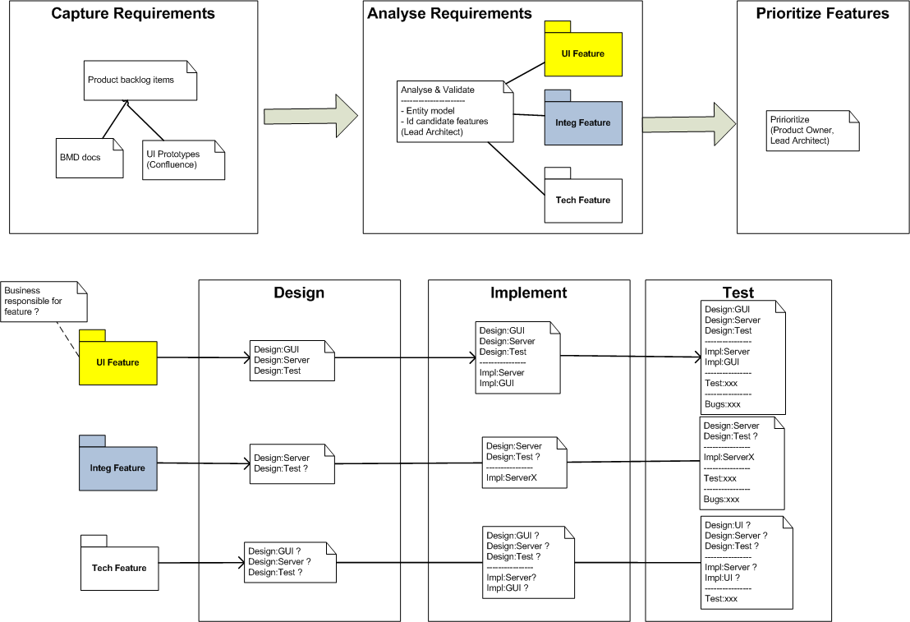

Slide 5
Design:Server
UI Feature
Validate suggested Entity model
Map all UI attributes to Entity model attributes
For input fields secure input validation rules
Identify Restful Services – Domain Services mapping
Integration Feature
Secure mapping of BMD attribute to Entity model attributes
For incoming fields secure input validation rules
Identify Gateway Services – Domain Services mapping
Tech Feature
Secure that Design input is enough
Communicate Design

Slide 6
Design:GUI
UI Feature
Validate suggested Entity model
For input fields secure input validation rules
Propose design for Client implementation
Identify Restful Services
Tech Feature
Secure that Design input is enough
Propose design for Client implementation

Slide 7
Way of working
1: Requirements & Acceptance Criterias
2: UI prototypes
3: Epic Analysis (with Entity model)
For each Page
4: a Gui Design
-> Implementation activities
4: b Server Design
-> Implementation activities
4: c Test Design
Acceptance criterias
IT Tests defined
4: d Agreed Design with Business

Slide 8
DELIVERY CONTROL
Delivery_Follow_up
Epic Analysis
Deliver Controller Home Page *** Scope acceptance Criteria (GLO-345,GLO-43)
Gui Design
Server Design
Test Design
Impl Sub tasks
Impl Sub tasks
Impl Sub tasks
Deliver Controller Home Page *** Scope acceptance Criteria (GLO-41)
Gui Design
Server Design
Test Design
Impl Sub tasks
Impl Sub tasks
Impl Sub tasks

