Slide 1
Test Management
Technologies

Slide 2
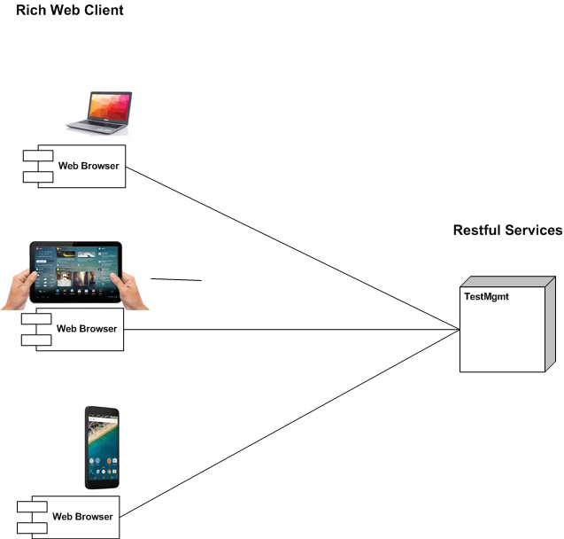
Rich Web Client – Restful Services
- Solutions runnable on different devices:
(desktop/laptop/Tablet/Mobile)
- Client not tied to a desktop/laptop
- Same Client/Server technology used for all devices

Slide 3
Technologies

Slide 4
Reuse Gloria Technologies
Gloria as reference Architecture
Design examples
Code examples
Competence re-use

Slide 5
JVS/NVS

