Slide 1
Architecture_And_More
TCP Test Management - Prepare

Slide 2
Planning

Slide 3
Suggested Roadmap
* May 2018
Step 1
Step 2
Step 3
Step 4
Test Manager
Prepare test - core
Test Manager
Perform test - core
Replace\update RDM
Test Manager
Prepare test - Extended
Disable PVT manager
Replace Efacts functionality
Test Manager
Perform test - Extended
Establish new TM with it’s own Database
Extend test specification with procedure(test method) and routine
Improve filtering test cases towards test object
Secure information exchange between New TM and Efacts
Establish basic system functionality for tester through tablet
Replace RDM functionality
Replace Efacts
Extend prepare test functionality
Extend perform test functionality
* =P2952 (FH and FM update)

Slide 4








Total Project Time Plan
Month + year
Month + year
Month + year
Month + year
Month + year
Month + year
Month + year
2016-12-13
2017-03-03
2017-04-15
2017-06-10
2017-12-15
2018-01-31
2018-02-15
Concept study
Concept
development
Detailed
requirement
development
Solution
development
Final verification
&
industrialization
Implementation

Slide 5
TCP Test Management - Prepare
Project Scope (-> 2018-01)
Build Application - Test Manager
Disable PVT Test Manager
Resolve EFACT – PVT Test Manager connections

Slide 6
As Is

Slide 7
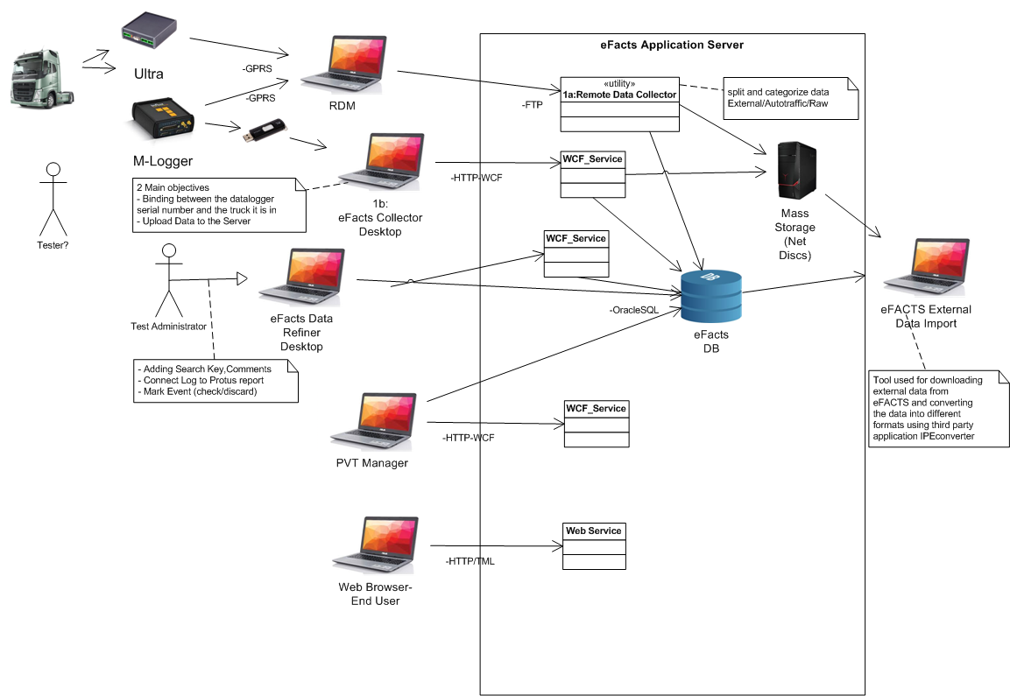

Slide 8
Analysis

Slide 9
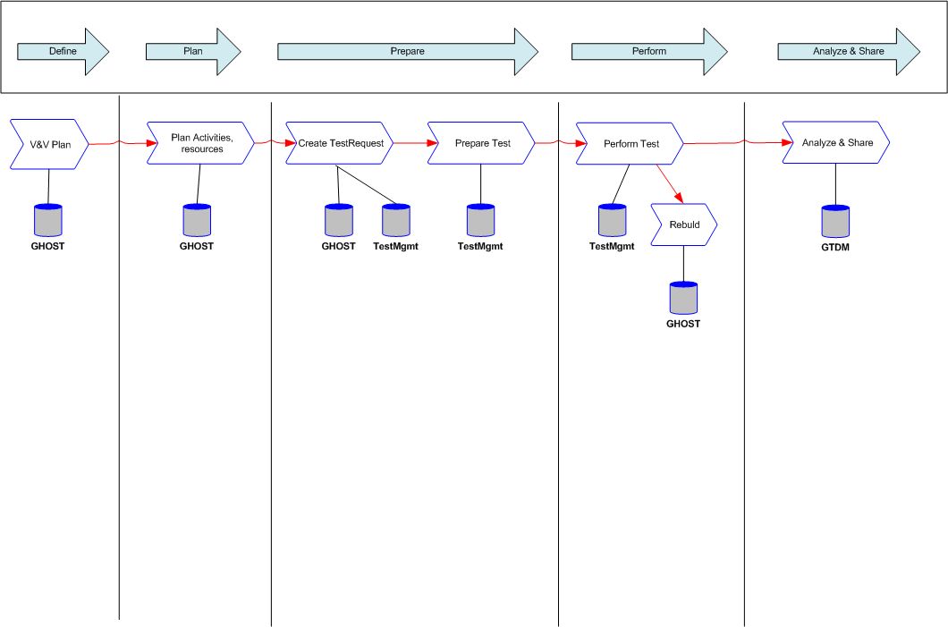
Process – To Be

Slide 10
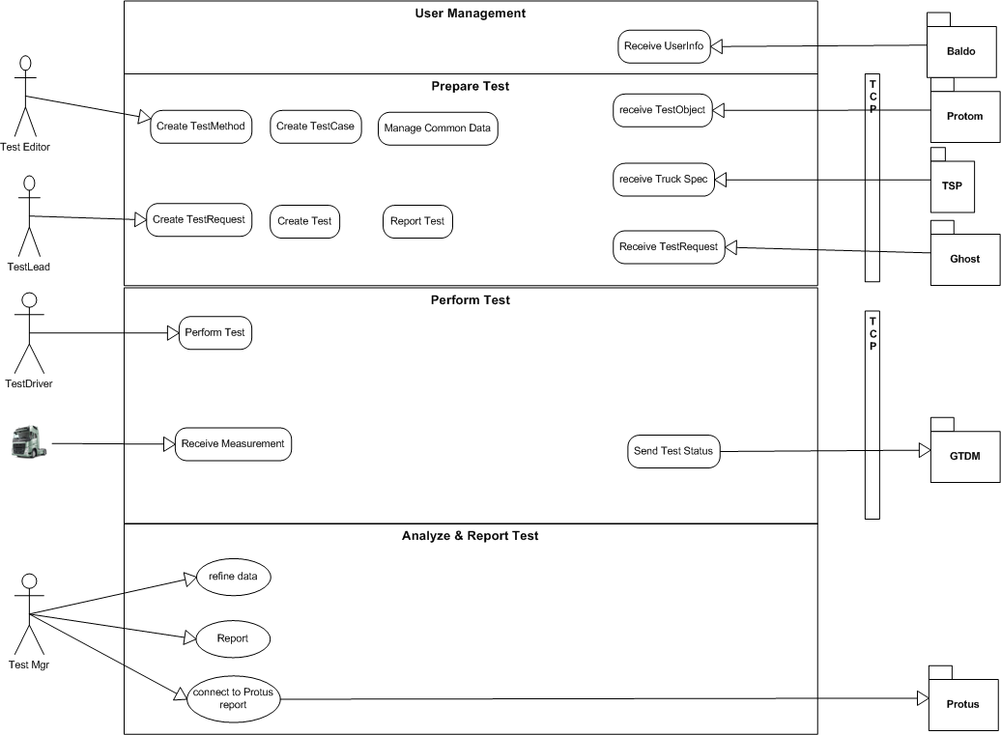

Slide 11
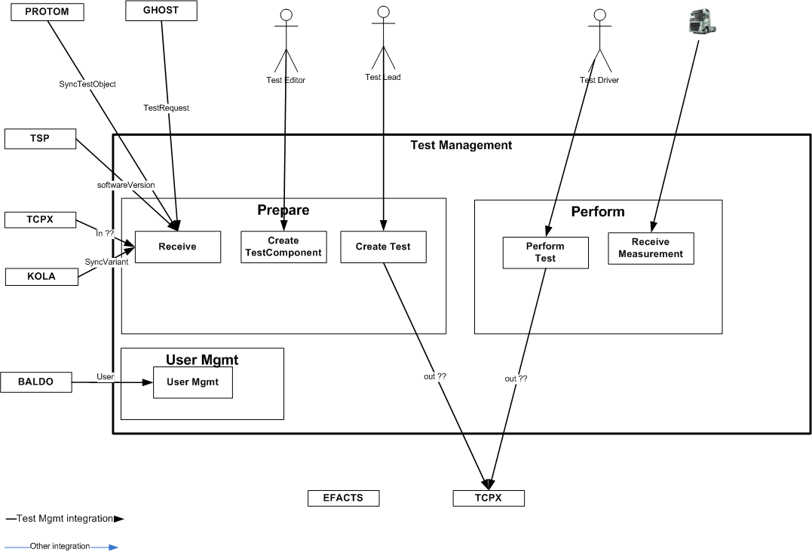

Slide 13
Architecture

Slide 14
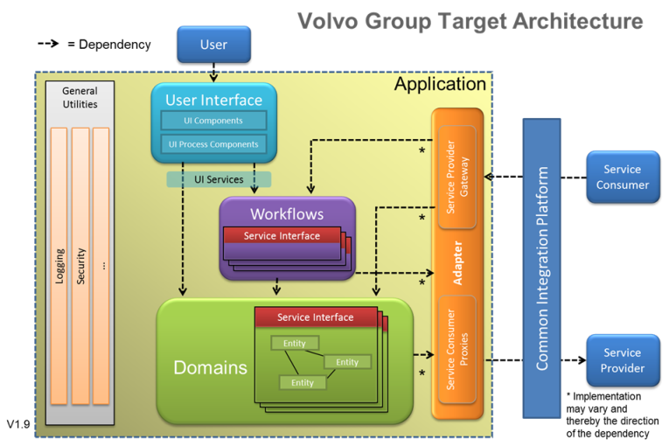

Slide 16
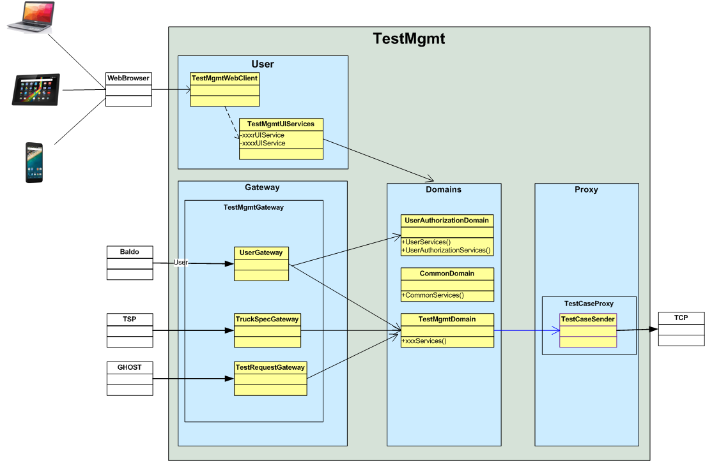

Slide 17
Technologies

Slide 18
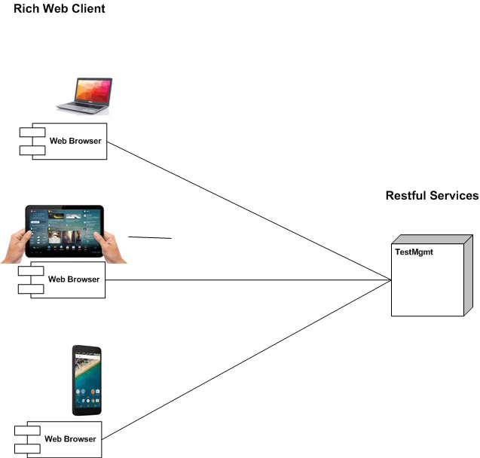
Rich Web Client – Restful Services
- Solutions runnable on different devices:
(desktop/laptop/Tablet/Mobile)
- Client not tied to a desktop/laptop
- Same Client/Server technology used for all devices

Slide 19
Technologies

Slide 20
Reuse Gloria Technologies
Gloria as reference Architecture
Design examples
Code examples
Competence re-use

Slide 21
JVS/NVS

Slide 22
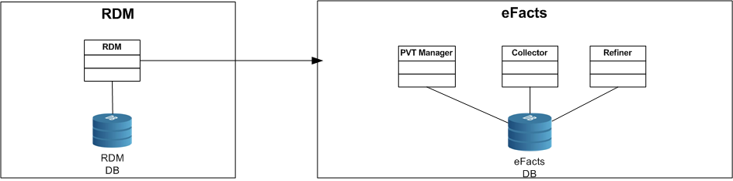
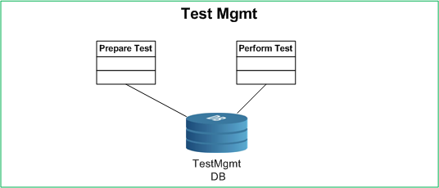
As Is
To Be
Step 1
Step 2

Slide 23
Critical Requirement
To define test case - per Product Class
Connection between logger device and Test case
New information model for test-specification->testCase
Improve information exchange towards Protus
Minimize manual input from Users
Track software versions in ECU’s
User Interface / Process flow

Slide 24
Identifying Architecture

