Slide 2
TCP

Slide 3

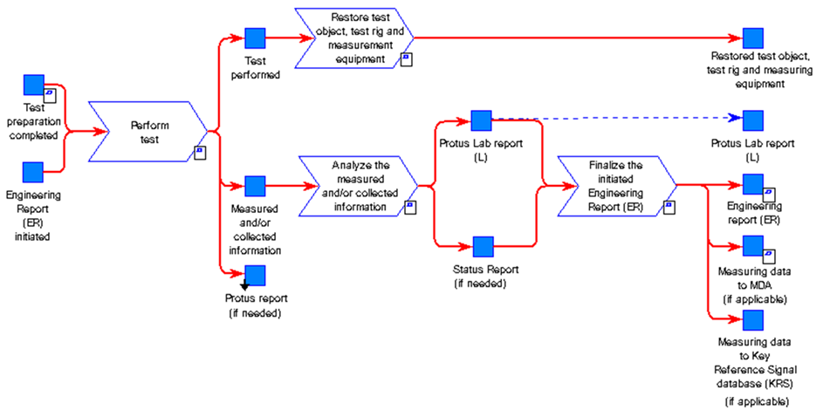
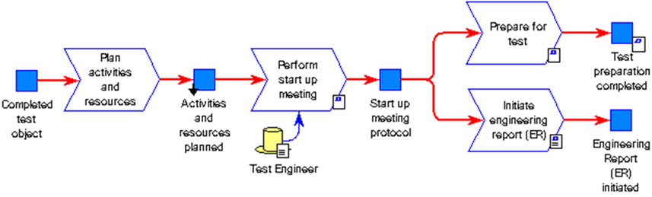


TO-BE
TCP
Test Collaboration Platform
GTDM Scope
Up- date
Re-plan
BOSS
GHOST
Test Manager
Incl Test Module?
HPG Planning tool
AXXOS
V&V plan
Defines acceptance criteria and methods. Selecting test objects and create time plan.
Test request
Based on V&V plan the test should be initiated e.g. n-8 weeks before the actual test should start.
In order to secure parts, material, resources and test object build. Quotation secured.
Plan activities and resources All needed resources and budget is secured.
Prepare for test The test object is
e.g. prepared with measurement equipment. The test procedure and method is prepared and secured.
Analyze/Reporting
Perform test Measurement systems and tools are efficient and control and give support during the test execution. E.g. test procedure, KPI, progress and status is available (results/running/faults found).
PROTUS
Vehicle Logging Tool
Data handling
Results and data are analyzed, documented and published. The data is also made available to upload for analysis or as input for future testing.
GHOST incl Test Module ?
Data information exchange
”Test Collaboration Platform”

Slide 4
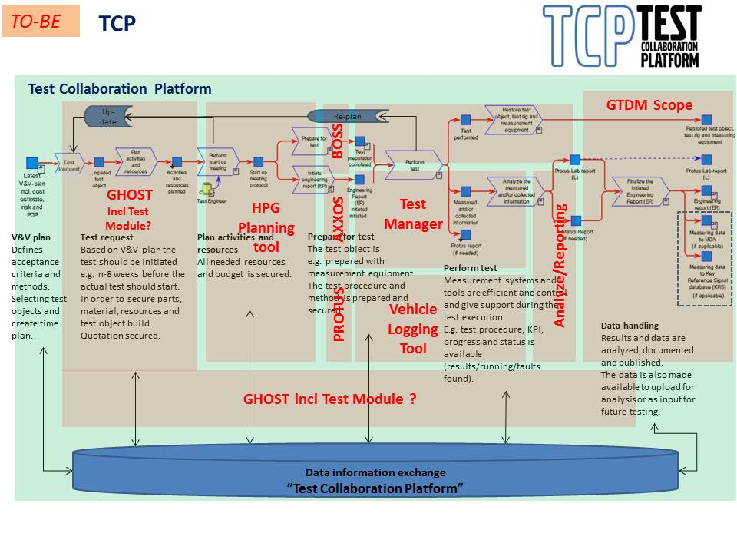

Slide 5
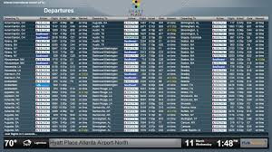

TEST COLLABORATION PLATFORM
SECURE THAT OUR TOOLS SUPPORTS THE PROCESS (PLAN & PERFORM TEST)
ENSURE THAT WE HAVE TOOLS THAT COVERS THE PROCESS
CREATE INTERFACES TO ENABLE INFORMATION EXCHANGE BETWEEN TOOLS
CREATE AN ENVIRONMENT TO CARRY TEST INFORMATION IN A STRUCTURED AND HARMONIZED WAY
CREATE BI SOLUTIONS FOR MONITORING STATUS AND PROGRESS OF TESTS AND TEST OBJECTS
TCP DATABASE & SERVICES
BI SOLUTIONS
12:38
12:38
http://www.windowsphone.com
http://www.url.com/
1

Slide 6
FVV tools capability - used during V&V process (AET/FT/PVT/RT)
Vehicle planning
Test request
Prepare
Perform
Collect
Analyze
Report
Store
GHOST
Manufacturer specific measurement software
Analyze tools
PROTUS ER-reports
TeDM
Data storage solution
Example
FVV Test Manager - incl Test PAD’s (PVT step 2 – VASP Volvo Active Safety Platform)
TDM/ Phoenix
RDM
RDM Data upload Distribute
RDM
eFACTS Refiner
eFACTS Refiner
eFACTS Refiner
PVT Manager
PVT Manager
PVT Manager
eFACTS Collector
eFACTS Collector
Keep
Phase out
Test Vehicle Viewer
New/change

Slide 7
Concepts – High Level

Slide 8
PVT Total/Base/Check
Time Independent –
part of Test Procedure*
Time Dependent –
Part of Test Specification*
Structure Independent
Test Start*
Start Inspection*
Test Sequence* PVT Check
Daily Inspection*
OFD*
Test Flow*
Test Data
Daily Inspection*
OFD*
Test Sequence* PVT Base
Daily Inspection*
OFD*
RESULTS & DATA
Test Data
Weekly Inspection*
Test Sequence* PVT Total
Daily Inspection*
OFD*
Daily Inspection*
Test Done*
Finish Inspection*
X repetitions
*= Has a definition

Slide 9
PVT Europe
Time Independent –
part of Test Procedure*
Time Dependent –
Part of Test Specification*
Structure Independent
Test Start*
Start Inspection*
Test Sequence* Start/Stop
Daily Inspection*
OFD*
Test Flow*
Test Data
Daily Inspection*
OFD*
Test Sequence* City Road
Daily Inspection*
OFD*
RESULTS & DATA
Test Data
Weekly Inspection*
Test Sequence* Country Road
Daily Inspection*
OFD*
Daily Inspection*
Test Done*
Finish Inspection*
X repetitions
(One for each day!)
*= Has a definition

Slide 10
Information objects - High level

Slide 11
TEST PROTOCOL
TESTSPECIFICATION
TESTPROCEDURE
TESTROUTINE – Start of test
TEST PROTOCOL
TESTSEQUENCE
TESTROUTINE – Daily Insp
TESTCASE
TESTROUTINE – Weekly Insp
TESTCASE
TESTROUTINE – Overnight
TESTCASE
Timestamp | Who | Type | Result | Tagged for
2013-08-22 09:16:21 | Driver – Kroken | TestRoutine – Start of Test | OK
2013-08-22 09:17:01 | Driver – Kroken | Testcase #314:1 | OK | #Testcase Review
2013-08-22 09:18:22 | Engineer – Motten | Diary Input | OK | #Note
2013-08-22 09:19:12 | Driver – Kroken | OFD | NOK | #Error
2013-08-22 09:19:13 | Driver - Kroken | TestRoutine – Trailer Swap | OK
TESTROUTINE – Trailer swap
TESTROUTINE
TESTROUTINE – Cargo weight
TESTSEQUENCE
TESTCASE
TESTROUTINE – 24h
TESTCASE
TESTROUTINE – Go/NoGo
TESTCASE
TESTROUTINE
TESTSEQUENCE
TESTCASE
TESTCASE
TESTCASE
TESTROUTINE – End of test

Slide 12
ALOT of new nomenclature
Name | Category | Sub category | Description
TEST | Nomenclature | Container | The overall container for every planned and executed activitites including the result
TESTSPECIFICATION | Nomenclature | Container | The container for the activities in the TEST. Contains both sequential and non-sequential activitites
TESTPROCEDURE | Nomenclature | Container | The container for all sequential activitites in a TESTSPECIFICATION, Needs to be executed in chronological order.
TESTPROTOCOL | Nomenclature | Container | The result of a TEST
TESTSEQUENCE | Nomenclature | Container | Set of testcases, Are default sorted but can be sorted individual as well.
TESTROUTINE | Nomenclature | Container | A generic container for every planned activity that is not a testcase/testsequence. Could be time-dependent(Such as Daily inspections) or independent (Such as Test start routine or Start Inspection)
TESTCASE | Nomenclature | Container | Description, Expected Result and attributes collected to one container, possible to generate structure and statistics
TESTREQUEST | Nomenclature | Container | Information from the customer, a desire to perform a TEST. Can be updated during the preparation of the TEST
TESTDIARY | Nomenclature | Container | A timebased notepad where all non-planned activities can be documented. Used for personal use, evaluation, knowledge management and formal reporting
PVT Check | Test
PVT Base | Test
PVT Total | Test
PVT Haulage | Test
PVT Development | Test |  | Custombuilt testspecification
PVT Europe | Test
Start Inspection | Test Routine |  | Inspection of vehicle before start of testing.
Daily Inspection | Test Routine |  | Inspection and routine after one day of testing.
Weekly Inspection | Test Routine |  | Inspection and routine after one week of testing.
End Inspection | Test Routine |  | Final inspection after all Sequences are performed. Includes to restore the truck in to normal shape.
Step Inspection | Test Routine |  | In between inspection
Overnight 1 person | Test Routine |  | Routine for spending the night alone in the truck
Overnight 2 person | Test Routine |  | Routine for spending the night in the truck with 2 persons
PVT Check Sequence | Test Sequence | Verification test | All PVT Check testcases in default order. Sorting based on driver input if available!
PVT Base Sequence | Test Sequence | Verification test | All PVT Base testcases except the PVT Check in default order. Sorting based on driver input if available!
PVT Total Sequence | Test Sequence | Verification test | All PVT Total testcases except the PVT Check and PVT Base in default order. Sorting based on driver input if available!
PVT Haulage Sequence | Test Sequence | Validation test | All PVT Haulage testcases
City Sequence | Test Sequence | Validation test | Sequence in PVT Europe
Country Road Sequence | Test Sequence | Validation test | Sequence in PVT Europe
Highway Sequence | Test Sequence | Validation test | Sequence in PVT Europe
Sleepover Sequence | Test Sequence | Validation test | Sequence in PVT Europe
Start/Stop Sequence | Test Sequence | Validation test | Sequence in PVT Europe
Driver Sorting | Test Sequence | Settings | Individual sorting of testcases for verification sequences

Slide 13
Step2_mockup_arto.pptx

Slide 14
GENERIC TEST CASE
CONTAINER
TEST CASES
A generic test case, a container for more
specific test cases. A generic test case can
be used on any truck. (With that functionality)
Multiple test cases can be held within that
container. Different descriptions, expected result
etc depending on product class, software release etc.
TEST CASE V1.3

Slide 15
GENERIC CONNECTIONS
TRUCK FUNCTION AREA
POWERTRAIN
TRUCK FUNCTION
IDLE ADJUST
GENERIC CONTAINER ID#023
Adjust idle speed
TEST CASE v1.0
PC 24-HDV
Depress brake pedal, and keep brake pedal depressed. Hold resume button for two seconds.
Container should be connected to a child in the hierarchy / structure . And hierarchy should be possible to change. Unlimited depth.
TEST CASE v1.1
PC 23-HDV, D3-HDV
Go into menu in DID and select adjust idle speed. Idle speed is expected to drop down to lowest possible setting.
TEST CASE v1.2
PC XX-MDV
Engage and disengage the cruise control three times within two seconds.

Slide 16
TEST CASE
TEST CASE CONTENT
ID
LOCATION
Possibility to connect a test case to one or several areas. GPS. When entering area test case should be displayed.
PARENT ID
DESCRIPTION
EXPECTED RESULT
LINK
Possibility to connect a test case to one or several test cases. When a test case with a link is displayed, the test cases linked with it should be displayed as ”relevant”.
VARIANT FILTER
PRODUCT CLASS FILTER
VISIBLE
TAGS
TOOLS NEEDED
IMAGES
If another column is needed in the database in the future, it should be possible to add this without breaking the code.
REPETITION
LAST CHANGE
TEST CASE NOTES

Slide 17
SEQUENCE
SEQUENCES
ID
NAME
SEQUENCE
TYPE
PRIVATE
LAST USAGE
TEST CASE 1
LAST CHANGE
TEST CASE 1
TEST CASE 1
TEST CASES
TEST CASE 1
STRICT
A sequence contains test cases. A sequence can belong to different groups. (Default / Dev / etc). And a sequence can be private, only visible to you. When doing development tests, before they are ready etc.
There should be a possibility for a sequence to be strict, driver is only able to follow the list exactly as it is without sorting or searching.

Slide 18
ROUTINE
ROUTINE
ID
NAME
DAILY INSPECTION
Make a daily inspection of the vehicle, check the following things.
Fluids
Tires
Lights
PROTOCOL
DESCRIPTION
LAST USAGE
LAST CHANGE
OVERNIGHT STAY
Sleep in the cab. Evaluate cab heater, curtains, living enviroment.
VERSION
REPEAT EVERY
A routine is an activity you do once, or periodically (daily/weekly etc). A routine can contain a protocol. A list of things you have to check off. The routine also contains a description.
The result of a routine during a test is an acknowledgement that the routine is done, and the protocol if it’s part of the routine, and comments from the driver.

Slide 19
PROCEDURE
PROCEDURE
ID
PROCEDURE
NAME
ROUTINE
SEQUENCE 1
SEQUENCE 2
ROUTINE
SEQUENCE 2
SEQUENCE 3
ROUTINE
A procedure is a container for sequences and routines. A list where you place sequences and routines in the order you want them. Also the ability to add repeating routines, performed without connection to the order. Ex. Daily inspection

Slide 20
ADMIN
Manage sub-groups
Manage users
Manage roles
Manage rights
Manage structure
Create / Edit
Create / Edit
Create / Edit
Delete
Delete
Delete
TEST ADMIN
Manage default sequences
Manage default routines
Manage TAGS
Manage TOOLS
Manage acronym translations
Create / Edit
Create / Edit
Create / Edit
Create / Edit
Create / Edit
Delete
Delete
Delete
Delete
Delete
PRODUCT CLASS
GJX / CKX ?

Slide 21
ADMIN / Manage sub-groups
/PVT/
Add sub-groups
Ex.
/PVT AGO
/PVT BLR
/PVT CUR
/PVT GOT
/PVT GSO
/PVT LYS
And assign users to that sub-group.
For example if a driver is assigned to /PVT/PVT GOT only tests created for PVT GOT will be showed and selectable.
Also used for default locations and views.

Slide 22
ADMIN / Manage users
Add access to users and assign roles / rights
Add VCN id and assign role / rights / and group belonging.
VCN id ...
Displayed name ...
Role ...
Add extra rights ...
Group ...
ADD
VCN Name Role Group Last login
T0C1836 Johan Jacobsson Test leader PVT GOT 2016-02-22 EDIT / DELETE
T0C1836 Johan Jacobsson Test leader PVT GOT 2016-02-22 EDIT / DELETE
T0C1836 Johan Jacobsson Test leader PVT GOT 2016-02-22 EDIT / DELETE

Slide 23
ADMIN / Manage roles
Create roles with different rights
Role name ...
Add right ...
ADD
TEST LEADER
Test Manager access
Driver Interface access
Refiner access
Create sequence
Create / follow / view tests
DRIVER
Driver Interface access

Slide 24
ADMIN / Manage structure
Add / Edit / Delete nodes in tree. The structure where test cases can be connected to leaf nodes....
ROOT
NODE
NODE
L
L

Slide 25
TEST ADMIN / Manage TAGS
Create TAGS
TAG name...
Description ...
ADD
TAG Description
DRIVING Vehicle in motion
VM PARKED Vehicle mode Parked
VM RUNNING Vehicle mode Running
HILLY Hilly terrain
STANDSTILL Vehicle standing still, parked
EDIT / DELETE
EDIT / DELETE EDIT / DELETE
EDIT / DELETE
EDIT / DELETE EDIT / DELETE

Slide 26
TEST ADMIN / Manage TOOLS
Create TOOLS needed in test cases etc.
Something more, serial / id numbers? General to track equipment and tools?
TOOL name...
Description ...
ADD
TOOL Description
Voltmeter Voltmeter
WIF Brake out Water in fuel brake out harness
USB with music USB stick with mp3/mp4/wma
Android phone Phone with android
Dummy key Key that’s dumb
EDIT / DELETE
EDIT / DELETE EDIT / DELETE
EDIT / DELETE
EDIT / DELETE EDIT / DELETE

Slide 27
TEST ADMIN / Acronym translation
Create acronym translations
If you use an acronym in a test case there will be an explanation below. Possible to get this from another DB?
Acronym...
Word / phrase...
ADD
Acronym Description
ACC Adaptive Cruise Control
CC Cruise Control
FCW Forward Collision Warning
LCS Lane Change Support
WTF What The Fuck
EDIT / DELETE
EDIT / DELETE EDIT / DELETE
EDIT / DELETE
EDIT / DELETE EDIT / DELETE
Example test case viewed to driver:
Description:
Activate ACC and change distance to target.
* ACC = Adaptive Cruise Control

Slide 28








PVT TEST MANAGER Editor Arto Mattila
List av all NOK from ALL sites in the lates 14 days
Status (graph) on FH-XXXX
Test case change log
etc
ONGOING TESTS : SITE GOT
FH-1824 PVT Total w1607 [ 34% ]
FH-1407 PVT Dev P2967 w1606 [ 4% ]
FH-1381 PVT Dev I-See E QJ w1605 [ 35% ]
OVERVIEW
TEST CREATOR
TASKHANDLER
12
TASKS
SEQUENCE HANDLER
Take a look
TEST CASE MANAGER
ADD ANOTHER FAVORITE VIEW
STATISTICS
SETTINGS
HELP & INFO

Slide 29



PVT TEST MANAGER Test leader Johan J
CREATE TEST
PROCEDURE: PVT TOTAL (Default)
OVERVIEW
SETUP:
PROCEDURE:
OPEN
Test name ...
START OF TEST
TEST CREATOR
Test leader
READ OUT FAULT CODES
SAVE
TEST OBJECT:
CHECK
Vehicle (Automatically from GHOST?)
GO / NO GO
ADD SEQUENCE
SEQUENCE HANDLER
BASE LOOP 1
Software (Automatically from GHOST?)
BASE LOOP 2
WBS (Automatically from GHOST?)
READ OUT FAULT CODES
TEST CASE MANAGER
ADD ROUTINE
EQUIPMENT:
MINI EXPEDITION
M-logger
ADD
TOTAL
Trailer (ID)
Container (ID)
READ OUT FAULT CODES
END OF TEST
STATISTICS
PERSONNEL:
Peter Andersson
ADD
SETTINGS
Driver team GOT
RECCURING ROUTINES:
DAILY INSPECTION
SAVE
SAVE LOG FILES
HELP & INFO

Slide 30
PVT TEST MANAGER Editor Arto Mattila
Search test case
OVERVIEW
Live search results ...
TEST CREATOR
TC
SEQUENCE HANDLER
TEST CASE MANAGER
STATISTICS
SETTINGS
HELP & INFO

Slide 31




PVT TEST MANAGER Editor Arto Mattila
Create / Edit test case
OVERVIEW
LINK
CONNECT TO PARENT
ADD IMAGE
CATEGORY
TEST CREATOR
Description...
PRIVATE
DEV
PRODUCTIO N
REPETITION
SEQUENCE HANDLER
LOCATION
Expected result...
TEST CASE MANAGER
TOOLS NEEDED
Variantfilter...
PRODUCT CLASS FILTER
TAGS
04-TLV
28-HDV
29-HDV
DAYLIGHT
DRIVING
STATISTICS
23-HDV
24-HDV
D3-HDV
VM RUNNING
HILLY
D4-MDV
63-HDV
06-MDV
USED IN SEQUENCE
SETTINGS
A1-MDV
A2-MHDV
A3-MDV
TOTAL
P1234 DEV
A4-MHDV
SAVE
HELP & INFO

Slide 32
Safety, Usability, Acceptance, Trust, Fun, Expectations,Usage behavior, Knowledge, Distraction
Light, dark, noise, location, temperature
Adaptivity, customization, flexibility, consistency, personalization

Slide 33

PVT DRIVER INTERFACE
Username...
Pin code...
7
8
9
4
5
6
1
2
3
LOGIN

Slide 34
PVT DRIVER INTERFACE Tester Arto Mattila
ONGOING PVT TESTS AT SITE GOT
FH-1824 Total w1623 IB
44%
DONE
LOAD
FH-1407 SEM w1607
23%
DONE
CURRENTLY CHECKED OUT BY:
THE HOOK
FH-1381 SEM w1607
5%
DONE
CURRENTLY LOCKED BY
TEST LEADER

Slide 35




PVT DRIVER INTERFACE FH-1824 Total w1623 IB Tester Arto Mattila
MESSAGES
TEST STATUS
Don’t remove driver card or change it to rest, tachograph test running over time. Check ongoing test cases.
KALLE ANKA| 2016-08-23 14:23
ROUTINE | START OF TEST
SEQUENCE | CHECK
I activated the engine heater with a timer, check that it starts by 07:00
THE HOOK | 2016-08-23 14:23
ROUTINE | READ OUT FAULTCODES
SEQUENCE | BASE
Could you please take a picture of that problem you found yesterday.
TESTLEADER| 2016-08-23 12:00
SEQUENCE | BASE LOOP 2 | [20%]
ROUTINE | READ OUT FAULTCODES
STATS
ROUTINE | MINI EXPEDITION
OK 230
NOK 22
REM 300
SEQUENCE | TOTAL
ROUTINE | END OF TEST
44% DONE
OVERVIEW
TEST CODE
AUTO MODE
FAULT REPORT
SETTINGS
CAMERA
CHECK IN

Slide 36
PVT DRIVER INTERFACE FH-1824 Total w1623 IB Tester Arto Mattila
Live search results...
BLANKS
ALL
OK
NOK
FUNCTION AREA
FUNCTION
TAGS
VERSION: 023_1.0
POWERTRAIN / IDLE ADJUST / ADJUST IDLE SPEED
DESCRIPTION:
EXPECTED RESULT:
Depress brake pedal, and keep brake pedal depressed. Hold resume button for two seconds.
The new idle speed should be saved.
OK
NOK
NT
TAGS:
STANDSTILL
RUNNING
ANTITHEFT / DOOR LOCK CONTROL / CENTRAL DOOR LOCK WITH KEY
VERSION: 426_1.1
DESCRIPTION:
EXPECTED RESULT:
Lock vehicle with key
Unlock vehicle
Repeat unlock
Both doors should lock
Driver door should unlock
Passanger door should unlock
OK
NOK
NT
TAGS:
FAULT REPORT
SETTINGS
CHECK IN
OVERVIEW
STANDSTILL
RUNNING
CAMERA
TEST CODE
AUTO MODE

Slide 37






PVT DRIVER INTERFACE FH-1824 Total w1623 IB Tester Arto Mattila
SORT BY TAGS:
STANDSTILL
RUNNING
ADD
POWERTRAIN / IDLE ADJUST / ADJUST IDLE SPEED
SELECT ON LOCATION
VERSION: 023_1.0
DESCRIPTION
Depress brake pedal, and keep brake pedal depressed. Hold resume button for two seconds.
WAIT 10 MINUTES
VIEW IMAGE
EXPECTED RESULT
BOOKMARK
The new idle speed should be saved.
READ IT TO ME
OK
NOK
NT
SKIP
REPORT TC FAULT
OVERVIEW
TEST CODE
AUTO MODE
FAULT REPORT
SETTINGS
CAMERA
CHECK IN

Slide 38
LOG FILES /

Slide 39


CENTRAL SERVER
Today there’s a lot of log files during PVT tests, and with slow connections and having to upload everything to a central server in Gothenburg takes time. Every location should have their own storage. As a first line where everything gets sorted, and then just sync logs that are going to be used in some way to the central server. And if off location, it should be possible to process and sort logs on your own computer / external drive.

Slide 40










PROTUS
FAULT REPORT
TEST LEADER
VIEW, SORT, USE
STATISTICS, HISTORY
TEST MANAGER
LOG DATA
TEST DATABASE
CENTRAL SERVER
REFINER
DRIVER INTERFACE
LOCAL SERVER / HDD
LOG DATA

Slide 41


DATA REFINER Test leader Johan J
Unhandled events
FH-1407
FH-1381
ADD
OVERVIEW
FH-1407
MEA_0415 / 01 2016-01-14 23:15:05 – 2016-01-14 23:15:35 4 TEST: FH-1407 SEM w1607
MEA_0415 / 02 2016-01-14 23:16:15 – 2016-01-14 23:16:45 4 TEST: FH-1407 SEM w1607
VIEW
MEA_0416 / 01 2016-01-14 23:30:10 – 2016-01-14 23:30:40 TEST: FH-1407 SEM w1607
FH-1381
MEA_0415 / 01 2016-01-14 23:15:05 – 2016-01-14 23:15:35 1
LOGS
MEA_0415 / 02 2016-01-14 23:16:15 – 2016-01-14 23:16:45 1
MEA_0416 / 01 2016-01-15 23:30:10 – 2016-01-14 23:30:40
MEA_0416 / 02 2016-01-15 14:15:05 – 2016-01-14 14:15:35
MEA_0416 / 03 2016-01-15 23:16:15 – 2016-01-14 23:16:45
MEA_1416 / 01 2016-02-01 15:30:10 – 2016-01-14 15:30:40 2
LOCAL SERVER CHANGES (Site GOT)
New logger data detected from vehicle FM-739 (Not connected to test)
New logger data detected from vehicle FH-1900 (Connected to: PVT Dev Cluster P1234, TL: Therese)
SETTINGS
HELP & INFO

Slide 42
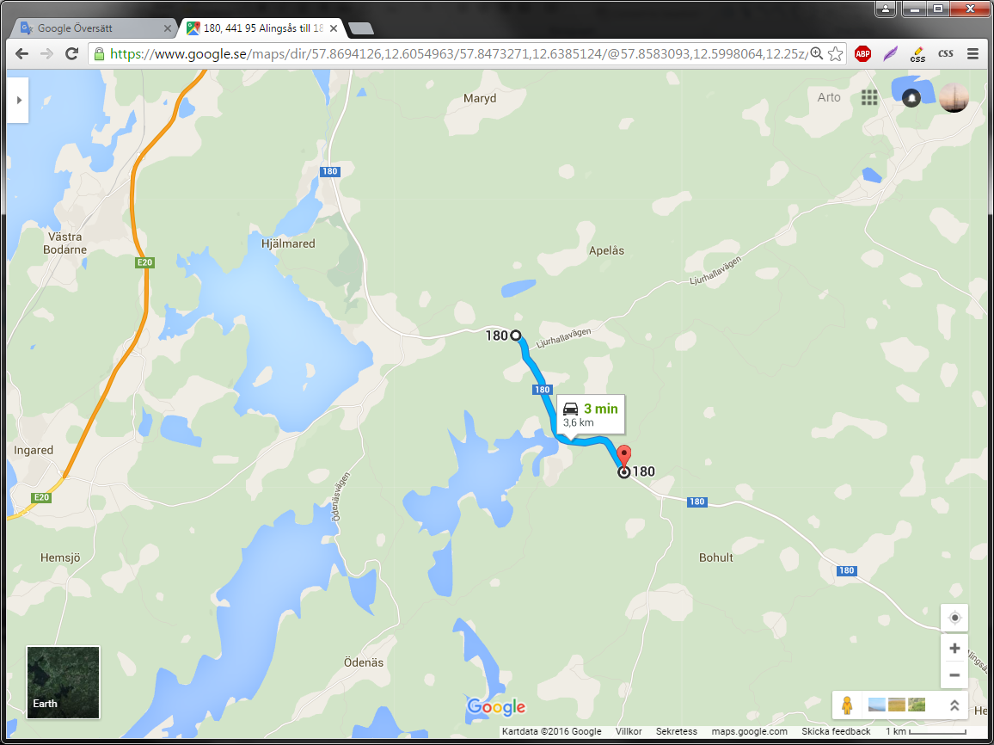
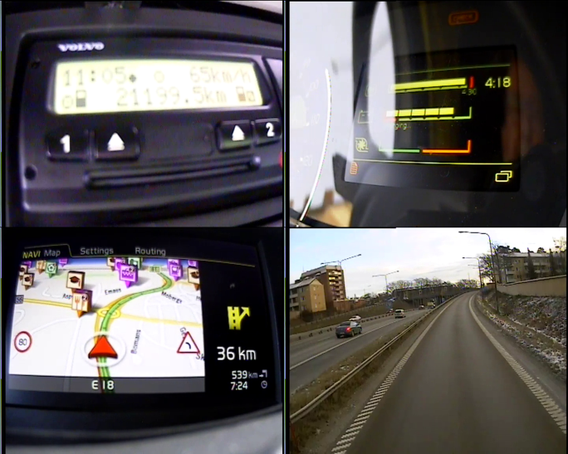

DATA REFINER Test leader Johan J
View
OVERVIEW
FH-1407 / MEA_0415 / 01 2016-01-14 23:15:05 – 2016-01-14 23:15:35
VIEW
ALL
VIEW
V 1
V 2
V 3
V 4
LOGS
CANalyzer
Protus ID ...
INCLUDE:
Comment ...
AUDIO
If protus id is entered, the log will be uploaded to central server and be attached as a link in protus report automatically.
If you don’t enter protus id the log is saved and stored on local server for later use.
VIDEO [CAM 1]
VIDEO [CAM 2]
SETTINGS
VIDEO [CAM 3]
NO VOICE
NAVI
ADD TAG
VIDEO [CAM 4]
2X2 GRID INCL AUD
DISCARD
Sorting category...
SAVE
HELP & INFO

Slide 43
DATA REFINER Test leader Johan J
LOGS (PVT Site GOT)
OVERVIEW
TEST: FH-1407 SEM w1607
TEST: FH-1824 PVT Total W23
Total events: 424 Unhandled events: 3
46 events connected to 14 protus reports
Total events: 89 Unhandled events: 6
15 events connected to 11 protus reports
VIEW
TEST: FH-1900 PVT Dev Cluster P1234
Total events: 5 Unhandled events: 5
0 events connected to 0 protus reports
LOGS
VEHICLE: FM-739
Total events: 20 Unhandled events: 320 0 events connected to 0 protus reports
SETTINGS
HELP & INFO

Slide 44
DATA REFINER Test leader Johan J
LOGS / FH-1407 SEM w1607
OVERVIEW
Unhandled events
MEA_0415 / 01 2016-01-14 23:15:05 – 2016-01-14 23:15:35 1
MEA_0415 / 02 2016-01-14 23:16:15 – 2016-01-14 23:16:45 1
VIEW
MEA_0416 / 01 2016-01-14 23:30:10 – 2016-01-14 23:30:40
Radio
MEA_0415 / 01 2016-01-14 23:15:05 – 2016-01-14 23:15:35 4 [L561612] [STATUS 21] [5p]
LOGS
MEA_0415 / 02 2016-01-14 23:16:15 – 2016-01-14 23:16:45 4
MEA_0416 / 01 2016-01-14 23:30:10 – 2016-01-14 23:30:40
Launcher Crash
MEA_0415 / 01 2016-01-14 23:15:05 – 2016-01-14 23:15:35 1 [L234556] [STATUS 21] [25p]
MEA_0415 / 02 2016-01-14 23:16:15 – 2016-01-14 23:16:45 1 [L234556] [STATUS 21] [25p]
MEA_0416 / 01 2016-01-15 23:30:10 – 2016-01-14 23:30:40
MEA_0416 / 02 2016-01-15 14:15:05 – 2016-01-14 14:15:35
MEA_0416 / 03 2016-01-15 23:16:15 – 2016-01-14 23:16:45
MEA_1416 / 01 2016-02-01 15:30:10 – 2016-01-14 15:30:40 2
I-SEE / No pre-speed
SELECTED EVENTS:
SETTINGS
ON MAP
CONNECT TO PROTUS
ON TIMELINE
STATS
HELP & INFO
CENTRAL SERVER LOCAL SERVER OWN HDD

Slide 45
DATA REFINER Test leader Johan J
TEST: FH-1407 SEM w1607
OVERVIEW
TIMELINE SELECTED EVENTS (Launcher Crash)
Radio
MEA_0415 / 01 2016-01-14 23:15:05 – 2016-01-14 23:15:35 4 [P: L561612] [STATUS 21]
MEA_0415 / 02 2016-01-14 23:16:15 – 2016-01-14 23:16:45 4
VIEW
MEA_0416 / 01 2016-01-14 23:30:10 – 2016-01-14 23:30:40
MEA_0415 E1
13:14
MEA_0415 E1
15:23
Launcher Crash
MEA_0415 / 01 2016-01-14 23:15:05 – 2016-01-14 23:15:35 1 [P: L234556] [STATUS 21]
LOGS
MEA_0415 / 02 2016-01-14 23:16:15 – 2016-01-14 23:16:45 1 [P: L234556] [STATUS 21]
MEA_0416 / 01 2016-01-15 23:30:10 – 2016-01-14 23:30:40
MEA_0416 / 02 2016-01-15 14:15:05 – 2016-01-14 14:15:35
14/1
15/1
MEA_0416 / 03 2016-01-15 23:16:15 – 2016-01-14 23:16:45
MEA_1416 / 01 2016-02-01 15:30:10 – 2016-01-14 15:30:40 2
System crash
I-See – No pre-speed
MEA_0415 E1
08:45
MEA_0415 E1
14:02
MEA_0415 E1
18:23
VIEW SELECTED EVENTS:
ON MAP
SETTINGS
TIMELINE
HELP & INFO
CENTRAL SERVER LOCAL SERVER OWN HDD

Slide 46
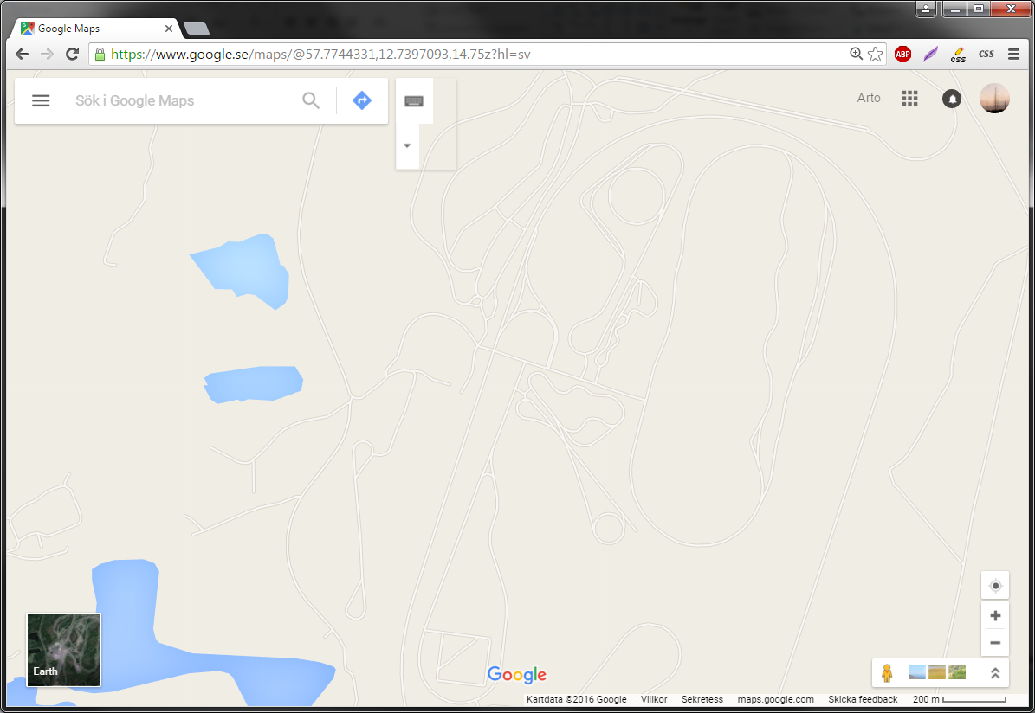
DATA REFINER Test leader Johan J
TEST: FH-1407 SEM w1607
OVERVIEW
MAP SELECTED EVENTS (Bad radio reception)
Radio
MEA_0415 / 01 2016-01-14 23:15:05 – 2016-01-14 23:15:35 4 [P: L561612] [STATUS 21]
MEA_0415 / 02 2016-01-14 23:16:15 – 2016-01-14 23:16:45 4
VIEW
MEA_0416 / 01 2016-01-14 23:30:10 – 2016-01-14 23:30:40
Launcher Crash
MEA_0415 / 01 2016-01-14 23:15:05 – 2016-01-14 23:15:35 1 [P: L234556] [STATUS 21]
LOGS
MEA_0415 / 02 2016-01-14 23:16:15 – 2016-01-14 23:16:45 1 [P: L234556] [STATUS 21]
MEA_0416 / 01 2016-01-15 23:30:10 – 2016-01-14 23:30:40
MEA_0416 / 02 2016-01-15 14:15:05 – 2016-01-14 14:15:35
MEA_0416 / 03 2016-01-15 23:16:15 – 2016-01-14 23:16:45
MEA_1416 / 01 2016-02-01 15:30:10 – 2016-01-14 15:30:40 2
System crash
I-See – No pre-speed
VIEW SELECTED EVENTS:
ON MAP
SETTINGS
TIMELINE
HELP & INFO
CENTRAL SERVER LOCAL SERVER OWN HDD

Slide 47
step2_new_unfineshed_slides.pptx

Slide 48
Step 1
Step 2
M-LOG
ONLINE / OFFLINE (Sync)
Import and view. JPEG and PNG.
Edit. Point at fault and mark vehicle position.
DATA HANDLER
PHOTO
VIEW/LISTEN
FAULT REPORT
Import and view.
Simple edit. Possible to convert and compress.
SORT
VIDEO
CONNECT
CANAlyzer
RS232
STORAGE

Slide 49
TEST OBJECT SPECIFICATION
TEST REQUEST
(GHOST)
COMPONENTS
A procedure is container for components.
TEST
TEST CASE
ROUTINE B
SEQUENCE A
INFORMATION
Answer back could pre-defined (OK / NOK / NT etc), written comment, audio comment, attached file etc.
ROUTINE C
SEQUENCE
(Test case group)
ROUTINE A
PROCEDURE A
ROUTINE
The different component types can be used to create standard building blocks to be used in different procedures and tests.
Procedures can be created and stored to be used in different tests. ”Test method”
SEQUENCE D
MAP ROUTES
TEST CASE A
TEST CASE B
PROCEDURE A
PROCEDURE B
INFORMATION
SEQUENCE A
ROUTINE A
PVT CHECK
PVT TOTAL
FAULT INJECTION
ROUTINE B
ROUTINE C
FAULT REPORT VERIFICATION
INFORMATION A
SEQUENCE D
UNKNOWN

Slide 50


DA
DATA REFINER - Overview
OVERVIEW
ADD DATA
VIEW DATA FROM SELECTED TRUCKS/TESTS
FH-1900
FH-1903
ADD
DATA SOURCE NAME DATE TAG FAULT REPORT ID
UNHANDELD DATA
M-LOG EVENT
M-LOG EVENT
M-LOG EVENT
PICTURE
PHONE VIDEO
M-LOG EVENT
MEA020_E0001
MEA023_E0004
MEA023_E0005
Cluster glare
Window reflections
MEA025_E0001
2016-04-03 12:00:00
2016-04-04 12:02:23
2016-05-05 16:00:00
2016-05-06 08:36:24
2016-05-06 08:42:56
2016-05-07 10:30:22
TAG: SCHWUNG
M-LOG EVENT
M-LOG EVENT
MEA018_E0001
MEA018_E0002
2016-04-01 12:00:00
2016-04-01 12:02:23
SCHWUNG
SCHWUNG

Slide 51
Step2_core.pptx

Slide 52
Step 2 - Core – Users/Roles/Groups
Users / roles
Management
Structure
Management
Building blocks
Management
Test
Management
Driver interface
Test result
Management
Users
Test cases
Start test
Perform test
Generate reports
Roles
Sequences
Follow test
Report faults
Groups
Routines
Update test
Test method
Temp test case
Permissions
Example
Users
Roles
Groups / subgroups
SU manages groups and assigning admin roles.
Users with admin role in each group manages adding/removing
users. And managing roles.
Tim Jansson
Arto Mattila
SU
Admin
PVT Global
PVT Test engineer
PVT Developer
Driver
AET/RT
Guest
...
PVT
GOT
AGO
CUR
BLR
GSO
LYS
AETRT
SAFETY
DRIVERS
FT
Building blocks are shared under a group, each sub-group will have access to the same standard building blocks.
Test Management (Tests) are only visible inside a sub-group.
It should be possible to belong to multiple groups.
Possible to save settings for each user.

Slide 53
Step 2 - Core – Users/Roles/Groups
Users / roles
Management
Structure
Management
Building blocks
Management
Test
Management
Driver interface
Test result
Management
Users
Test cases
Start test
Perform test
Generate reports
Roles
Sequences
Follow test
Report faults
Groups
Routines
Update test
Test method
Temp test case
Example
Test cases
Sequences
Routines
Test method
Test cases <-> Requirement connection (TSE Tool)
TF connection
Version
Description
Expected
Variant filter
PC filter
Test case level
Test case group
Tags
Pre-condition
Post-action
Group of test cases.
Add / sort / remove test
cases.
Multiple instances of a TC.
Freedom of choice, or absolute.
All TC from a level / groups.
Standard / Other
Description
Protocol
Comment
Return / answer:
OK / NOK / NT / BLOCKED
YES / NO
Activity report
( SKIP / SNOOZE)
File attchment
Countain all different building blocks.
Link a sequence to another. TACHO / TELE
Side by side.

Slide 54
Step 2 - Core – BB – Test case
TEST CASE NUMBER | Unique. Ex. 100, 101, 545
VERSION NUMBER | Updated with each change. Ex. 1, 2, 3, 4, 5, 6
BELONG TO NODE IN STRUCTURE | Connect to a node in the structure.
DESCRIPTION | Text. ”Markdown”. Bold, underline, lists.
EXPECTED RESULT | Text. ”Markdown”. Bold, underline, lists.
VARIANT FILTER | Filter truck spec by variant.
PRODUCT CLASS FILTER | Filter truck spec by product class.
TEST CASE ”LEVEL” | Managed by admin. Level 1, Level 2, ...
TEST CASE GROUP | Managed by admin. Development, Stable, Telematics, ...
TAGS | One or many, selectable. Managed by admin. RAIN, SUN, DRIVING, STANDSTILL, UPHILL, ...
NEEDED TOOLS | One or many, selectable. Managed by admin. MULTIMETER, BLUETOOTH 2.0 DEVICE, ...
IMAGE | Possible to add an image.
PRE-CONDITION
POST-ACTION
TEST CASE NOTES | Text. Notes about the test case. Reasons, reference
LAST CHANGE | Last version creation of test case

Slide 55
Step 2 - Core – BB – Sequence
Possiblity to alway include test cases based on level and group.
(Truck function)
#22 – Sequence name
ALL TRUCK FUNCTIONS
INCLUDE ALL LEVEL / GROUP
LEVEL 1
STABLE
THIS TRUCK FUNCTION
INCLUDE ALL LEVEL / GROUP
LEVEL 1
STABLE
Possible to name the sequence
Sequence should have a uniqe ID.
Possible to add/remove test cases to the sequence.
Possible to sort / order the test cases in the sequence.
Possible to have multiple instances of one test case.
Possible to create standard sequences. Usable by all
but only the admin can create / modify.
LEVEL
ALL
TEST CASE
LEVEL 1
LEVEL 2
LEVEL 3
LEVEL 4
GROUP
KEEP ORDER
SORTABLE
ALL
If the driver has to perform the test cases in the order they are,
Or if they can sort/order/order by tag.
STABLE
VISIBLE TO ME
VISIBLE TO ALL
DEVELOPMENT
If the sequence should be visible only to the user or to
everyone. Used during development, temporary etc.
TELEMATICS
P2967 (dev) (subgroup)
...

Slide 56
Step 2 - Core – BB – Routine
#14– Routine
Possible to name the routine
Routine should have a uniqe ID.
Version of routine.
Possible to create standard routine. Usable by all
but only the admin can create / modify.
Description text
Include protocol / check list (optional)
CHECK ENGINE OIL
TIRES
...
Answer
Answer back from driver should be:
OK / NOK / NT / BLOCKED
OK / NOK / NT / BLOCKED
YES / NO
DONE / NOT DONE
Possible to attach file in answer
...
VISIBLE TO ME
VISIBLE TO ALL
If the routine should be visible only to the user or to
everyone. Used during development, temporary etc.
REPEAT
DAILY
ONCE
INTERVAL
EACH DRIVER LOGIN
WEEKLY
...

Slide 57
Step 2 - Core – BB – Test method / procedure
#2– Test method / procedure
MAIN FLOW
SECONDARY FLOW
Container for different building blocks.
Test cases
Sequences
Routines
...
1.
ROUTINE (ONCE)
ROUTINE (INTERVAL)
2.
SEQUENCE
3.
ROUTINE (ONCE)
Available in 4 & 5
4.
SEQUENCE
SEQUENCE
5.
SEQUENCE
”Available in 4 & 5”
Second flow. That sequence (those test cases) should be included
during excecution of the selected sequences in main ”flow”.
Telematics & Tachograph etc.
TEST CASE
VISIBLE TO ME
VISIBLE TO ALL
If the procedure should be visible only to the user or to
everyone. Used during development, temporary etc.

