Slide 1
Architecture_And_More

Slide 2
Project Description

Slide 3
Project Vision and alignment with Strategic Objectives
Project vision
Vision is to develop and implement a scalable, stable and high-performing solution easily adaptable for future business demands supporting complete vehicle testing activities in an effective way.
Project alignment with Volvo Group core values (Quality, Safety, Environmental Care), and Volvo Group policies and directives
Quality: We will secure quality in the delivery through use appointed solution components, work methods and the project will follow Volvo Group target architecture. Policies and directives will be followed.
Environment: The new system will improve work environment for roles involved in the process.
Safety: Better solution support will improve test work which in the end will lead to more secure products
Project alignment with Business strategic objectives and Corporate Process & IT strategy (including integration strategy and IT policies and directives) and roadmaps
This project will be a start of the realisation of the road map to develop future system solution/s for supporting Validation and Verification of complete vehicles. From an IT perspective we will follow ten architectural principals, Volvo group target architecture and VIAP(Volvo Group Infrastructure Architecture Policy).
Requirements breakdown – Strategic Objectives (SO): link

Slide 4
Suggested Roadmap
* May 2018
Step 1
Step 2
Step 3
Step 4
Test Manager
Prepare test - core
Test Manager
Perform test - core
Replace\update RDM
Test Manager
Prepare test - Extended
Disable PVT manager
Replace Efacts functionality
Test Manager
Perform test - Extended
Establish new TM with it’s own Database
Extend test specification with procedure and routine
Improve filtering test cases towards test object
Secure information exchange between New TM and Efacts
Establish basic system functionality for tester through tablet
Replace RDM functionality
Replace Efacts
Extend prepare test functionality
Extend perform test functionality
* =P2952 (FH and FM update)

Slide 5








Total Project Time Plan
Month + year
Month + year
Month + year
Month + year
Month + year
Month + year
Month + year
2016-12-13
2017-03-03
2017-04-15
2017-06-10
2017-12-15
2018-01-31
2018-02-15
Concept study
Concept
development
Detailed
requirement
development
Solution
development
Final verification
&
industrialization
Implementation

Slide 6
As Is

Slide 7
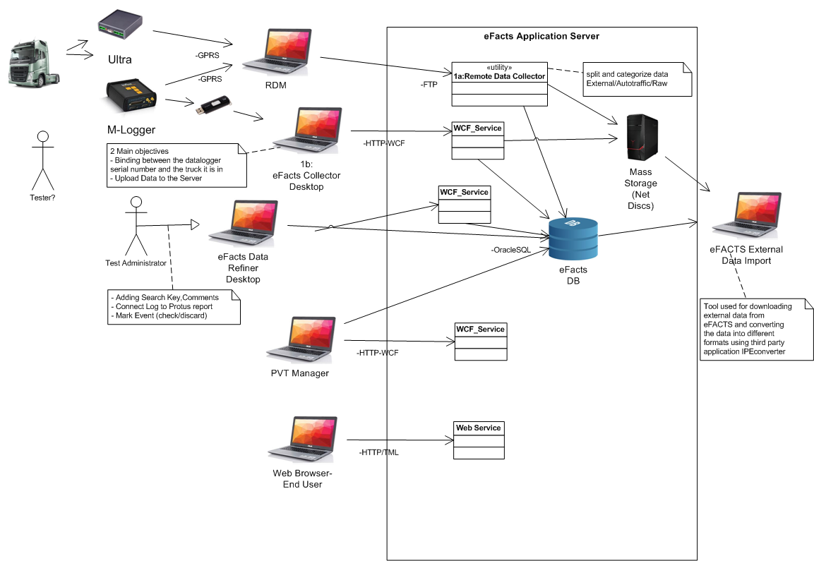

Slide 8
Analysis

Slide 9
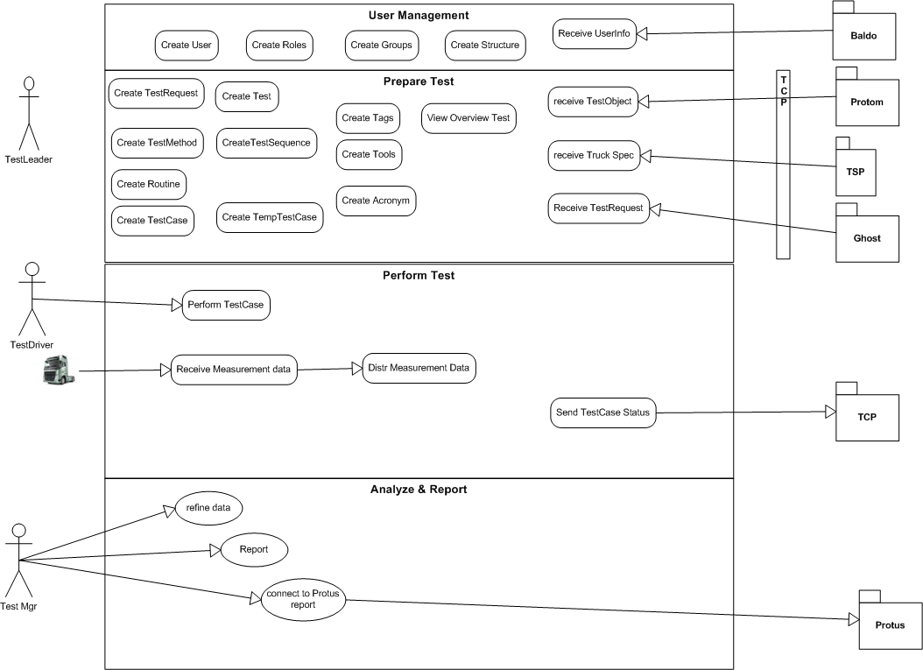

Slide 11
Architecture

Slide 12
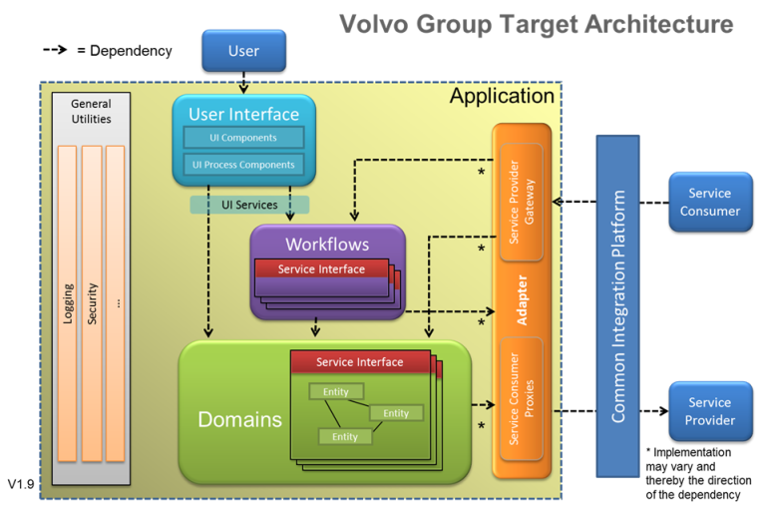

Slide 14
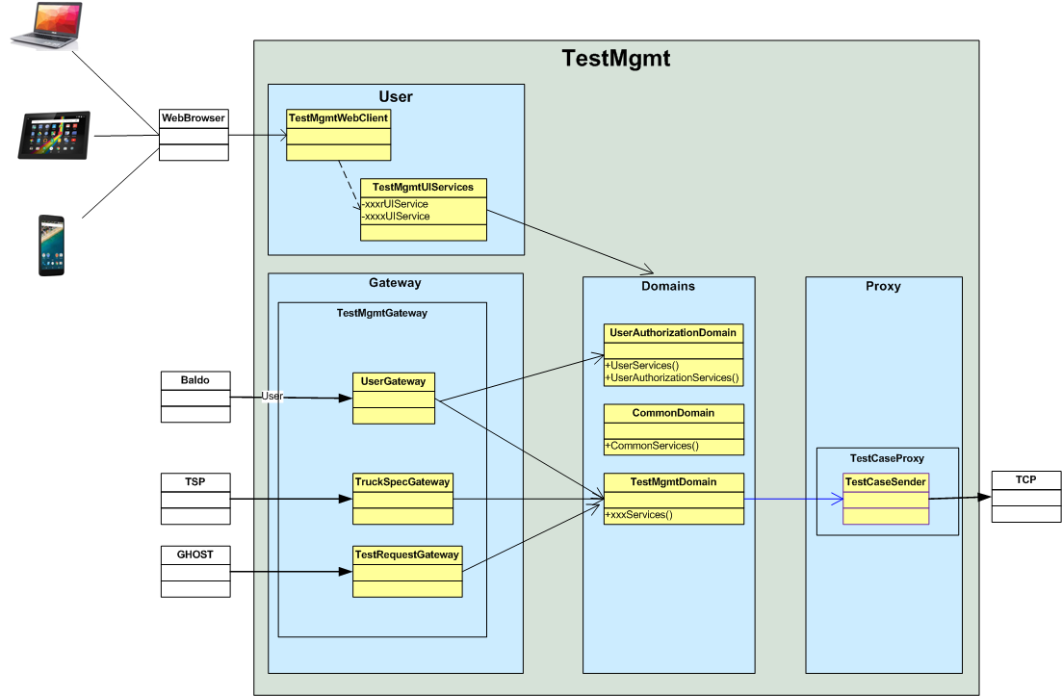

Slide 15
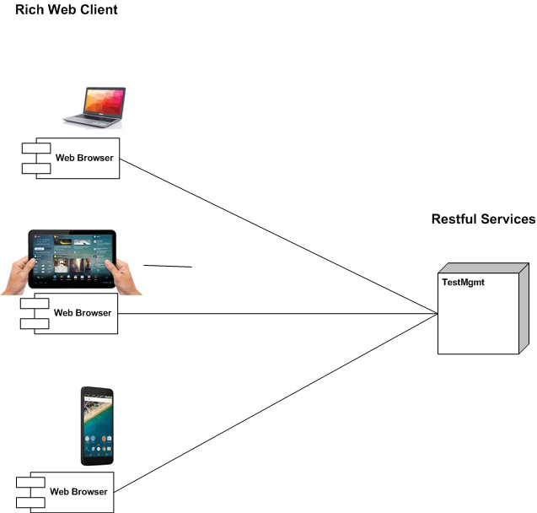
Rich Web Client – Restful Services

Slide 16
Technologies to be used

Slide 17
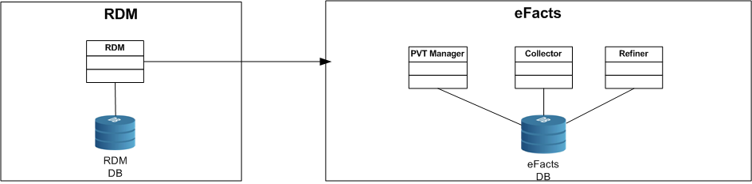
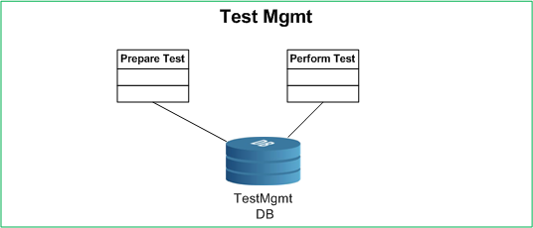
As Is
To Be
Step 1
Step 2

Slide 18
Critical Requirement
To define test case - per Product Class
Connection between logger device and Test case
New information model for test-specification->testCase
Improve information exchange towards Protus
Minimize manual input from Users
Track software versions in ECU’s
User Interface / Process flow

Slide 19
Identifying Architecture

