Slide 1
Way Of working

Slide 2
WOW – Test Mgmt
Intention: reuse Gloria's best practice
Process & Artifacts
Business Requirement
Analysis
Design
Implementation
Test

Slide 3
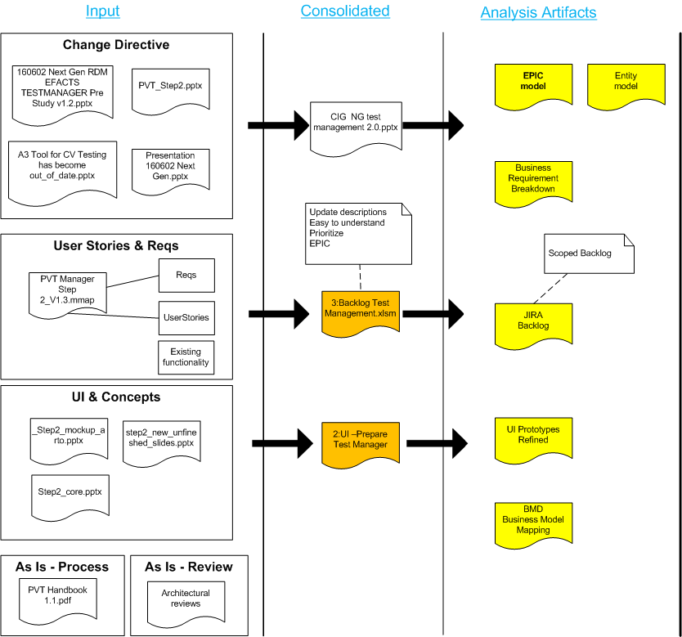

Slide 4
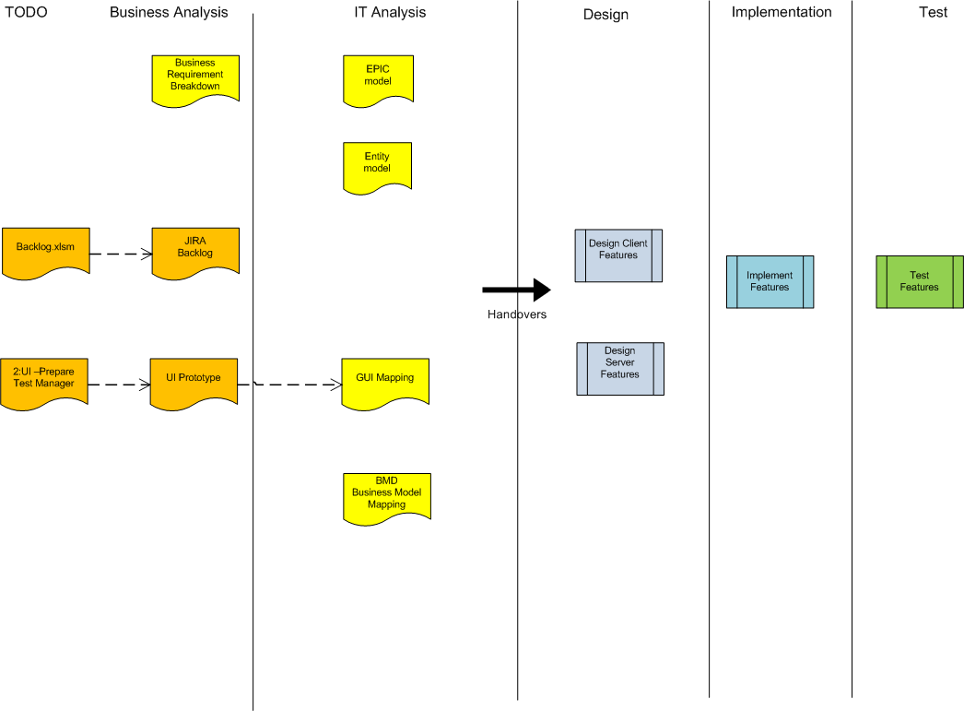

Slide 5
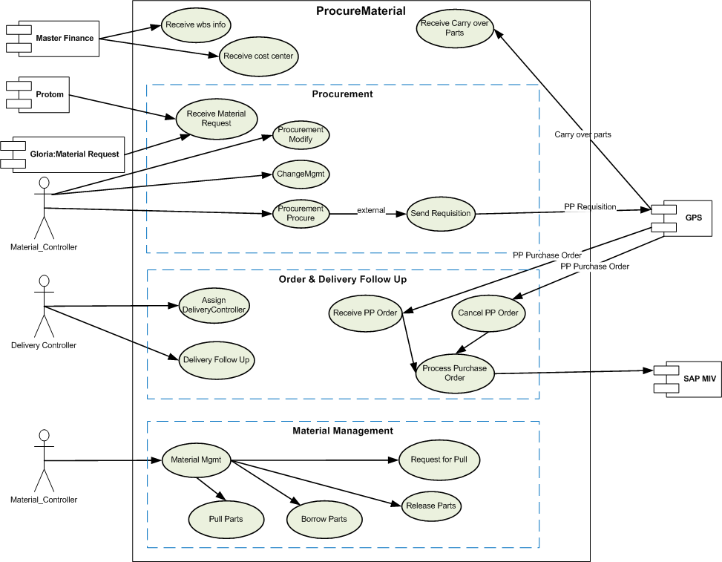
EPIC model - Example

Slide 6
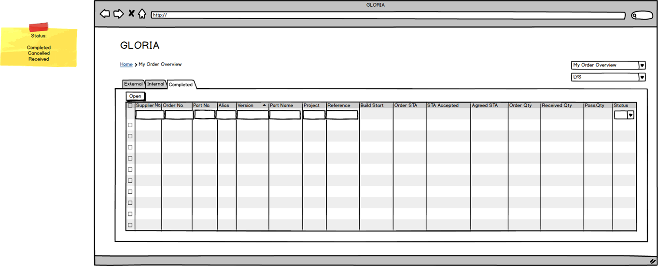
UI Prototype - Example

Slide 7
GUI Mapping - Example

Slide 8
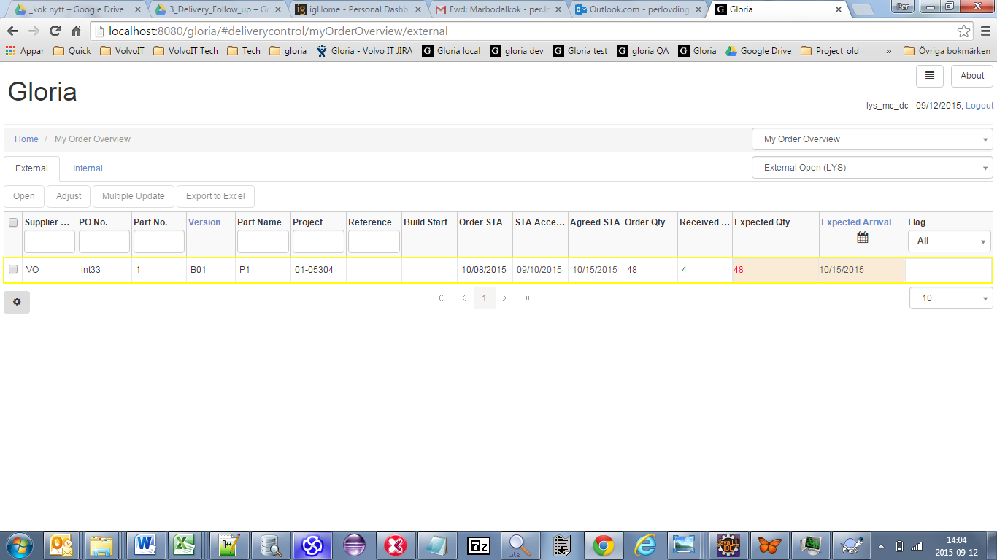
Real Application

