Slide 2
Topics
PVT_TOTAL,PVT_BASE...
TestCase Container
PVT and Software

Slide 3
Test Code/Test Sequence
PVT Development
Custom Built test
early in project
PVT CHECK
Very high level testing
8 H
PVT Base
HALF of all testcases/Available
2 weeks
PVT TOTAL
ALL testcases/Available functions Dig deep
4 weeks
PVT Europe
Most used functions during normal use are tested in several different environments
6 weeks
Environment factor
PVT Haulage
PVT EU

Slide 4
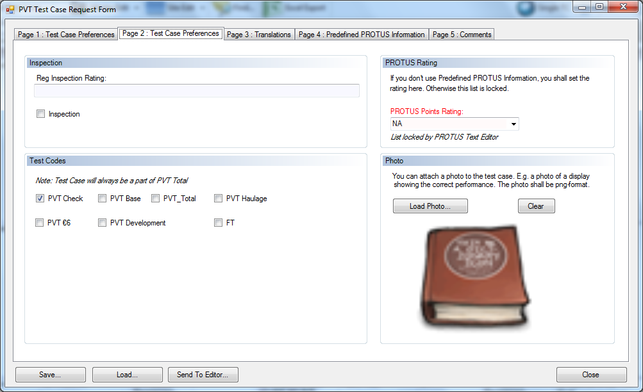
If copying TC some mandatory fields will be empty

Slide 5
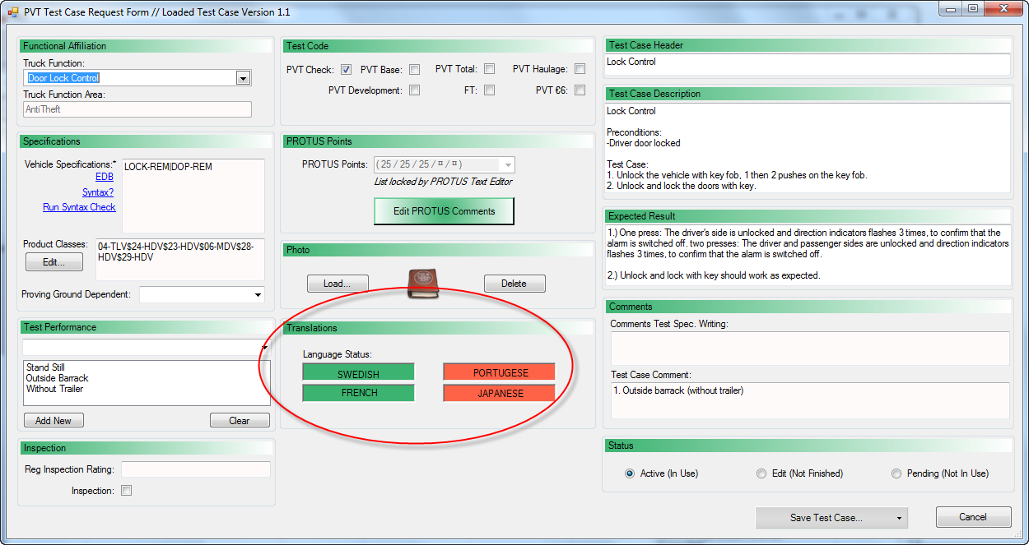
Master Editor view – will indicate if translation done for local language.

Slide 6
Formal Truck Function Verification & Validation PVT CHECK
One testcase/Available functions
Very high level testing
~8h/truck
Finds stoppers in all available functions
Used for delivery control
box
= One testcase for a Function

Slide 7
Formal Truck Function Verification & Validation PVT TOTAL
ALL testcases/Available functions
Dig deep!
~4weeks/truck
Exercise and challenge complete system
Most thorough Formal Verification
box
= One testcase for a Function

Slide 8
Questions
Name for PVT_TOTAL,PVT_BASE...
Sequence,test code
Category
Now :
Sequences are ”hardcoded”
TC selects Sequences
New:
Sequences are created

Slide 9
TEST OBJECT SPECIFICATION
TEST REQUEST
(GHOST)
COMPONENTS
A procedure is container for components.
TEST
TEST CASE
ROUTINE B
SEQUENCE A
INFORMATION
Answer back could pre-defined (OK / NOK / NT etc), written comment, audio comment, attached file etc.
ROUTINE C
SEQUENCE
(Test case group)
ROUTINE A
PROCEDURE A
ROUTINE
The different component types can be used to create standard building blocks to be used in different procedures and tests.
Procedures can be created and stored to be used in different tests. ”Test method”
SEQUENCE D
MAP ROUTES
TEST CASE A
TEST CASE B
PROCEDURE A
PROCEDURE B
INFORMATION
SEQUENCE A
ROUTINE A
PVT CHECK
PVT TOTAL
FAULT INJECTION
ROUTINE B
ROUTINE C
FAULT REPORT VERIFICATION
INFORMATION A
SEQUENCE D
UNKNOWN

Slide 10
GENERIC TEST CASE
CONTAINER
TEST CASES
A generic test case, a container for more
specific test cases. A generic test case can
be used on any truck. (With that functionality)
Multiple test cases can be held within that
container. Different descriptions, expected result
etc depending on product class, software release etc.
TEST CASE V1.3

Slide 11
GENERIC CONNECTIONS
TRUCK FUNCTION AREA
POWERTRAIN
TRUCK FUNCTION
IDLE ADJUST
GENERIC CONTAINER ID#023
Adjust idle speed
TEST CASE v1.0
PC 24-HDV
Depress brake pedal, and keep brake pedal depressed. Hold resume button for two seconds.
Container should be connected to a child in the hierarchy / structure . And hierarchy should be possible to change. Unlimited depth.
TEST CASE v1.1
PC 23-HDV, D3-HDV
Go into menu in DID and select adjust idle speed. Idle speed is expected to drop down to lowest possible setting.
TEST CASE v1.2
PC XX-MDV
Engage and disengage the cruise control three times within two seconds.

Slide 12
TEST CASE
TEST CASE CONTENT
ID
LOCATION
Possibility to connect a test case to one or several areas. GPS. When entering area test case should be displayed.
PARENT ID
DESCRIPTION
EXPECTED RESULT
LINK
Possibility to connect a test case to one or several test cases. When a test case with a link is displayed, the test cases linked with it should be displayed as ”relevant”.
VARIANT FILTER
PRODUCT CLASS FILTER
VISIBLE
TAGS
TOOLS NEEDED
IMAGES
If another column is needed in the database in the future, it should be possible to add this without breaking the code.
REPETITION
LAST CHANGE
TEST CASE NOTES

Slide 13
SEQUENCE
SEQUENCES
ID
NAME
SEQUENCE
TYPE
PRIVATE
LAST USAGE
TEST CASE 1
LAST CHANGE
TEST CASE 1
TEST CASE 1
TEST CASES
TEST CASE 1
STRICT
A sequence contains test cases. A sequence can belong to different groups. (Default / Dev / etc). And a sequence can be private, only visible to you. When doing development tests, before they are ready etc.
There should be a possibility for a sequence to be strict, driver is only able to follow the list exactly as it is without sorting or searching.

Slide 14
ROUTINE
ROUTINE
ID
NAME
DAILY INSPECTION
Make a daily inspection of the vehicle, check the following things.
Fluids
Tires
Lights
PROTOCOL
DESCRIPTION
LAST USAGE
LAST CHANGE
OVERNIGHT STAY
Sleep in the cab. Evaluate cab heater, curtains, living enviroment.
VERSION
REPEAT EVERY
A routine is an activity you do once, or periodically (daily/weekly etc). A routine can contain a protocol. A list of things you have to check off. The routine also contains a description.
The result of a routine during a test is an acknowledgement that the routine is done, and the protocol if it’s part of the routine, and comments from the driver.

Slide 15
PROCEDURE
PROCEDURE
ID
PROCEDURE
NAME
ROUTINE
SEQUENCE 1
SEQUENCE 2
ROUTINE
SEQUENCE 2
SEQUENCE 3
ROUTINE
A procedure is a container for sequences and routines. A list where you place sequences and routines in the order you want them. Also the ability to add repeating routines, performed without connection to the order. Ex. Daily inspection

Slide 16
PVT – Performance Validation Test
Verify and Validate functionality in a truck from a driver perspective
Verify – the driver manual
Validate – with experienced drivers
Corresponds to many very demanding customers using ALL functionality in the complete vehicle

Slide 17
Questions
What about software ?

