Slide 1
Way Of working

Slide 2
WOW – Test Mgmt
Intention: reuse Gloria's best practice
Process & Artifacts
Business Requirement
Analysis
Design
Implementation
Test

Slide 3
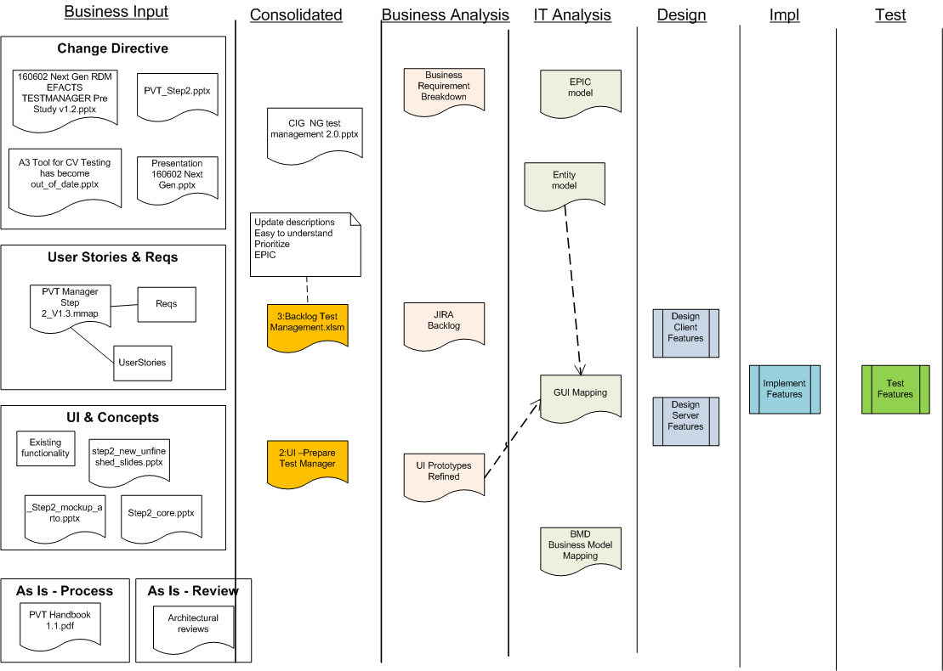

Slide 4
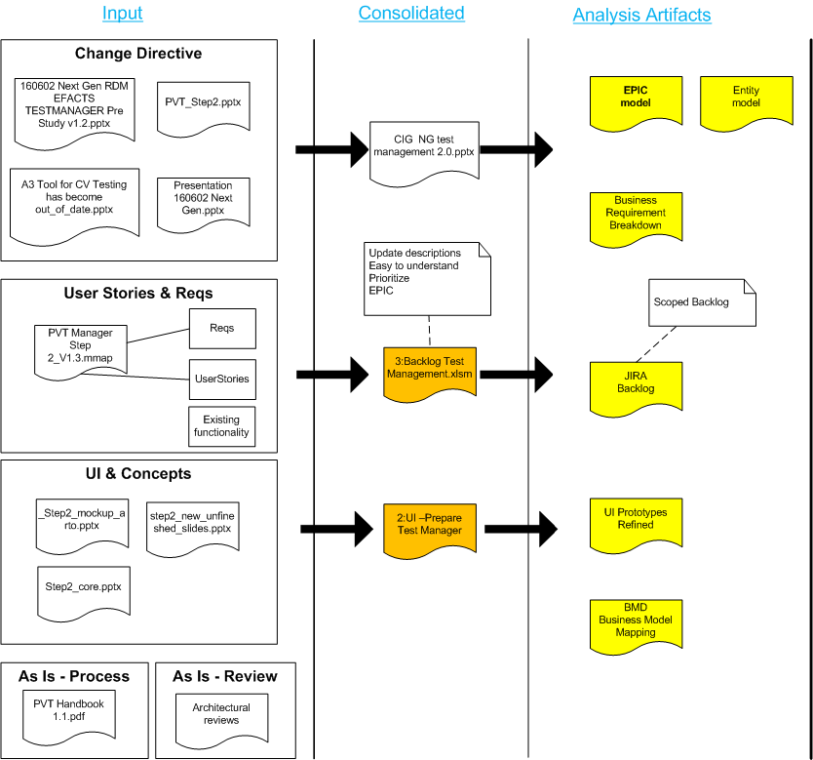

Slide 5
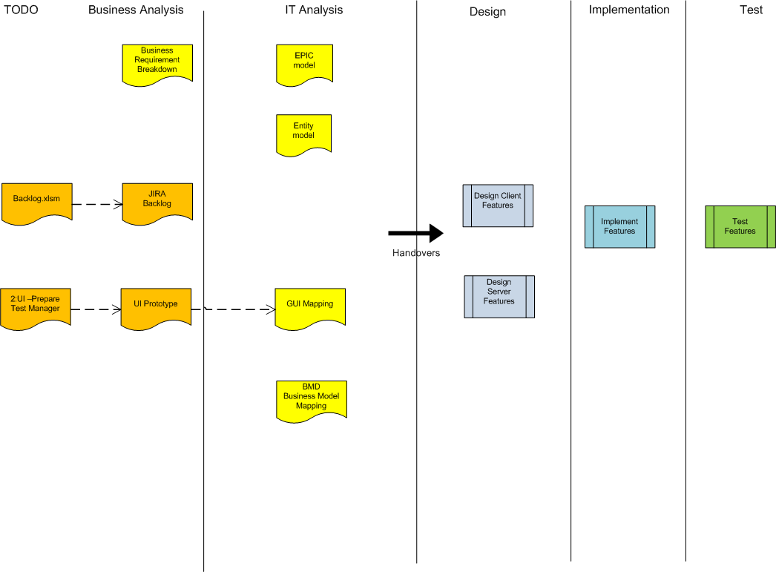

Slide 6
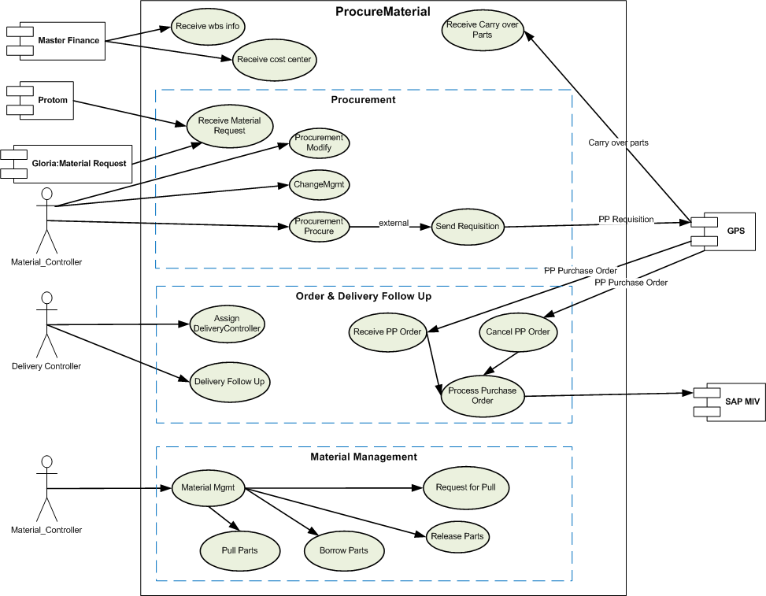
EPIC model - Example

Slide 7
Entity model - Example

Slide 8
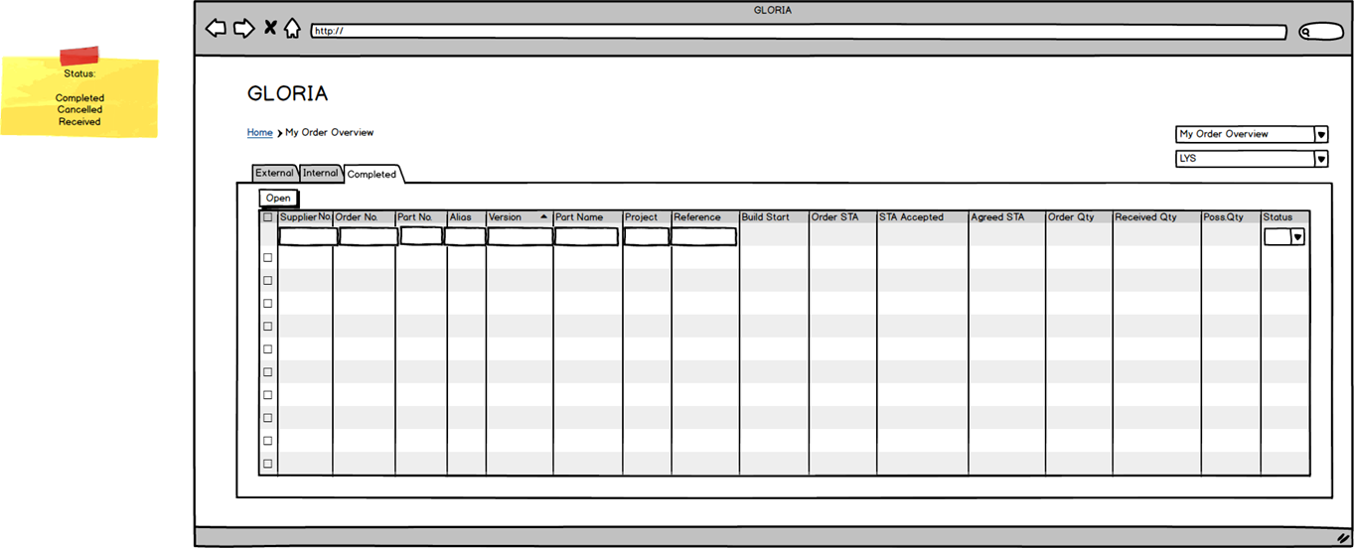
UI Prototype - Example

Slide 9
GUI Mapping - Example

Slide 10
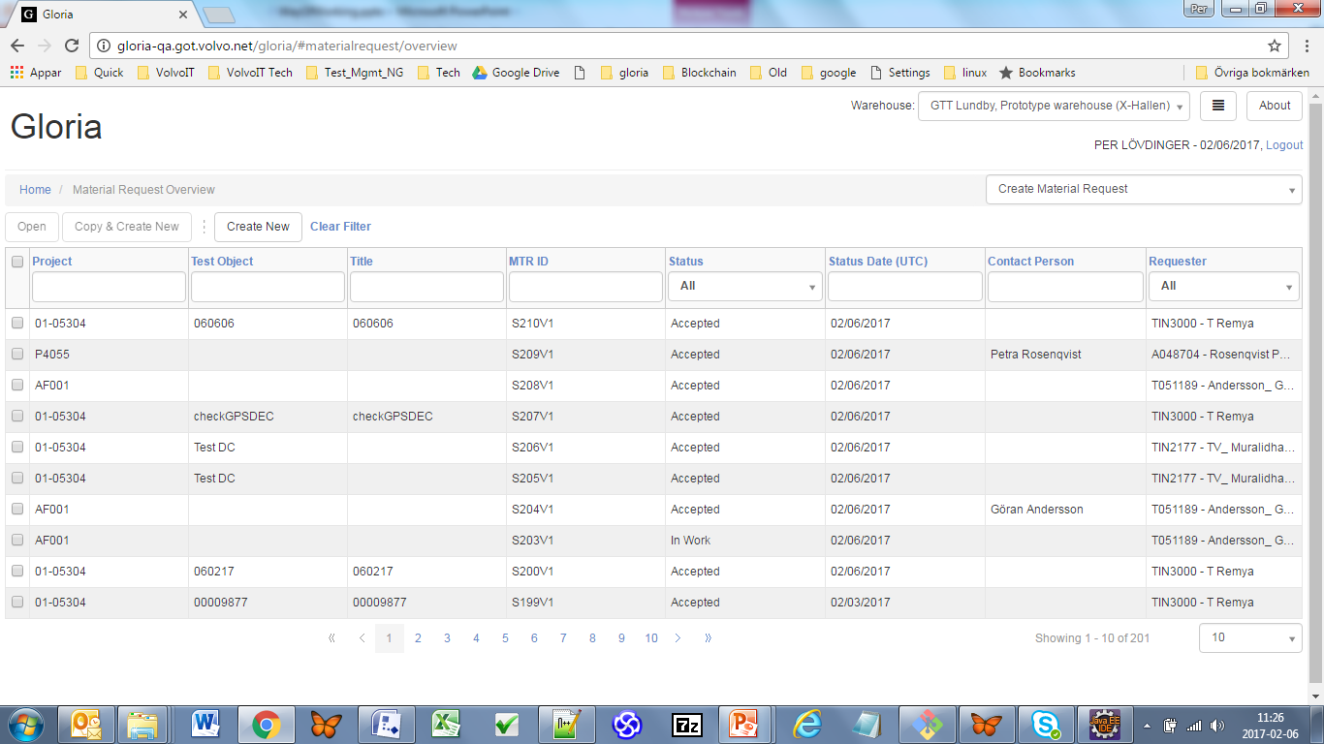
Material Request List– Real

Slide 11
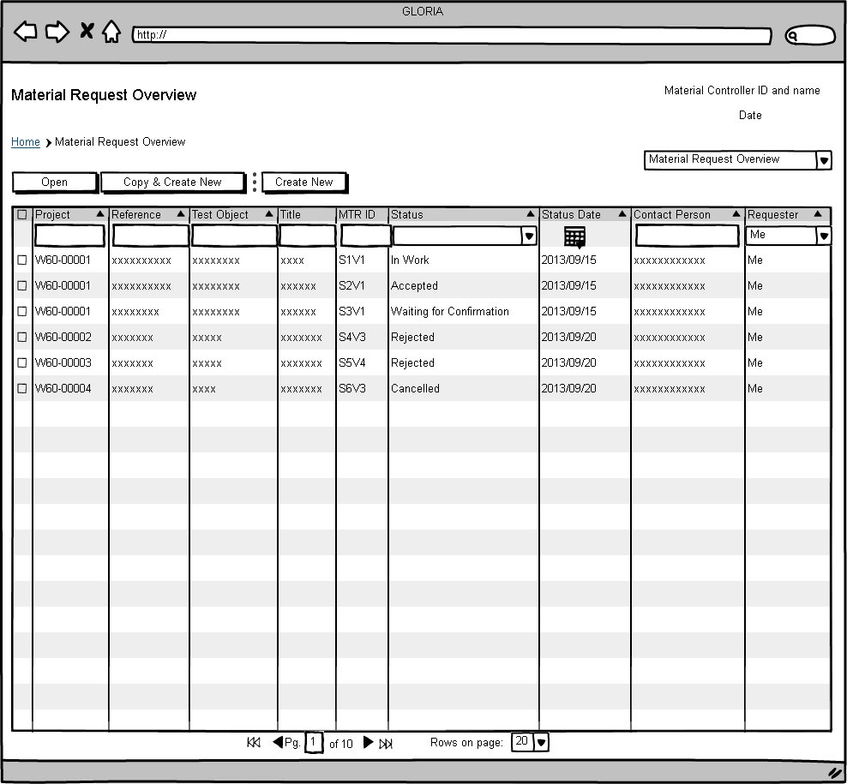
Material Request List– UI prototype

Slide 12
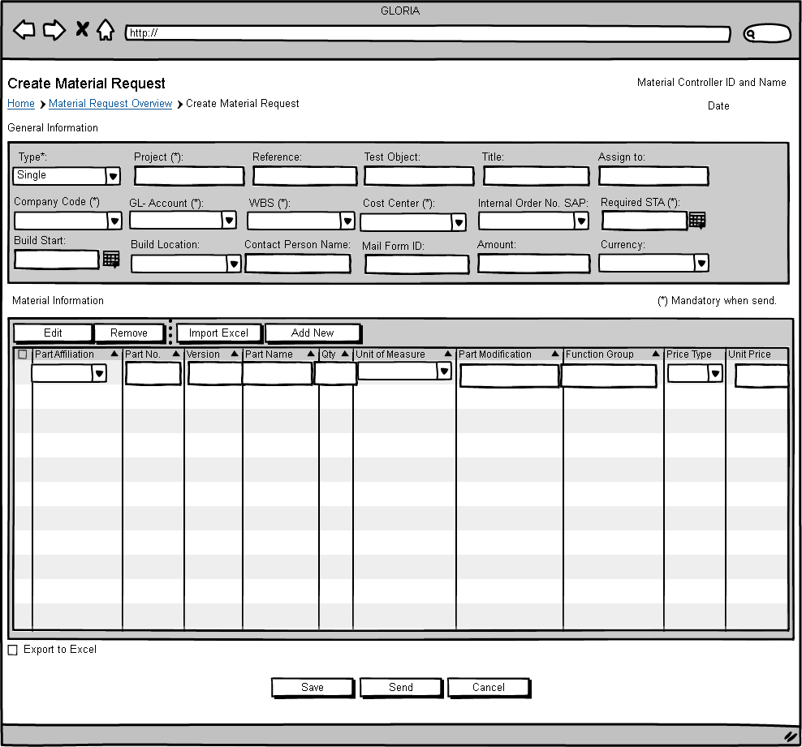
Material Request Detail – UI prototype

Slide 13
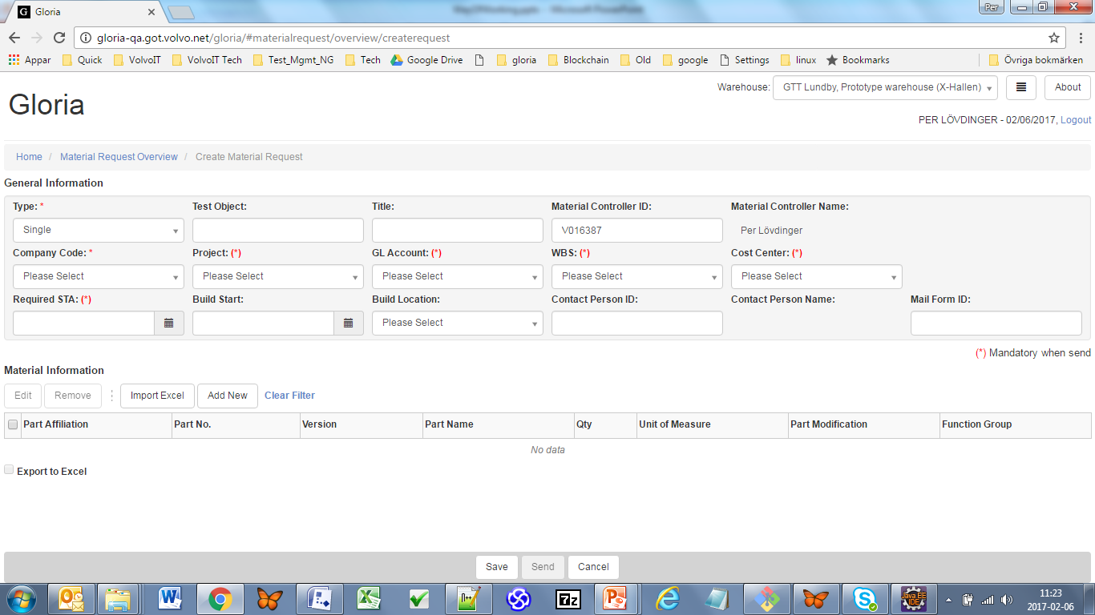
Material Request Detail - Real

