Slide 1
Architecture Notes

Slide 2
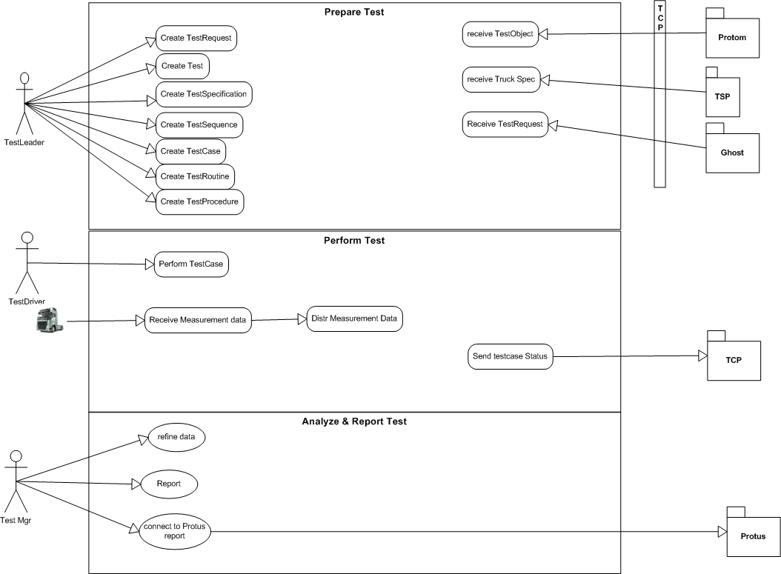

Slide 4
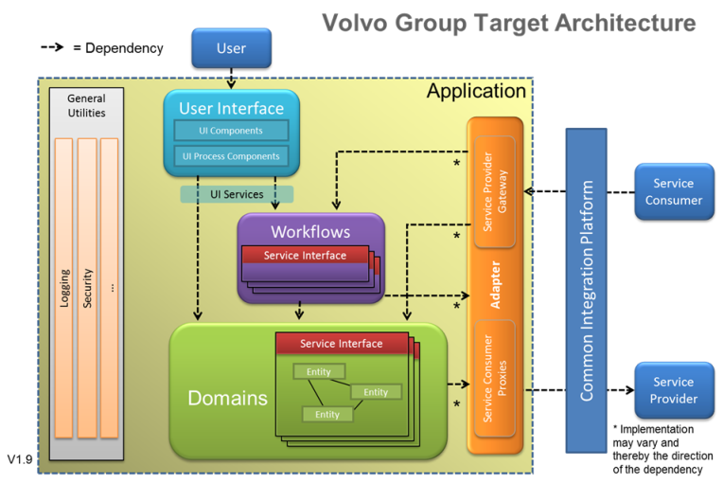

Slide 5
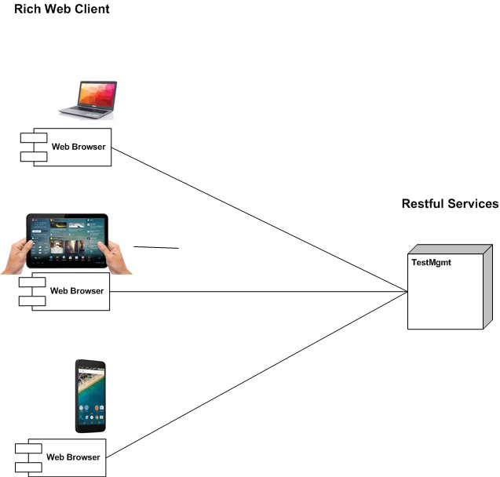
Rich Web Client – Restful Services

Slide 6
Technology

Slide 7
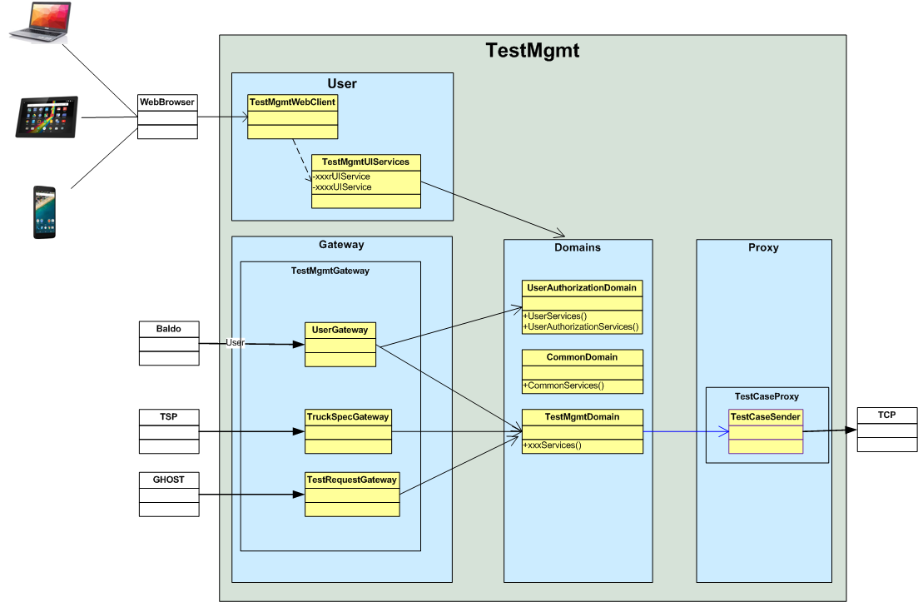

Slide 8
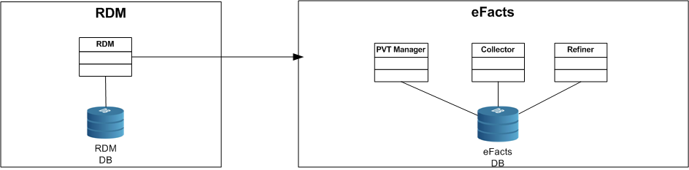
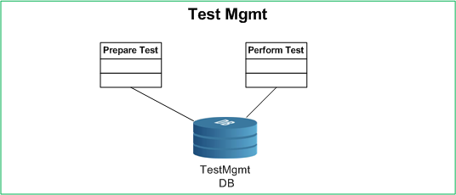
As Is
To Be
Step 1
Step 2

Slide 9
Suggested Roadmap
Step 1
Step 2
Test Manager
Prepare test - core
Test Manager – Driver interface
Perform test - core
Disable PVT manager
Establish new TM with it’s own Database
Extend test specification with procedure and routine
Improve filtering test cases towards test object
Secure information exchange between New TM and Efacts
Establish basic system functionality for tester through tablet

Slide 10
Critical Requirement
To define test case - per Product Class
Connection between logger device and Test case
New information model for test-specification->testCase
Improve information exchange towards Protus
Minimize manual input from Users
Track software versions in ECU’s
User Interface / Process flow

Slide 11
Identifying Architecture

