Slide 1
zergRush
VirusTotal Scanning for the Practical

Slide 2
Background
Online API tools for VirusTotal scanning already exist
Many require users to manually upload files individually
Place files into a text file prior to submission
What’s the issue?
Multiple files / entire directories that need to be scanned
Requires user oversight

Slide 3
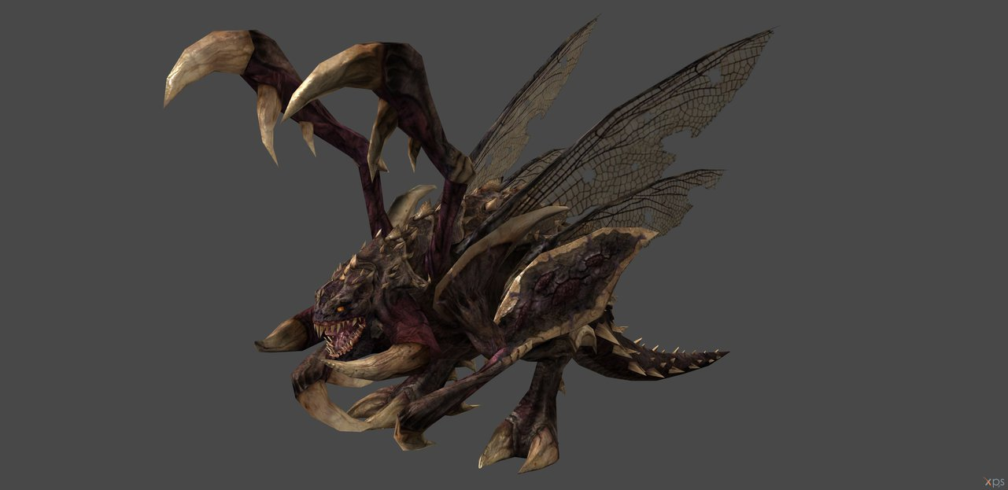
Suspected Malicious File

Slide 4
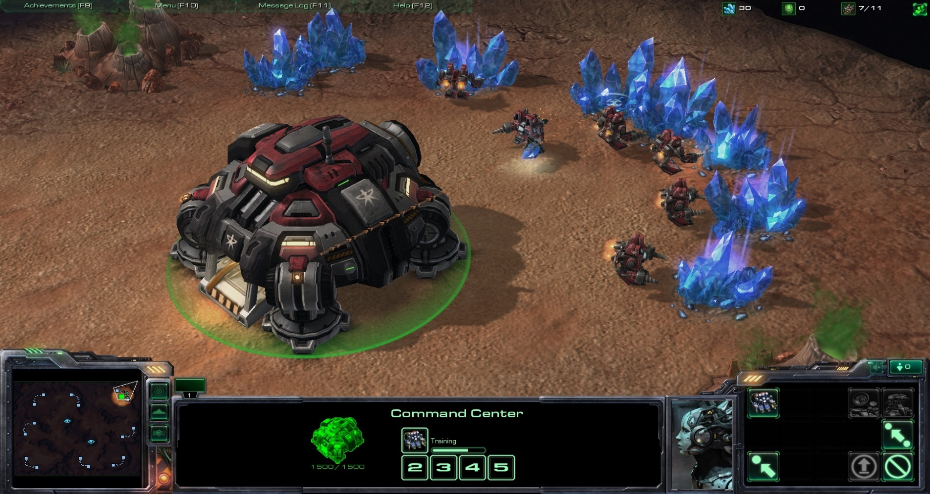
VirusTotal

Slide 5

zergRush with VirusTotal Deployed

Slide 6
zergRush Explained
Modification upon an existing tool – VirusTotal_API_Tool, built by Adam Meyers and Chris Clark
VirusTotal_API_Tool uploads MD5 hash of individual files to the VirusTotal API for scanning
Returns report on hash, detail and specificity depends on user arguments
zergRush takes in a directory path rather than file path / file hash.
Submits all files within provided directory rather than individual files

Slide 7
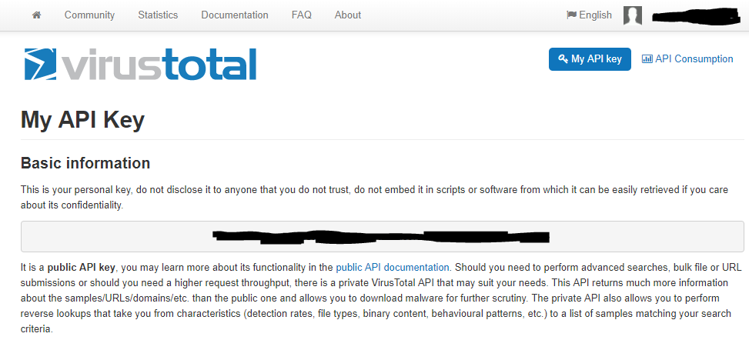
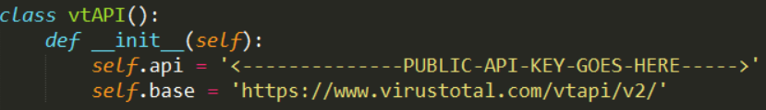
Using zergRush
Open VirusTotal account
Retrieve VirusTotal profile API key
Open zergRush.py
PasteAPI key under corresponding section

Slide 8
Using zergRush
Open cmd.exe
Execute the following command in the format of:
>python ../../zergRush.py ../../directoryOfChoice –s/v/j/r

Slide 9
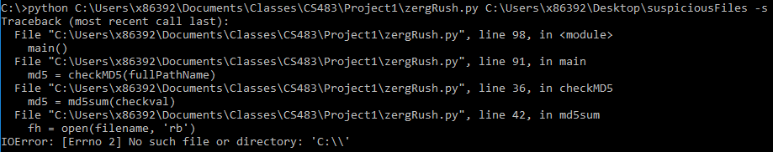
Does It Work?
No

Slide 10
Follow On Work
Resolve Pathing Error
Incorporate other scanning services such as Metacan online, VIRscan, and Jotti
Create executable that takes user API key as input to prevent modification of source file.
Segregate scanned files into separate subdirectories based on detection rates
Buckets of High Risk, Medium Risk, Low Risk

Slide 11
Works Cited
Meyers, Adam and Chris Clark. The large majority of this file is taken from the vtlite.py file from their VirusTotal_API_Tool repository. Lines 9-77, 79-87, and 91-98 are unmodified from the original vtlite.py file. These were retained to maintain basic functionality of generating MD5 hashes for individual files and running them through the VirusTotal API. The additional optional arguments were also retained as the user will still be allowed to specify the degree of detail in the returned reports for all files. The source repository can be found at https://github.com/Xen0ph0n/VirusTotal_API_Tool. West Point, NY. 29 APR 2018.
DiveIntoPython. I used the code present on this website to find the path name and absolute path names of files. This can be seen in lines 8, 89, 90, and 91. I imported os, called for the directory path portion of the file within the Directory, and then called for the absolute path of that directory path portion. This absolute path of the file would then be used as input in the checkMD5 function. The borrowed code can be found at http://www.diveintopython.net/functional_programming/finding_the_path.html within the codeblock of Example 16.3. West Point, NY. 29 APR 2018.
Zergling: https://lezisell.deviantart.com/art/Starcraft-2-Zergling-XPS-ONLY-614279827
Terran Base: http://www.dadsgamingaddiction.com/wp-content/uploads/2012/02/screenshot2012-02-08-20_51_27.jpg
Zerg Rush: http://farm4.static.flickr.com/3459/3237728456_4dc64a8aaf_o.jpg

