Slide 1




CTA Dark matter analysis with gammapy
Gammapy Coding Sprint
Observatoire de Paris
25/02/2019
An extension of the Dark Matter package
Judit Pérez-Romero, judit.perez@uam.es, IFT UAM-CSIC
Jose Enrique Ruiz, jer@iaa.es, IAA-CSIC
Miguel Á. Sánchez-Conde, miguel.sanchezconde@uam.es, IFT UAM-CSIC
Gonzalo Rodríguez, grferna@roma2.infn.it, Sezione INFN di Tor Vergata

Slide 2
Gammapy Coding Sprint
Observatoire de Paris
outline
Context of the project
CTA Dark Matter community
Brief introduction to Dark Matter science
Proposal for Gammapy: An extension of the dark matter package
Notebook work flow
Summary

Slide 3

Gammapy Coding Sprint
Observatoire de Paris
Context of the project
Project started in July 2018:
Perform an state-of-the-art study of the capabilities CTA has for Dark Matter searches, mainly using Galaxy Clusters as targets
Need of a software to perform the analysis: Gammapy
Existence of a basic dark matter utilities package: https://tinyurl.com/y3puzrl5
Embedded in the CTA Dark Matter SWG:
General need of a software to perform the characteristic Dark Matter analysis
Notes:
My project started in July 2018 and the and the main goal is to perform an state-of-the-art study of the capabilities CTA has for Dark Matter searches, mainly using Galaxy Clusters as targets.
Después de hablarlo con masc y jer, se decide que es una Buena opcion usar gammapy. Despues del coding sprint en la UCM y de una visita a jer en Granada, llegamos a la conclusion de que el modulo que ya existe en gammapy para hacer analisis de dm es muy básico, y que para poder hacer state-of-the-art se necesita ampliar el paquete con nuevas features.
Python codigo abierto, herramienta más cara el future, en el context de la tesis venía mejor, learning skills, más flexible→ Al ser más flexible, más abierto, es más fácil adaptar e incluir features para las necesidades del grupo de DM, que con posibilidad de el paquete pueda crecer conforme crezcan los modelos de dm

Slide 4
Gammapy Coding Sprint
Observatoire de Paris
CTA Dark matter community
CTA Collaboration developed an ambitious Dark Matter Programme: CTAC17
https://arxiv.org/abs/1709.07997
Dark Matter SWG Coordinators:
General document for CTA Dark Matter searches:
https://tinyurl.com/yylbj8t8
More than 150 people working in different projects!
Miguel Á. Sánchez-Conde (IFT UAM-CSIC, Spain)
Gabrijela Zaharijas (U. Nova Garica, Slovenia)
Notes:
Puntualización, comunidad active unas 30 personas

Slide 5
Gammapy Coding Sprint
Observatoire de Paris
Consortium papers within Dark Matter SWG:
Galactic Center (KSP) Shared with Diffuse SWG
Dwarf Spheroidal Galaxies Dark Matter Exclusively!
Galaxy Clusters (KSP) Shared with Cosmic Rays SWG
Large Magellanic Cloud (KSP) Shared with Diffuse SWG
Axion-Like Particles Shared with Gamma-ray Propagation Task Force
More non-consortium projects from CTA researchers
CTA Dark Matter SWG webpage for more info:
https://portal.cta-observatory.org/WG/PHYS/SitePages/Dark Matter and Exotic Physics SWG.aspx
Notes:
Non-consortium papers: some of them are non-consortium because the study extends beyond the ksp initially settled in the cta science paper
Regular meetings each month

Slide 6
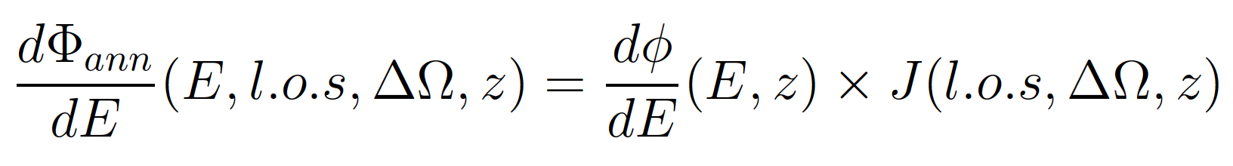
Gammapy Coding Sprint
Observatoire de Paris
WIMp Dark matter science
Dark Matter (DM) flux:
Total DM flux coming from an astrophysical object
Particle Physics Model
Astrophysical Model
Difficult to parametrize analytically
All WIMP models are tabulated in Cirelli+12
Accounts for the DM distribution of the object
State-of-the-art computations:
Strong simulation efforts are needed
E = Energy
l.o.s = Line of sight
ΔΩ = Angular extension
z = redshift
Notes:
Tablas de Cirelli: Mirar cuales son, hay espacio para mejorar el flujo (implementar EBL?), solo wimps
Lo que hay en gammapy es toy model de los J-factor, el grupo del que vengo state of the art expertise to model this part, a lot of feature regarding the inner structure of the object and also its dynamics

Slide 7
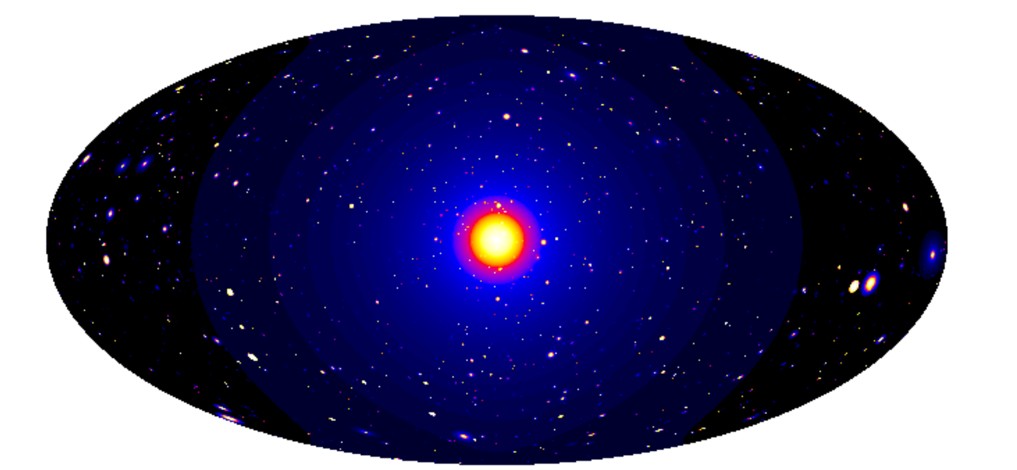
Gammapy Coding Sprint
Observatoire de Paris
Dark Matter induced gamma-ray sky simulation
Galactic Centre
Milky Way Halo
Galaxy Clusters
Dwarf Satellite Galaxies
Pieri+09, arXiv:0908.0195
Notes:
Just some examples of the targets that can be used to study dark matter (AGNs for ALPs), remark the idea that the modelling of the dm distribution depends a lot on the target complexity and most of the cases needs a more sophisticated computation that the one already in gammapy (even less that a first order approximation)

Slide 8

https://clumpy.gitlab.io/CLUMPY/
C/C++ code widely used by the DM community to compute J-factors for different structures
A lot of parameters regarding inner structure of the objects are allowed to tune
State-of-the-art modelling of the astrophysical DM component
https://docs.gammapy.org/dev/astro/darkmatter/index.html?highlight=primaryflux

Slide 9
Gammapy Coding Sprint
Observatoire de Paris
Proposal for gammapy
Create a tutorial notebook
(maybe two) for this analysis pipeline
Create a standard analysis pipeline for DM searches
Make an extension of the existing dm-package
Add some new classes
Refactorize the code
CTA Dark Matter SWG needs
Gammapy Implementations
Notes:
Talking with JER, the best way to do it would be through the creation of a (some) notebook.
Hay códigos cocinados, pero lo importante es que gammapy sea capaz de leer los datos tabulares de modelos de DM y 2Dskymaps

Slide 10
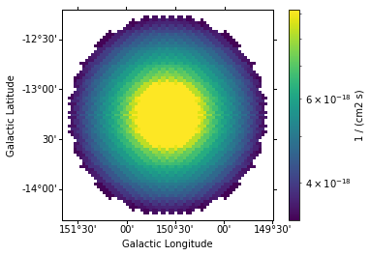
Gammapy Coding Sprint
Observatoire de Paris
Input J factor
(Clumpy/own cooked file):
One value
2D skymap
Clumpy 2d skymap
CTA IRFs
Total DM flux dphi/dE:
Spatial information
Spectral informatio
Plot of a typical spectrum
Particle Physics Model in Gammapy
(already dm-package)
Notes:
Leyenda de colores

Slide 11
Gammapy Coding Sprint
Observatoire de Paris
Signal!:
Treat as an usual astrophysical source
3D analysys
CTA IRFs
No Signal:
Flux Upper limits obtained by fitting the ‘data'
Data with the rand smoothing?
Sigma-v plot
Constraints in the DM parameter space
Notes:
Leyenda de colores

Slide 12
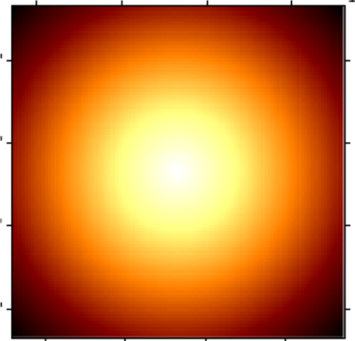
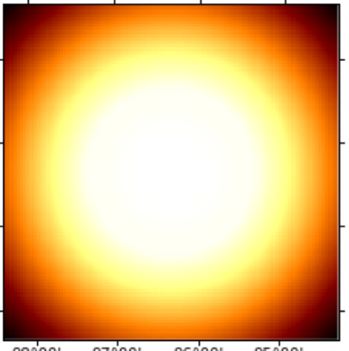
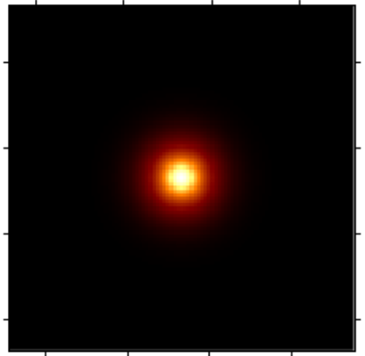
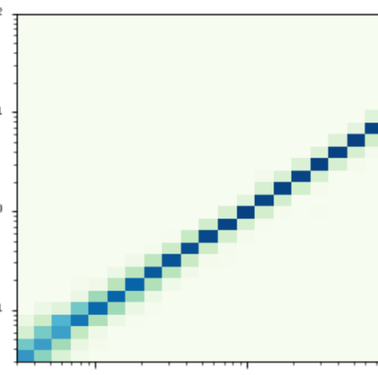
Notebook
Load IRFs
South z=20º T=50h
Build DM Emission Model
Define map geometry
Spatial
Spectral
- source position
- spatial range /bins
- energy range /bins
SkyPointSource
Parametrized User Model
- j-factor . number
- mass
- channel
Derive ancillary IRF maps
.could also be a 2D Map
- cross-section
Observational values
- pointing
- lifetime
- offset
Evaluate Fixed Reference 3D Model
exposure
background
- mass 5000 GeV
- annihilation channel b
using ancillary IRF maps
PSF
Edisp

Slide 13
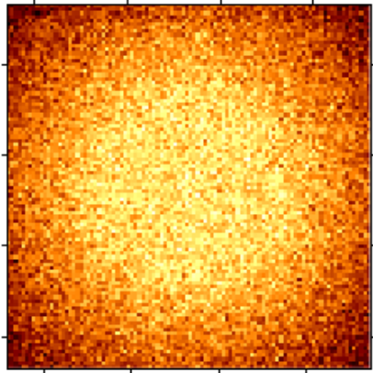
Fixed Reference Model
Build a set of models
- mass range
- channel list
- mass 5000 GeV
- annihilation channel b
MapFit
LRT
UL norm value
add random Poison noise
MapFit
LRT
UL norm value
MapFit
LRT
UL norm value
Loop n runs
MapFit
LRT
UL norm value
derive norm values on 95% CI of detection
take the mean values
9 runs of 7 Mapfit + LRT each ~ 4.5 min

Slide 14
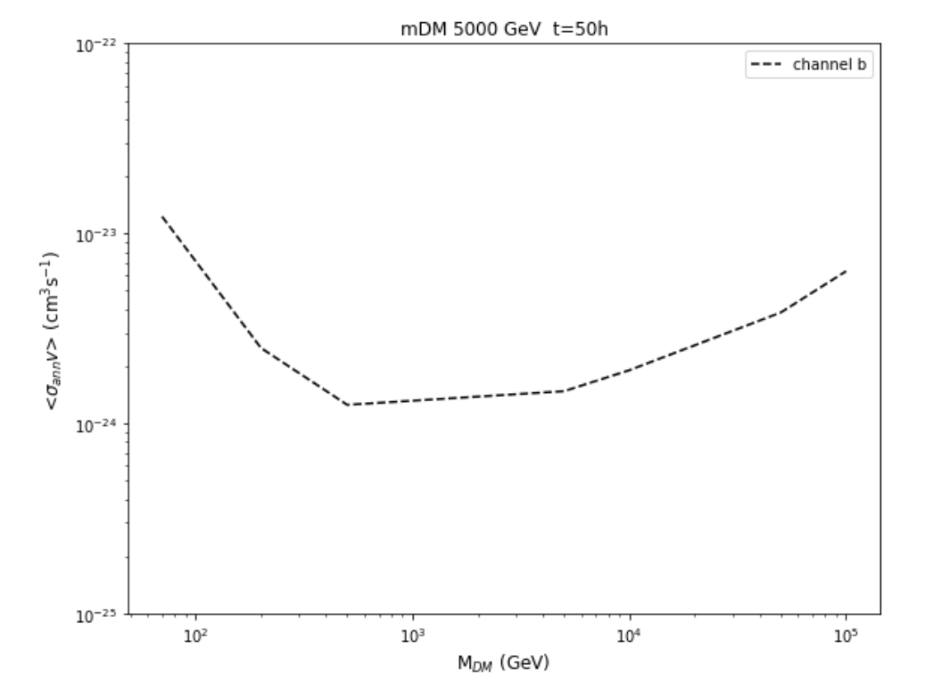
for a reference model
- mass 5000 GeV
- annihilation channel b

Slide 15
summary

