Slide 1




CTA Dark matter analysis with gammapy
Gammapy Coding Sprint
Observatoire de Paris
25/02/2019
An extension of the Dark Matter module
Judit Pérez-Romero, judit.perez@uam.es, IFT UAM-CSIC
Jose Enrique Ruiz, jer@iaa.es, IAA-CSIC
Miguel Á. Sánchez-Conde, miguel.sanchezconde@uam.es, IFT UAM-CSIC
Gonzalo Rodríguez, grferna@roma2.infn.it, Sezione INFN di Tor Vergata

Slide 2
Gammapy Coding Sprint
Observatoire de Paris
outline
Context of the research project
CTA Dark Matter community
Brief introduction to Dark Matter science
Proposal for Gammapy: Dark Matter analysis pipeline and dm-module extension
An example notebook and workflow
Summary

Slide 3

Gammapy Coding Sprint
Observatoire de Paris
Context of the research project
Project started in July 2018:
Perform an state-of-the-art study of the capabilities CTA has for Dark Matter searches, mainly using Galaxy Clusters as targets
Need of a software to perform the analysis: Gammapy
Existence of a basic dark matter utilities notebook:
https://docs.gammapy.org/dev/notebooks/astro_dark_matter.html
Embedded in the CTA Dark Matter SWG:
General need of a software to perform the characteristic Dark Matter analysis
Notes:
My project started in July 2018 and the and the main goal is to perform an state-of-the-art study of the capabilities CTA has for Dark Matter searches, mainly using Galaxy Clusters as targets.
Después de hablarlo con masc y jer, se decide que es una Buena opcion usar gammapy. Despues del coding sprint en la UCM y de una visita a jer en Granada, llegamos a la conclusion de que el modulo que ya existe en gammapy para hacer analisis de dm es muy básico, y que para poder hacer state-of-the-art se necesita ampliar el paquete con nuevas features.
Python codigo abierto, herramienta más cara el future, en el context de la tesis venía mejor, learning skills, más flexible→ Al ser más flexible, más abierto, es más fácil adaptar e incluir features para las necesidades del grupo de DM, que con posibilidad de el paquete pueda crecer conforme crezcan los modelos de dm

Slide 4
Gammapy Coding Sprint
Observatoire de Paris
CTA Dark matter community
CTA Collaboration developed an ambitious Dark Matter Programme: CTAC17
https://arxiv.org/abs/1709.07997
Dark Matter SWG Coordinators:
General document for CTA Dark Matter searches:
https://forge.in2p3.fr/projects/dmep-swg-standards-and-conventions-for-cta-dm-analyses/wiki
More than 150 people working in different projects!
Miguel Á. Sánchez-Conde (IFT UAM-CSIC, Spain)
Gabrijela Zaharijas (U. Nova Garica, Slovenia)
Notes:
Puntualización, comunidad active unas 30 personas

Slide 5
Gammapy Coding Sprint
Observatoire de Paris
Consortium papers within Dark Matter SWG:
Galactic Center (KSP) Shared with Diffuse SWG
Dwarf Spheroidal Galaxies Dark Matter Exclusively!
Galaxy Clusters (KSP) Shared with Cosmic Rays SWG
Large Magellanic Cloud (KSP) Shared with Diffuse SWG
Axion-Like Particles Shared with Gamma-ray Propagation Task Force
More non-consortium projects from CTA researchers
CTA Dark Matter SWG webpage for more info:
https://portal.cta-observatory.org/WG/PHYS/SitePages/Dark Matter and Exotic Physics SWG.aspx
Notes:
Non-consortium papers: some of them are non-consortium because the study extends beyond the ksp initially settled in the cta science paper
Regular meetings each month

Slide 6
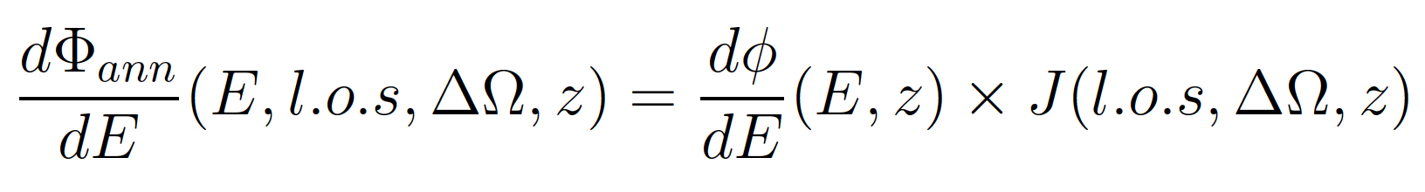
Gammapy Coding Sprint
Observatoire de Paris
WIMp Dark matter science
Dark Matter (DM) flux:
Total DM flux coming from an astrophysical object
Particle Physics Model
Astrophysical Model
Difficult to parametrize analytically
All WIMP models are tabulated in Cirelli+12
Accounts for the DM distribution of the object
State-of-the-art computations:
Strong simulation efforts are needed
E = Energy
l.o.s = Line of sight
ΔΩ = Angular extension
z = redshift
Notes:
Tablas de Cirelli: Mirar cuales son, hay espacio para mejorar el flujo (implementar EBL?), solo wimps
Lo que hay en gammapy es toy model de los J-factor, el grupo del que vengo state of the art expertise to model this part, a lot of feature regarding the inner structure of the object and also its dynamics

Slide 7
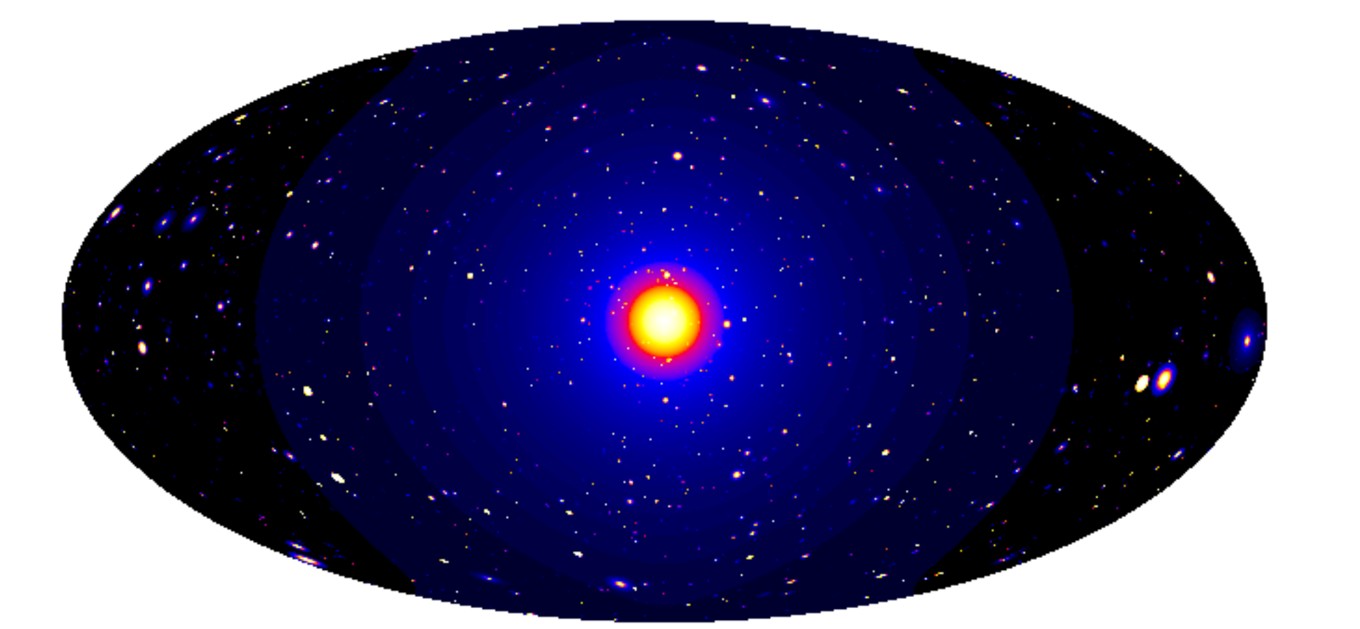
Gammapy Coding Sprint
Observatoire de Paris
Dark Matter induced gamma-ray sky simulation
Galactic Centre
Milky Way Halo
Galaxy Clusters
Dwarf Satellite Galaxies
Pieri+09, arXiv:0908.0195
Notes:
Just some examples of the targets that can be used to study dark matter (AGNs for ALPs), remark the idea that the modelling of the dm distribution depends a lot on the target complexity and most of the cases needs a more sophisticated computation that the one already in gammapy (even less that a first order approximation)

Slide 8

Gammapy Coding Sprint
Observatoire de Paris
https://clumpy.gitlab.io/CLUMPY/
C/C++ code widely used by the DM community to compute J-factors for different structures
A lot of parameters accounting for the inner structure of the objects
State-of-the-art modelling of the astrophysical DM component
J-factor calculations in dm-module:
Toy models
Already suggested the possibility of cross checking the compatibility with Gammapy:
https://docs.gammapy.org/dev/astro/darkmatter/index.html?highlight=CLUMPY
Clumpy outputs:
Single value of the J-factor
2D skymap of the J-factor

Slide 9
Gammapy Coding Sprint
Observatoire de Paris
Proposal for gammapy
Create tutorial notebooks
for this analysis pipeline
Create a standard analysis pipeline for DM searches
Incorporate functionalities
Identify notebook needs
Make an extension of the existing dm-module
Add some new classes
Refactor code
CTA Dark Matter SWG needs
Gammapy Implementations
Notes:
Talking with JER, the best way to do it would be through the creation of a (some) notebook.
Hay códigos cocinados, pero lo importante es que gammapy sea capaz de leer los datos tabulares de modelos de DM y 2Dskymaps

Slide 10
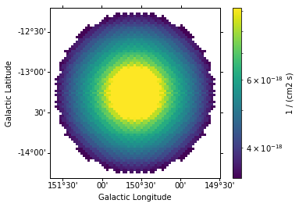

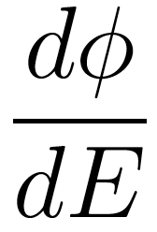
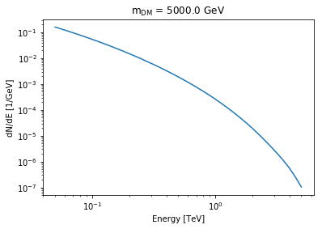
Gammapy Coding Sprint
Observatoire de Paris
Colour legend:
Already implemented in Gammapy (or minor improvements)
Needs to be implemented in Gammapy (or major improvements)
Needs to read in Gammapy (created outside Gammapy)
Input J factor
(Clumpy/own cooked file):
One value
2D skymap
2D skymap + mask
Particle Physics Model in Gammapy
(dm-module)
Notes:
Leyenda de colores

Slide 11
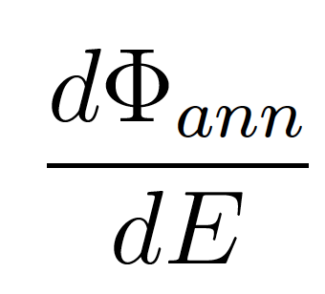
Gammapy Coding Sprint
Observatoire de Paris
Colour legend:
Already implemented in Gammapy (or minor improvements)
Needs to be implemented in Gammapy (or major improvements)
Needs to read in Gammapy (created outside Gammapy)
Input J factor
(Clumpy/own cooked file):
One value
2D skymap
2D skymap + mask
Total DM flux:
Spatial information
Spectral information
Particle Physics Model in Gammapy
(dm-module)
Notes:
Leyenda de colores

Slide 12
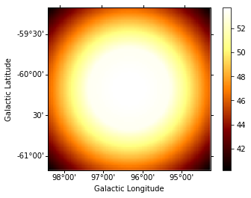
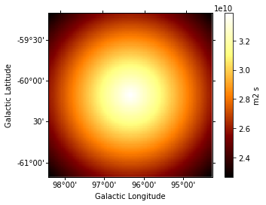
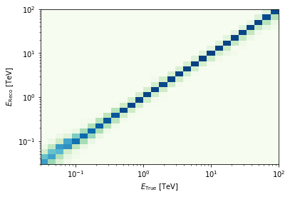
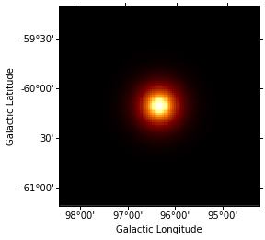
Gammapy Coding Sprint
Observatoire de Paris
Colour legend:
Already implemented in Gammapy (or minor improvements)
Needs to be implemented in Gammapy (or major improvements)
Needs to read in Gammapy (created outside Gammapy)
Input J factor
(Clumpy/own cooked file):
One value
2D skymap
2D skymap + mask
Total DM flux:
Spatial information
Spectral information
Particle Physics Model in Gammapy
(dm-module)
CTA IRFs
Notes:
Leyenda de colores

Slide 13
Gammapy Coding Sprint
Observatoire de Paris
CTA IRFs
Colour legend:
Already implemented in Gammapy
Needs to be implemented in Gammapy
Needs to read in Gammapy
Notes:
Leyenda de colores

Slide 14
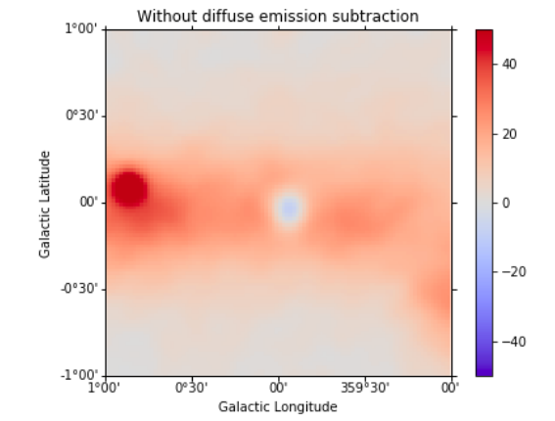
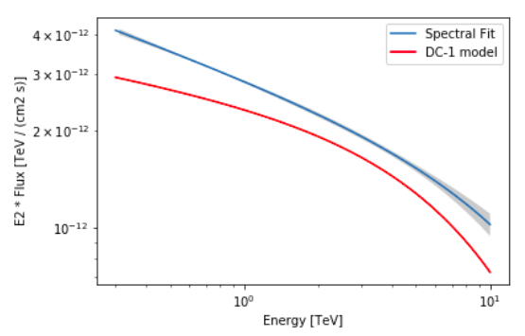
Gammapy Coding Sprint
Observatoire de Paris
Signal!:
Treat as an usual astrophysical source
3D analysis
CTA IRFs
Colour legend:
Already implemented in Gammapy
Needs to be implemented in Gammapy
Needs to read in Gammapy
Notes:
Leyenda de colores

Slide 15
Gammapy Coding Sprint
Observatoire de Paris
Signal!:
Treat as an usual astrophysical source
3D analysis
CTA IRFs
Flux upper limits obtained by fitting the simulation
No Signal
(typical in DM searches)
Colour legend:
Already implemented in Gammapy
Needs to be implemented in Gammapy
Needs to read in Gammapy
Notes:
Leyenda de colores

Slide 16
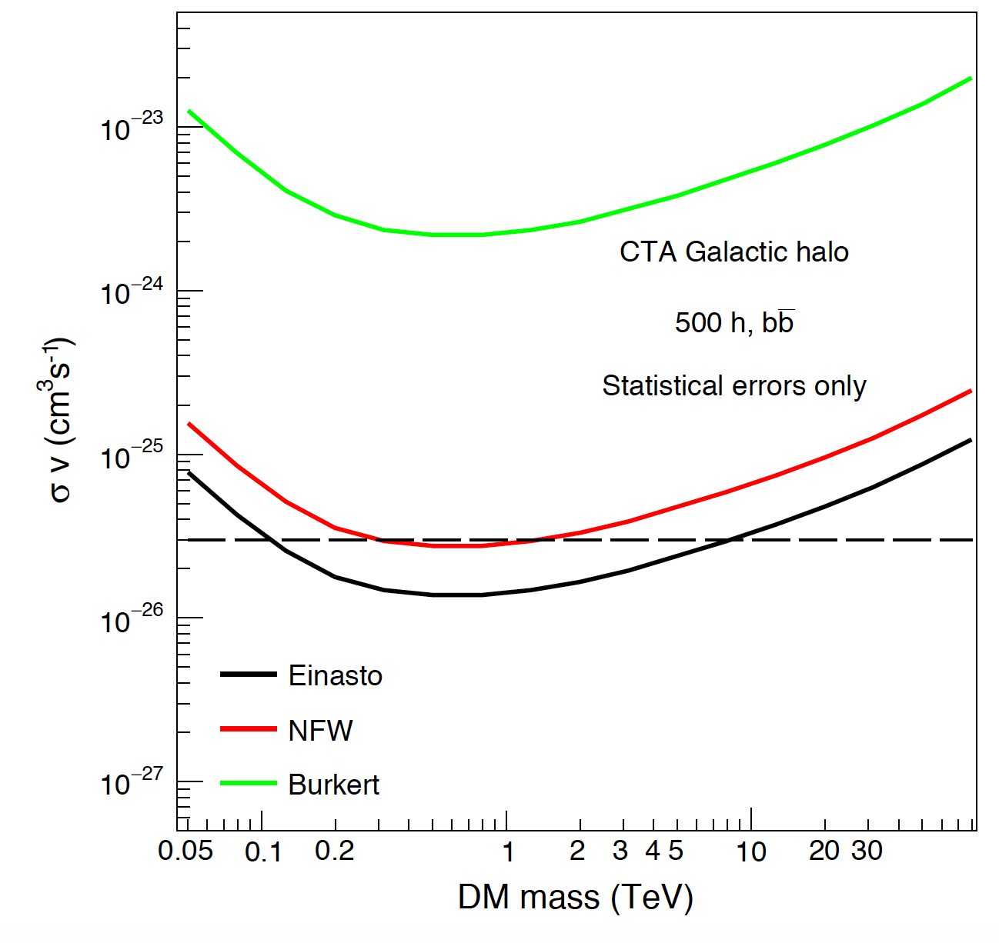
Gammapy Coding Sprint
Observatoire de Paris
Signal!:
Treat as an usual astrophysical source
3D analysis
CTA IRFs
Flux upper limits obtained by fitting the simulation
No Signal
(typical in DM searches)
Constraints in the DM parameter space
CTAC17, arXiv:1709.07997
Colour legend:
Already implemented in Gammapy
Needs to be implemented in Gammapy
Needs to read in Gammapy
<𝝈v> vs. DM mass
Notes:
Leyenda de colores

Slide 17
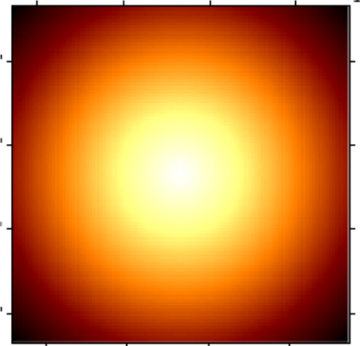
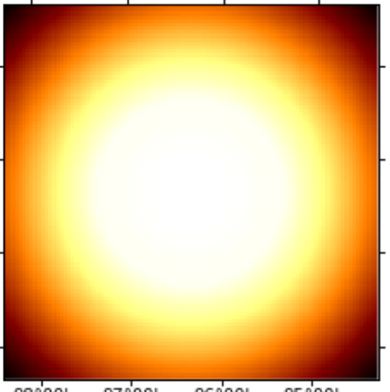
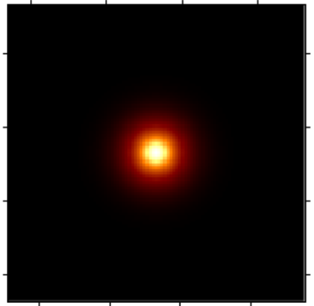
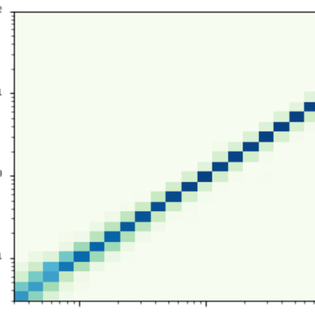
Gammapy Coding Sprint
Observatoire de Paris
An example notebook
Load IRFs
i.e. South z=20º T=50h
Build DM Emission Model
SkyPointSource
- j-factor .number
Spatial
Spectral
Define map geometry
- source position
- spatial range /bins
- energy range /bins
SkyDiffuseMap
Parametrized User Model
- j-factor .2D Map
- cross-section
- mass
- channel
Derive ancillary IRF maps
Observational values
- pointing
- lifetime
- offset
Evaluate Fixed Reference 3D Model
exposure
background
- mass 5000 GeV
- annihilation channel b
using ancillary IRF maps
PSF
Edisp

Slide 18
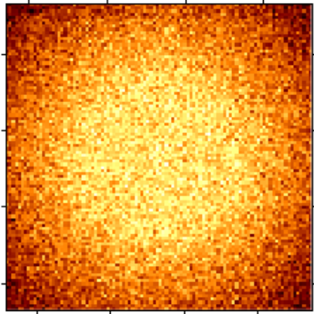
Gammapy Coding Sprint
Observatoire de Paris
Fixed Reference Model
Build a set of models
- mass range
- channel list
- mass 5000 GeV
- annihilation channel b
MapFit
LRT
cross section value i
add random Poison noise
MapFit
LRT
cross section value j
MapFit
LRT
cross section value k
Loop n runs
MapFit
LRT
cross section value n
derive cross section values on 95% CI of detection
take the mean values
9 runs of 7 Mapfit + LRT each ~ 4.5 min

Slide 19
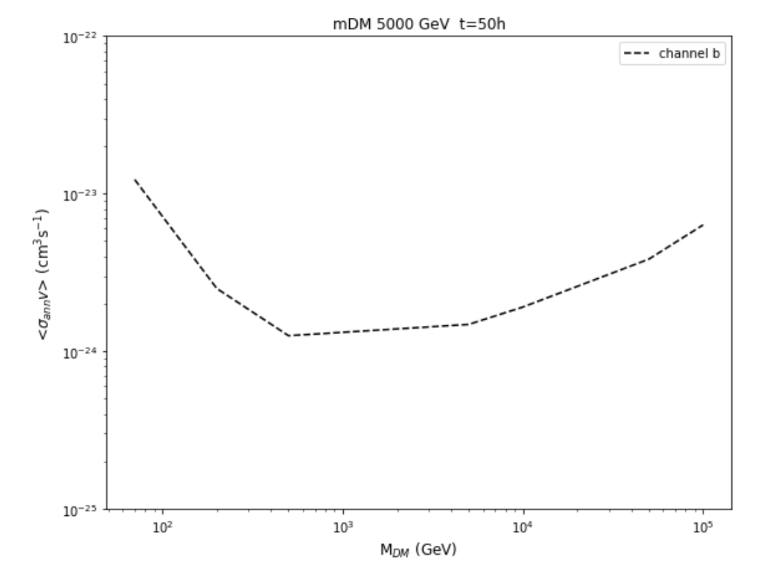
Gammapy Coding Sprint
Observatoire de Paris
for a reference model
- mass 5000 GeV
- annihilation channel b

Slide 20
Gammapy Coding Sprint
Observatoire de Paris
summary
Identified the need in the CTA DM community of the standard analysis software for DM searches
Why Gammapy?
Reviewed the standard WIMP Dark Matter scenario, common to CTA DM community:
Need of tolerating J-factors computed outside Gammapy Compatibility with Clumpy outputs
Gammapy already includes state-of-the-art models for the particle physics term
Creation of standard DM analysis in the form of tutorial notebooks
Methodology: iterative progress between the notebook needs and the dm-module implementations
Work during the Coding Sprint:
Need of general feedback: Are there already functions in Gammapy built or that can be adapted?
Specific need: Likelihoods in MapFit
open code
easy to adapt the the DM community needs
speed in the computation
20

