Slide 1
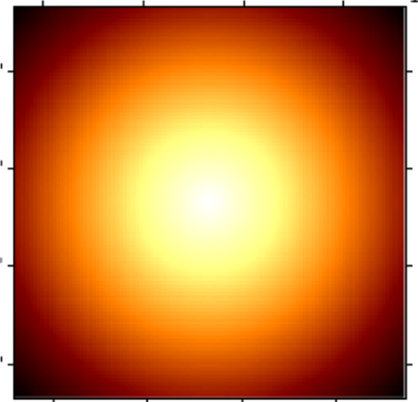
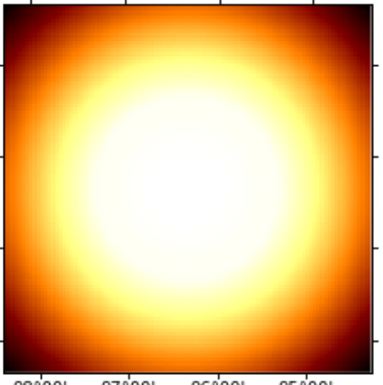
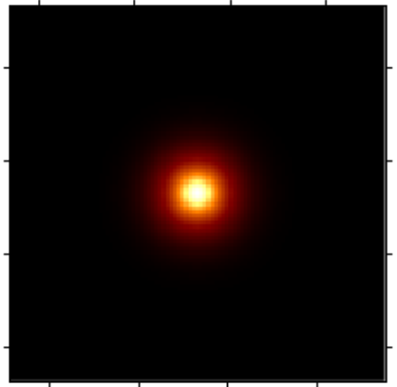
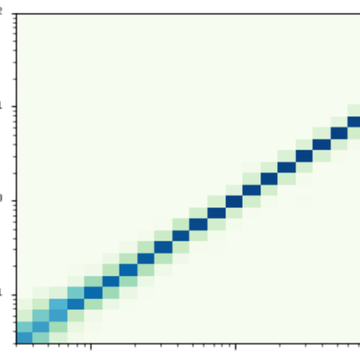
Load IRFs
i.e. South z=20º T=50h
Build DM Emission Model
SkyPointSource
- j-factor .number
Spatial
Spectral
Define map geometry
- source position
- spatial range /bins
- energy range /bins
SkyDiffuseMap
Parametrized User Model
- j-factor .2D Map
- cross-section
- mass
- channel
Derive ancillary IRF maps
Observational values
- pointing
- lifetime
- offset
Evaluate Fixed Reference 3D Model
exposure
background
- mass 5000 GeV
- annihilation channel b
using ancillary IRF maps
PSF
Edisp

Slide 2
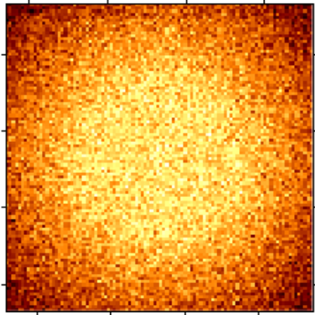
Fixed Reference Model
Build a set of models
- mass range
- channel list
- mass 5000 GeV
- annihilation channel b
MapFit
LRT
cross section value i
add random Poison noise
MapFit
LRT
cross section value j
MapFit
LRT
cross section value k
Loop n runs
MapFit
LRT
cross section value n
derive cross section values on 95% CI of detection
take the mean values
9 runs of 7 Mapfit + LRT each ~ 4.5 min

Slide 3
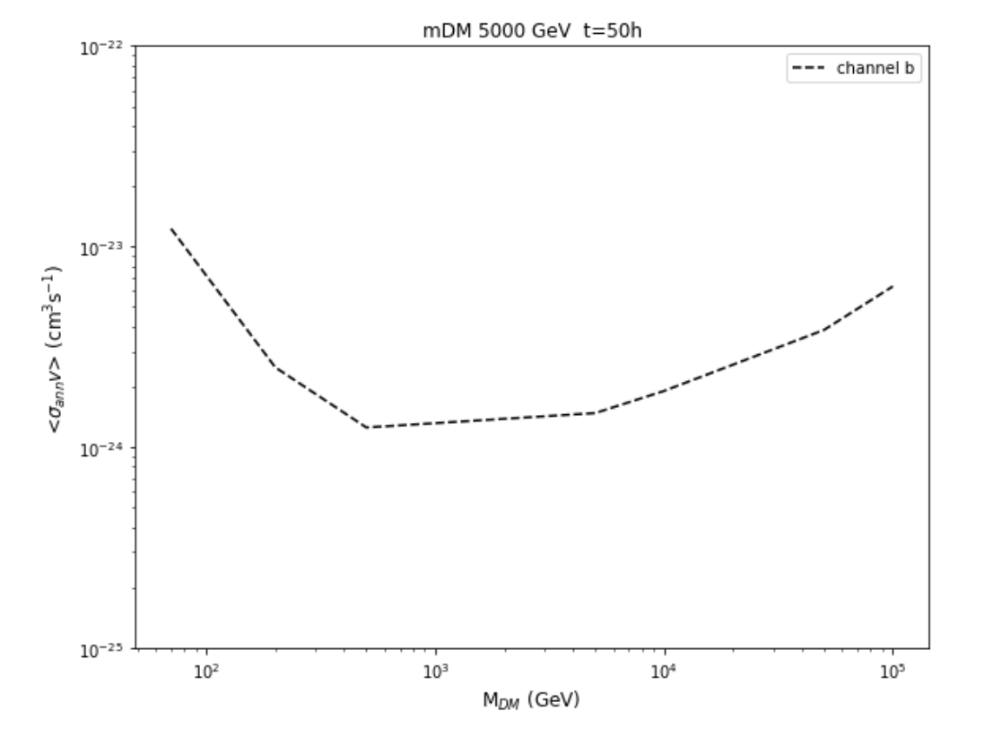
for a reference model
- mass 5000 GeV
- annihilation channel b

