Slide 1
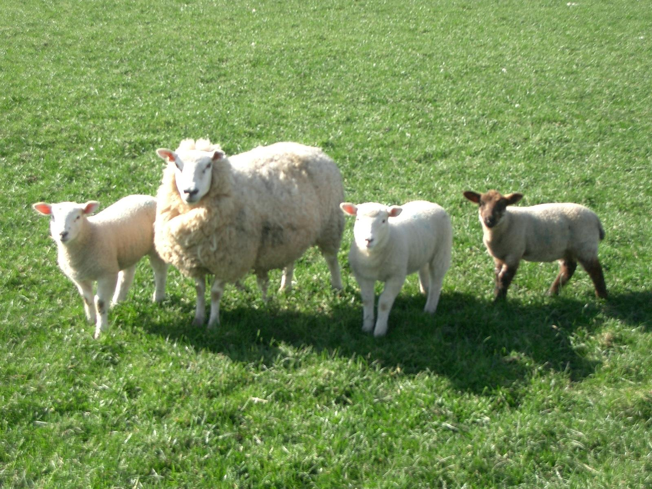
Gruppe 10
Sheep surveillance application

Slide 2
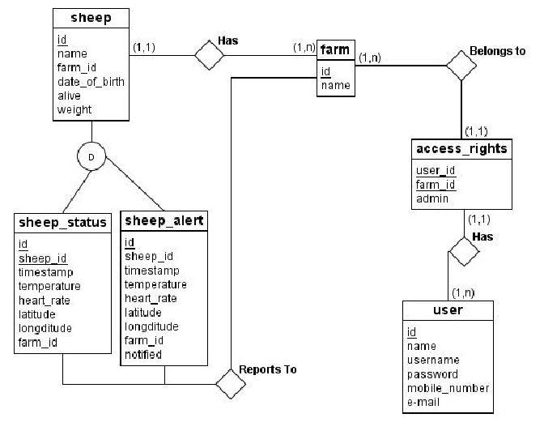
ER-diagram

Slide 3
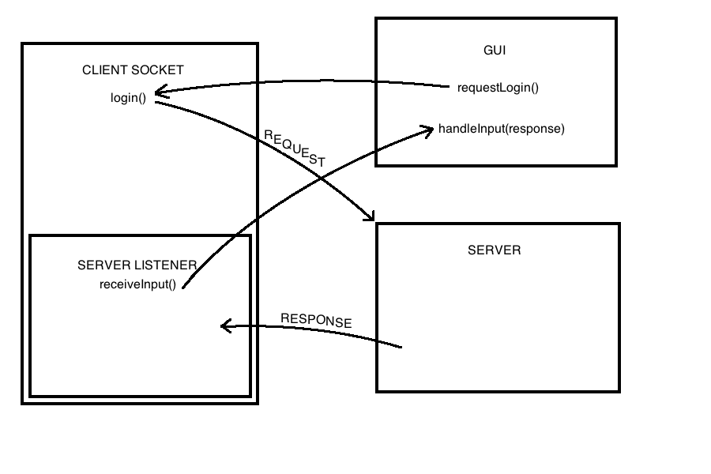
Serveroppsett

