Slide 2
About Baseline
Space Saving (SS)
Replace minimum(e_min) of Top with arriving element e when Top is full.
Positive count scenario only.
Fast( replace e_min and sort)
Count Min Sketch (CMS)
Map whole data stream S into rows with hashes.
Multiple hashes guarantee error bound.
Negative count scenario is fine.
Huge error due to hash collision
Slow (count and estimate min)

Slide 3
How to
Combine stream-summary (Top) and Sketch to achieve:
Fast
e_max to remember max element of Sketch.
Replace e_max with e_min as SS.
Accuracy
Hyperloglog to estimate distinct elements of a row in Sketch.
Query(e) by count * ratio of each element in a bucket.
Negative count support
Sketch support negative count.

Slide 4
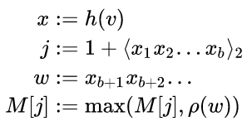
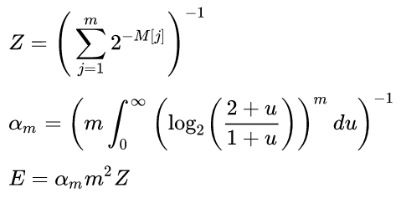
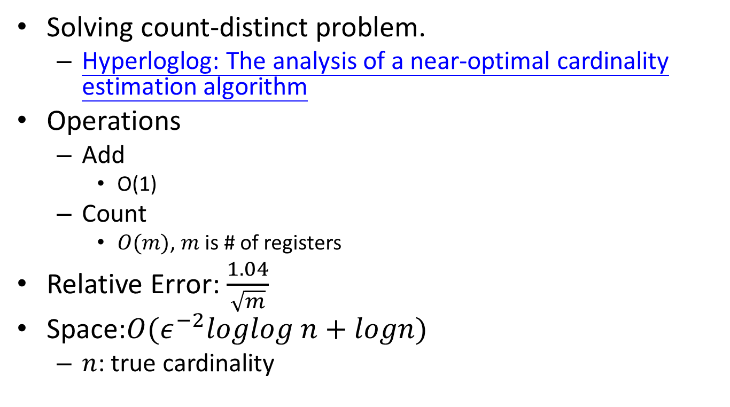
About Hyperloglog
Solving count-distinct problem.
Hyperloglog: The analysis of a near-optimal cardinality estimation algorithm
Operations
Add
O(1)
Count
$O(m)$, $m$ is # of registers
Relative Error: $\frac{1.04}{\sqrt{m}}$
Space:$O(ε^{−2}loglog n+logn)$
$n$: true cardinality

Slide 5
Settings
Top=[k]
Sketch=[depth][width]
Sketch_head=[depth]
hash1(x):[n]->[depth]
hash2(x):[n]->[width]
Main
For arriving e:
if e in Top:
Top[e]+=1
else:
UpdateSk(e)
if e_max.count > Top[min].count:
BringBack(e_max, Top[min])
Functions
UpdateSk(e):
row,col=get_index(e)
Sketch_head[row].total_count+=e.count
Sketch_head[row].distinct= hyperloglog.add(e)
Sketch[row][col]+=1
Update_local_max(e, Sketch_head[row])
Update_e_max(e_max, Sketch_head)
BringBack(e_max, e_min):
Swap(e_max, e_min, Top)
DeleteSk(e_max, Sketch)
UpdateSk(e_min, Sketch)
Query(e):
if e in Top:
return Top[e]
else:
row, col= get_index(e)
ratio=width/ Estimate_distinct_hyperloglog(Sketch_head[row])
estimate=Sketch[row][col]*ratio
return estimate

Slide 6
guarantee
All arriving count= count(Top) + count(Sketch)
count(Top) >= count(Sketch)

Slide 7
Dataset
Caida2016(1 / 10)
Distinct: 177,335
Arriving: 2,472,727
Kosarak
Distinct: 606,770
Arriving: 990,002
Webdocs(1 /20)
Distinct: 591,722
Arriving: 15,487,894

Slide 8
Performance-Caida0

Slide 9
Performance-Kosarak

Slide 10
Performance- Webdocs

