Slide 2
Settings
Top=[k]
Sketch=[depth][width]
Sketch_head=[depth]
hash1(x):[n]->[depth]
hash2(x):[n]->[width]
Main
For arriving e:
if e in Top:
Top[e]+=1
else:
UpdateSk(e)
if e_max.count > Top[min].count:
BringBack(e_max, Top[min])
Functions
UpdateSk(e):
row,col=get_row_col(e)
Sketch_head[row].total_count+=e.count
Sketch_head[row].distinct= hyperloglog.add(e)
Sketch[row][col]+=1
Update_local_max(e, Sketch_head[row])
Update_e_max(e, Sketch_head)
BringBack(e_max, e_min):
Swap(e_max, e_min)
DeleteSk(e_max, Sketch)
UpdateSk(e_min, Sketch)
Query(e):
if e in Top:
return Top[e]
else:
row, col= get_index(e)
ratio=width/ Estimate_distinct_hyperloglog(Sketch_head[row])
estimate=Sketch[row][col]*ratio
return estimate

Slide 3
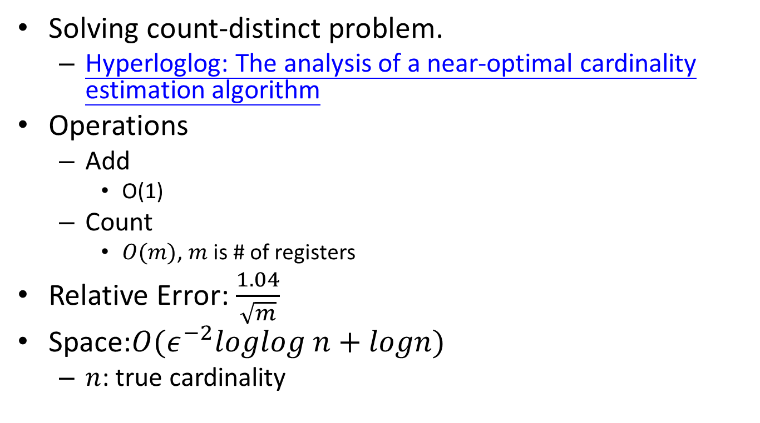
About Hyperloglog
Solving count-distinct problem.
Hyperloglog: The analysis of a near-optimal cardinality estimation algorithm
Operations
Add
O(1)
Count
$O(m)$, $m$ is # of registers
Relative Error: $\frac{1.04}{\sqrt{m}}$
Space:$O(ε^{−2}loglog n+logn)$
$n$: true cardinality

