Slide 1





The Battle of Neighborhoods
Vishal Jotwani
14th December 2020

Slide 2



OUTLINE
Introduction
Data Acquisition
Methodology
Data Preprocessing
Modeling
Results
Notebook
Discussion
Conclusion

Slide 3

INTRODUCTION
Kanpur and Lucknow are the two most important cities of Uttar Pradesh.
The two cities being in Uttar Pradesh have various similarities and dissimilarities.
This study focuses on finding the similarities within neighborhoods of each city.
This project helps business persons can set up their ventures like restaurants, hotels etc.

Slide 4

DATA ACQUISITION
The data of neighborhoods is collected through https://data.gov.in.
All India Pin code Directory contains all the pin-code list across India with geocodes and other relevant information.
Location data is collected using Foursquare API.

Slide 5
METHODOLOGY
Data Preprocessing
Appropriate columns like officename, pincode, districtname and the rows with districtname Kanpur Nagar and Lucknow are drawn from the dataset.
The new names are given to the columns, officename is converted into Neighborhood, pincode is given Pincode and districtname is given City.

Slide 6
METHODOLOGY
Data Preprocessing
S.O., B.O., H.O. and G.P.O which is removed from Neighborhood feature.
The dataset is grouped on the column Pincode.
New columns Latitude and Longitude are added to the dataset.
Foursquare API is used to collect location data for each neighborhood.

Slide 7
METHODOLOGY
2. Modeling
K-Means clustering, an unsupervised machine learning technique is used for segmentation of neighborhoods.
K-Means Clustering machine learning technique is used for finding similarities in neighborhoods of each city.
K is chosen as 5, which denotes the no. of clusters.

Slide 8
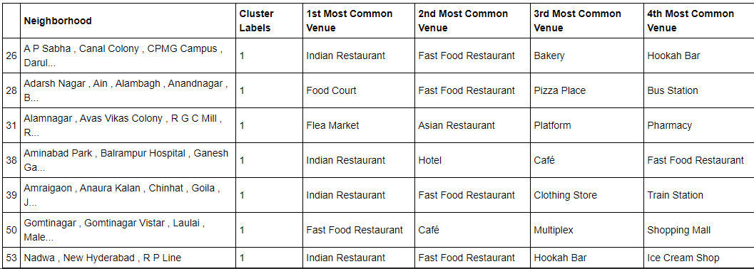
RESULTS
The neighborhoods of Lucknow are clustered through K-Means are as follows -
Table 1 : Cluster 1
Table 2 : Cluster 2

Slide 9
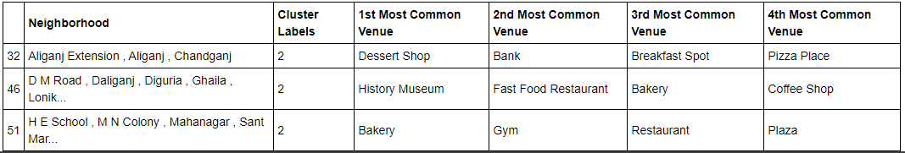
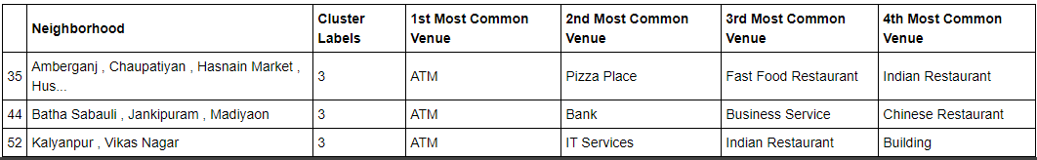
RESULTS
Table 3 : Cluster 3
Table 4 : Cluster 4

Slide 10
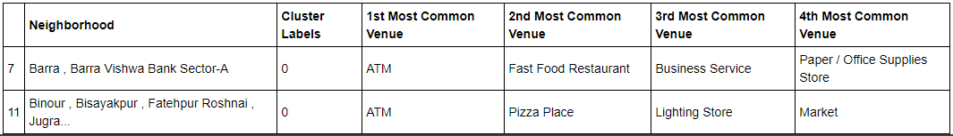
RESULTS
Table 5 : Cluster 5
The neighborhoods of Kanpur are clustered through K-Means are as follows -
Table 6 : Cluster 1

Slide 11
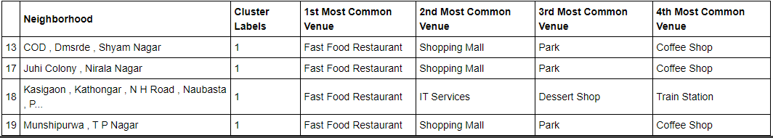
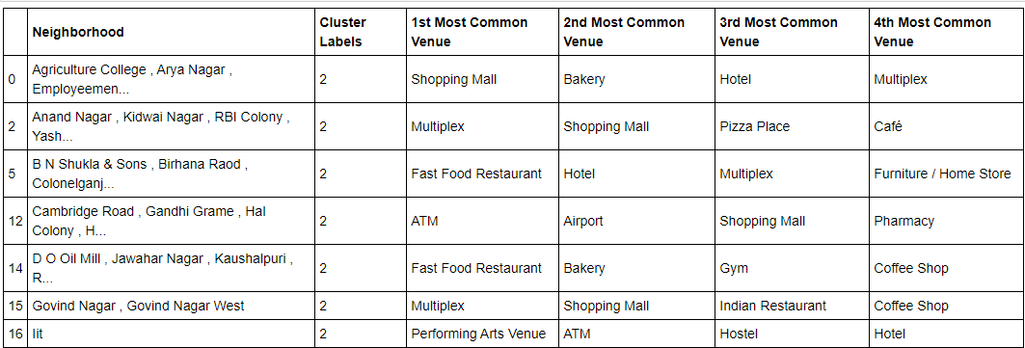
RESULTS
Table 7 : Cluster 2
Table 8 : Cluster 3

Slide 12
RESULTS
Table 9 : Cluster 4
Table 10 : Cluster 5

Slide 13

NOTEBOOK
The Battle of Neighborhoods.ipynb (github.com)

Slide 14
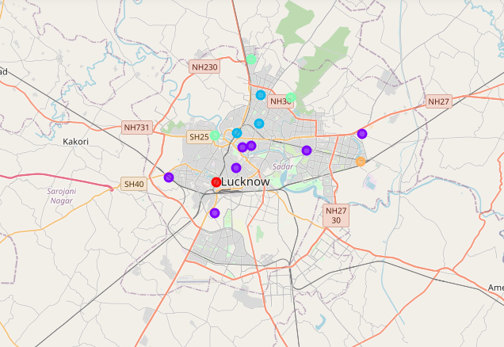
MAP OF LUCKNOW

Slide 15
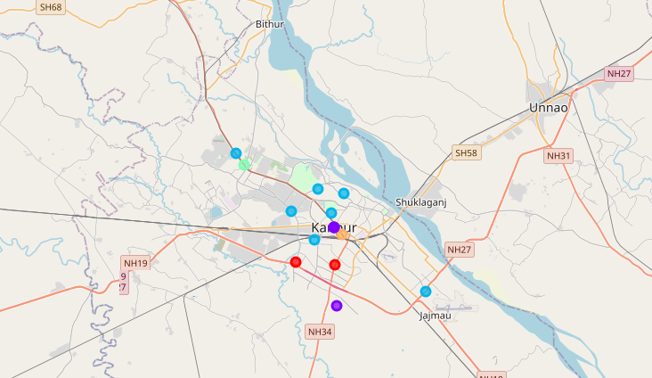
MAP OF KANPUR

Slide 16
DISCUSSION
In each of the neighborhood the most common venues include hotels, restaurants and cafes indicating that these are the most visited places in those neighborhoods.

Slide 17

CONCLUSION
In this study, similar neighborhoods of two largest cities of Uttar Pradesh, Kanpur and Lucknow are found.
For each neighborhood four most common venues are found which can help the business person to set up their business in that neighborhood, by providing an idea for which that neighborhood is famous.
The most common venues include hotels, restaurants and cafes.

