Slide 1
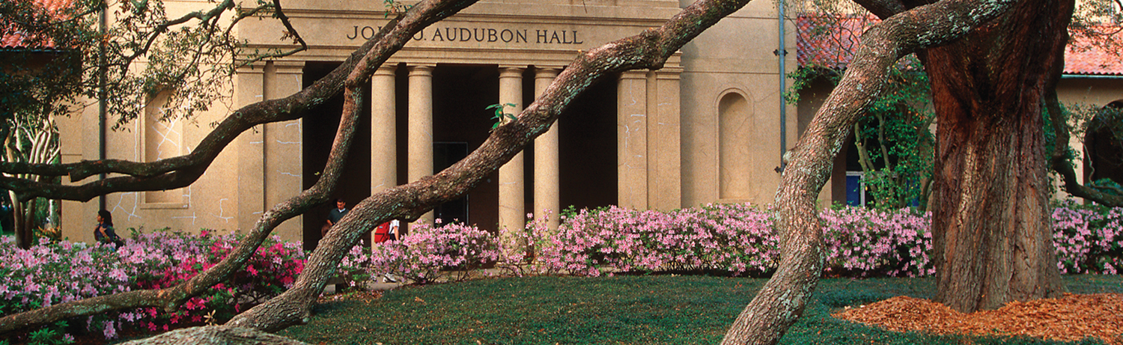


Toward Scalable, Concurrent and Parallel Garbage Collection
05.11.14
Hari Krishnan

Slide 2



Garbage Collection (GC)
In heap memory, objects hold pointer/reference/link to other object in the heap.
Stack variables and global variables hold reference to objects in heap. They are also called roots.
A node is said to be reachable if there is any path from root to the node.
Unreachable nodes are called garbage and memory allocated for those nodes can be reclaimed for future use.
So garbage collection is the process of collecting unreachable nodes in the heap.

Slide 3
Why memory management?
Memory is allocated.
But never used.
So application crashes out of memory availability.

Slide 4
How to collect garbage?
Garbage collection can be done manually and with help of runtime systems.
Manual Memory Management (MMM) is used by programmers who use languages with no managed run-time systems such as C/C++.
Automatic garbage collection or simply garbage collector (GC) is the thread that runs in the runtime systems(managed runtime systems) to automatically detect the garbage and reclaim them.
Garbage collectors are widely available in various runtime systems including Java Virtual Machine, LISP, and Scheme systems.

Slide 5

Why is MMM not good?
MMM might appeal to someone who wants to control the world! But in practice, it is not possible.
Dangling pointer is one of the serious issues of manual GC.
Memory Leak is another big concern that arises from not de-allocating dead objects.
Dangling Pointer and memory leak

Slide 6
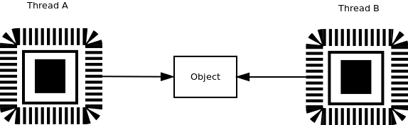
Can these issues be solved in MMM?
NO!
In concurrent programming, there is no easy way to solve these issues unless you borrow some ideas from GC algorithm.
In concurrent programming, dangling pointers and memory leaks are very common among the GC less run-time systems.

Slide 7
Advantages of GC
GC has the global knowledge to solve the dangling pointers and memory leaks issues on concurrent programming.
Software components when built does not need to worry about cleaning memory.
Reduces number of lines of code to write.
AHA! Boehm and Spertus announced that in the next C++ standard, GC can be expected! [Boehm and Spertus,2009]
Commercial Software Development research claims it reduces development cost. [Butters, 2007]

Slide 8
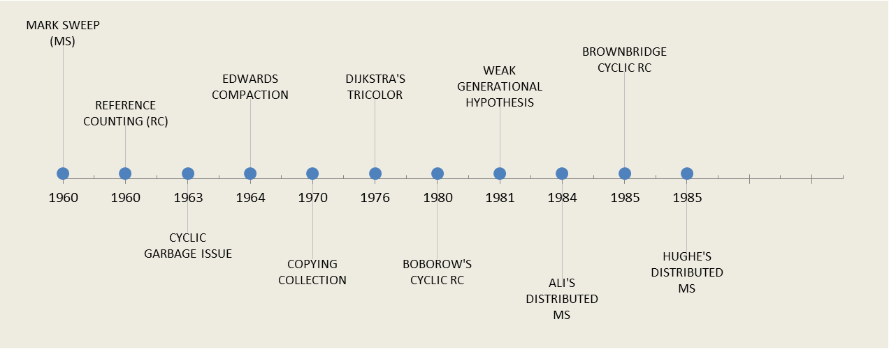
Literature Review

Slide 9
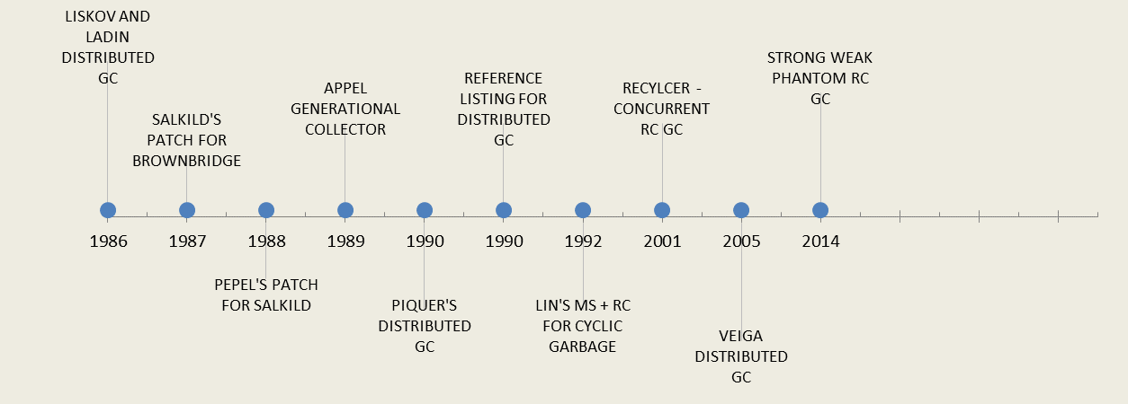
Literature Review

Slide 10
Mark-Sweep
When memory reached its threshold, the collector starts marking the nodes from the roots.
Mark and Sweep only needs one bit and can be easily made concurrent.
Garbage cannot be collected promptly.
The whole allocated heap is traversed for each collection as they first traverse all the live nodes and then they traverse all the dead nodes to delete.

Slide 11
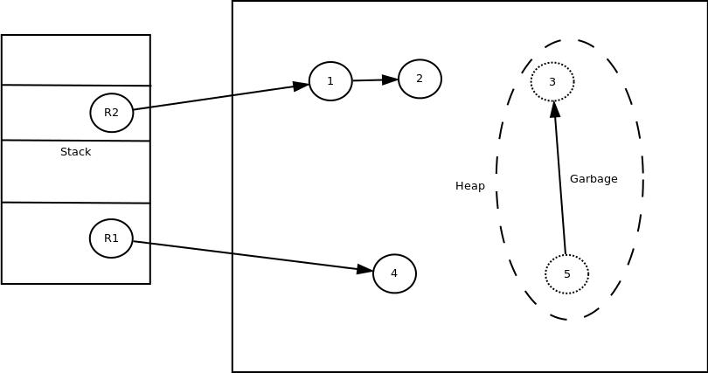
Mark-Sweep

Slide 12
Reference Counting (RC)
Each object has RC that denotes how many incoming references a node has.
When an object has zero RC, it is garbage. So collector starts deleting the nodes.
But the method cannot delete the cyclic garbage as all cyclic garbage nodes have positive RC.
Apart from inability to detect cyclic garbage, reference count has to updated for object when new reference is made or deleted to it.
Reference Counting method only traverses the garbage object.

Slide 13

Reference Counting

Slide 14
Compaction & Copying
MS creates fragmentation issues.
To and From space partition and traverse only live nodes and do compaction.
Copying collectors are very helpful when they are only very few objects left alive.
Apart from this advantage, only half of the memory is used by the application.

Slide 15
Dijkstra's Tricolor Method
The method uses three colors.
Black: A node is painted black If it is visited and immediate children of the nodes are visited. Collector need not visit them again.
Grey: A node is painted grey if it is visited and immediate children are not visited or if the node experience the change (add/delete link) since the last visit.
White : A node is white if it is garbage.

Slide 16
Ali's and Hughes' Distributed MS
In Ali’s method, each site uses MS to collect its own heap independently.
Incoming references from different machine is considered roots.
This algorithm allows each site to do collection at their own time.
But the cyclic garbage cannot be detected by this MS.
Hughes’ extended Ali's method to reclaim cyclic structure.
This method uses a centralized garbage collection that stops the application when the collection is initiated.

Slide 17
Brownbridge Method
RC and tracing based technique to collect cyclic garbage.
It uses two reference count instead of one.
Strong Reference count (SRC) and Weak Reference Count (WRC).
References are named as Strong and Weak.
All live nodes have positive SRC.
The invariant that this method strongly requires to follow is there are not cycles of strong references. So all cycle have at least one weak reference.
When a reference is created to a node, if the target node already has outgoing references, it is considered a weak reference.

Slide 18
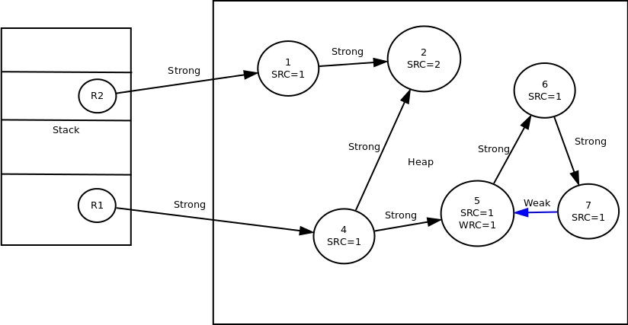
Brownbridge Method

Slide 19
Brownbridge Method
Delete Method
delete(SOURCE, DEST)
if(SRC(DEST)==1 && SOURCE->DEST is strong && WRC(DEST)>0)
delete the strong references and then convert all WRC to SRC(DEST)
for T in children(D) suicide(DEST,DEST->T)
if(SRC(DEST)==0) then
for T in children(DEST) delete(DEST,T)

Slide 20
Brownbridge Method
Suicide Method
Suicide (Start, SOURCE->DEST)
if SOURCE->DEST is strong then
if SOURCE == Start then make SOURCE->DEST to weak link
else if SRC(SOURCE)>1 then make SOURCE->DEST to weak link
else
for T in children(DEST) suicide( Start, DEST->T )

Slide 21
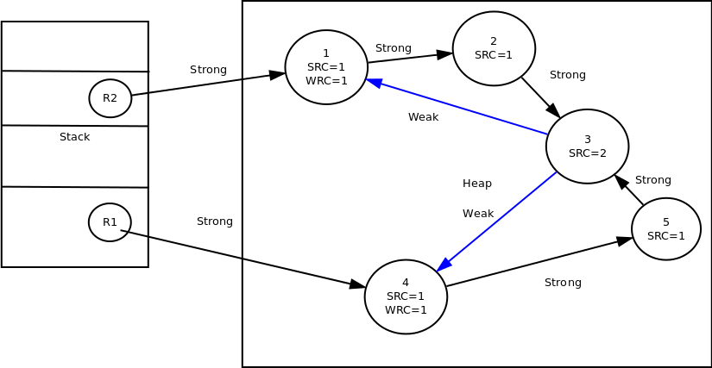
Delete Case

Slide 22
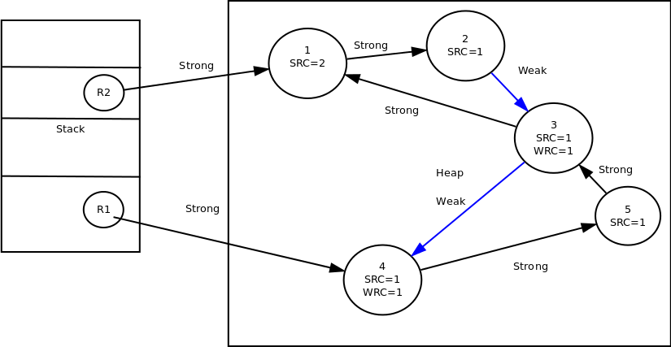
Premature Delete Case

Slide 23
Salkild's and Pepel's Work
Salkild eliminated the premature deletion but introduced non-termination in certain cases.
Pepel improved the Salkild’s work with trade-off of exponential cleanup cost.
So practically all of the attempts to correct the Brownbridge failed.

Slide 24
Recycler
Lin's algorithm uses colors to distinguish the node as we mentioned in Dijkstra's method.
David Bacon et al used the variant of Lin’s color algorithm to design a concurrent garbage collection.
Unlike Dijkstra's approach, this method uses reference counting along with tracing to identify cyclic garbage collection and runs concurrently.
Alas! Antony Hosking et al claims that the method is incomplete and proof is insufficient.

Slide 25
Proposed Hypothesis
Mark-Sweep traces all live objects and then detect garbage.
Pure Reference counting always traces only garbage object although cannot distinguish cyclic garbage.
Hybrid collector (MS + RC) traces potential garbage.
Generational collection traces full heap once in a while and always traces live objects in the young generation.
Distributed marks sweep does not work very well.

Slide 26
Proposed Hypothesis
For distributed systems, hybrid collector would be the best solution considering the communication and orchestration overhead involved in the other approaches.
So any hybrid collection that has good heuristics towards potential cyclic garbage perform better than other if it is optimized very well.
Apart from that, the hybrid collector that uses local knowledge to detect garbage does not incur orchestration overhead to identify cyclic garbage and ideal for distributed systems.

Slide 27
Preliminary Work
Strong-Weak-Phantom(SWP) Reference Count GC.
Based on Brownbridge cyclic RC GC.
Every node has three reference counts: Strong Reference Count (SRC), Weak Reference Count (WRC), and Phantom Reference Count (PRC).
Every edge/reference is classified as Strong, Weak, and Phantom. The use of Strong, Weak, and Phantom has to do nothing with Java's reference types.
The idea is to create a path from root to each live node through strong reference and avoid creating cycle of strong reference by using weak reference at the potential cycle creation event.
Every incoming strong reference increments SRC and respectively.
Phantom is a transient state that is used only in the cycle detection algorithm.

Slide 28
SWP
A positive SRC denotes the node is reachable from a root.
A node with zero SRC and positive WRC denotes the potential cyclic garbage.
A node with zero SRC and zero WRC denotes it is garbage.
A node with positive PRC denotes that node is processed by cycle detection algorithm.
Apart from reference counts, each node also has which bit, phantomized flag, and array of which bits for outgoing references.
The two bits for which bit and phantomized bit can be squeezed in the object headers and which for each reference is stored in the last bit of the reference address which are free due to 4 Byte addressing in many systems.

Slide 29
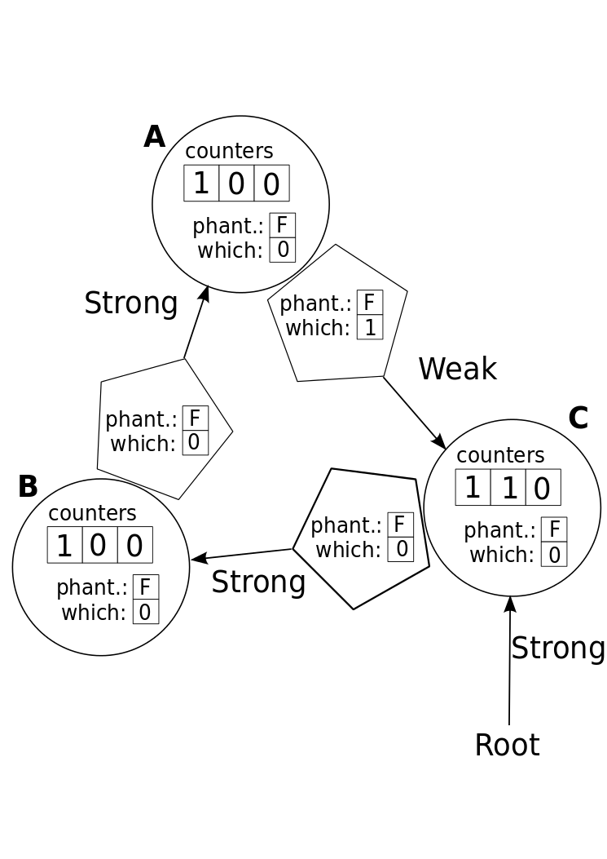
Object Header

Slide 30
Link Creation
When object is created, the first incoming link will be Strong Reference and SRC is incremented.
A link will be Weak when the link is created to when the node already has outgoing links.
This ensures that no cycle of strong reference is created.

Slide 31
Delete Link
When a node lose its last strong reference:
if(WRC==0 && PRC==0)
start deleting the node and delete all outgoing links
else if(WRC>0 )
convert all the incoming weak references to strong and phantomized
outgoing links

Slide 32
Phantomization
When an incoming link is phantomized, increment the phantom count and decrement appropriate RC.
if there is a positive SRC
stop phantomization
else if there is a positive WRC
convert all WRC to SRC and phantomized outgoing links

Slide 33
Three phases
Phantomize
Recovery
Cleanup
These three phases happen for each traversal initiated. Each collector thread maintains list of nodes it processed in each phase.

Slide 34
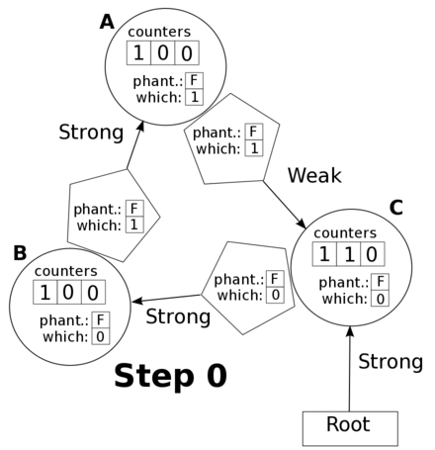
Simple Cycle Demo

Slide 35
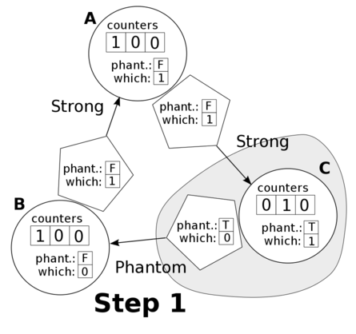
Simple Cycle Demo

Slide 36
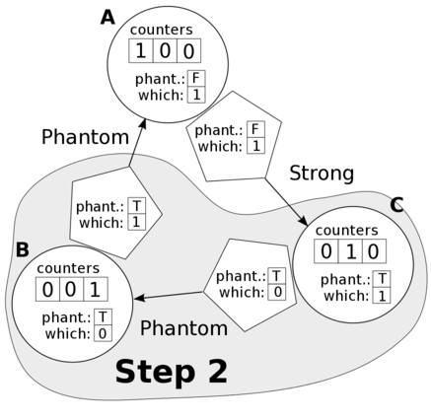
Simple Cycle Demo

Slide 37
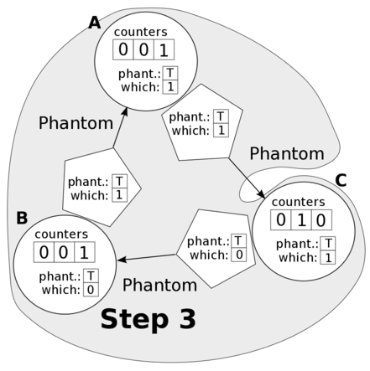
Simple Cycle Demo

Slide 38
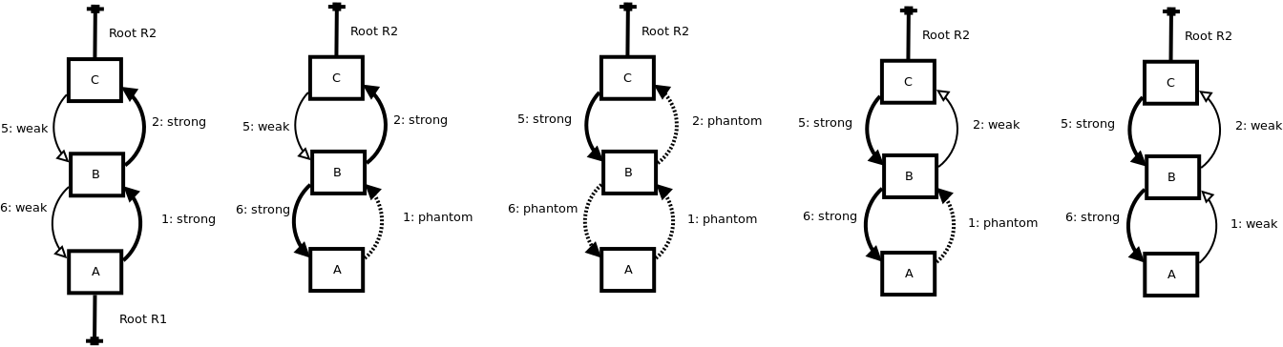
Doubly Linkedlist recovery Demo

Slide 39
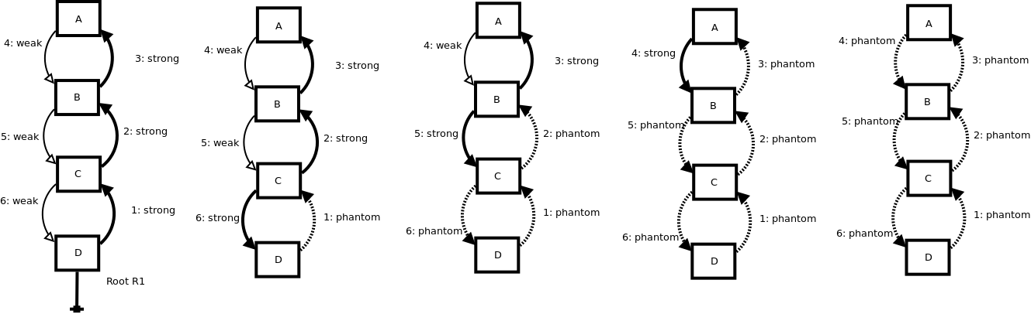
Doubly Linkedlist delete Demo

Slide 40
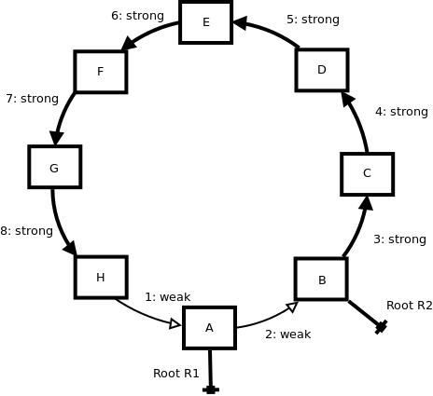
Traversal Optimization
Traversal Optimization
If Root R1 is deleted, traversal started at A will only traverse nodes till it finds a node with strong support. This substantially reduces the search space.
This method inherently has this optimization ability.

Slide 41
Concurrent and parallel Collector
Atomic operations can be used to access RCs.
SWP collection does not stop the application.
Requests are queued.
Collector thread process the queue and starts the requested tasks.
Collectors write their own id in collector id in parallel collector mode.
When collector visits a node with different id, then they synchronize.

Slide 42
Concurrent and parallel Collector
When two or more collector synchronizes, it merges their list of processed nodes and one of the collector takes the processing of those nodes.
Other collectors start to process the request in the queue.
Parallel collector adds one more attribute to the object header.

Slide 43
How SWP can be used?
SWP algorithm is directly applicable to shared memory systems.
SWP algorithm is also applicable to the distributed system with centralized queue.
Unlike other distributed systems which require application to be halted, this does not require it.
This collector can function concurrently as it is now, but requires centralized queues.
Mobile actor based collector does not require centralized queue and makes it directly applicable to the distributed systems.

Slide 44
Issues in SWP
Queue size is too big for mobile actors.
RC updates.
Too many object headers.

Slide 45
Future Work
Localized algorithm is necessary.
SWP concept helps to break the cycle and help detect cycle.
The distributed GC works are impractical due to one or more of the following reasons :
  Inability to detect cycles
  Moves object
  Weak heuristics to detect cycle
  No fault tolerance (Message Failure -> lost, late and duplicate)
  Centralized solution
  Stopping the world
  Not scalable
  Implement in an environment.

Slide 46
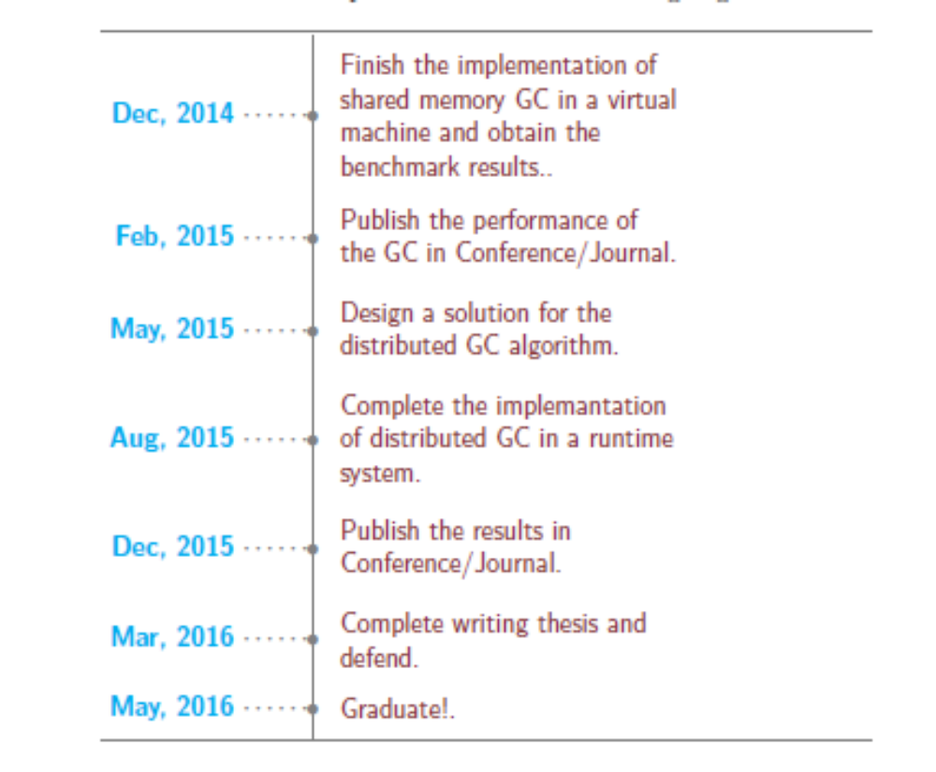
Future Work

Slide 47
Conclusion
This proposal discusses about previously published method.
The benefits of the method and its wide usage helped to better shape the future work and find the best possible solution in distributed garbage collection system.

