Slide 1
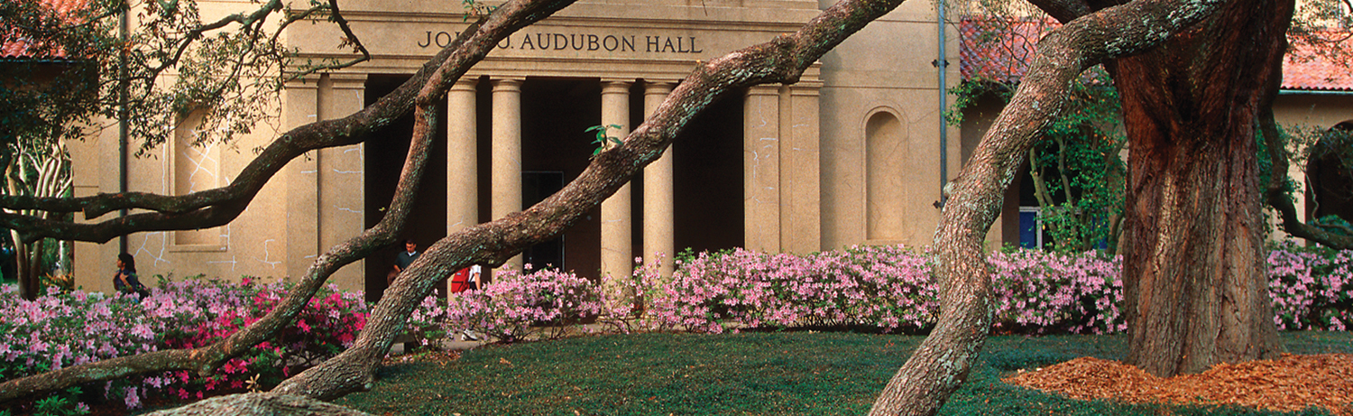


Garbage Collection for General
Graphs
06.10.16
Hari Krishnan

Slide 2



Garbage Collection (GC)
In heap memory, objects hold pointers/references/links to other objects in the heap.
Stack variables and static variables hold references to objects in the heap. They are called roots ( R ).
An object is said to be reachable / live if there is any path from a root to the object.
Unreachable objects are called garbage and memory allocated for those objects can be reclaimed for future use.
Garbage collection is the process of collecting unreachable objects in the heap.

Slide 3
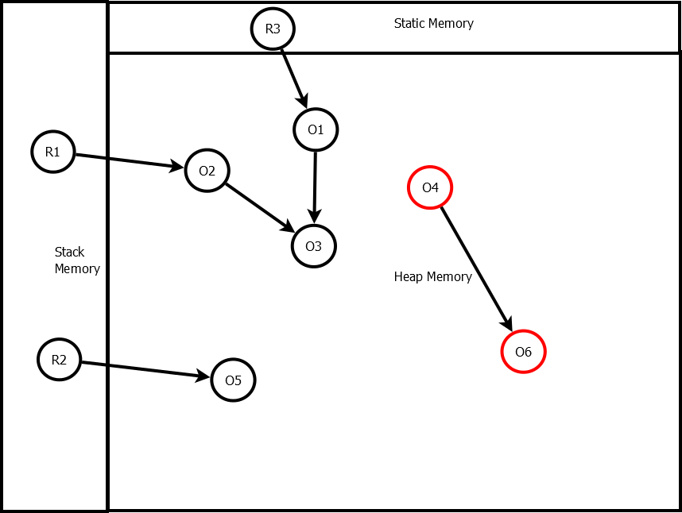
Garbage Collection (GC)

Slide 4
How to collect garbage?
Manual Memory Management (MMM) and Automatic Memory Management (GC).
MMM is used by programmers who use languages with no managed run-time systems such as C/C++.
GC is the thread that runs in the runtime systems(managed runtime systems) to automatically detect the garbage and reclaim them.
GCs are widely available in various runtime systems including Java Virtual Machine, LISP, and Scheme systems.

Slide 5
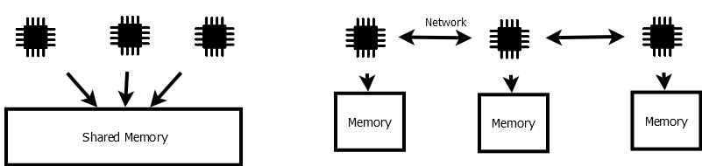
Dangling Pointers
Dangling pointer is a pointer that points to a deleted object.
Some other object is allocated in the same address in the interim time.
In MMM, simple reference counting based smart pointers can sometimes solve this problem in a concurrent programming environment.
We focus on concurrent programs and their environments in this presentation.

Slide 6
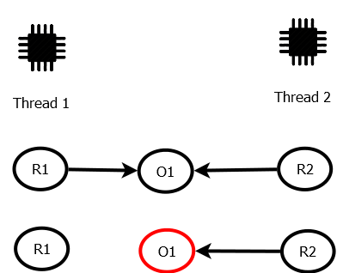
Dangling Pointers

Slide 7
Double-free Bugs (DFB)
DFB is pointer that points to a deleted object calls delete again.
Some other object is allocated in the same address in the interim time and creates dangling pointers, or crashes.
In MMM, simple reference counting based smart pointers can solve this problem in concurrent programming environment in an acyclic graph.
Otherwise, timestamps are used in lock-free algorithms to avoid this problem (similar to ABA ).

Slide 8
Memory Leak
Objects in heap memory are not referenced by any roots but not deleted.
Low memory utilization.
Cycles in the heap cannot be reclaimed by smart pointers.

Slide 9
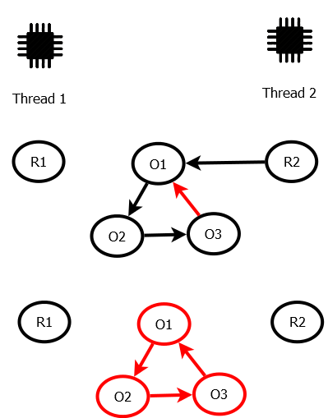
Memory Leak

Slide 10
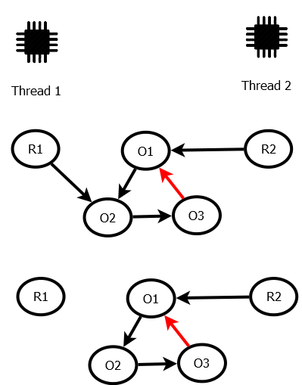
Memory Leak

Slide 11
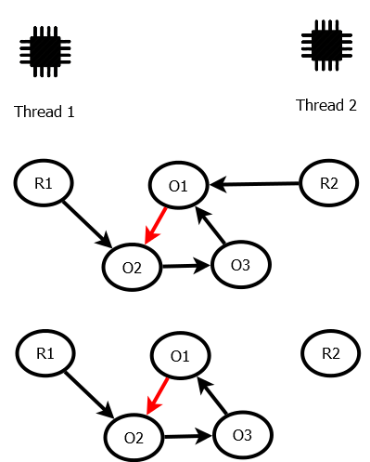
Memory Leak

Slide 12
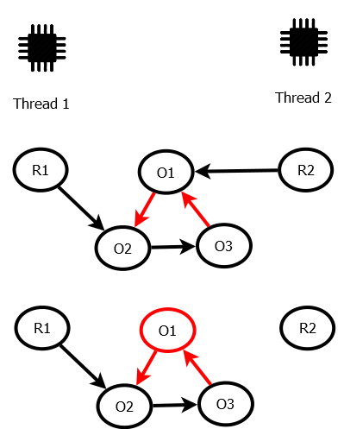
Dangling Pointer

Slide 13
Advantages of GC
GC has the global knowledge solves the problem of dangling pointers, double-free bugs and memory leaks.
Reduces number of lines of code to write.
AHA! Boehm and Spertus announced that in the next C++ standard, GC can be expected!
Commercial Software Development research claims GC reduces development cost. [Butters, 2007]
Distributed object stores, parallel and distributed programming languages, distributed databases, and WWW.

Slide 14
Mark-Sweep
When memory reached its threshold, the collector starts marking the nodes reachable from the roots.
Mark and Sweep only needs one bit and can be easily made concurrent.
Garbage cannot be collected promptly.
The whole allocated heap is traversed for each collection as they first traverse all the live nodes and then they traverse all the dead nodes to delete.

Slide 15
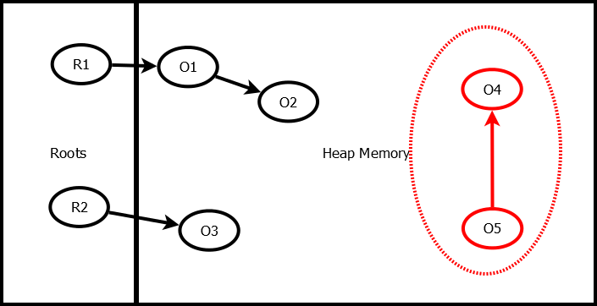
Mark-Sweep

Slide 16
Reference Counting (RC)
Each object has RC that denotes how many incoming references a node has.
When an object has zero RC, it is garbage.
But the method cannot delete the cyclic garbage as all cyclic garbage nodes have positive RC.
Apart from inability to detect cyclic garbage, reference count has to updated for object when new reference is made or deleted to it.
Reference Counting method only traverses garbage objects.

Slide 17
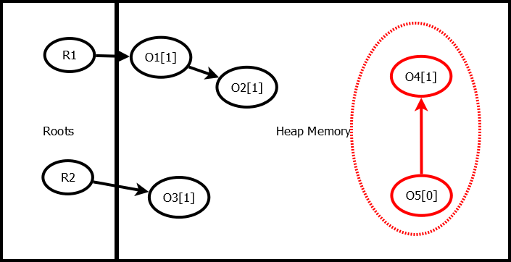
Reference Counting

Slide 18
Proposed Hypothesis
Concurrent GC (Less Pause Time)
Multi-collector GC (Parallel and High Throughput)
No global Synchronization (High Throughput)
Locality-based GC (High Throughput)
Scalable
Prompt
Safe
Complete

Slide 19
Literature Review
Name | C | MCA | GS | Locality | Scalable | Safe | Complete | Prompt | S/D
Mark Sweep | Yes | Yes | Yes | No | No | Yes | Yes | No | S & D
Reference Counting | Yes | No | No | Yes | No | Yes | No | Yes | S
Cyclic Reference Counting | Yes | No | No | Yes | No | Yes | Yes | Yes | S
Generational | Yes | No | Yes | No | No | Yes | Yes | No | S
Liskov | No | No | Yes | No | No | Yes | Yes | No | D

Slide 20
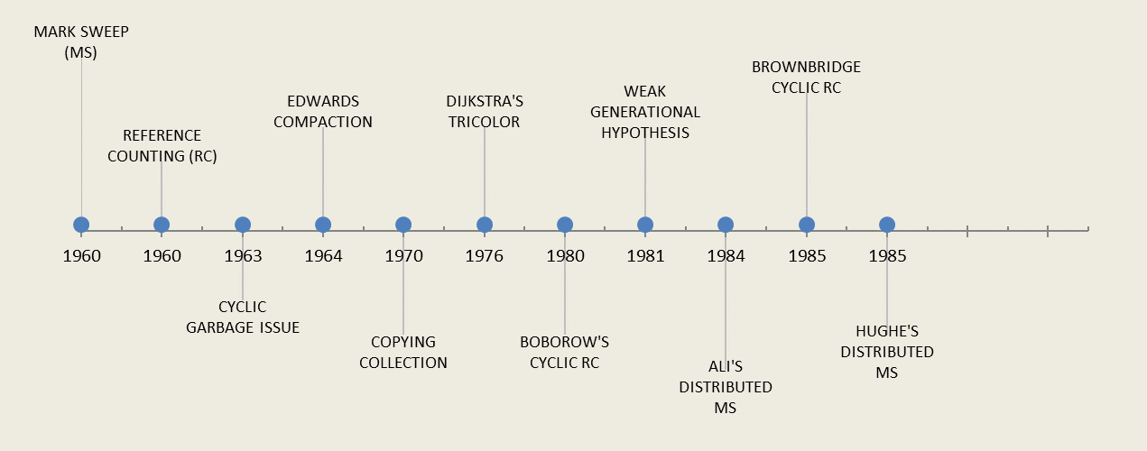
Literature Review

Slide 21
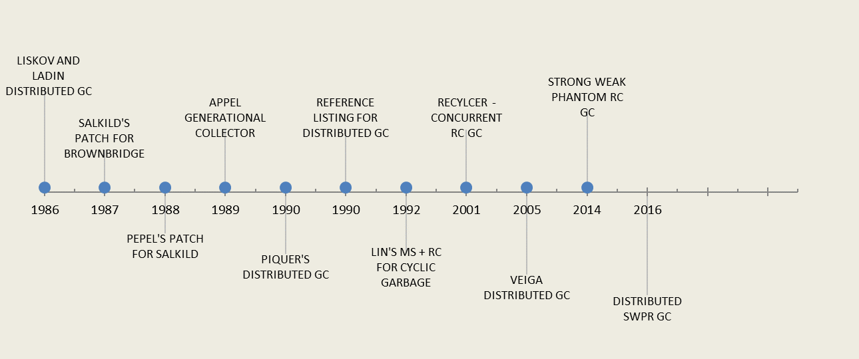
Literature Review

Slide 22
Compaction & Copying
MS creates fragmentation issues.
To and From space partition and traverse only live nodes and do compaction.
Copying collectors are very helpful when they are only very few objects left alive.
Apart from this advantage, only half of the memory is used by the application.

Slide 23
Dijkstra's Tricolor Method
The method uses three colors.
Black: A node is painted black If it is visited and immediate children of the nodes are visited. Collector need not visit them again.
Grey: A node is painted grey if it is visited and immediate children are not visited or if the node experience the change (add/delete link) since the last visit.
White : A node is white if it is garbage.

Slide 24
Ali's and Hughes' Distributed MS
In Ali’s method, each site uses MS to collect its own heap independently.
Incoming references from different machine is considered roots.
This algorithm allows each site to do collection at their own time.
But the cyclic garbage cannot be detected by this MS.
Hughes’ extended Ali's method to reclaim cyclic structure.
This method uses a centralized garbage collection that stops the application when the collection is initiated.

Slide 25
Brownbridge Method
RC and tracing based technique to collect cyclic garbage.
It uses two reference counts instead of one.
Strong Reference count (SRC) and Weak Reference Count (WRC).
References are named as Strong and Weak.
All live nodes have positive SRC.
Strong Cycle Invariant.
When a reference is created to a node, if the target node already has outgoing references, it is considered a weak reference.

Slide 26
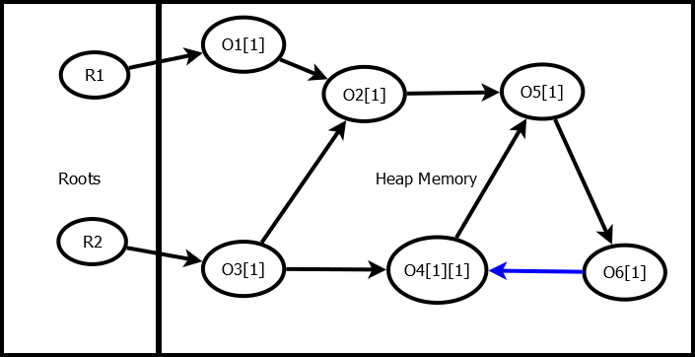
Brownbridge Method

Slide 27
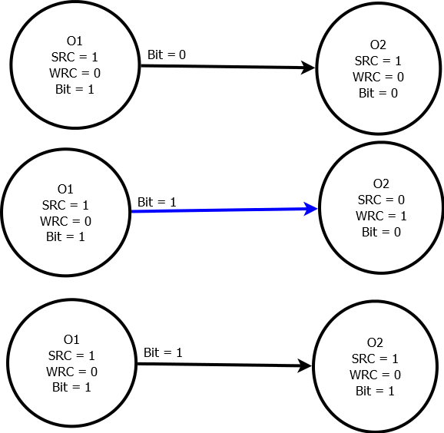
Brownbridge Toggle

Slide 28
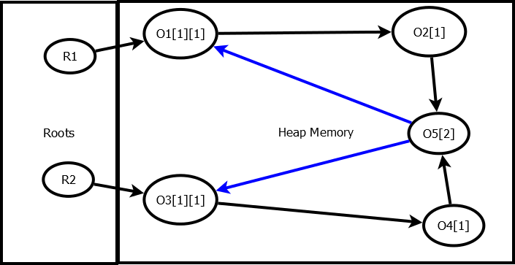
Delete Case

Slide 29
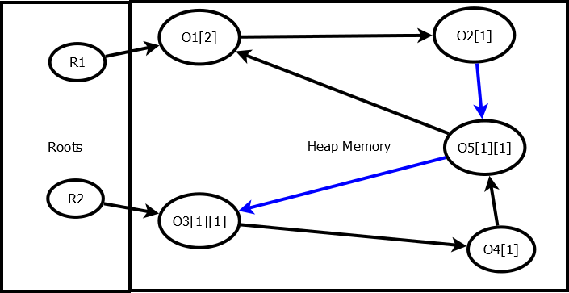
Premature Delete Case

Slide 30
Salkild's and Pepel's Work
Salkild eliminated the premature deletion but introduced non-termination in certain cases.
Pepel improved the Salkild’s work with trade-off of exponential cleanup cost.
So practically all of the attempts to correct the Brownbridge failed.

Slide 31
Recycler
David Bacon et al used the color algorithm to design a concurrent garbage collection.
This method uses reference counting along with tracing to identify cyclic garbage collection and runs concurrently.
It traces entire connected graph and cannot be made to run parallel.
Antony Hosking et al claims that the method is incomplete and proof is insufficient.

Slide 32
SWP
Strong-Weak-Phantom(SWP) Reference Count GC.
The idea is to create a path from a root to each live node through strong reference and avoid creating cycle of strong reference by using weak reference at the potential cycle creation event.
Strong Cycle Invariant : No strong cycles will exist in the reference graph at any point in time.
Weak Heuristic : All weak edges are not cycle closing edges.
Edge Label Heuristic: An edge will be weak when the target node has outgoing edges at the time of creation.
Phantom is a transient state that is used only in the cycle detection algorithm.

Slide 33
SWP
Graph of strong edges form a connected, directed acyclic graph.
Strong edge represents liveness.
Counters | State
SRC > 0 | Live
SRC = 0 & WRC > 0 | Potential Cyclic Garbage
PRC > 0 | GC processing node
SRC = 0 & WRC = 0 & PRC = 0 | Garbage

Slide 34
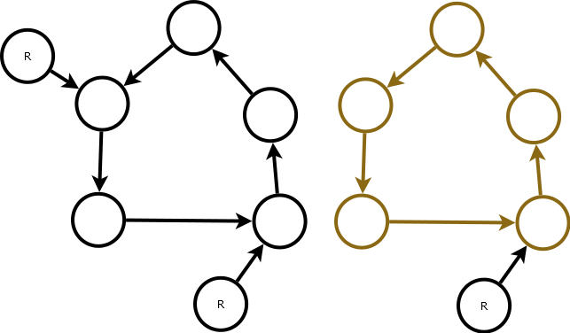
SWP
Counters | State
SRC > 0 | Live
SRC = 0 & WRC > 0 | Potential Cyclic Garbage
PRC > 0 | GC processing node
SRC = 0 & WRC = 0 & PRC = 0 | Garbage

Slide 35
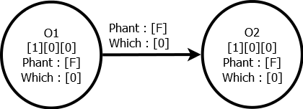
SWP & Header
Apart from reference counts, each node also has which bit, phantomized flag, and array of which bits for outgoing references.
Process list and request queues are used.

Slide 36
Edge Creation
When object is created, the first incoming edge will be Strong Reference and SRC is incremented.
An edge will be Weak when the edge is created to the node that already has outgoing edges.
This ensures that no cycle of strong reference is created.

Slide 37
Delete Edge
When a node lose its last strong reference:
if(WRC==0 && PRC==0)
start deleting the node and delete all outgoing edges
else if(WRC>0 )
convert all the incoming weak references to strong and phantomized
outgoing edges

Slide 38
Phantomization
When an incoming edge is phantomized, increment the phantom count and decrement appropriate RC.
if there is a positive SRC
stop phantomization
else if there is a positive WRC
convert all WRC to SRC and phantomized outgoing edges

Slide 39
Three phases
Phantomize
Recovery
Cleanup
These three phases happen for each traversal initiated. Each collector thread maintains list of nodes it processed in each phase.

Slide 40
Phantomization
Decrement all internal references.
Phantomization stop when it reaches a phantomized node, live node.
It performs toggling if any weak reference appear and has to propagate the phantomization.

Slide 41
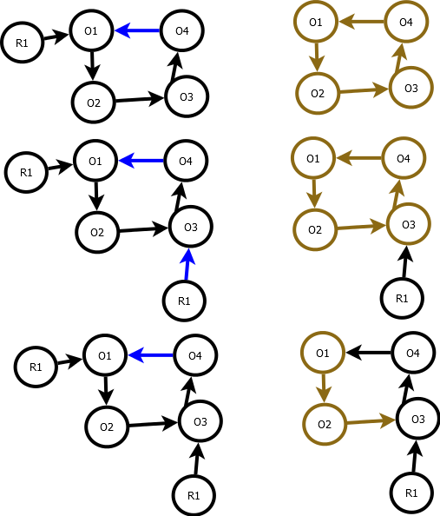
Phantomization

Slide 42
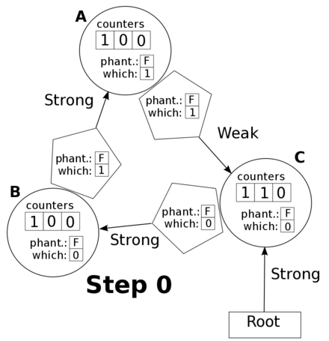
Simple Cycle Demo

Slide 43
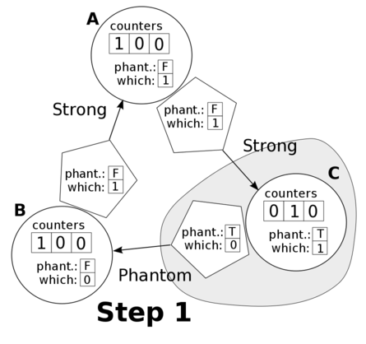
Simple Cycle Demo

Slide 44
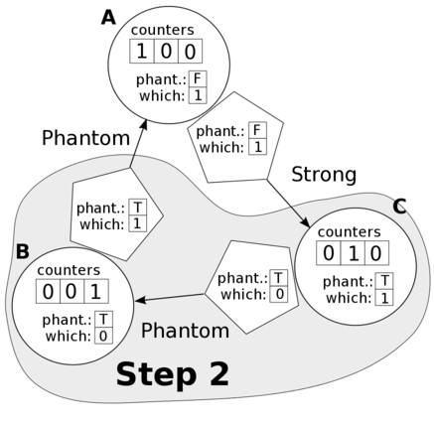
Simple Cycle Demo

Slide 45
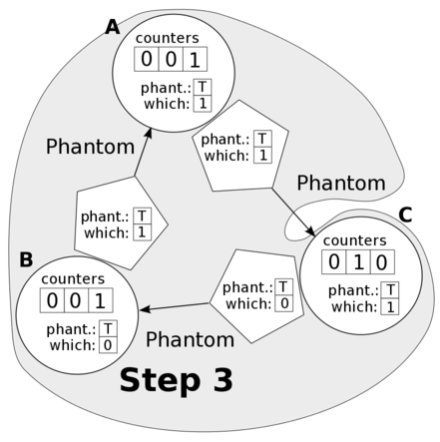
Simple Cycle Demo

Slide 46
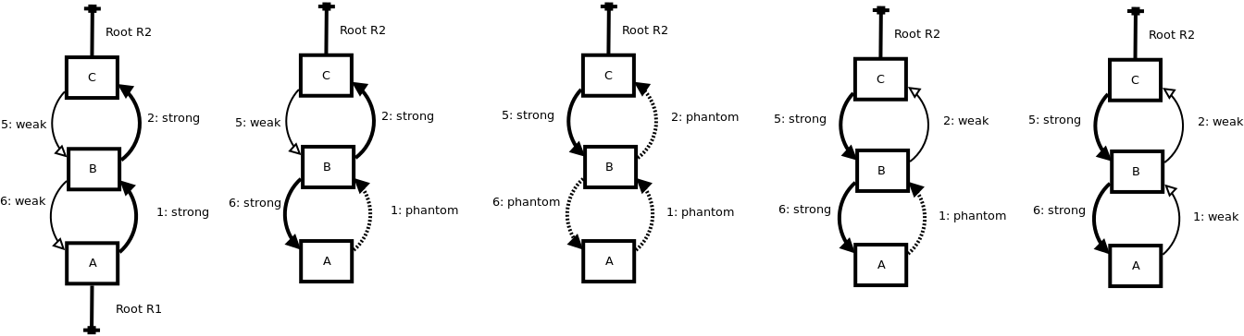
Doubly Linkedlist recovery Demo

Slide 47
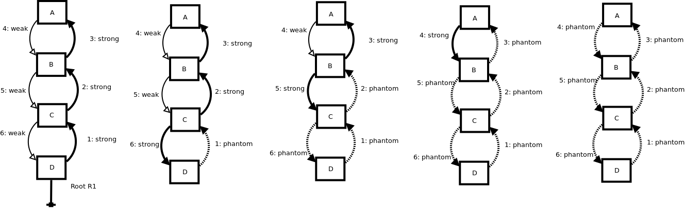
Doubly Linkedlist delete Demo

Slide 48
Recovery
If any external reference found, correct the graph to strong / weak graph
Delete nodes from process list as they are recovered.

Slide 49
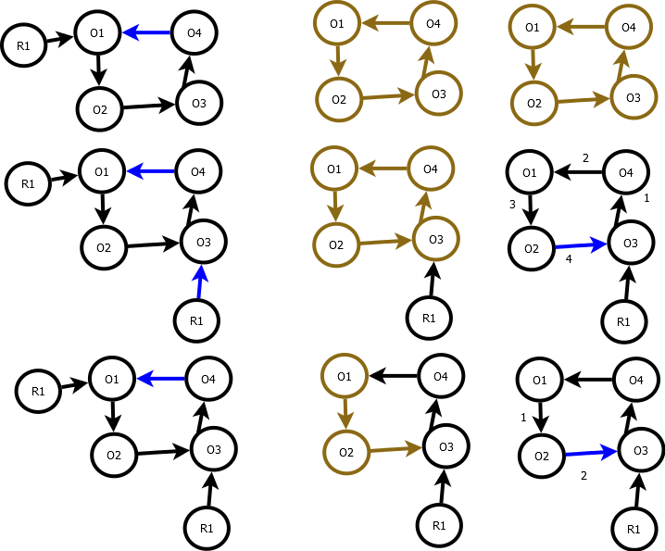
Recovery

Slide 50
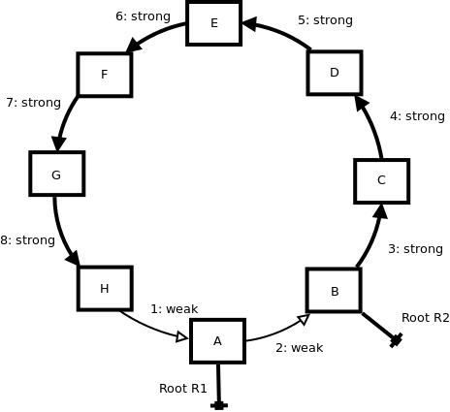
Traversal Optimization
Traversal Optimization
If Root R1 is deleted, traversal started at A will only traverse nodes till it finds a node with strong support. This substantially reduces the search space.
This method inherently has this optimization ability.

Slide 51
Concurrent and parallel Collector
Atomic operations can be used to access RCs.
SWP collection does not stop the application.
Requests are queued.
Collector thread process the queue and starts the requested tasks.
Collectors write their own id in collector id in parallel collector mode.
When collector visits a node with different id, then they synchronize.

Slide 52
Concurrent and parallel Collector
No Partition Principle : When two or more collector synchronizes, it merges their list of processed nodes and one of the collector takes the processing of those nodes.
Other collectors start to process the request in the queue.
Parallel collector adds one more attribute to the object header.

Slide 53
How SWP can be used?
SWP algorithm is directly applicable to shared memory systems.
SWP algorithm is also applicable to the distributed system with centralized queue.
Unlike other distributed systems which require application to be halted, this does not require it.
This collector can function concurrently as it is now, but requires centralized queues.
Mobile actor based collector does not require centralized queue and makes it directly applicable to the distributed systems with longer message size proportional to graph size.

Slide 54
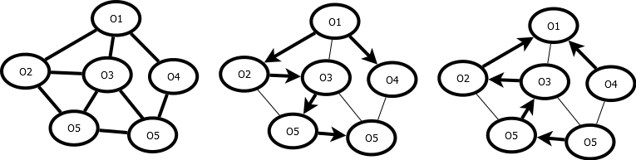
SWPR GC
SWPR - > (Strong, Weak, Phantom, Recovery).
Strong Cycle Invariant.
Weak Heuristic.
Distributed Termination Detection is used. (Parent attribute and Wait Count).
SWPR is concurrent, multi-collector, locality-based, scalable, prompt, safe, complete, and functions without global synchronization.

Slide 55
Model
Congest : O(log n ) message size.
No reference listings allowed.
Garbage stable property.
Nodes will only know out-neighbors.
Nodes can send messages only to neighbors.
Asynchronous network model.

Slide 56
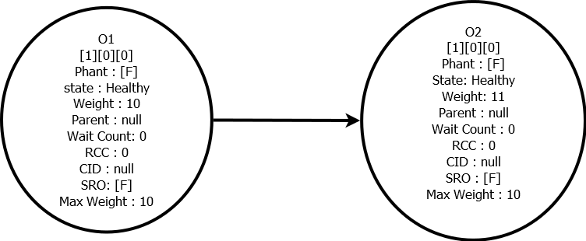
Weight System
Weights of source and target node determines type of edge.
Strong -> (Weight of Source < Weight of Target).
Weight of Root = 0.

Slide 57
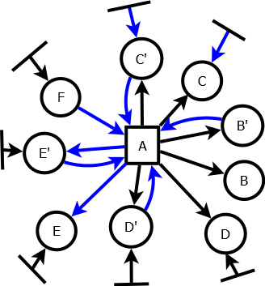
Node Classification
A - > Initiator
B, B’ -> Purely Dependent Set
C, C’ -> Partially Dependent Set
D, D’, E, E’, F -> Independent Set
C’, D’, E’, F -> Supporting Set
F, D’, E’ -> Build Set
C’ -> Recovery Set

Slide 58
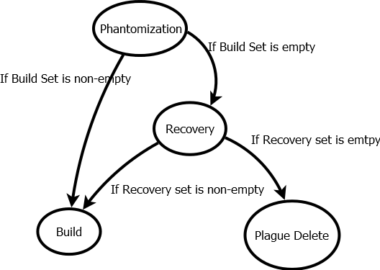
State Diagram

Slide 59
Phantomization
Converts all the internal edges that are reachable to non-independent nodes to phantom.
The process is to make sure all the internal edges are not counted for the decision process.
External weak edges are converted into strong during this process.
The process uses forward phase and backward phase to finish operations.

Slide 60
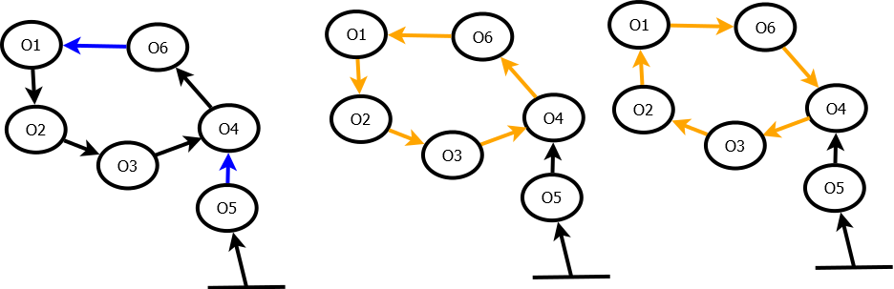
Phantomization

Slide 61
Correction
Recovery, Build, and Plague Delete are correction phases.
After phantomization, if the initiator has nodes in build set, it converts all the phantom edges in the subgraph into strong / weak based on weak heuristic.
Test to find build set : If initiator has any strong edges after phatonmization.
Build by initiator get the graph back to regularity.

Slide 62
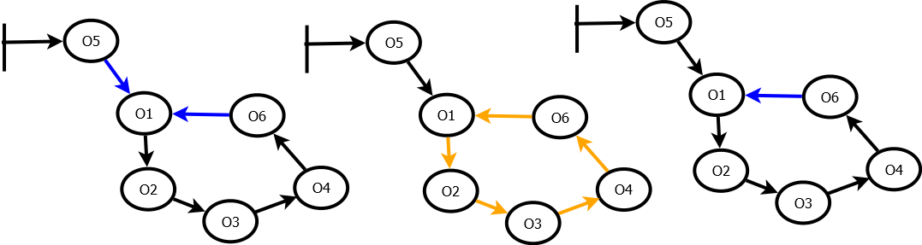
Build Phase

Slide 63
Recovery
Recovery is a complicated phase.
If initiator does not have any build set, recovery messages are sent.
A recovery node message will start building the subgraph that is not yet processed.
On reverse phase, a recovery node can start building too.
Recovery node also reduces the size of the affected subgraph during processing.

Slide 64
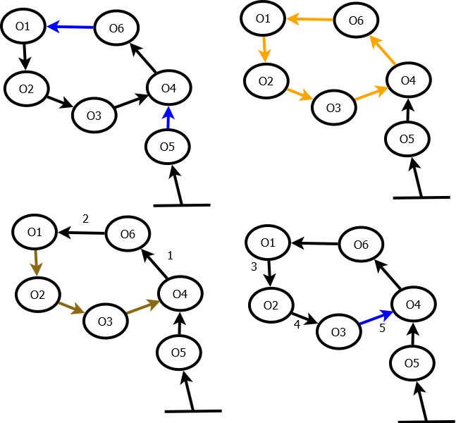
Recovery

Slide 65
Plague Delete
A node will be deleted only if all the counts are zero.
A node on receiving plague delete will send plague delete only if there is no strong incoming edge.
Plague Delete is invoked by initiator if there is no build set and no recovery set.

Slide 66
Plague Delete
A node will be deleted only if all the counts are zero.
A node on receiving plague delete will send plague delete only if there is no strong incoming edge.
Plague Delete is invoked by initiator if there is no build set and no recovery set.

Slide 67
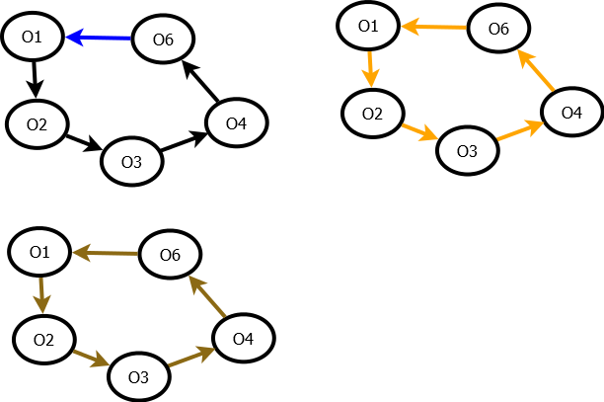
Plague Delete

Slide 68
Isolation property
The affected subgraph is not mutated.
Mutation to the affected subgraph occurs, but do no affect the decisions of the initiator to delete or build.
Do not affect the decision of recovery set to build by the correction phases.

Slide 69
Symmetry Breaking
When multiple collector processes the same subgraph, there is possibility of cycle dependency.
Leader needs to be elected among conflicting collector operations.
Each node contains a collector id in the correction phase.
Phantomization phase is similar to marking where the nodes does not need to know which collection process it belongs to.
During correction phases, a node get the collector id it belongs to.
All nodes prefer to be in higher collection id.
All collection ids are unique and so there is a total ordering among collections.

Slide 70
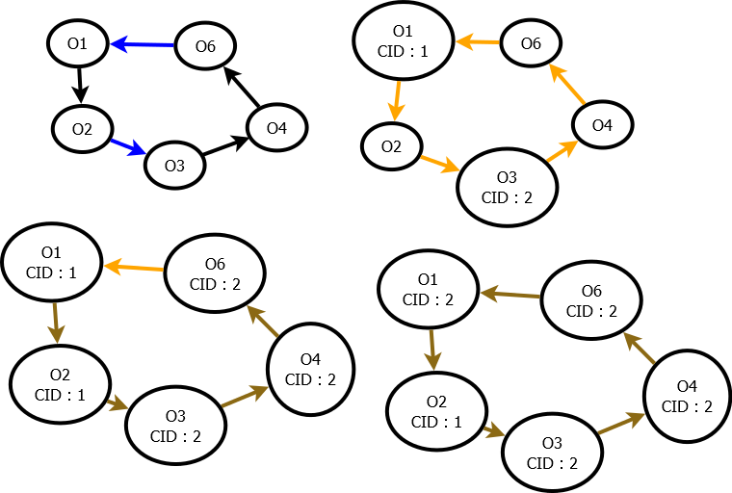
Acyclic Principle (Isolation)

Slide 71
Recovery Count
For recovery to start reverse phase, it must have recovery count equal to phantom count.
Every recovery message received increments recovery count.
This creates ordering among subgraphs based on topology, regardless of uncertainty in the collection ids.
Low collector id cannot increment higher collection recovery count.

Slide 72
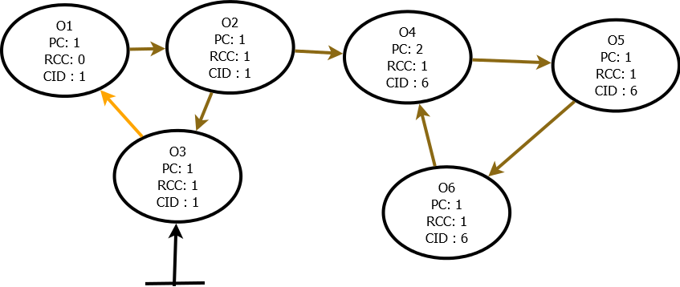
Topology Ordering (Isolation)

Slide 73
Transactional Approach
When two collectors’ operation meet at a point, the lower collection id will not proceed through symmetry breaking rules.
To complete the computation of the lower collection process during recovery, recovery phases alone are restarted. Other phases work seamlessly with multiple collector colliding.
When multiple collectors of different phase meet, we wait until the reverse phase gets over and then redo if they need to upgrade.

Slide 74
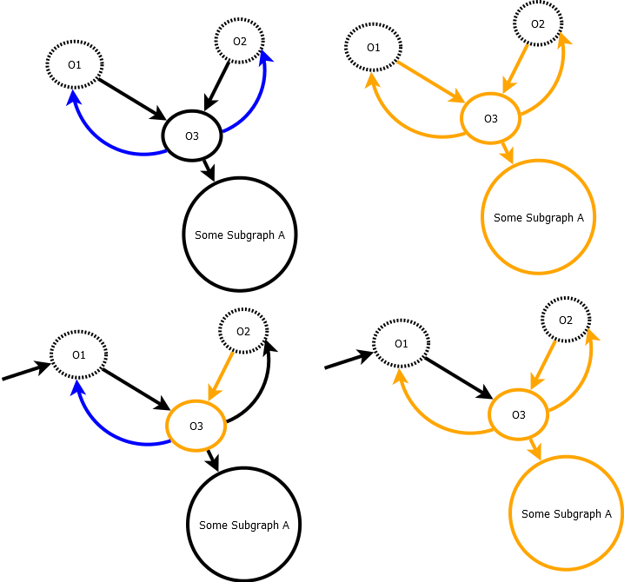
Redo transaction (Isolation)

Slide 75
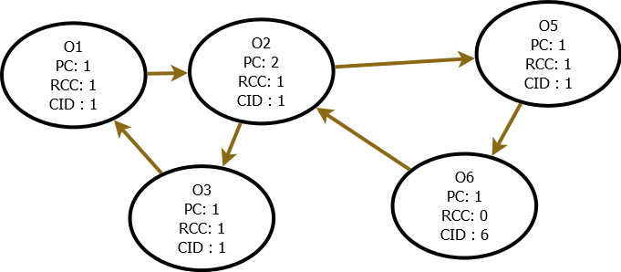
Recovery Start Over

Slide 76
Advantages of SWPR
Concurrent
Multi-collector algorithm
Locality-based algorithm
No global synchronization
Scalable
Prompt
Safe
Complete
O(log n) message size.

Slide 77
Future Work
Destructor ordering is necessary.
Fault-tolerance is necessary to make it more reliable.

