Slide 1


www.globalbigdataconference.com
Twitter : @bigdataconf

Slide 2
Data Analysis And Graphics Using R
Anusua Trivedi
Data Scientist
Texas Advanced Computing Center

Slide 3
A little about TACC
One of the largest supercomputer center
Non-profit, part of UT Austin
HIPAA compliant
How can TACC help you?
How can you help TACC?

Slide 4
What is R?
R implements a dialect of the language that was developed at AT&T Bell Laboratories.
Versions of R are available, at no cost, for versions of Microsoft Windows, Unix/Linux, Mac OS.
Supporting packages are available through the Comprehensive R Archive Network (CRAN).
Neither R nor any statistical system will provide you the statistical expertise, it just acts as a analysis tool.

Slide 5
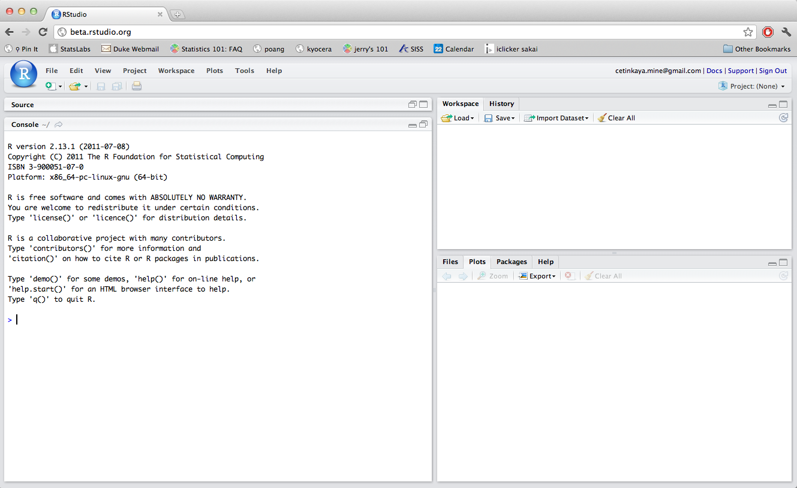
What is RStudio?
RStudio is the convenient interface for R.
Versions of RStudio are available, at no cost, for versions of Microsoft Windows, Unix/Linux, Mac OS.
When we first launch RStudio:
The frame in the upper right contains your workspace
Any plots will show up in the lower right corner.
The left frame is the console where the action happens.
Below console is the prompt, which is really a request for a command.
RStudio is a fairly efficient way to access and organize data, describe and invoke statistical computations.

Slide 6
Talk Outline
Basic Data Exploration Commands in R
Simple Graphics in R
Advanced Graphics in R with ggplot2 package
Basic Spatial plots in R
Basic Statistical Analyses in R
Basic ML with R
Big Data in R

Slide 7
Basic Data Exploration Commands in R

Slide 8
Load data file(s)
Input data sets can be in various formats (.XLS, .TXT, .CSV, JSON ).
# Read CSV into R
> myData <- read.csv(file="abc.csv", header=TRUE, sep=",")
# Read a Tab seperated file
> myTabSeperatedData <- read.table("abc.txt", sep="\t", header=TRUE)
# Read a excel file
> mydata = read.xls("mydata.xls")
# Read a json file
> library("rjson")
> json_file <- “jason_file_path.txt”
> json_data <- fromJSON(file=json_file)

Slide 9
Convert a variable to different data type
is.numeric(), is.character(), is.vector(), is.matrix(), is.data.frame()
  To test
as.numeric(), as.character(), as.vector(), as.matrix(), as.data.frame()
  To convert
However, conversion of data structure is more critical than the variable transformation.
  To convert a vector(x,y) to matrix, a cbind(x,y)rbind(x,y) is used

Slide 10
Transpose a Data set
It is also some times required to transpose a dataset from a wide structure to a narrow structure.
# example of melt function
> library(reshape)
> transpose_mydata <- melt(mydata)

Slide 11
Sort Dataframe
Data can be sorted using variable name as an index .
It can be based on multiple variables.
Can be sorted either in ascending or in descending order.
# sort by var1(ascending)
> order_mydata <- mydata[order(var1),]
# sort by var1(ascending) and var2 (descending)
> order_mydata <- mydata[order(var1, -var2),]

Slide 12
Sample Data set in R
For sampling a dataset in R, we need to first find a few random indices.
# random sample of 100 observations from the table mydata.
> mysample <- mydata[sample(1:nrow(mydata), 100, replace=FALSE),]

Slide 13
Remove duplicate values of a variable
Removing duplicates in R example:
# random normal distribution with mean=0 and standard deviation=1
> x <- round(rnorm(40, 20, 10))
> x
[1] 18 11 11 10 21 32 24 1 12 8 19 23 5 31 30 17 9 39 10 25 21 9 32 32 23 23 11 17 26
[30] 12 -7 15 -4 27 4 42 21 26 12 9
> unique(x)
[1] 18 11 10 21 32 24 1 12 8 19 23 5 31 30 17 9 39 25 26 -7 15 -4 27 4 42

Slide 14
Find class level count average and sum in R
We generally use ‘apply’ functions to do these jobs.
# In statistics, a contingency table is a type of table in a matrix format that displays the (multivariate) frequency distribution of the variables
# we get the contingency table from dataframe ‘warpbreaks’
# warpbreaks$breaks – 1st column
# warpbreaks[,-1] – All other columns except the 1st column
> tapply(warpbreaks$breaks, warpbreaks[,-1], sum)
tension
wool L M H
A 401 216 221
B 254 259 169
# find quarterly means
# cycle(): gives the positions in the cycle of each observation
> tapply(presidents, cycle(presidents), mean, na.rm = TRUE)
1 2 3 4
58.44828 56.43333 57.22222 53.07143

Slide 15
Recognize and treat missing values and outliers
Identifying missing values can be done as follows :
# vector with number and missing value
> mydata <- c(4,5,6,NA)
> is.na(mydata)
[1] FALSE FALSE FALSE TRUE
And here is a quick fix to get rid of the missing values and get the mean:
> mydata [is.na(mydata )] <- mean(mydata ,na.rm=TRUE)
> mydata
[1] 4 5 6 5

Slide 16
Merge / join data sets
To merge two dataframes horizontally, use the merge function.
# merge two dataframes by key
> merged_dataframe <- merge(dataframeA,dataframeB,by="ID")
To join two dataframes vertically, use the rbind function.
# two dataframes must have the same variables, but they do not have to be in the same order.
> joined_dataframe<- rbind(dataframeA, dataframeB)

Slide 17
Simple Graphics in R
File Name In Github scripts folder: 2_SimpleGraphics.R

Slide 18
Advanced Graphics in R with ggplot2 package
File Name In Github scripts folder: 4_ggplot2Graphics.R

Slide 19
Basic Spatial plots in R
File Name In Github scripts folder:5_shapefiles_graphics.R

Slide 20
Basic Statistical Analyses in R
File Name In Github scripts folder: 6_Statistical_Analyses.R

Slide 21
Basic Machine Learning with R
File Name In Github scripts folder: 7_Basic_ML_code.R

Slide 22
Big Data in R
Sampling:
If data is too big to be analyzed in complete, its’ size can be reduced by sampling.
Naturally, the question arises whether sampling decreases the performance of a model significantly. Much data is of course always better than little data.
But according to Hadley Wickham’s useR! talk, sample based model building is acceptable, at least if the size of data crosses the one billion record threshold.
Bigger hardware:
R keeps all objects in memory. This can become a problem if the data gets large.
One of the easiest ways to deal with Big Data in R is simply to increase the machine’s memory.
Today, R can address 8 TB of RAM if it runs on 64-bit machines. That is in many situations a sufficient improvement compared to about 2 GB addressable RAM on 32-bit machines.

Slide 23
Big Data in R
3. Store objects on hard disk and analyze it chunkwise:
Objects are stored on hard disk and analyzed chunkwise.
As a side effect, the chunking also leads naturally to parallelization, if the algorithms allow parallel analysis of the chunks in principle.
A downside of this strategy is that only those algorithms can be performed that are explicitly designed to deal with hard disk.
Integration of high performing programming languages (C++/Java):
Small parts of the program are moved from R to another language to avoid bottlenecks and performance expensive procedures.
Alternative interpreters:
The first one that became popular to a bigger audience was pqR (pretty quick R).

Slide 24
Conclusion
  Pros:
    Open Source
    Great statistical package with fabulous visuals and lots of plugins availability
    Great community support
  Cons:
    Parallelization is not that great
    Big Data depends mainly on main memory, packages as still being developed/improved.

Slide 25
Acknowledgement
Hox, Joop. "Multilevel Analysis”:http://joophox.net/mlbook1/preview.pdf
W.B. King. “Linear Regression”: http://ww2.coastal.edu/kingw/statistics/R-tutorials/simplelinear.html
Joshua Reich (josh@i2pi.com) "ML in R”
Code adapted from R-bloggers: http://www.r-bloggers.com/
Quick-R: http://www.statmethods.net
http://colorbrewer2.org/
Many good ggplot2 examples and references online:
  documentation: http://docs.ggplot2.org/current/
  cool examples, including code: http://learnr.wordpress.com/
  good reference for editing plot: http://www.cookbook-r.com/Graphs/

Slide 26
THANKS
Thank you for your attention!
Questions?

