Slide 1
Measuring the Performance of Low Earth Orbit Regional Positioning Satellite Constellations
Joe Perrella

Slide 2
Motivation
State-of-the-art navigation systems:
Continuous global coverage
Medium or geosynchronous Earth orbits
Require high production, launch, operation, and sustainment costs.
High accuracy services for professionals:
Surveying & mapping
Research
Precision agriculture
Military
Notes:
There are systems that do not require continuous global coverage
and can use commercial off-the-shelf products implemented in low Earth orbit constellations to provide regional coverage at reduced costs.

Slide 3
Motivation
Growth of mass market in entry level internet-of-things devices that require GPS
Need: regional networks that provide redundancies in security and safety
Availability and quality of commercial-off-the-shelf (COTS) parts
Drives down production and launch costs
[1]
Notes:
2 major paradigm shifts that were the impetus for this project:
Necessity for redundancy: Disaster relief/emergency services: many emergency services depend upon GPS for location and timing capabilities.
What do I do if I am:
producing redundant system
Performing research
Developing a proof of concept prototype and doing design verification testing
WE need redundant systems for security and safety,
WE can build them cheaper with COTS parts
BUT, even though COTS systems are getting better, they are still limited to low earth orbit signal transmission

Slide 4
Objective
Compare the performance of several low Earth orbit constellations that provide regional positioning and navigation coverage to a preselected latitude and longitude
Revisit time
Average coverage time
Total coverage time
Position dilution of precision
Determine burn requirements to maintain orbit
Notes:
Generate constellations of various size and compare their performance.
Martin Hall at the University of Maryland.

Slide 5
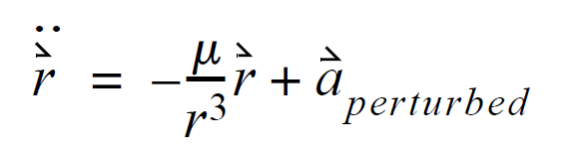
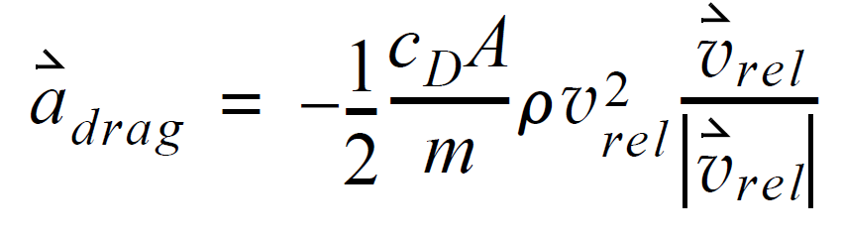
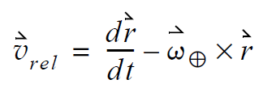
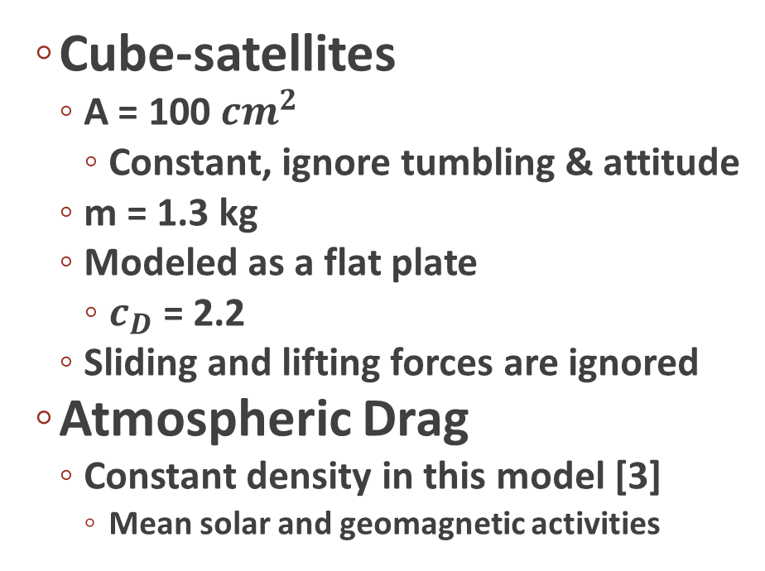
Propagation
Cube-satellites
A = 100 ${cm}^{2}$
Constant, ignore tumbling & attitude
m = 1.3 kg
Modeled as a flat plate
$c_{D}$ = 2.2
Sliding and lifting forces are ignored
Atmospheric Drag
Constant density in this model [3]
Mean solar and geomagnetic activities
[2]
Notes:
Propagate using 2 body problem numerical integrator. Included atmospheric drag into the acceleration computations.
Also ran without any perturbing forces, in order to measure the effect of the perturbations on the constellation performance
The ram area is also considered a constant in this model, as tumbling and satellite attitude are
ignored.
COSPAR International Reference Atmosphere

Slide 6
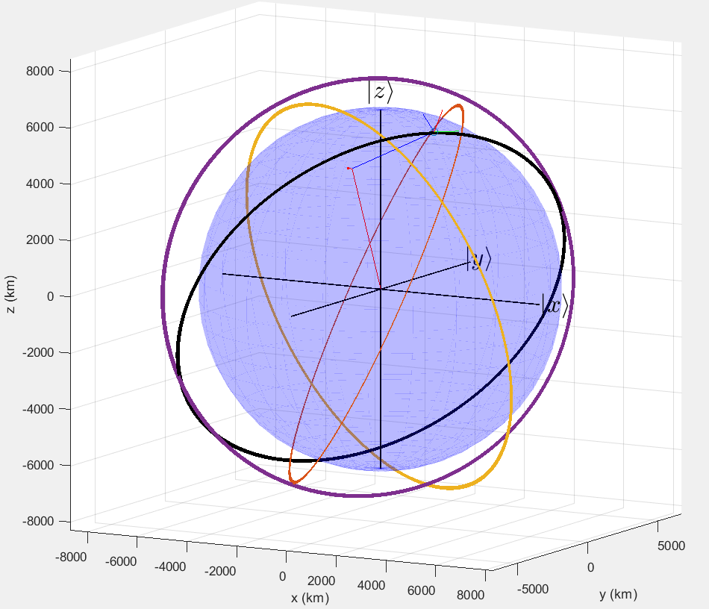
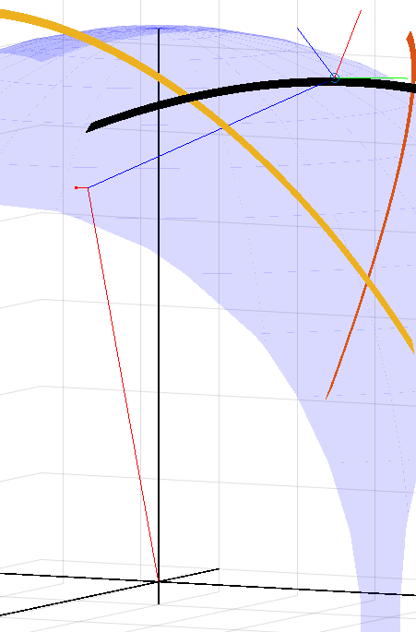
Notes:
Initialize the ground station at the geocentric longitude and latitude of Martin Hall at UMD
Assuming Earth is spherical, so ignore eccentricity in ground station location propagation
Earth-Centered Inertial (ECI) frame is used in this analysis, so the ground
station location is rotated about true north at rotational velocity of the Earth
Satellites are initialized at an altitude of 880 km at the same longitude as Martin hall
The constellations are distributed at random latitudes around the globe. None of the
latitudes are within 5 degrees of each other, to ensure the network geometry is dispersed
Each constellation is made up
of the previous constellation’s orbits, with the addition of a newly generated orbit. This construction technique ensures
that the performance variation is not due to unique geometry, but rather constellation size.

Slide 7
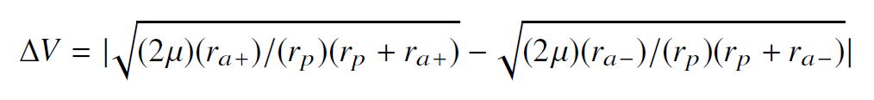
Orbital Modifications
Compute Keplerian orbital elements
Verify within LEO and reentry bounds: 2000 km – 100 km [4].
Determine magnitude of orbit maintenance burns
Drag acts to circularize the orbit
Combat apoapsis reduction
Notes:
Compute Keplarian orbital elements for each satellite at each time step.
Verify the minimum and maximum orbital radii of each satellite is within the bounds of LEO defined at 2000km minimum restriction at 100km so that there were not reentry situations.
Compared apoapsis at initialization and after 1 period
The change in velocity required to perform a general orbital modification to
return the apoapsis back to its original state is computed using the following equation:

Slide 8
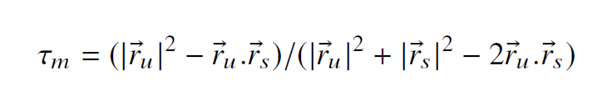
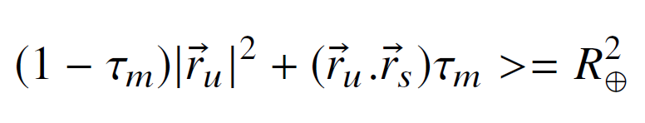

Line of sight
LOS = False
If
$${0<τ}_{m}<1$$
LOS = True
Else, if
LOS = True
[2]
Notes:
Vector from the origin of the ECI frame to the receiver (martin hall) and transmitter (Satellite)
TAU M minimizes the distance to the central body
Geometric derivation can be found in Vallado

Slide 9
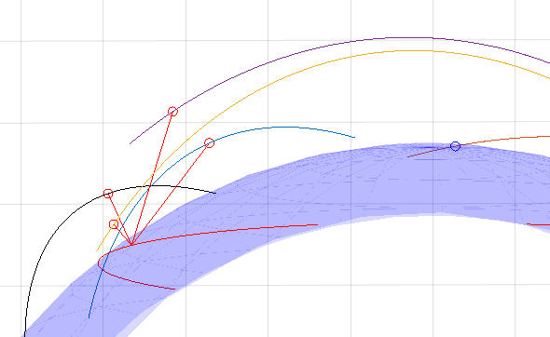

Slide 10
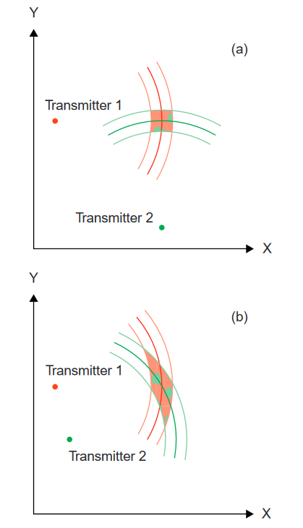
Position Dilution of Precision
[5]
Notes:
Dilution of precision (DOP) is a quantification of a satellite system’s accuracy.
Others factor in transmission and timing errors
This graphic explains the theory: (a), the position uncertainty is small (low
dilution of precision). In (b), transmitter 2
is moved closer to transmitter 1, and,
although the measurement uncertainty
is the same, the position uncertainty is
considerably larger (high dilution of
precision).
The PDOP is only measured when there is LOS for the total constellation, and only those satellites which have LOS are included in A. If the PDOP of the constellation is larger than 6, the measurement is considered too imprecise, and therefore the constellation is considered out-of-sight at that
moment [5].

Slide 11
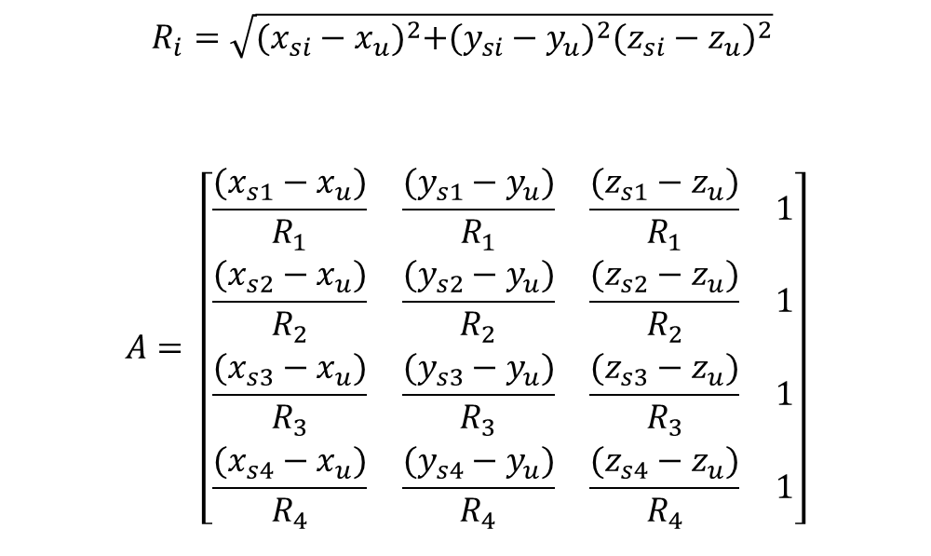

Position Dilution of Precision
$$R_{i}=\sqrt{{(x_{si}−x_{u})}^{2}+{(y_{si}−y_{u})}^{2}{(z_{si}−z_{u})}^{2}}$$
$$A= \left[\begin{matrix}\begin{matrix}\frac{(x_{s1}−x_{u})}{R_{1}} & \frac{(y_{s1}−y_{u})}{R_{1}} \\ \frac{(x_{s2}−x_{u})}{R_{2}} & \frac{(y_{s2}−y_{u})}{R_{2}}\end{matrix} & \begin{matrix}\frac{(z_{s1}−z_{u})}{R_{1}} & 1 \\ \frac{(z_{s2}−z_{u})}{R_{2}} & 1\end{matrix} \\ \begin{matrix}\frac{(x_{s3}−x_{u})}{R_{3}} & \frac{(y_{s3}−y_{u})}{R_{3}} \\ \frac{(x_{s4}−x_{u})}{R_{4}} & \frac{(y_{s4}−y_{u})}{R_{4}}\end{matrix} & \begin{matrix}\frac{(z_{s3}−z_{u})}{R_{3}} & 1 \\ \frac{(z_{s4}−z_{u})}{R_{4}} & 1\end{matrix}\end{matrix}\right]$$
$C_{∆}={\left(A^{T}A\right)}^{−1}$
$$C_{∆}= \left[\begin{matrix}\begin{matrix}σ_{x}^{2} & σ_{xy} \\ σ_{xy} & σ_{y}^{2}\end{matrix} & \begin{matrix}σ_{xz} & σ_{xt} \\ σ_{yz} & σ_{yt}\end{matrix} \\ \begin{matrix}σ_{xz} & σ_{yz} \\ σ_{xt} & σ_{yt}\end{matrix} & \begin{matrix}σ_{z}^{2} & σ_{zt} \\ σ_{zt} & σ_{t}^{2}\end{matrix}\end{matrix}\right]$$
$PDOP=\sqrt{σ_{x}^{2}+σ_{y}^{2}+σ_{z}^{2}}$
[5]
Notes:
A = matrix of receiver position unit vectors
C = covariance matrix

Slide 12
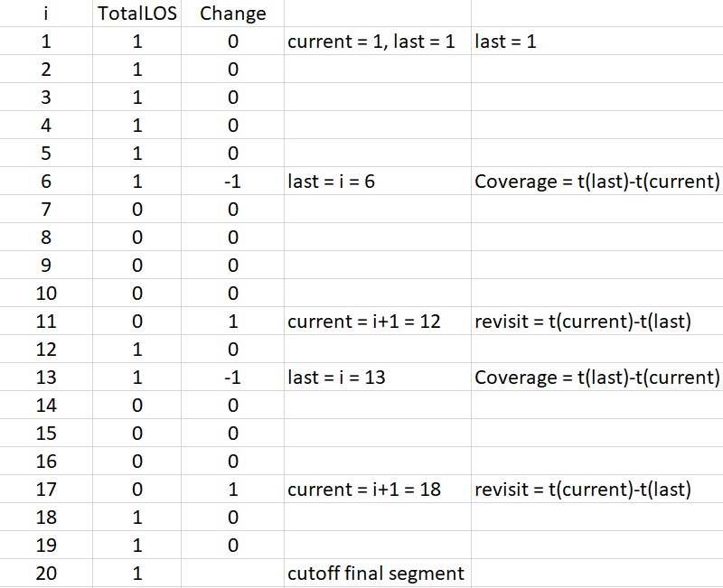
Coverage

Slide 13
Results
Notes:
The average revisit time decreases rapidly as the constellation size grows. However, the inverse is not true of the
average coverage time
The larger constellations make much more frequent revisits, but the coverage is shorter in duration.
If the end user is concerned only with long blocks of
coverage, and not the revisit time, they may implement a constellation with a small size. Conversely, a large
constellation size should be implemented a user desires a high number of visits at a high frequency.

Slide 14
Results
Notes:
Although the average coverage time does not increase with the size of the constellation, the total does.
Again, this is due to the frequency and number of visits.

Slide 15
Results
Notes:
The last performance metric that was measured was the PDOP. PDOP is worsened by a close proximity of satellites
As the constellation size grows, excess satellites in the PDOP computations reduce the distance between satellites. These
excess contributions crowd out the 4 satellites that would offer the best PDOP
And subsequently the precision does not get better as the constellation size grows.

Slide 16
Results
Constellation Size | PDOP | PDOP (no drag) | PDOP diff
4 | NaN | NaN | NaN
5 | 3.4025 | 3.3991 | -0.0034
6 | 3.4019 | 3.4032 | 0.0013
7 | 3.7362 | 3.7344 | -0.0018
8 | 3.8810 | 3.8815 | 0.0005
9 | 3.6211 | 3.6204 | -0.0007
10 | 3.5778 | 3.5786 | 0.0008
Notes:
Drag does not have a larger impact on the accuracy of the model is the constellation is larger
In the future if you are doing back of the envelope calculations on constellations with 10-less satellites you could ignore drag

Slide 17
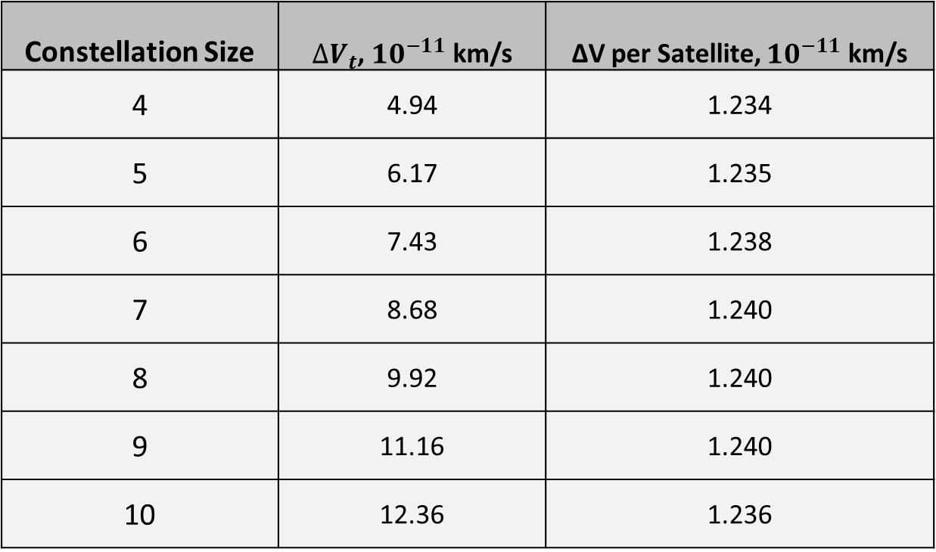
Results
Constellation Size | ${∆V}_{t}$, ${10}^{−11}$ km/s | ∆V per Satellite, ${10}^{−11}$ km/s
4 | 4.94 | 1.234
5 | 6.17 | 1.235
6 | 7.43 | 1.238
7 | 8.68 | 1.240
8 | 9.92 | 1.240
9 | 11.16 | 1.240
10 | 12.36 | 1.236
Notes:
The delta Vt for the system scales linearly with how many satellites are included in the constellation. This is expected, as satellites with
similar Keplerian orbital parameters will have to perform modifications that require similar V. Research indicates that operation costs are scaled linearly with the number of satellites, we can say that operation and orbital sustainment costs increase linearly with constellation size [6].

Slide 18
Conclusion
Advantages of large constellations:
Total coverage grows
Revisit time rapidly decreases
Penalty of implementing large constellations:
Average coverage time slightly decreases
The PDOP does not improve
Operation and sustainment costs increase linearly [6].
Notes:
There are limitations to the value added by implementing more satellites in a constellation. A designer should take into account which performance metrics need to be optimized, and act accordingly.

Slide 19
Future Work
Include:
Zonal harmonic perturbations
Geometric model error in the computation of PDOP
Atmospheric density that varies with altitude
Add:
Algorithm that produces the best PDOP at each time step by exclusively factoring in the 4 most spread out satellites.

Slide 20
Questions?

Slide 21
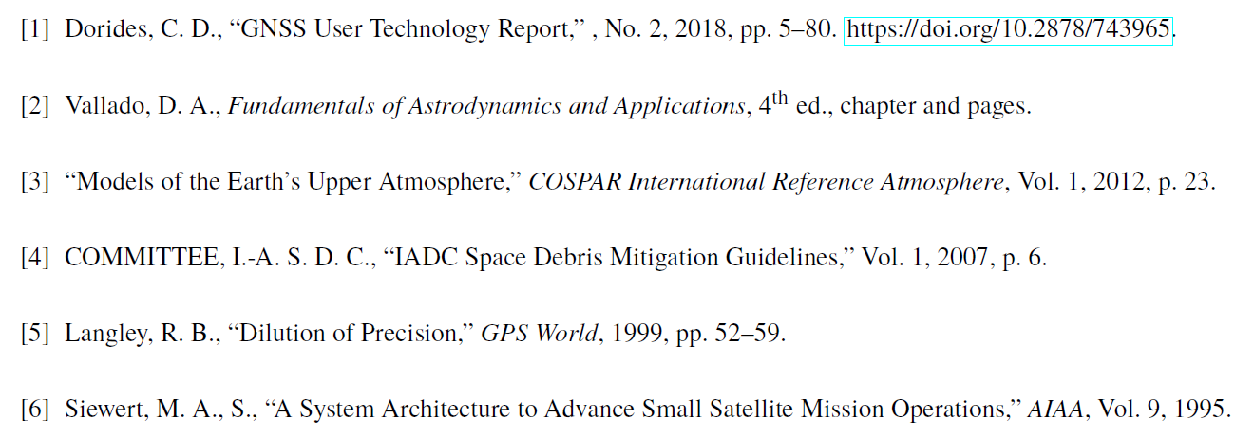
References

