Slide 1


LOGISWARM
Logistics Using Semi-Automated Multi-Robot Systems

Slide 2
Flow of Presentation
Problem Statement
Abstract
Objectives of the Project
Applications
State of the art
BudgeBOTS
Pushing strategies
LOGISWARM-Testbed
Flowchart – Working
Implementation
Impact
Budget
Outcomes
Projects completed
Achievements

Slide 3
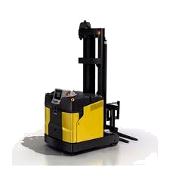
Problem Statement
Automated Guided Vehicles (AGVs) – conventional means of payload relocation within a warehouse
AGVs – highly static system
Payload – different shapes and sizes
Light payload movement with AGVs is inefficient
AGVs – cannot carry payloads of larger size than it’s capacity
Technology breakdown interrupts functioning of whole system
Human interference causes undesired error
Unnecessary cost involved with human labour

Slide 4

Abstract
Multi Robot System - A system consisting of multiple robots which can cooperate and communicate with each other to accomplish certain tasks
LOGISWARM simplifies the process of transporting payload within a warehouse by cooperative transport using Multi-Robot Systems
Our goal is to help manage problems in a warehouse such as
Inventory
Cost
Time
Prevention of technology breakdown

Slide 5
Objectives of LOGISWARM
The follower robots will take the leader’s direction as the input and generate the summed output force that aligns in the same direction as the input and has larger magnitude than the input force
The most efficient way of payload movement will be determined by analysis of various object pushing strategies

Slide 6
Applications
Warehouse logistics
Airports and Railway stations.
Extended applications
Underwater Search and Rescue
Plastic Removal from River Banks
Simultaneous localization and mapping (SLAM)

Slide 7
State of the art
(7)
The act of collective transport can be broken down into two phases.
The first phase involves BudgeBOTs being placed around the object to grip it.
The second phase involves the agents applying forces to the object to transport it to the goal.
Two or three implementations are introduced and analyzed, accounting for two different classes of object dynamics:
small objects where kinetic friction dominates
and large objects where inertia dominates.

Slide 8
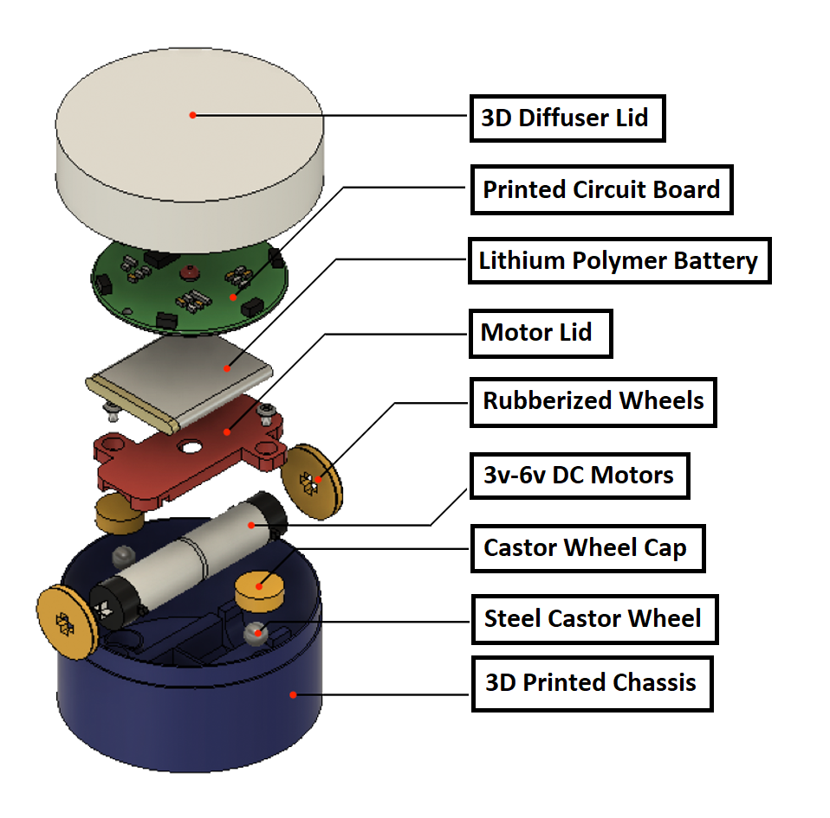
BudgeBOTS
ATMEGA based differential drive robots – Two wheels for locomotion and two castor wheels for support
3D printed body
Radio Frequency Communication
3.7 V Lithium rechargeable Polymer Battery
Can collectively transport complex shaped and irregular payloads
Approx run-time (on battery) is 40 mins

Slide 9
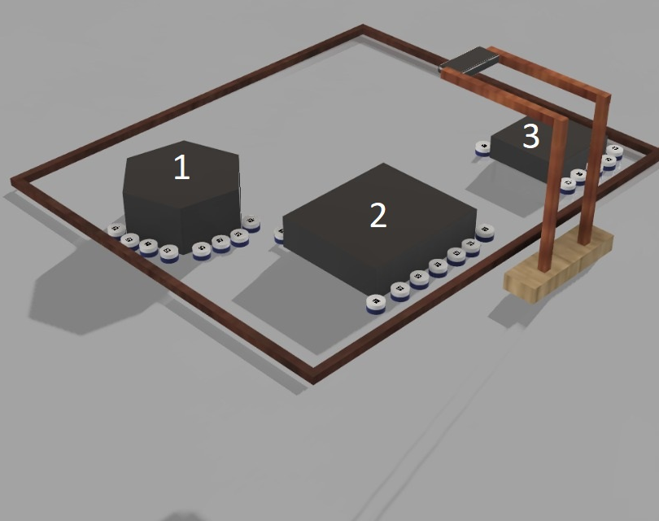
Pushing strategies
Number of robots employed according to shape and size of payload
Object closure strategy implemented
Pushing strategy helps transport payload to the goal
Limitations -
Size of object should be lesser than the testbed
Friction

Slide 10
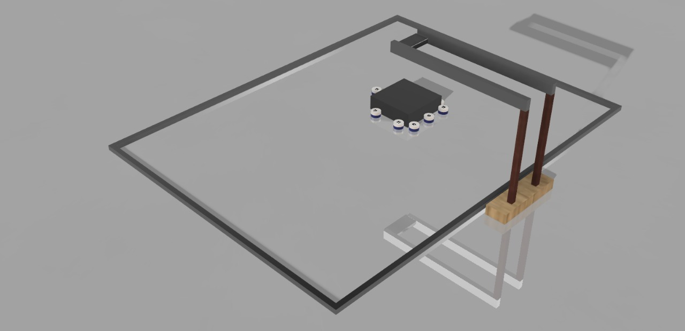
LOGISWARM-Testbed
The LOGISWARM – testbed will be used for testing of our robots
Dimensions – 100cm*60cm
Overhead camera (Logitech C270 HD Webcam) – for tracking AprilTags / Fiducial markers
The testbed will also have charging stations for robots

Slide 11
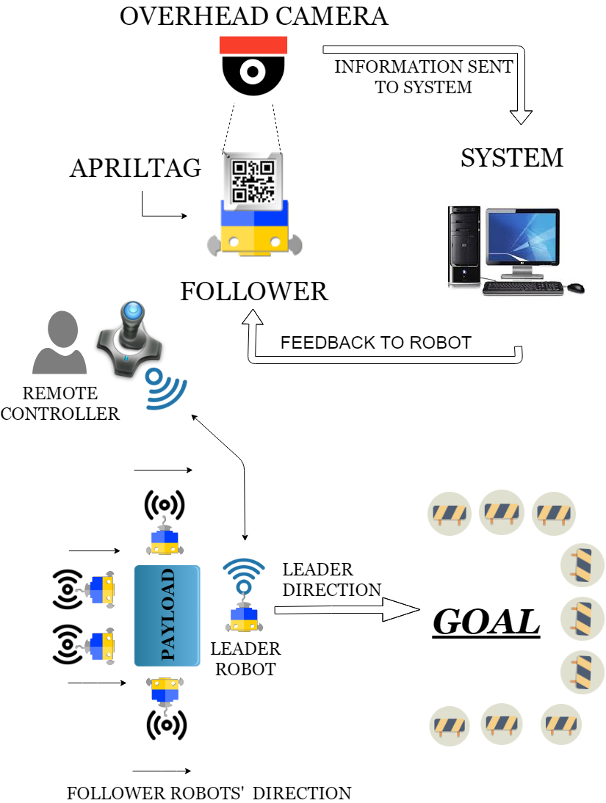
Flowchart - Working
CONSENSUS THEOREM STATES THAT A ROBOT TENDS TO GET THE AVERAGE OF THE STATES OF IT’S NEIGHBOURING ROBOTS AND EVERY ROBOT SHARES A COMMON STATE AFTER A CERTAIN TIME.
(11)

Slide 12
Implementation
Various stages called WORK-PACKAGES (WPs)
Deliverable will be obtained after completion of each work package
Each work package will be assigned to the respective domain
Everything will be compiled for completion of LOGISWARM
Improvements will be done through evaluation, testing, research and development

Slide 13
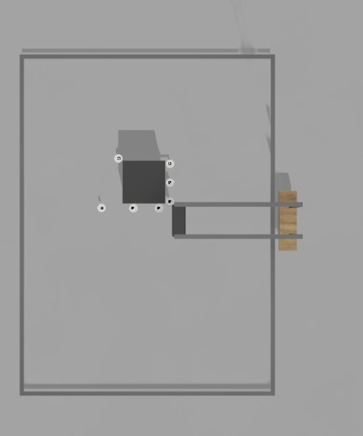
WORK PACKAGE 1
Testbed:
Platform for testing of robots
Feedback system for detecting position and orientation of robots
using an overhead camera ( Logitech C270)
Charging station for robots
Dimensions of testbed : 100cms*60cms
DELIVERABLE (D1) – Testbed with Overhead Camera

Slide 14
WORK PACKAGE 2
Single Robot Prototype
Specifications:
ATmega based differential drive robot
3D printed body
RF communication
DELIVERABLE (D2) – Working single robot
prototype

Slide 15
WORK PACKAGE 3
Teleoperated Robot
Single BudgeBOT can be taken to goal location using remote control
Remote Controller will be fabricated
Communication using Radio Frequency
Feedback using Overhead Camera
Range of remote controller is 50metres
DELIVERABLE (D3) – A leader robot with remote controller

Slide 16
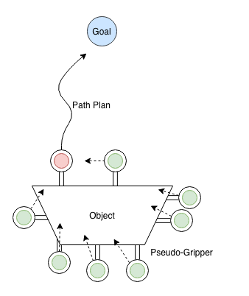
WORK PACKAGE 4
Directional consensus Multi-robot system
Initially ,robots will be randomly oriented
Instructions will be sent to leader robot only
After sometime follower robots will achieve same state according
to directional consensus
DELIVERABLE (D4) – Multi-Robot System capable of co-ordination

Slide 17
WORK PACKAGE 5
LOGISWARM completed for testing and evaluation
Robots will cage the object and transport object to desired location
Followers amplify leader’s force to achieve the task
DELIVERABLE (D5) – LOGISWARM completed for testing and evaluation
(17)

Slide 18
Timeline
The deadline for the deliverables have been summarized in the following Gantt Chart :
 | M1 | M2 | M3 | M4 | M5 | M6 | M7 | M8 | M9 | M10 | M11 | M12 | M13 | M14 | M15
WP1 |  |  | D1
WP2 |  |  |  |  |  | D2
WP3 |  |  |  |  |  |  |  |  | D3
WP4 |  |  |  |  |  |  |  |  |  |  |  | D4
WP5 |  |  |  |  |  |  |  |  |  |  |  |  |  |  | D5

Slide 19
Impact
BudgeBOTs will be tested for different scenarios and efficiency in different scenarios will be analyzed and improved
Initially, BudgeBOTs will have a leader robot which will be remotely controlled, and the follower robots will be autonomously sync with the leader robot and its nearest neighbors. Further development can be done to make the system fully autonomous which will make human interruption almost null
employment of BudgeBOTs will also reduce the amount of human intrusion thereby minimizing errors occurring due to human fatigue

Slide 20
Budget for a single BudgeBOT
S.No. | PARTS | Cost/piece | QUANTITY | COST (IN ₹)
1. | PCB | 350 | 1 | 350
2. | Lithium Polymer Battery | 700 | 1 | 700
3. | RF Module | 400 | 1 | 400
4. | Motor drivers | 350 | 1 | 350
5. | SMD Passive Components |  | 20 Resistors & 15 Capacitors | 300
6. | 3V-6V DC Motors | 200 | 2 | 400
7. | NRF24L01+ | 350 | 1 | 350
8. | Microcontroller | 300 | 1 | 300
9. | Castor wheels | 10 | 2 | 20
10. | Voltage Regulator | 200 | 1 | 200
11. | IR sensors | 31.25 | 8 | 250
12. | Switches | 75 | 6 | 450
Total |  |  | ₹4070 * 1.5 = ₹6150
Price Estimate of 30 Robots @ ₹6150 each is ₹1,84,000

Slide 21
Budget (contd.)
S.No. | DESCRIPTION | Cost/piece | QUANTITY | COST in ₹
1. | 3D Printing Filament | 30,000 |  | 30,000
2. | Soldering Station | 3,500 | 2 | 7,000
3. | Hot-Air Station | 4,500 | 2 | 9,000
4. | Soldering Tools – Lead, Flux, Solder Paste, Wire Cutter, Tweezers, Solder Sucker, Solder Wick |  |  | 20,000
5. | Connectors – Jumpers and Headers |  |  | 6000
6. | Testing Boards – Breadboards and Perforated Boards |  |  | 7000
6. | Multimeter | 600 | 2 | 1200
7. | Testbed and Overhead Camera | 18,000 | 1 | 18,000
8. | Atmel ICE Programmer | 15,000 | 1 | 15,000
9. | Conferences and Competition Participation |  |  | 45,000
10. | Miscellaneous |  |  | 10,000
TOTAL |  |  | ₹1,68,200

Slide 22
Budget (contd.)
Price Estimate for 30 BudgeBOTs = ₹1,84,000
Price Estimate for Consumables and Electronic Equipment = ₹ 1,68,200
TOTAL BUDGET = ₹3,52,200

Slide 23
Outcomes
PATENTS
A patent on multi robot testbed for research
CONFERENCES
IROS-International Conference on Intelligent Robots and Systems
ICRA-International Conference on Robotics and Automation
ROBIO-International Conference on Robotics and Biomimetics
JOURNALS
International Journal of Robotics and Automation (by ACTA press)
Industrial Robot : An International Journal
IEEE Robotics & Automation Magazine

Slide 24
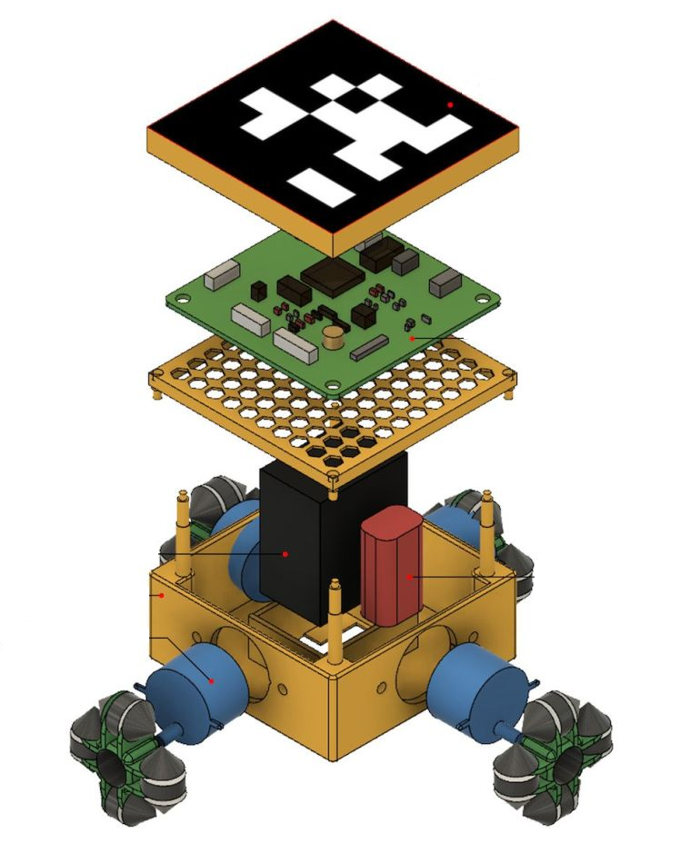
Projects Completed
Sprinter : A multi-robot printing system
A multi robot system capable of printing over a surface as they move.
The entire task of printing is divided among all the sprinters.
They communicate and coordinate themselves to complete the
printing.
Printing can be done irrespective of the paper size.
Amount Sanctioned ₹80,000
Amount Spent ₹1,60,000

Slide 25
Achievements
Achievements in 2017 Siemens MakeITReal Hackathon 2017 Finalists WSSIMP Workshop Demo | Achievements in 2018 International Autonomous Robotics Competition (IARC) Finalists, Techriti, IIT Kanpur The Institution of Engineers India (IEI) PCB Design, Fabrication and Testing Workshop Organizers IEI Machine Learning for Intelligent Speech (MLSIP) Workshop Demonstration Siemens MakeITReal Hackathon 2018 Finalists Tecknicus (An initiative taken to educate school students the basics of electronics) The Institution of Engineering and Technology (IET’s) IOT India Congress Demo, IOT based mobile printer Publication of the paper ‘Perturbation Analysis in Decentralized Estimators’ in the proceedings of IEEE International Conference on Robotics and Biometrics (ROBIO), Kuala Lumpur by Kedar Prasad Karpe, Dhanalakshmi Samiappan, Kumar Ramamoorthy and Lorenzo Sabattini. | Achievements in 2019 First place in Line Follower competition at Daksh, Sastra, IIT Madras Third place in Line Follower competition at Roboprix, VIT Chennai

Slide 26
THANK YOU

