Slide 1
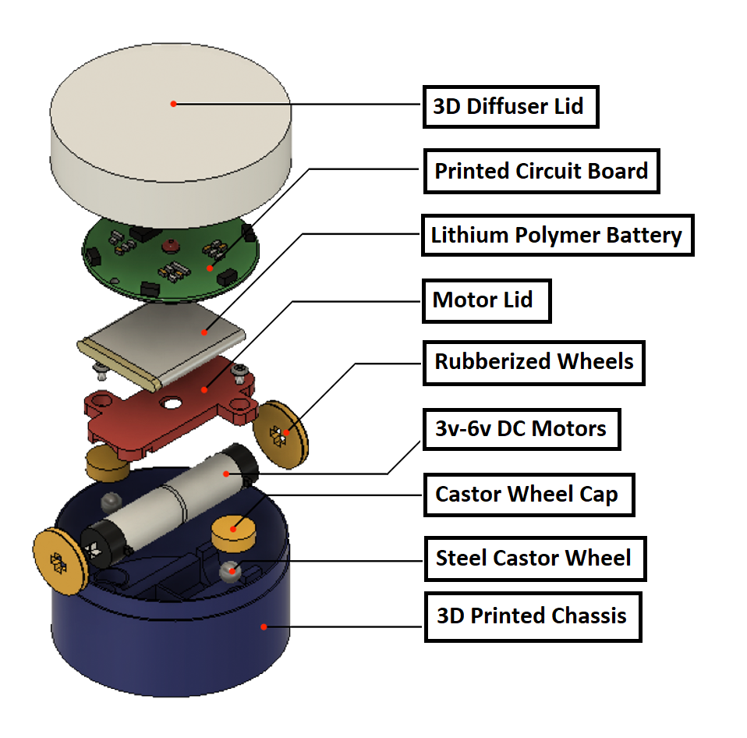
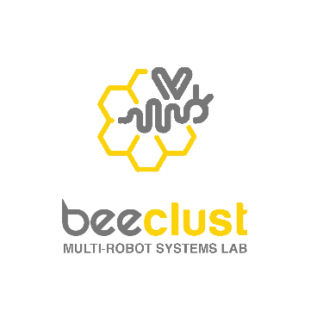

BudgeBOT
LOGISWARM
Logistics Using Semi-Automated Multi-Robot Systems
by BEECLUST MULTI ROBOT SYSTEMS LAB, Dept. of ECE, Tech Park 1306/A
OBJECTIVES:
To develop a Multi-Robot System for :
Simplifying warehouse transportation problems
Prevention of problems arising due to human intrusion
Making the system more energy efficient
Reduction of cost and time

Slide 2
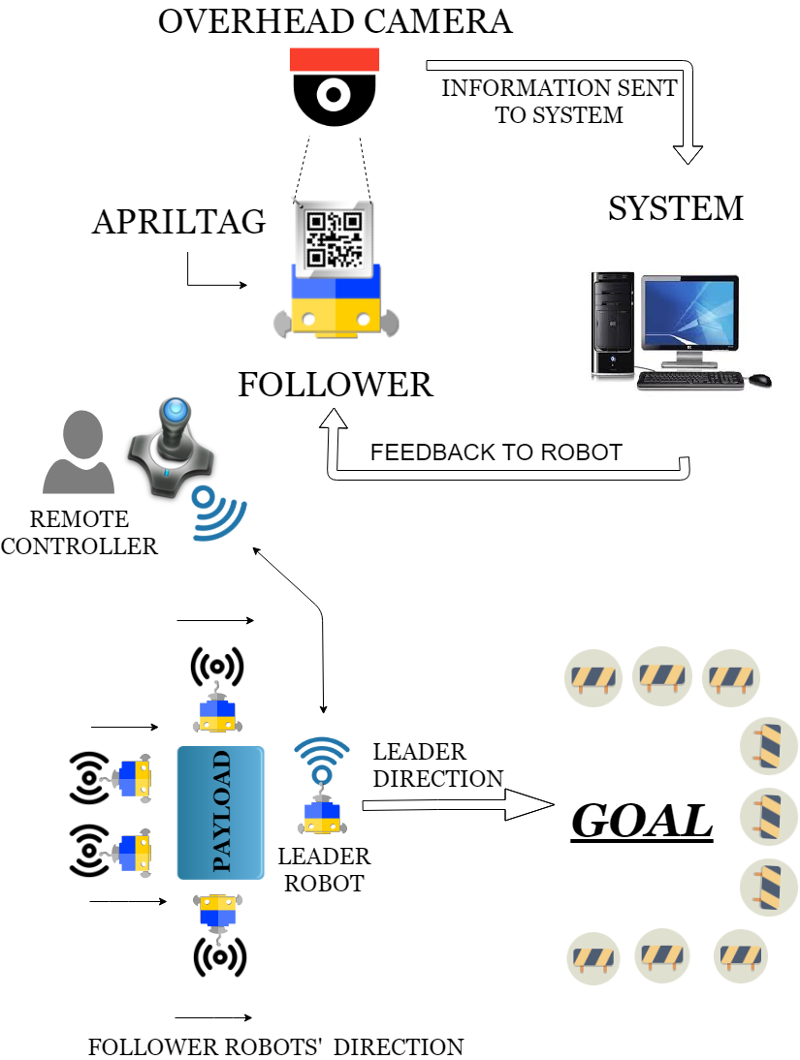
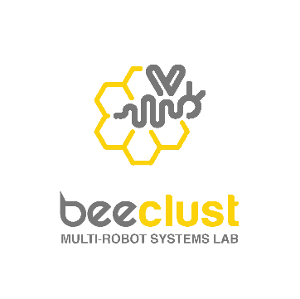
Flowchart - Working
Deliverable 1 :
Development of tracking system for robots
Deliverable 2:
Design and Development of BudgeBOTs
Deliverable 3:
Coordinating the Multi-Robot System to work together
Deliverable 4:
Testing of the developed system in different scenarios
WORKFLOW:

Slide 3
Project Guides:
Dr. R. Kumar, Principal Guide, Professor, Dept. of ECE
Dr. S. Dhanalakshmi, Co-guide, Associate Professor, Dept. of ECE
Time Limit:
15 Months (until September 2020)
Fund Approved:
Rs. 1,60,000
No. of Students:
B.Tech IVth Year – 5
B. Tech IIIrd Year – 12
B.Tech Ii^{nd} Year – 10

