Slide 1
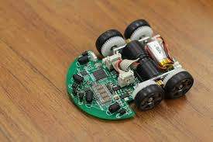
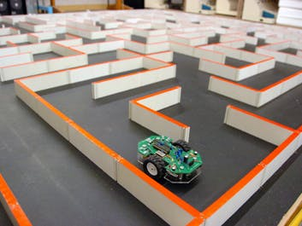
Project Micromouse

Slide 2
INTRODUCTION
The Micromouse is an autonomous robot
It has the capability to navigate through any environment by itself given the destination
The whole path taken by the mouse is mapped in its memory and the shortest path to the destination can be determined easily
Uses minimal hardware and intelligent algorithms
Wide range of applications such as obstacle avoidance, planning, mapping, autonomous decision-making, spatial navigation, knowledge acquisition

Slide 3
Competition:
Micromouse competitions are organized globally since 1970’s
Notable events are MicromouseUSA, Applied Power Electronics Competition(APEC), Technoxian
The event consists of a maze which is to be solved in the shortest possible time
A trial run is made where the mouse navigates through the whole maze
A speed run where it takes the shortest path to the destination
Held in two variants: Half-size and Full-size

Slide 4
Half Size vs Full Size Micromouse
Half Size
Full Size
Expected to be lesser than 8cm in length and breadth
32x32 maze
Walls of the maze are smaller
Should be contained within a square of area 12.5x12.5 cm
16x16 maze
Walls are 50mm in length and height

Slide 5
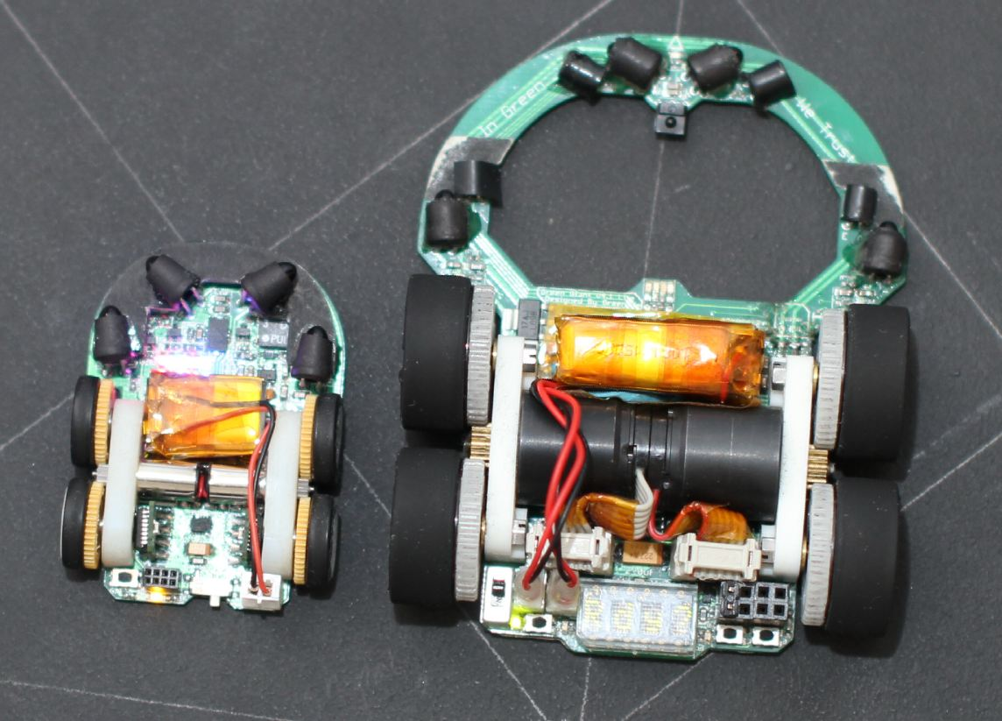

Slide 6
Hardware
Microcontroller
IR sensors
Gyroscope
Motors
Motor driver
Encoder
Necessary passives and components for user interface

Slide 7
Fabrication of the bot:
The components are directly mounted on the PCB and it serves both as an electrical and mechanical medium to support the micromouse
The placement of components determines the operation of the robot
Precise placement of IR-sensors along with the gyroscope and encoders is essential to perfect the locomotion
Weight distribution plays an important role in dynamics of the bot

Slide 8
Algorithms Used:
Floodfill algorithm
Bruteforce method

Slide 9
Working:

Slide 10
International Autonomous Robotics Competition(IARC)
Techkriti-2018
IIT KANPUR

Slide 11
About the Event
Autonomous robot to be designed
The robot has to perform tasks such as Line-following, Wall-following, Color Sensing
The fastest bot to complete the tasks accurately is the winner
Beeclust Multi-Robot Systems Lab has qualified for the finals to be held on 16th March 2018 at IIT-Kanpur

Slide 12
Problem Statement:
You shall place your bot at point A in any direction, in order to perform line following.
After reaching the point B by line following it then has to travel to another point C by following a path, bounded by a continuous wall on one side and a line running parallel to the wall on the other side at a distance of 400mm, by the principles of the wall following. In case the bot crosses the line, human intervention would be allowed and points would be cut for the same.
After reaching point C, the bot has to follow a continuous wall again, according to the same rules as mentioned above, but this time, the wall will be in the opposite direction as that of the previous one. It would then reach point D.
After reaching D it must again traverse on black lines.
At each intersection I_{A}, the bot has to detect the color of the block placed in front and has to turn as described below to reach point I_{B}:
Blue Block: The bot has to turn left at intersection I_{A}.
Red Block: The bot has to turn right at intersection I_{A}.
Following the above directions, the bot would reach the Finish area. There it has to show the number of boxes encountered on an LCD display, as well as has to blink a LED which will mark the end of the game.

Slide 13
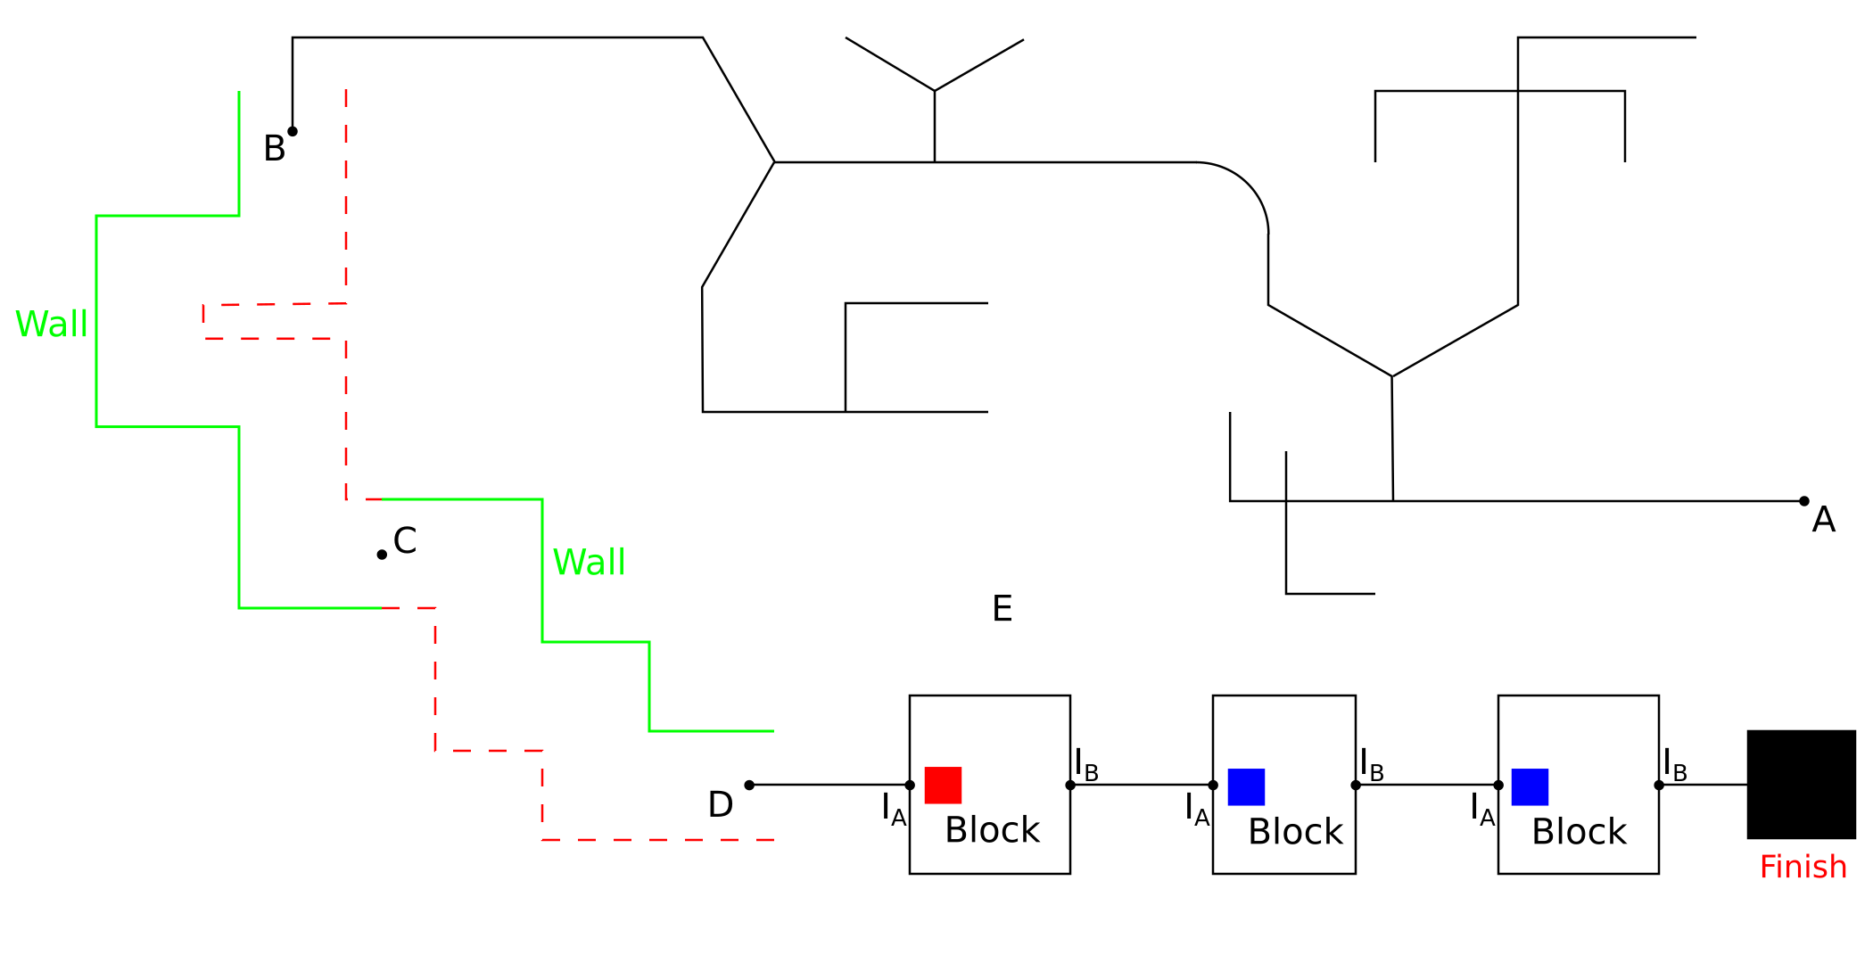
The Arena:

Slide 14
Hardware Used:
Arduino Mega-2560
TCRT5000 IR-sensor array
HC-SR04 Ultrasonic sensors
TCS3200 Color sensors
L293D motor driver
6V BO motors
Nokia 5110 LCD

Slide 15
Algorithms and Control Systems Used:
Line following:
Left-hand rule or Right-hand rule
PID controller
Wall following:
PID controller

Slide 16
THANK YOU

