Slide 1
Linux Sound Programming in C++
Digital Sound Production Workshop
Summer '08
This work was funded by National Science Foundation CCLI Grant DUE 0717743
Jennifer Burg PI, Jason Romney Co-PI

Slide 2
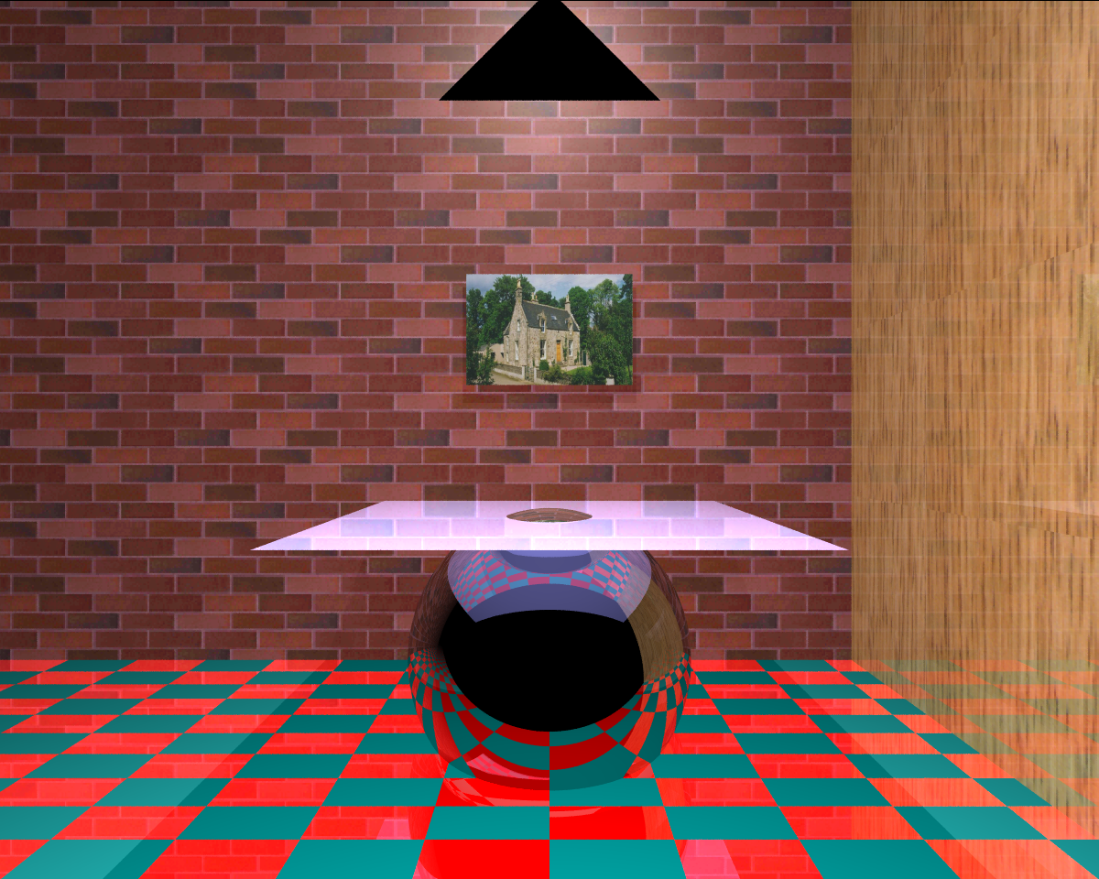

Slide 3
midiSample.cpp
Concepts Presented:
- Midi note representation
- Midi to frequency conversion
- Frequency to sample conversion
- Raw sound output on Linux

Slide 4
midiInput.cpp
Concepts Presented:
- Receiving midi input from a device

Slide 5
wavPlay.cpp
Concepts Presented:
- Wave file format
- Controlled sound output on Linux

Slide 6
vocode.cpp
Concepts Presented:
- FFT's
- Wave File Handling

Slide 7
octaveShift.cpp
Concepts Presented:
- The use of Fast Fourier Transforms in sound
- The logarithmic nature of human hearing

Slide 8
noteDetect.cpp & dehar.cpp
Concepts Presented:
- Further use of the Fast Fourier Transform
- Harmonics in vocals

Slide 9
autoTune.cpp
Concepts Presented:
- FFT's
- Vocal Harmonics
- Wave Files
- Logarithmic Octave Scale
- Sound Input/Output

