Slide 1













presents
Silver sponsor
Neural Watch : Intelligence that thinks before Fraud happens
(Neural Nexus)
Official Sparkling water partner

Slide 2


Problem Statement:
Financial Fraud Detection System (Elite Level – Real-Time Adaptive Intelligence):
Design a system that can detect and prevent financial fraud before transactions are completed. The system should identify coordinated, stealthy, and evolving fraud patterns across users and channels.It must analyze behavior, transaction context, and device intelligence to detect anomalies. Focus on real-time decision-making with minimal latency. The solution should balance accuracy, adaptability, and explainability.

Slide 3
Solution:
NeuralNexus is a real-time fraud detection system designed to identify and prevent fraudulent transactions before execution.
It uses a hybrid approach combining machine learning (XGBoost, Isolation Forest, Autoencoder) with rule-based logic.
The system builds dynamic user behavior profiles using transaction history, device, and location data.
Each transaction is processed through feature engineering, ML prediction, and rule validation to generate a risk score.
Based on the risk level, the system makes instant decisions such as approve, trigger MFA, or block the transaction.

Slide 4
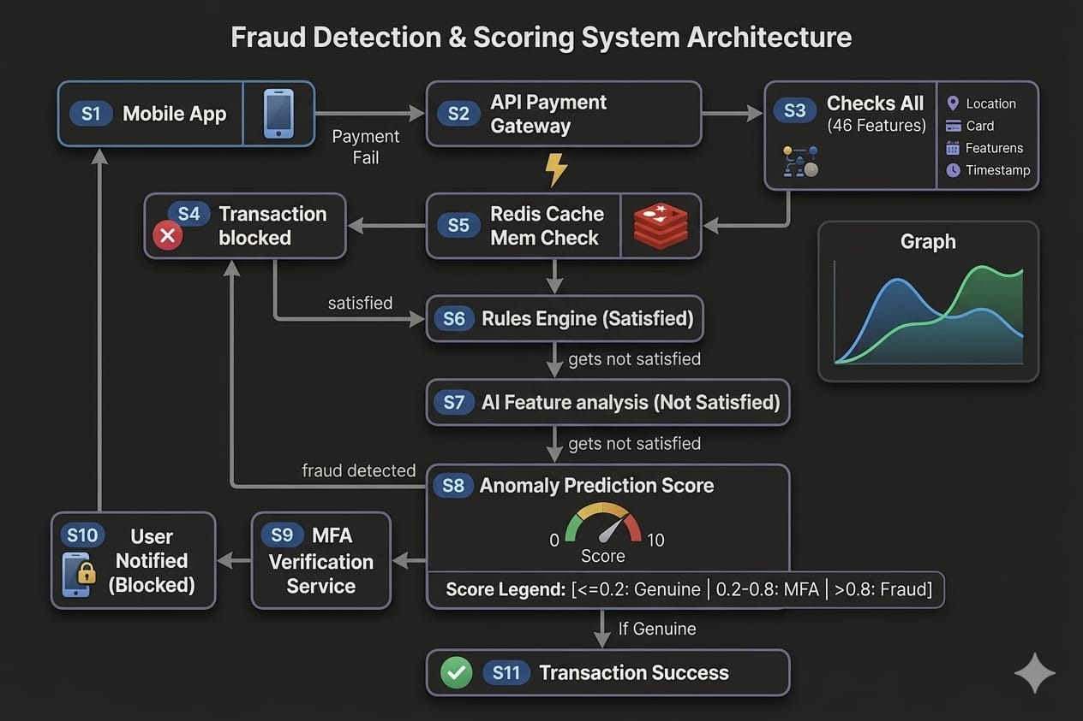
System Architecture:
Fig.1: System Architecture

Slide 5
Feasibility:
The system is technically feasible using proven technologies like FastAPI, Redis, and XGBoost.
It supports real-time processing (~70ms latency), making it suitable for live financial systems.
The modular architecture ensures easy integration with banking and fintech platforms via APIs.
It is cost-effective, as it relies on open-source tools and scalable cloud infrastructure.
Continuous learning capability makes the system adaptive to evolving fraud patterns.

Slide 6
Business Model:
NeuralNexus follows a B2B SaaS model, targeting banks, fintech companies, and payment platforms.
Revenue can be generated through API-based pricing (per transaction processed).
We can integrate Subscription plans (Basic, Pro, Enterprise) provide tiered feature access.
Additional income comes from fraud prevention savings sharing and analytics dashboards.
The system delivers value by reducing financial losses, improving security, and ensuring compliance.

Slide 7
Future Scope:
In the future, the system can be expanded to support multi-channel fraud detection, including credit cards, and cryptocurrency transactions, making it more adaptable to diverse financial ecosystems. The inclusion of real-time alerting mechanisms and advanced analytics dashboards will provide instant notifications and deeper insights into fraud patterns, improving response time and decision-making. Furthermore, integrating global compliance frameworks will ensure that the system meets international regulatory standards, increasing its scalability and adoption across different regions. Continuous enhancement of behavioral analysis and rule-based systems will further improve detection accuracy and system reliability.

Slide 8


Thank you!
Title sponsor
Silver sponsor
Official Sparkling water partner

