Slide 1
Computational Methods for Digital Communications
Overall Objective
  Gain experience in “digital” processing on high-performance computing architectures
  Algorithm -> Performance under arithmetic constraints
  Algorithm -> Architecture -> Optimization -> Computational Performance
Design of digital processing systems
  Numerical Computation
    Finite-precision arithmetic
    Numerical methods for characterizing the performance of algorithms (simulation)
    Lab work on fixed-point testbench for FFT algorithm
  Software Frameworks for real-time computing
    Current SIMD implementation in C
      x86 SIMD (AMD/Intel)
      aarch64 SIMD (Nvidia Grace / Ampere Altra)
    Nvidia-based frameworks for GPU/DPU
      CUDA
      DOCA
  Real-time data acquisition / mini-project
    Lab work using real devices
      More complex x86/aarch64 optimization
    openCL/CUDA – GH200 benchmarking
    Nvidia Bluefield3

Slide 2
Experimentally-oriented course
  Several lab sessions and personal work
Grading
  50% mini-project, 50% practical exercises

Slide 3
First Part
Finite-precision representation of numbers
Lab Session 1

Slide 4
Numerical Representations
Numbers (whether real, complex, integers) are always represented using finite-precision integers (e.g. 8-bit, 16-bit, 32-bit, 64-bit, 128-bit)
Fixed-point
  B-bit representation of integers
Fractional
  B-bit representation of bounded reals -> contains bits to the right and left of decimal point (e.g. 0110.1011)
Floating-point
  B-bit Mantissa/exponent representation of reals
  Fractional with exponent
Block Floating point/A-law/mu-Law (used in signal processing systems)

Slide 5
Fixed-point arithmetic
Unsigned integers (uint8_t,uint16_t,uint32_t,uint64_t,uint128_t)
  X+Y = (X+Y)mod 2^{B} with unsaturated arithmetic
  X+Y = min(X+Y, 2^{B} -1) with saturated arithmetic
  X-Y = (X-Y)mod 2^{B} with unsaturated arithmetic
  X-Y = max(X-Y,0) with saturated arithmetic
  X*Y requires up to 2B bits
In general, problem with overflow/saturation
  Manage the dynamics of the signals at the input and in the algorithm itself
Similar with signed integers (int8_t,int16_t,int32_t,int64_t,int128_t)
  B => B-1 above
  Subtraction saturates at - 2^{B-1}

Slide 6
Integer Fixed-Point Representation
B-bit (signed) fixed point, 2’s complement integer representation
X = -b_{B-1} 2^{B-1} + b_{B-2} 2^{B-2} + … + b₀2⁰
Difficult to use due to possible overflow
  In a 16-bit processor, the dynamic range is
  -32,768 to 32,767.
    Example:
    200 × 350 = 70000, which is an overflow!

Slide 7
Fractional Fixed-Point Representation
Also called Q-format
Fractional representation suitable for DSPs algorithms.
Fractional number range is between 1 and -1
Multiplying a fraction by a fraction always results in a fraction and will not produce an overflow (e.g., 0.99 x 0.9999 less than 1)
Successive additions may cause overflow
Represent numbers between
  -1.0 and 1 − 2^{−(B-1)}, when B is number of bits

Slide 8
Fractional Fixed-Point Representation
Equivalent to scaling
Q represents the “Quantity of fractional bits”
Number following the Q indicates the number of bits that are used for the fraction.
Q15 used in 16-bit DSP chip, resolution of the fraction will be 2^–15 or 30.518e–6
  Q15 means scaling by 1/2¹⁵
  Q15 means shifting the decimal point to the left by 15
Example: how to represent 0.2625 in memory:
  Method 1 (Truncation): INT[0.2625*2¹⁵]= INT[8601.6] = 8601 = 0010000110011001
  Method 2 (Rounding): INT[0.2625*2¹⁵+0.5]= INT[8602.1] = 8602 = 0010000110011010

Slide 9
General Fixed-Point Representation
Qm.n notation
  m bits for integer portion
  n bits for fractional portion
  Total number of bits N = m + n + 1, for signed numbers
  Example: 16-bit number (N=16) and Q2.13 format
    2 bits for integer portion
    13 bits for fractional portion
    1 signed bit (MSB)
  Special cases:
    16-bit integer number (N=16) => Q15.0 format
    16-bit fractional number (N = 16) => Q0.15 format; also known as Q.15 or Q15

Slide 10
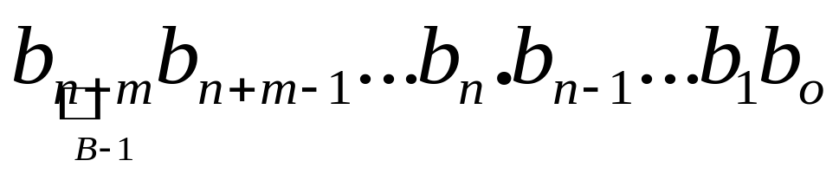
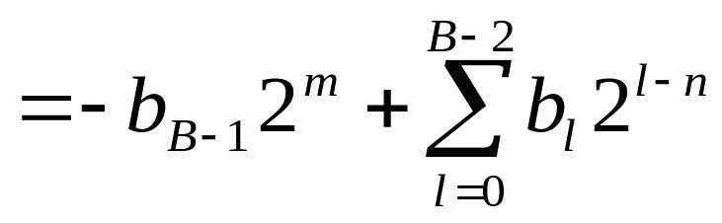
General Fixed-Point Representation
B-bit number in Qm.n format:
Value of N-bit number in Qm.n format:
Fixed Point

Slide 11
How to Compute Fractional Number
Q m.n Format
b’_{s}b’_{m-1}…b’₀ | b_{n-1}b_{n-2}…b₀
.
-2^{m}b’_{s}+…+2¹b’₁+2⁰b’₀+2⁻¹b_{n-1 +} 2⁻²b_{n-2}…+2^{-n}b₀
Examples:
1110 Integer Representation Q3.0: -2³ + 2² + 2¹ = -2
11.10 Fractional Q1.2 Representation: -2¹ + 2⁰ + 2⁻¹ = -2 + 1 + 0.5 = -0.5
(Scaling by 1/2²)
1.110 Fractional Q3 Representation: -2⁰ + 2⁻¹ + 2⁻² = -1 + 0.5 + 0.25 = -0.25 (Scaling by 1/2³)

Slide 12
Truncating or Rounding?
Which one is better?
Truncation
  Magnitude of truncated number always less than or equal to the original value
    Consistent downward bias
Rounding
  Magnitude of rounded number could be smaller or greater than the original value
    Error tends to be minimized (positive and negative biases)
  Popular technique: rounding to the nearest integer
Example:
  INT[251.9] = 251 (Truncate or floor)
  ROUND [ 251.9] = 252 (Round or ceil)
  ROUNDNEAREST [251.9] = 252

Slide 13
Q format Multiplication
Product of two Q15 numbers is Q30.
So we must remember that the 32-bit product has two bits in front of the binary point.
  Since NxN multiplication yields 2N-1 result
  Addition MSB sign extension bit
On some computers (or instructions) only the most significant 15 bits (plus the sign bit) are stored back into memory, so the write operation requires a left shift by one.
Q15
Q15
16-bit memory
Sign bit
X
Extension sign bit
15 bits
15 bits

Slide 14
General Fixed-Point Representation
Fixed-point DSPs use 2’s complement fixed-point numbers in different Q formats
  Example (Texas Instruments) : 16bit x 16bit => 40 bit result
    Interpretation : Q0.15 x Q0.15 => Q8.31
Assembler only recognizes integer values
  Need to know how to convert fixed-point number from a Q format to an integer value that can be stored in memory and that can be recognized by the assembler.
  Programmer must keep track of the position of the binary point when manipulating fixed-point numbers in assembly programs.

Slide 15
How to convert fractional number into integer
Conversion from fractional to integer value:
  Step 1: normalize the decimal fractional number to the range determined by the desired Q format
  Step 2: Multiply the normalized fractional number by 2^{n}
  Step 3: Round the product to the nearest integer
  Step 4: Write the decimal integer value in binary using N bits.
Example:
Convert the value 3.5 (assuming that the largest amplitude is 4) into an integer value that can be recognized by a DSP assembler using the Q15 format => 1) Normalize: 3.5/4 = 0.875;
2) Scale: 0.875*2¹⁵= 28,672; 3) Round: 28,672

Slide 16
How to convert an integer into fractional number
Numbers and arithmetic results are stored in the DSP processor in integer form.
Need to interpret as a fractional value depending on Q format
Conversion of integer into a fractional number for Qm.n format:
  Divide integer by scaling factor of Qm.n => divide by 2^{n}
Example:
Which Q15 value does the integer number 2 represent? 2/2¹⁵=2*2⁻¹⁵=2⁻¹⁴

Slide 17
Finite-Wordlength Effects
Wordlength effects occur when wordlength of memory (or register) is less than the precision needed to store the actual values.
Wordlength effects introduce noise and non-ideal system responses
Examples:
  Quantization noise due to limited precision of Analog-to-Digital (A/D) converter, also called codec
  Limited precision in representing input, filter coefficients, output and other parameters.
  Overflow or underflow due to limited dynamic range
  Roundoff/truncation errors due to rounding/truncation of double-precision data to single-precision data for storage in a register or memory.
    Rounding results in an unbiased error; truncation results in a biased error => rounding more used in practice.

Slide 18
Real Floating-Point Numbers
Numbers with fractions
Could be done in pure binary
  1001.1010 = 2⁴ + 2⁰ +2⁻¹ + 2⁻³ =9.625
Where is the binary point?
Fixed?
  Ok if overflow/underflow is manageable
Moving?
  How do you show where it is?

Slide 19
Floating Point
Sign bit
Biased
Exponent
Significand or Mantissa
+/- .significand x 2^{exponent}
Point is actually fixed between sign bit and body of mantissa
Exponent indicates place value (point position) – used to offset the location of the binary point left or right

Slide 20
Floating Point Number Representation
Mantissa is stored in 2’s complement
Exponent is in excess or biased notation
  Excess (bias): 127 (single precision); 1023 (double precision) to obtain positive or negative offsets
  Exponent field: 8 bits (single precision); 11 bits (double precision) – determines dynamic range
  Mantissa: 23 bits (single precision); 52 bits (double precision) – determines precision

Slide 21
Floating-Point Number Representation
Floating-point numbers are usually normalized; i.e., exponent is adjusted so that leading bit (MSB) of mantissa is 1
Since MSB of mantissa is always 1, there is no need to store it

Slide 22
IEEE 754
Standard for floating point storage
32 and 64 bit standards
8 and 11 bit exponent respectively
Extended formats (both mantissa and exponent) for intermediate results

Slide 23
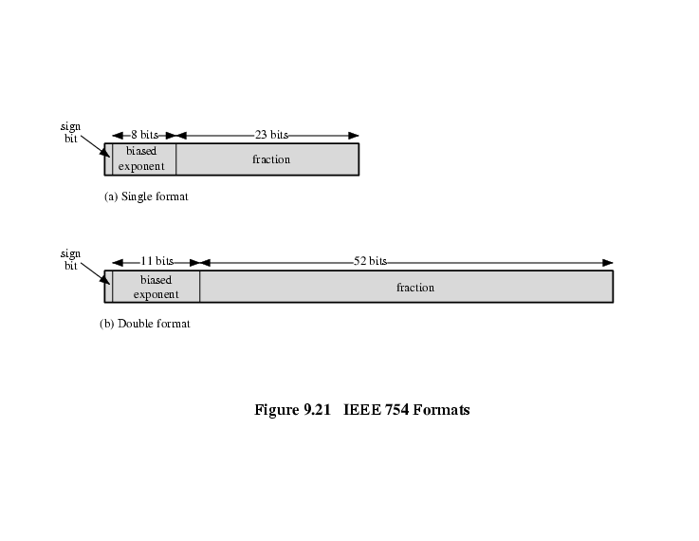
IEEE 754 Formats

Slide 24
Floating-point Arithmetic +/-
Check for zeros
Align significands (adjusting exponents)
Add or subtract significands
Normalize result

