Slide 1

Game Theory Presentation

Slide 2
Part 1

Slide 3
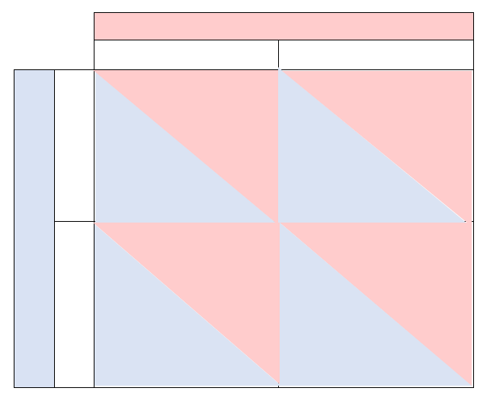
U.S
2 Players: U.S and other countries
2 Feasible strategies at play: decarbonise (DC) or nearly business-as-usual (NBAU)
Viewpoint is to be played from an optimistic game theorist point of view
(decarbonise) DC
(NBAU) nearly business-as-usual
10
6
(decarbonise) DC
Other countries
10
2
2
4
(NBAU) nearly business-as-usual
6
4

Slide 4
Interpreting payoff matrix
As this game is played out from an Optimistic point of view, the game closely resembles the stag-hare game where both parties receive greatest self benefit by co-operating. Even if one player may act in self-interest their greatest gain is to be achieved by co-operating.
By co-operating (both choosing DC), there is a net gain for both countries, the value of the benefit being chosen as 10 units. This strategy is the best response for both players.
Both players choosing NBAU will see some gain for both parties with a chosen margin of 4 units, but with both players benefit being greater if they had instead chosen DC.
In the scenario where a player may choose NBAU they will receive reliable short-term results at the detriment of the other player who chooses to co-operate (DC). The player acting in self interest (NBAU) will benefit by a chosen value of 6 units and the player choosing to co-operate (DC) will only benefit by 2 units.

Slide 5
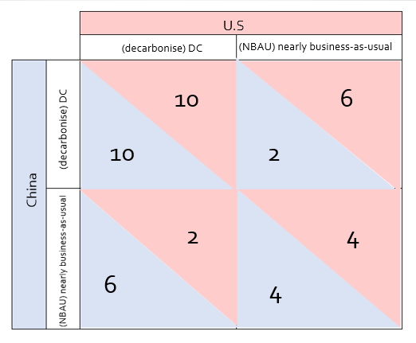
Best responses and the dominant strategies
There are 2 Nash equilibria:
Risk dominant (NBAU, NBAU) – if player 1 chooses NBAU then player 2 will also choose NBAU to increase their payoff from 2 -> 4 and vice versa.
Payoff dominant (DC, DC) – payoffs are higher for both players
In this game it just so happens that acting in self-interest and co-operating are both the same response, leading to a socially desirable outcome.
Best response from both players is to choose DC as they are both better off and can achieve no greater payoff
There is no dominant strategy for either players as both decisions could potentially have the greater payoff

Slide 6
Economic outcomes: Efficiency and Fairness
Pareto efficiency: There is no alternative in which one player may be made better off with the other playing being made worse off. DC,DC is the only Pareto efficient outcome.
Fairness: The outcome of DC,DC and NBAU,NBAU may both be considered fair as both parties receive equal benefit in both outcomes without one player feeling left out and or feeling their detriment is to the others gain. Both of these outcomes can be considered “just” and fair without inequality.
DC,DC
DC,NBAU
NBAU,NBAU
NBAU,DC
DC,DC = Both U.S and Other countries choose DC
NBAU,NBAU = Both U.S and Other countries choose NBAU
DC,NBAU = U.S choose DC Other countries choose NBAU
NBAU,DC = U.S choose NBAU Other countries choose DC

Slide 7
Social preferences and game outcome
If the game is to be played out from the POV of an optimistic game theorist, the following outcomes are to be predicted:
Both players will choose DC when choosing to co-operate and even when acting in self-interest as this will yield them their greatest individual pay-off and all ceteris paribus (all other things being equal) there is no incentive to choose NBAU
If one player has a reciprocal mind set as well this will continue to feed the cycle of both countries choosing DC on every turn
A player may decide to choose NBAU if something else changes between their relationship (political turmoil, war, etc.) Other countries may choose NBAU if the U.S choose DC to try and cause damage to the U.S regardless of the opportunity cost to their own gain as long as they feel they are inflicting a disadvantage to their opponent and to ‘win’ the game by benefitting greater than their opponent (pay-off of 6 vs 2). In response to this the U.S will certainly not replicate their pervious move in choosing DC and will instead choose NBAU to increase their payoff from 2 -> 4 and evening the pay-offs. Once the game crosses this threshold of malicious intentions/mindset I believe it would be difficult to bring it back to both players choosing DC unless there is some sort of truce

Slide 8
Part 2

Slide 9
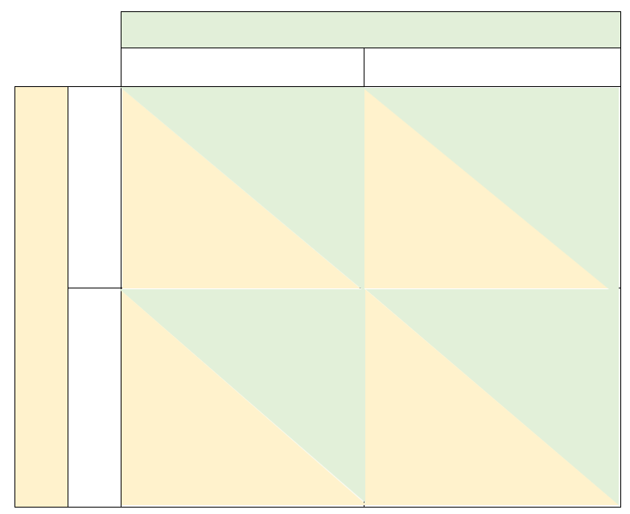
2 Players: Russia and NATO
Each player has 2 strategies:
Russia:
Transgress
Not transgress
NATO:
Sanction
Not punish
Each player acts rationally
Game is turn based. Player 1 (Russia) moves and player 2 (NATO) responds
Russia
Transgress
Not transgress
-4
-6
Sanction
-2
-2
NATO
Not punish
6
1
0
1

Slide 10
Summary of the game
This game is turn based and also a repeated sanctions game whereby player 1 (an adversary) can choose to either inflict damage (transgress) or to do nothing (not transgress). In turn player 2 must respond to player 1’s decision making by either choosing to punish (sanction) or do nothing (not punish). There are no dominant strategies for either player. The caveat of this game is that even though player 2 may choose to punish player 1, this also comes at a cost to player 2 (the punisher). Player 1 may choose to transgress if they believe player 2 is bluffing (not willing to accept the cost of punishment to themselves) by calling player 2’s bluff player 1 may choose to transgress believing there may be no consequences,. Alternatively player 1 may choose to transgress regardless of player 2’s decision in an attempt to drag them down with them (not acting rationally)

Slide 11
Interpreting payoff matrix
If player 1 chooses Transgress player 2 is most likely to choose Sanction. player 1 incurs a payoff of -4 units as Russia may gain a small amount by invading Ukraine but ultimately incur a net loss due to restrictions to their trade in the form of tariffs/taxes. Player 2 also incurs a loss but a smaller amount of -2 units this is due to an increase in price from Russian export (oil) and due to the inefficient allocation of resources inflicted by taxations. Both players are affected by the dead weight loss associated with tariffs and both players (society) loses as a whole. It is unlikely, though if player 2 chooses to Not punish player 1 then player 1 benefits by 6 units as they gain dominance over Ukraine and face no consequence of their actions. In this instance player 2 does not occur a benefit or loss (0 units) but this action may encourage player 1 to continue with choosing to transgress at every turn if they believe player 2 will not punish them. In this situation player 1 will walk over player 2 and win the game
If player 1 chooses to Not transgress player 2 is most likely to choose Not punish. Both player 1 and 2 will incur a payoff of 1 unit as trade commences as usual and both economies can continue to grow. If player 2 chooses to Sanction player 1 will incur a payoff of -6 units as they gain no territory/dominance over Ukraine and also incur loss to economic growth due to tariffs and taxes imposed on their trade. Player 2 will incur a loss of -2 units due to the cost of taxation mentioned above.

Slide 12
Best responses and the dominant strategies
There are 2 dominant strategies:
Player 1’s dominant strategy is to choose Transgress as regardless of what player 2 chooses, player 1’s payoff will always be higher when choosing to transgress (-4>-6) and (6>1)
Player 2’s dominant strategy is to choose Not punish as their payoff is always higher regardless of what player 1 chooses (0>-2) and (1>-2)
Player 2’s best response taken at face value is to choose Not punish as when they choose Sanction they always incur a payoff of -2 units
Player 1 does not have a best response as they cannot respond to player 2 since player 1 chooses first every turn.

Slide 13
Economic outcomes: Efficiency

Slide 14
Social preferences and game outcome

