Slide 2

U.S
2 Players: U.S and other countries
2 Feasible strategies at play: decarbonise (DC) or nearly business-as-usual
Viewpoint is to be played from an optimistic game theorist
(decarbonise) DC
(NBAU) nearly business-as-usual
10
6
(decarbonise) DC
10
2
China
2
4
(NBAU) nearly business-as-usual
6
4

Slide 3
Interpreting payoff matrix
By co-operating (both choosing DC), there is a net gain for both countries, the value of the benefit being chosen as 10 units. This strategy is the best response for both players.
Both players choosing NBAU will see some gain for both parties with a chosen margin of 4 units, but with both players benefit being greater if they had instead chosen DC.
In the scenario where a player may choose NBAU they will receive reliable short term results at the detriment of the other player who chooses to co-operate (DC). The player acting in self interest (NBAU) will benefit by a chosen value of 6 units and the player choosing to co-operate (DC) will only benefit by 2 units.

Slide 4
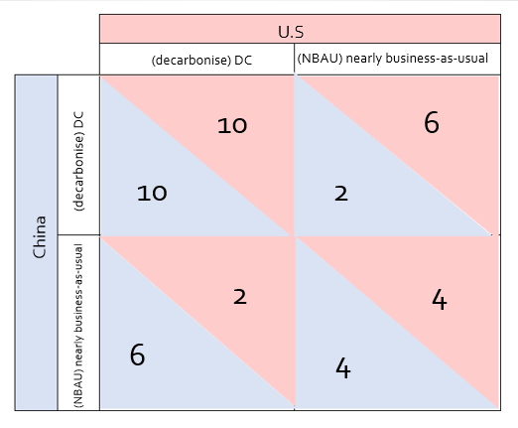
Best responses and the dominant strategies
There are 2 Nash equilibria:
Risk dominant (NBAU, NBAU) – if player 1 chooses NBAU then player 2 will also choose NBAU to increase their payoff from 2 -> 4 and vice versa.
Payoff dominant (DC, DC) – payoffs are higher for both players
In this game it just so happens that acting in self-interest and co-operating are both the same response, leading to a socially desirable outcome.
Best response from both players is to choose DC as they are both better off and can achieve no greater payoff

Slide 5
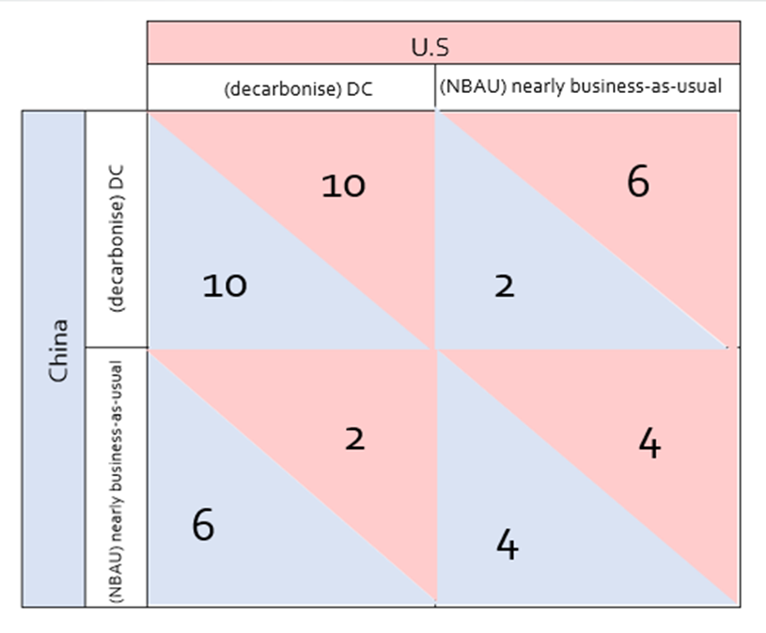
Economic outcomes, efficiency and fairness

