Slide 1
NBA Team Performance Analysis
Game-Level Data (2019–2020 Season)
Perry Jones
Notes:
Introduce the project and explain that the goal is to analyze NBA team performance using Python and nba_api data. Mention the Spurs, Rockets, and Thunder.

Slide 2
Project Overview
Analyze game-level NBA data
Teams: Spurs, Rockets, Thunder
Season: 2019–2020
Tools: Python, pandas, matplotlib, seaborn
Notes:
Explain why these teams were selected and what tools were used to perform the analysis.

Slide 3
Research Questions
How do the teams compare statistically?
Which metrics correlate with winning?
Does home court advantage affect performance?
Which stats best predict wins?
Notes:
Walk through the research questions guiding the project.

Slide 4
Data Collection
Data pulled from basketball reference
Game level statistics
Exported to CSV
Analyzed entirely in Python
Notes:
Explain that nba_api provides official NBA statistics and the data was exported for analysis.

Slide 5
Data Cleaning & Preparation
Removed duplicates
Handled missing values
Created win indicator variable
Created home vs away indicator
Notes:
Describe the preprocessing steps used to prepare the dataset.

Slide 6
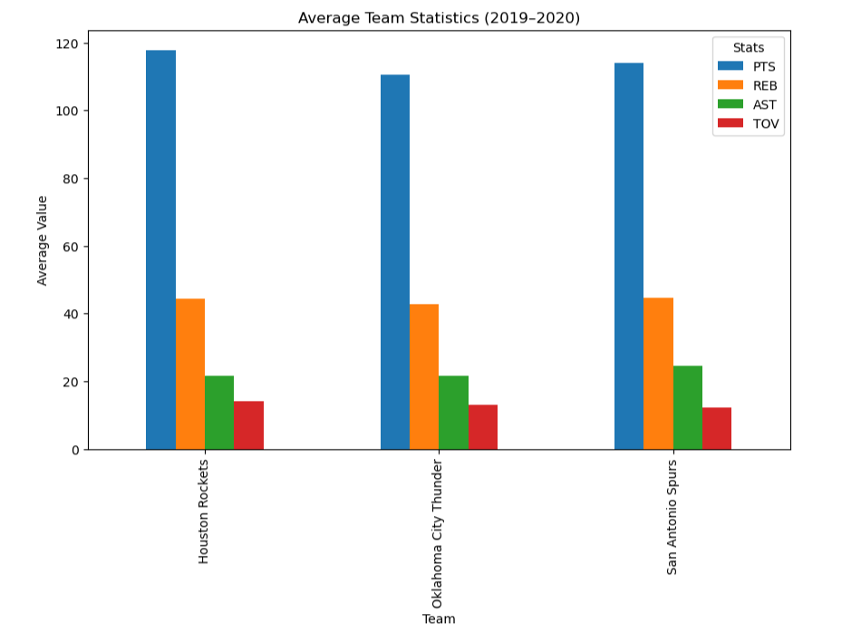
Team Statistical Comparison
Insert Chart Here:
Average Points, Rebounds, Assists, Turnovers by Team
Notes:
Explain the bar chart comparing average stats between the three teams.

Slide 7
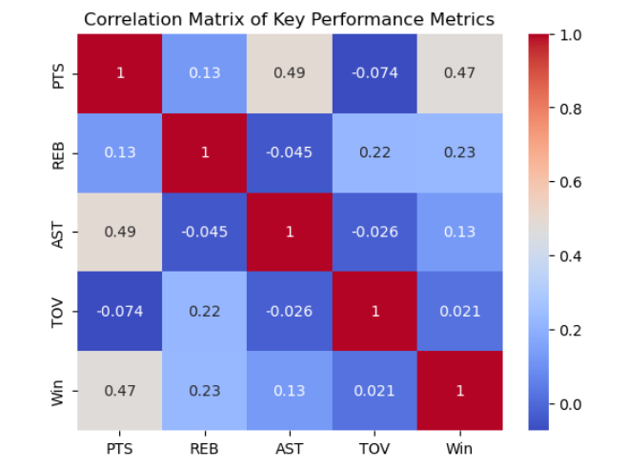
Correlation Analysis
Insert Chart Here:
Correlation Heatmap of Stats vs Wins
Notes:
Discuss which metrics are most strongly correlated with winning.

Slide 8
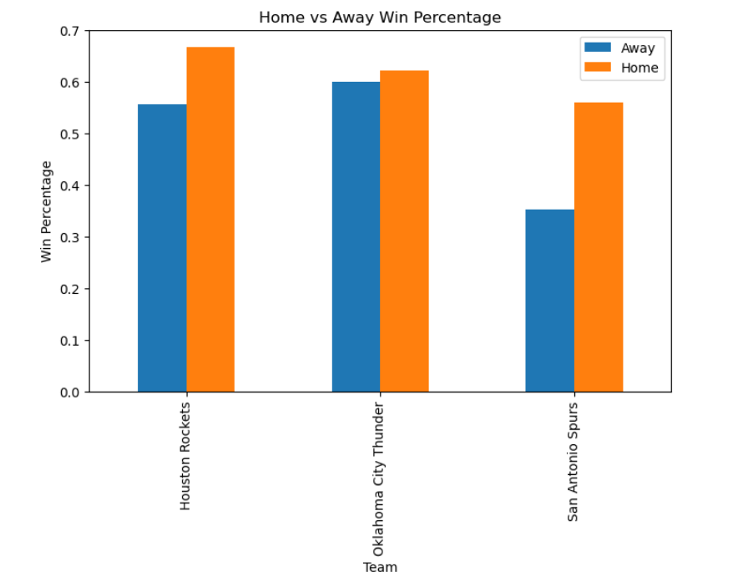
Home vs Away Performance
Insert Chart Here:
Win Percentage by Home/Away
Notes:
Explain the effect of home court advantage on team performance.

Slide 9
Key Findings
Offensive metrics correlate strongly with wins
Turnovers negatively impact win probability
Home teams win slightly more often
Different play styles visible across teams
Notes:
Summarize the major insights discovered from the visualizations.

Slide 10
Conclusion
Python enables full sports analytics workflow
Basketball reference provides rich game-level data
Clear statistical trends were identified
Future work could include more teams or seasons
Notes:
Close the presentation and suggest future extensions.

