Slide 1





P.R.I.M.E.
Day 1 Orientation
blindspot
Today's agenda
detecting what the tracker cannot see
Introductions & research culture
The 10-week experience
North Dakota State University
P.R.I.M.E. Research Experience - Summer 2026
Paper assignments & annotation format
Sabrina Perry, PhD + Floyd Dodwell + Christina Page
GitHub & the blindspot repo
Week 1 assignments
Summer 2026

Slide 2


01: Introductions & Research Culture
11:00 – 11:30 · 30 minutes
Who we are
What research feels like
Lab norms
Names, majors, one thing you are genuinely curious about outside of class. Researcher shares their background and current work on data poisoning.
No grades, no right answers, failure is data. The goal is contribution, not completion. Questions are the actual work.
Group text for quick questions. GitHub issues for technical questions. Email for formal things. Friday 5pm deadlines. Monday presentations.
This is real research — the goal by week 10 is a paper draft good enough to submit to a conference.

Slide 3
02: The 10-Week Experience
11:30 – 12:00 · 30 minutes
Phase 1
Phase 2
Phase 3
Phase 4
Weeks 1–2
Weeks 3–4
Weeks 5–7
Weeks 8–10
Foundation
Exploration
Assess & Build
Write & Publish
Orientation, threat modeling, seed paper reading
Clean baseline, embedding poison, degradation measured
Midpoint review ★, detector built, scalability tested ★
Paper drafted, revised, venues identified, NDSU final
Weekly rhythm:
→ Mon – Thu: reading & experiments
→ Sun 5pm: annotation + slides due to GitHub
→ Mon: paper presentation (10 min each)

Slide 4



The Research Question
What we are investigating and why it is an open problem
In a multi-camera tracking system where 2 of N cameras are fed poisoned embedding vectors - how do we detect which cameras are compromised before the system silently fails?
The attack
The damage
The detection
Poisoned embedding vectors from 2 cameras shift cosine distances - cross-camera identity association collapses silently
IDF1 drops, identity switches spike, trajectories break - the tracker appears to work but its output is wrong
Cross-camera cosine distance distributions shift when a camera is poisoned - detectable without ground truth identity labels
Why it is open: no prior paper has characterized embedding-space poisoning in MTMC tracking or proposed a label-free cross-camera detector.

Slide 5
03: Paper Assignments & Annotation Format
12:00 – 12:30 · 30 minutes
Seed papers — 4 total, weeks 1–2
Annotation template — 6 fields, every paper
Dr. Perry provides these. You find everything else independently.
1
Full citation (IEEE or APA)
Week 1 → Christina
2
Argument summary (2–3 sentences)
Wild Patterns Reloaded - Cinà et al.
3
Method used
Week 1 → Floyd
ByteTrack - Zhang et al.
4
Strength of evidence
Week 2 → Both
5
Limitation or gap
BadNets — Gu et al.
6
Relevance to project
Week 2 → Both
Blinding & Blurring the MOT Tracker
By week 8 your annotation files ARE the literature review. You are pre-writing the paper all summer.

Slide 6
Friday Paper Presentation Format
10 minutes per student · same 6-point structure every week · used from week 1 through week 10
1
Paper ID
4
Key finding or result
Title, authors, venue, year
The single most important thing the paper found
2
Main argument
5
Limitation or question
One sentence: what does this paper claim?
What does it leave unsolved? What are you skeptical of?
3
Method or evidence
6
Connection to project
How did they show it? Dataset, experiment, proof
How does this change how you think about the research?

Slide 7
04: GitHub & the blindspot Repository
12:30 – 1:00 · 30 minutes
5 commands — that is all you need
blindspot — folder structure
git clone
download the repo to your laptop - once
/docs
program documents - read these first
git pull
get latest changes - every morning
/papers
your annotation files - christina / floyd
git add
stage your changed files
/src
shared code - embed_poison.py + detector
git commit
save a snapshot with a message
/experiments
one folder per experiment week
git push
send changes to the shared repo
/results
metrics, tables, and figures
/paper-draft
the growing paper - all sections
Commit often. Small commits with clear messages are better than one big commit at the end of the week.

Slide 8
05: Week 1 Assignments
Before you leave today — confirm every item out loud
Christina
Floyd
Read Seed 1 — Cinà et al., Wild Patterns Reloaded (arxiv.org/abs/2205.01992)
Read Seed 2 — Zhang et al., ByteTrack (arxiv.org/abs/2110.06864)
Complete annotation entry - all 6 fields using the template
Complete annotation entry - all 6 fields using the template
Commit annotation to papers/christina/ before Friday 5pm
Commit annotation to papers/floyd/ before Friday 5pm
Prepare Friday presentation slides - 6-point format, 10 minutes
Prepare Friday presentation slides - 6-point format, 10 minutes
Push slides to repo by Friday 5pm
Push slides to repo by Friday 5pm
Both students:
Write a 1-paragraph reflection - what you understood today, what you are uncertain about, one question for week 2. Push this to your papers folder.
Monday:
Both students present their seed paper - 10 minutes, 6-point format. Bring questions, not just summaries.

Slide 9
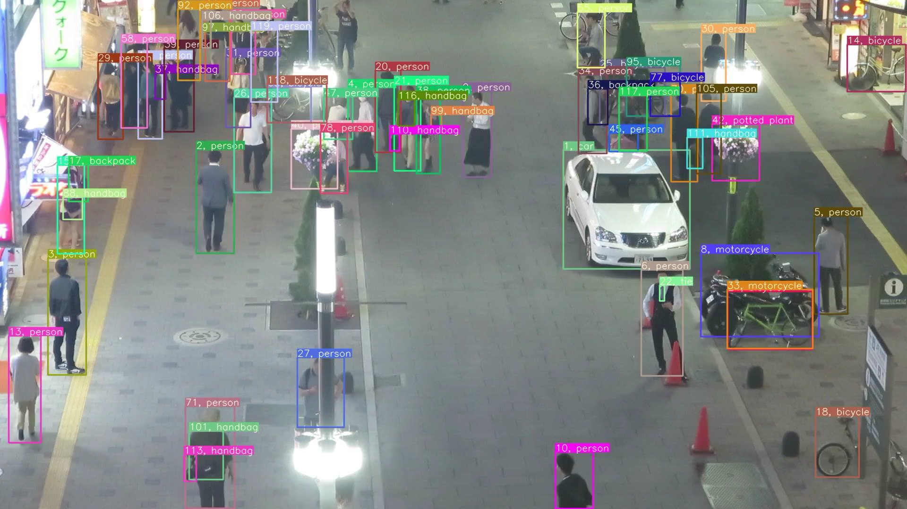
detecting what the tracker cannot see
Questions before we wrap up?
Travel plans
Group text
See you Tuesday
P.R.I.M.E. Research Experience — NDSU Summer 2026

Slide 10
blindspot
detecting what the tracker cannot see
Questions before we wrap up?
Travel plans
Group text
See you Tuesday
P.R.I.M.E. Research Experience — NDSU Summer 2026

