Slide 1

blindspot
detecting what the tracker cannot see
ByteTrack: Multi-Object Tracking by Associating Every Detection Box.
Zhang, Y., Sun, P., Jiang, N., Yu, Z., Weng, F., Yuan, Z., Luo, D., Liu, W., & Wang, X.
Proceedings of the European Conference on Computer Vision(2022)
https://doi.org/10.1007/978-3-031-19815-1_1
Floyd Dodwell · Week 1 · P.R.I.M.E. Summer 2026
P.R.I.M.E. Research Experience · blindspot-summer-2026 · APSU CSIT
1 / 7

Slide 2
blindspot · Paper Presentation
2
Main Argument
The papers main argument is that BYTE and Bytetrack are the best data association software's available.
Why does this matter?
This claim matters to blindspot because using BYTE & Byte track would be the most effective way to get sufficient data on association and data poisoning.
P.R.I.M.E. Research Experience · blindspot-summer-2026 · APSU CSIT
2 / 7

Slide 3
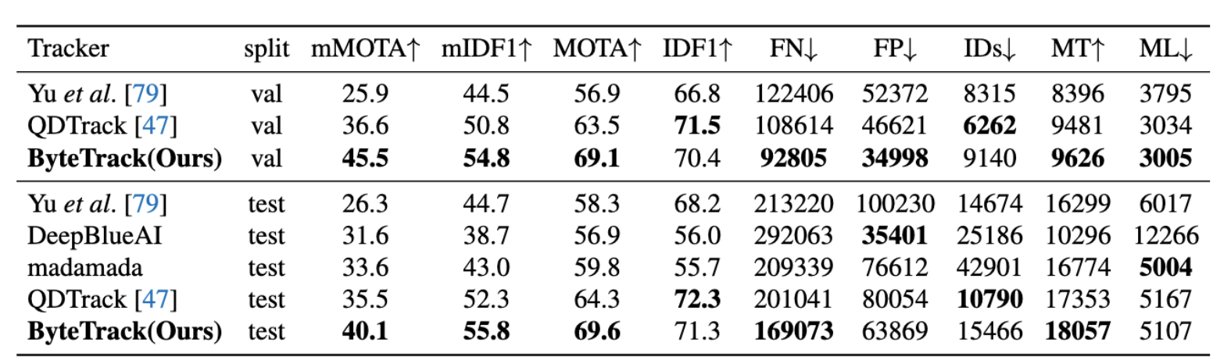
blindspot · Paper Presentation
3
Method or Evidence
Dataset or setting
Experimental approach
How they measured success
In the paper they use multiple charts to support their findings. A lot of the charts were bar graphs, pie charts, and number charts. All these charts showed that BYTE was the best along with Bytetrack.
During their research they showed numbers of how BYTE was the most efficient data associator and used IDF1, MOTA, FN, FP, and IDs for their claims
They measured how useful their software was based on comparisons to other software's, in every stat, BYTE and Byte track beat the other software’s.
Tracklet Interpolation
a crucial post-processing technique in computer vision and multi-object tracking (MOT) used to reconstruct the trajectory of an object during brief periods when it is completely occluded or missed by the object
P.R.I.M.E. Research Experience · blindspot-summer-2026 · APSU CSIT
3 / 7

Slide 4
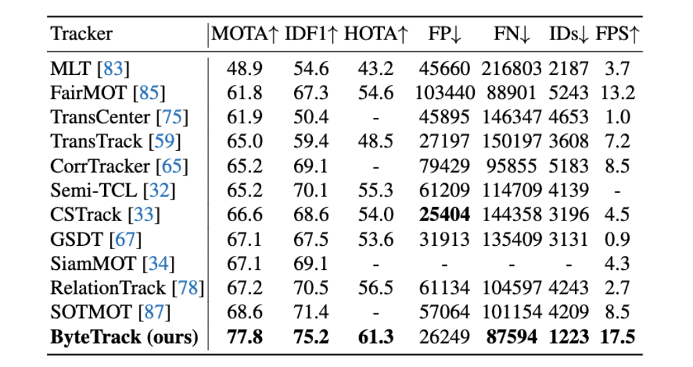
blindspot · Paper Presentation
4
Key Finding or Result
The single most important thing the paper found or demonstrated.
★ Main finding
In this paper Bytetrack is shown to be the best software available, however, assumes that even when an object is heavily occluded, the object detector will still generate a bounding box (even if it has a very low confidence score). If an object is completely hidden and the detector outputs absolutely nothing (0.0 confidence), ByteTrack has no low-score box to "rescue," and the track will break. This paper fails to test non-linear and unpredictable movements and as a result, BYTE doesn’t know where to find the object if the object moves in a non-linear fashion and will struggle to fix it.
Supporting result 1
Supporting result 2
MOTA: Multi-Object Tracking Accuracy
IDF1: ID F1 Score (Identity F1 Score)
HOTA: Higher Order Tracking Accuracy
FP: False Positives
FN: False Negatives
IDs: Identity Switches
FPS: Frames Per Second
In the paper it talks about tracklet interpolation, I explained what it was in the last slide. This supports how BYTE has its flaws but it is still the best software out there, if BYTE added tracklet interpolation it would have no competition.
P.R.I.M.E. Research Experience · blindspot-summer-2026 · APSU CSIT
4 / 7

Slide 5
blindspot · Paper Presentation
5
Limitation or Open Question
What does this paper leave unsolved? What are you skeptical of?
What it leaves unsolved
What you are skeptical of
What question it raises for us
Complex or Non-Linear Motion: The system relies heavily on a linear Kalman Filter to estimate where objects move next. It struggles to handle complex, unpredictable, or sudden direction changes (e.g., erratic camera jitter, fast-moving athletes, or sports equipment).
Over-Reliance on the Detector: The main claim is that the algorithm "rescues" low-confidence bounding boxes to maintain tracks. However, this assumes the object detector will always output some box at an occluded spot. I am skeptical about how well this holds up in scenarios where severe lighting drops or complete camouflage drop detection scores down to absolute zero
Downstream Multi-Camera Poisoning: For our project focus, if ByteTrack creates false associations on a local camera feed, how severely does that corrupt data downstream? If this bad trajectory data is fed into a multi-camera tracking network, will it poison the global embedding space?
Could you figure out if data was poisoned in real time?
P.R.I.M.E. Research Experience · blindspot-summer-2026 · APSU CSIT
5 / 7

Slide 6
blindspot · Paper Presentation
6
Connection to Our Project
How does this paper change how you think about embedding-space poisoning in multi-camera tracking?
How this paper connects to blindspot:
In the paper, the failure to identify an object that is doing spiritic and uncommon movements could lead to data poisoning being an easy task. Since it fails to identify an object that moves nonlinearly a majority of the time, if someone wanted to tell the camera feed that the object moving in a certain area already has a low confidence score, it will use that later for other objects with a low confidence rating. If ByteTrack gets confused by non-linear motion and accidentally assigns a low-confidence background artifact or a completely different person to an active track, it sends bad data to the global Re-ID model. This forces the multi-camera system to learn incorrect visual features for that ID, effectively poisoning its embedding space.
This paper supports our approach because...
This paper challenges our approach because...
We are trying to find poisoned frames, essentially seeing what the detector cannot see.(0.0 confidence scores)
If the video feeds we use have BYTE and don’t notice the object or if it assigns an object the wrong classification then it will be much more challenging for us.
P.R.I.M.E. Research Experience · blindspot-summer-2026 · APSU CSIT
6 / 7

