Slide 1

PHANTOM
blindspot
detecting what the tracker cannot see
Papers presented this week:
1
Multi-Camera Tracking of Vehicles based on Deep Features Re-ID and Trajectory-Based Camera Link Models — Hsu et. al. · Proceedings of the IEEE/CVF Conference on Computer Vision and Pattern Recognition Workshops (CVPRW) (pp. 416–424) · 2019
2
Multi-camera Multi-object Tracking — Liu et. al. · Computer Vision and Pattern Recognition (cs.CV) · 2017
3
[Optional — Click to enter if you found a third paper]
[Your name] · Week [N] · P.R.I.M.E. Summer 2026
P.R.I.M.E. Research Experience · blindspot-summer-2026 · APSU CSIT
1 / 7

Slide 2
blindspot
detecting what the tracker cannot see
Paper title:
[Click to enter full paper title]
Authors:
[Author names]
Venue & year:
[Conference / Journal · Year]
Link:
[arxiv.org/abs/... or DOI]
[Your name] · Week [N] · P.R.I.M.E. Summer 2026
P.R.I.M.E. Research Experience · blindspot-summer-2026 · APSU CSIT
1 / 7

Slide 3
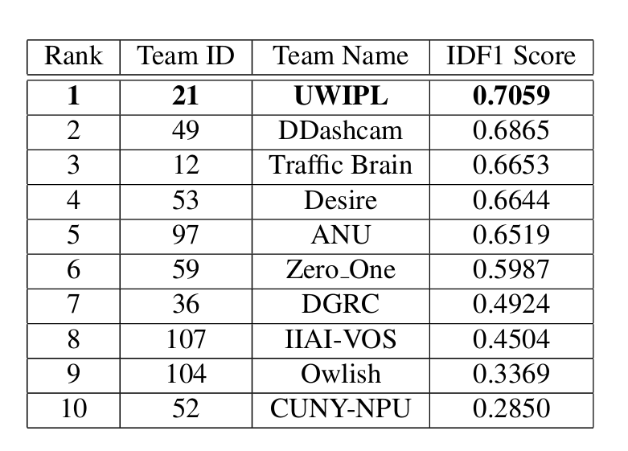
P.R.I.M.E. · blindspot-summer-2026 · Multi-Paper Presentation
2
Paper 1
Cover all four fields: argument, method, key finding, and your reaction
Main argument
Method or evidence
This paper is about building a system that tracks vehicles across multiple cameras by combining single camera tracking, deep embedding based vehicle re-identification and traffic/route time constraints.
For the single camera tracking they used the AI City Challenge 2018 dataset, and to extract deep embedded features for the Re-ID they used ResNet50
Key finding
Your reaction
A question that this would raise in regards to our project is: What if the embeddings are maliciously manipulated? This paper never touches on what happens if the embeddings can’t be trusted.
Link / Citation:
H.-M. Hsu, T.-W. Huang, G. Wang, J. Cai, Z. Lei, and J.-N. Hwang, "Multi-Camera Tracking of Vehicles based on Deep Features Re-ID and Trajectory-Based Camera Link Models," in Proceedings of the IEEE/CVF Conference on Computer Vision and Pattern Recognition Workshops (CVPRW), 2019, pp. 416–424.
P.R.I.M.E. Research Experience · blindspot-summer-2026 · APSU CSIT
2 / 7

Slide 4
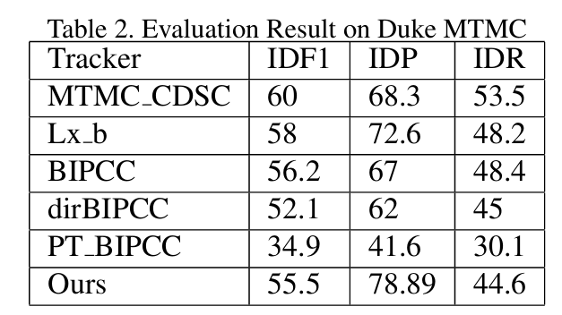
P.R.I.M.E. · blindspot-summer-2026 · Multi-Paper Presentation
3
Paper 2
Cover all four fields: argument, method, key finding, and your reaction
Main argument
Method or evidence
Multi-camera tracking works better when appearance information and motion information are combined into a single global optimization problem rather than making tracking decisions independently from each camera.
The two datasets that were used were: EPFL Terrace and Duke MTMC.
Key finding
Your reaction
The results of this experiment were an IDF1 of 55.5.
From this paper I was surprised to see that the authors admitted their results needed improvements for tracking accuracy.
Link / Citation:
https://doi.org/10.48550/arXiv.1709.07065
P.R.I.M.E. Research Experience · blindspot-summer-2026 · APSU CSIT
3 / 7

Slide 5
P.R.I.M.E. · blindspot-summer-2026 · Multi-Paper Presentation
4
Paper 3 — Optional
Use this slide if you found a third paper. Skip it if you only found two.
If you only found 2 papers this week, leave this slide blank and move straight to slide 5.
Main argument
Method or evidence
[One sentence: what does this paper claim?]
[What data or experiment did they use to show it?]
Key finding
Your reaction
[The single most important result]
[What surprised you or what question does it raise?]
P.R.I.M.E. Research Experience · blindspot-summer-2026 · APSU CSIT
4 / 7

Slide 6
blindspot · Paper Presentation
2
Main Argument
State the paper's central claim in ONE sentence. If you cannot say it in one sentence, keep refining.
[Click here and type the paper's main argument in one sentence]
Why does this matter?
[1–2 sentences: why does this claim matter to the PHANTOM project?]
P.R.I.M.E. Research Experience · blindspot-summer-2026 · APSU CSIT
2 / 7

Slide 7
blindspot · Paper Presentation
3
Method or Evidence
How did they show it? Describe the dataset, experiment, proof, or analysis.
Dataset or setting
Experimental approach
How they measured success
[What data did they use? How large? What domain?]
[What did they actually do? What comparisons did they make?]
[What metrics? What threshold for a good result?]
Additional notes on the method:
[Any additional context about how they conducted the study]
P.R.I.M.E. Research Experience · blindspot-summer-2026 · APSU CSIT
3 / 7

Slide 8
blindspot · Paper Presentation
4
Key Finding or Result
The single most important thing the paper found or demonstrated.
★ Main finding
[Describe the key result in 2–3 sentences. Be specific — include numbers if the paper reports them.]
Supporting result 1
Supporting result 2
[Secondary finding or supporting data point]
[Another supporting finding or comparison]
P.R.I.M.E. Research Experience · blindspot-summer-2026 · APSU CSIT
4 / 7

Slide 9
blindspot · Paper Presentation
5
Limitation or Open Question
What does this paper leave unsolved? What are you skeptical of?
What it leaves unsolved
What you are skeptical of
What question it raises for us
[What gap or assumption does this paper leave unaddressed?]
[What claim or result would you push back on and why?]
[What new question does this paper create for the blindspot project?]
Critical thinking prompt: Could you replicate this paper's results? What would you need?
P.R.I.M.E. Research Experience · blindspot-summer-2026 · APSU CSIT
5 / 7

Slide 10
P.R.I.M.E. · blindspot-summer-2026 · Multi-Paper Presentation
5
What Connects These Papers?
Look across all the papers you presented this week, what do they have in common?
Theme or pattern across this week's papers
How these papers connect to ALL prior reading
What idea, method, or approach shows up in more than one of the papers you read this week? Be specific — name the papers.
Do these papers agree with, contradict, or extend what you read in earlier weeks? Name specific prior papers.
Both Hsu et. al. 2019 and Liu et. al. 2017 covered the concept of multi-camera multi object tracking. They both argue that detecting the objects is not the hardest part, and they both use visual appearance to recognize objects.
These papers extend previous papers that I have read. In particular the Cina et. al. paper relates the most since both of these papers laid the foundation of how these trackers work which opens up the opportunity for adversarial attacks.
What is still missing across everything you have read?
The idea that is still missing across all of the papers I have read is how adversarial manipulations of embeddings impacts multi-camera tracking.
P.R.I.M.E. Research Experience · blindspot-summer-2026 · APSU CSIT
5 / 7

Slide 11
P.R.I.M.E. · blindspot-summer-2026 · Paper Presentation
7
Synthesis: Connecting the Papers
Starting from week 3, use this slide to connect ALL the papers you have read so far, not just this week's paper.
1
What pattern connects the papers?
2
Where is the gap?
3
Which paper surprised you most and why?
What theme, idea, or approach shows up across multiple papers you have read? Name at least two papers in your answer.
What has NOT been done yet across all the papers you have read? How does PHANTOM fill that gap?
Pick one paper from any week. What did it say that you did not expect — and did it change how you think about the project?
Liu et. al. and Hsu et. al. lay the groundwork for how trackers can work i.e. using deep re-ID embeddings and LOMO appearance features. All of the attack papers build off of ideas like this to show where these trackers can be attacked and how successful they are.
Throughout all of the papers I have read none have done adversarial attacks on multi camera multi object trackers. This is what we hope to accomplish.
The Liu et. al. paper was unexpected because the authors were very up front about how their results still needed improvement and where that could potentially come from.
This slide is pre-writing your Week 8 literature review. The patterns you identify here become the themes that organize the paper.
P.R.I.M.E. Research Experience · blindspot-summer-2026 · APSU CSIT
6/ 7

Slide 12
P.R.I.M.E. · blindspot-summer-2026 · Multi-Paper Presentation
7
One Question for the Group
End every presentation with one open question. It should come from the gap you identified, something the group can actually discuss.
❓
How does embedding-space poisoning affect the accuracy and reliability of cross-camera identity association in multi-camera tracking systems?
A good question is one you genuinely do not know the answer to. It should make the group think, not just recap what the papers said.
P.R.I.M.E. Research Experience · blindspot-summer-2026 · APSU CSIT
7 / 7

