Slide 1

PHANTOM
blindspot
detecting what the tracker cannot see
Papers presented this week:
1
HIJACKING TRACKER: A POWERFUL ADVERSARIAL ATTACK ON VISUAL TRACKING — Xiyu Yan, Xuesong Chen, Yong Jiang, Shu-Tao Xia, Yong Zhao, Feng Zheng · ICASSP 2020 - 2020 IEEE International Conference on Acoustics, Speech and Signal Processing (ICASSP) · 2020
2
Robust Filtering for Multi-Object Tracking Against Stealthy Measurement-Oriented Adversarial Attacks — V. Ghorbani et al. · IEEE Transactions on Signal Processing · 2026
3
[Optional — Click to enter if you found a third paper]
[Christine] · Week [3] · P.R.I.M.E. Summer 2026
P.R.I.M.E. Research Experience · blindspot-summer-2026 · APSU CSIT
1 / 7

Slide 2
blindspot
detecting what the tracker cannot see
Paper title:
[Click to enter full paper title]
Authors:
[Author names]
Venue & year:
[Conference / Journal · Year]
Link:
[arxiv.org/abs/... or DOI]
[Your name] · Week [N] · P.R.I.M.E. Summer 2026
P.R.I.M.E. Research Experience · blindspot-summer-2026 · APSU CSIT
1 / 7

Slide 3
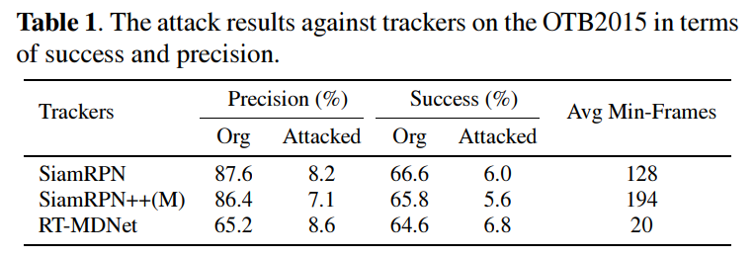
P.R.I.M.E. · blindspot-summer-2026 · Multi-Paper Presentation
2
Paper 1
Cover all four fields: argument, method, key finding, and your reaction
Main argument
Method or evidence
This paper claims that by making adversarial perturbations to video frames to hijack the bounding boxes and mislead the trackers by modifying the location and shape of the bounding boxes.
[The authors used OTB2015 for the dataset and performed this attack on SiamRPN, SiamRPN++, and RT-MDNet.
Key finding
Your reaction
The single most important result was that the authors found that they could consistently force trackers to follow the wrong object. They used two metrics to show this: precision and success rate.
A question that this paper raises could be: Can an attacker achieve the same type of identity hijacking by manipulating the tracker's appearance embeddings instead of modifying the input images?
Link / Citation:
doi: 10.1109/ICASSP40776.2020.9053574.
P.R.I.M.E. Research Experience · blindspot-summer-2026 · APSU CSIT
2 / 7

Slide 4
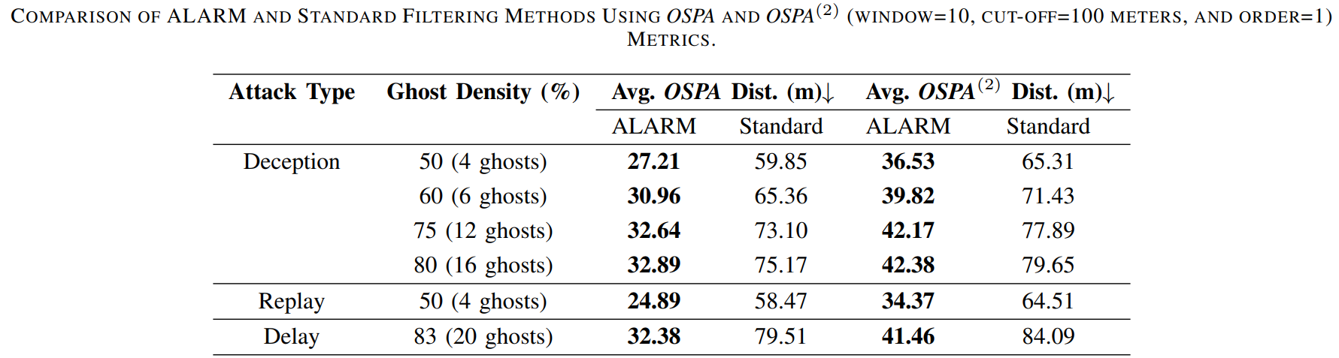
P.R.I.M.E. · blindspot-summer-2026 · Multi-Paper Presentation
3
Paper 2
Cover all four fields: argument, method, key finding, and your reaction
Main argument
Method or evidence
This paper argues that tracking systems can defend against fake ghost targets by detecting measurements that do not agree with observations from nearby sensors.
They used a simulated MSMOT environment in which they injected adversarial ghost measurements into the simulation to test whether the ALARM can reject them
Key finding
Your reaction
The most important finding was that the ALARM consistently produced lower tracking errors and execution times than a standard filtering approach using up to 20 ghost targets.
Can an attack silently corrupt identity associations without creating obvious false targets?
Link / Citation:
doi: 10.1109/TSP.2026.3697369
P.R.I.M.E. Research Experience · blindspot-summer-2026 · APSU CSIT
3 / 7

Slide 5
P.R.I.M.E. · blindspot-summer-2026 · Multi-Paper Presentation
4
Paper 3 — Optional
Use this slide if you found a third paper. Skip it if you only found two.
If you only found 2 papers this week, leave this slide blank and move straight to slide 5.
Main argument
Method or evidence
[One sentence: what does this paper claim?]
[What data or experiment did they use to show it?]
Key finding
Your reaction
[The single most important result]
[What surprised you or what question does it raise?]
P.R.I.M.E. Research Experience · blindspot-summer-2026 · APSU CSIT
4 / 7

Slide 6
blindspot · Paper Presentation
2
Main Argument
State the paper's central claim in ONE sentence. If you cannot say it in one sentence, keep refining.
[Click here and type the paper's main argument in one sentence]
Why does this matter?
[1–2 sentences: why does this claim matter to the PHANTOM project?]
P.R.I.M.E. Research Experience · blindspot-summer-2026 · APSU CSIT
2 / 7

Slide 7
blindspot · Paper Presentation
3
Method or Evidence
How did they show it? Describe the dataset, experiment, proof, or analysis.
Dataset or setting
Experimental approach
How they measured success
[What data did they use? How large? What domain?]
[What did they actually do? What comparisons did they make?]
[What metrics? What threshold for a good result?]
Additional notes on the method:
[Any additional context about how they conducted the study]
P.R.I.M.E. Research Experience · blindspot-summer-2026 · APSU CSIT
3 / 7

Slide 8
blindspot · Paper Presentation
4
Key Finding or Result
The single most important thing the paper found or demonstrated.
★ Main finding
[Describe the key result in 2–3 sentences. Be specific — include numbers if the paper reports them.]
Supporting result 1
Supporting result 2
[Secondary finding or supporting data point]
[Another supporting finding or comparison]
P.R.I.M.E. Research Experience · blindspot-summer-2026 · APSU CSIT
4 / 7

Slide 9
blindspot · Paper Presentation
5
Limitation or Open Question
What does this paper leave unsolved? What are you skeptical of?
What it leaves unsolved
What you are skeptical of
What question it raises for us
[What gap or assumption does this paper leave unaddressed?]
[What claim or result would you push back on and why?]
[What new question does this paper create for the blindspot project?]
Critical thinking prompt: Could you replicate this paper's results? What would you need?
P.R.I.M.E. Research Experience · blindspot-summer-2026 · APSU CSIT
5 / 7

Slide 10
P.R.I.M.E. · blindspot-summer-2026 · Multi-Paper Presentation
5
What Connects These Papers?
Look across all the papers you presented this week, what do they have in common?
Theme or pattern across this week's papers
How these papers connect to ALL prior reading
What idea, method, or approach shows up in more than one of the papers you read this week? Be specific — name the papers.
Do these papers agree with, contradict, or extend what you read in earlier weeks? Name specific prior papers.
Both of the papers I read this week had to do with adversarial attacks on tracking systems. The Hijacking Tracker: A Powerful Adversarial Attack On Visual Tracking paper corrupted image pixels, while Robust Filtering for Multi-Object Tracking Against Stealthy Measurement-Oriented Adversarial Attacks inserted false sensor measurements.
I think these papers agree with the two papers from last week in the sense that all four papers show that tracking systems are vulnerable to adversarial attacks. All four papers used a different method of creating perturbations.
What is still missing across everything you have read?
The thing that has been missing from all papers I have read so far is how adversarial perturbations can be used in multi-camera tracking systems.
P.R.I.M.E. Research Experience · blindspot-summer-2026 · APSU CSIT
5 / 7

Slide 11
P.R.I.M.E. · blindspot-summer-2026 · Paper Presentation
7
Synthesis: Connecting the Papers
Starting from week 3, use this slide to connect ALL the papers you have read so far, not just this week's paper.
1
What pattern connects the papers?
2
Where is the gap?
3
Which paper surprised you most and why?
What theme, idea, or approach shows up across multiple papers you have read? Name at least two papers in your answer.
What has NOT been done yet across all the papers you have read? How does PHANTOM fill that gap?
Pick one paper from any week. What did it say that you did not expect — and did it change how you think about the project?
All five papers that I have read so far all talk about some form of data poisoning and different methods of attacks.
So far all five papers I have read have not touched on adversarial perturbations in multi camera tracking systems.
The first paper Wild Patterns Reloaded: A Survey of Machine Learning Security against Training Data Poisoning was the paper that has changed how I think about the project. It gave me a better understanding of the different types of attacks and potential defenses.
This slide is pre-writing your Week 8 literature review. The patterns you identify here become the themes that organize the paper.
P.R.I.M.E. Research Experience · blindspot-summer-2026 · APSU CSIT
6/ 7

Slide 12
P.R.I.M.E. · blindspot-summer-2026 · Multi-Paper Presentation
7
One Question for the Group
End every presentation with one open question. It should come from the gap you identified, something the group can actually discuss.
❓
Can a tracking system detect and localize compromised cameras when the attack occurs in the appearance embedding space rather than through sensor measurements or image pixels?
A good question is one you genuinely do not know the answer to. It should make the group think, not just recap what the papers said.
P.R.I.M.E. Research Experience · blindspot-summer-2026 · APSU CSIT
7 / 7

